Slide 1
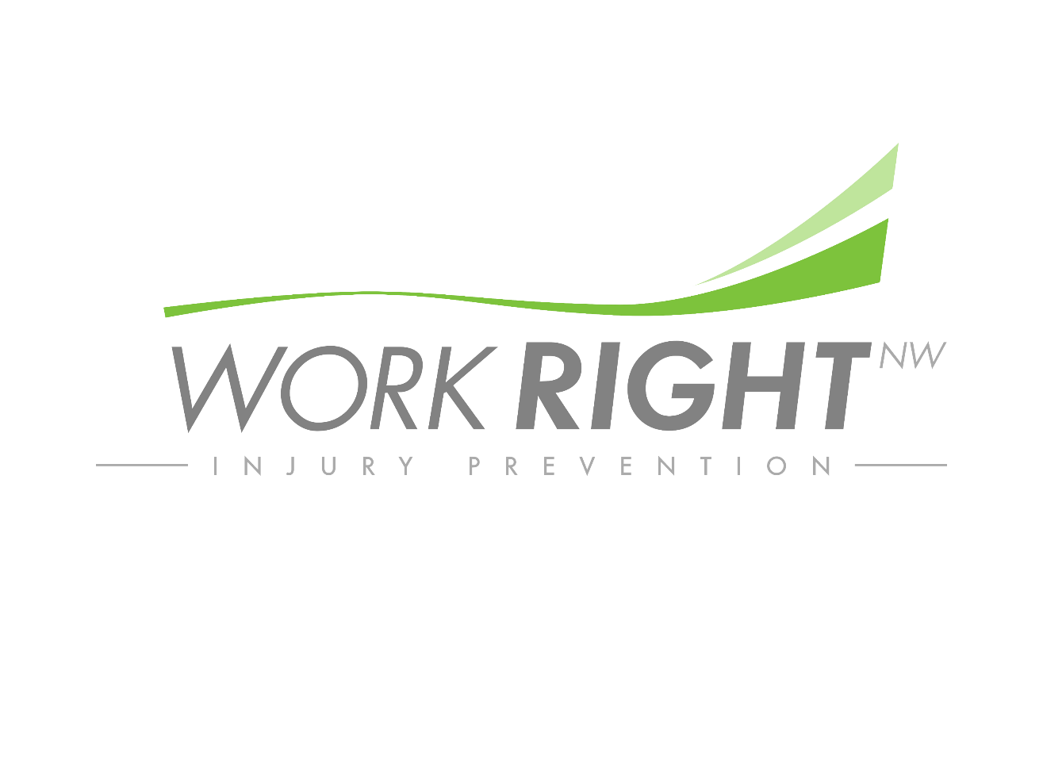
Best Practice Train the Trainer
Ergonomics in Logging

Slide 2
Objective
Speaker Introductions
Project Background – Why does this matter?
What is Ergonomics?
What is DorsaVi Technology?
Project Overview
Identified Ergonomic Best Practices
Equipment Operator
Rigging Men
Timber Cutters
Human Performance Recommendations
Opportunities for Further Development

Slide 3
Nic Patee, DPT
Work Right NW – Founder & CEO
Work Right recognizes that corporations are struggling with the impacts of musculoskeletal injuries and the impact they have on their workforce. Because of this we have developed a program that integrates the expertise of injury prevention from sports sciences and are integrating them into the workforce to allow corporations to maximize the capabilities & efficiencies of their workforce by keeping them healthy & safe.

Slide 4
Why does this matter?
What are the most common injuries that you have seen in logging?
How many of you have had back or shoulder pain within the last year?
What kind of impact would it make for your organization if your workforce was healthy & efficient day in & day out?
Notes:
What are the most common injuries that you have seen in logging?
Industry data demonstrates that musculoskeletal injuries account for the largest percentage of compensable occupational claims within the logging industry. Specifically in the logging industry in the State of Washington, data demonstrates the following ranking of injuries:
In 2015, trunk and low back musculoskeletal injuries had a greater incidence rate than any other body part, at 14.9 injuries for trunk and 12.3 injuries for low back, with shoulder next at 5 injuries and knee next at 3.1*.
Of all injuries caused by exertion in 2015, overexertion from lifting or lowering is the largest sub-category, with 31% of all overexertion injuries caused by lifting or lowering.
The median number of days taken off from a musculoskeletal injury in 2015 was 12
*All incidence rates were calculated as injuries per 10,000 full time workers
Source:
Bureau of Labor Statistics. Nonfatal occupational injuries and illnesses requiring days away from work, 2015.
https://www.bls.gov/news.release/osh2.nr0.htm
How many of you have had back or shoulder pain within the last year?
Ask the audience to stand. Once everyone is standing, ask them to sit down IF they have had ZERO episodes of shoulder or back pain within the last year.
Have the group look around the room. Allow them the opportunity to recognize the majority (if not all of them) are still standing. Ask a few of them to illustrate how this pain impacted their work? Ask them what they feel caused the issue? Ask them what they have done to ensure that it doesn’t come back (if anything)?
What kind of impact would it make for your organization if your workforce was healthy & efficient day in & day out?
Open it up to the group. Highlight the challenges organizations have staffing their companies. Highlight the length of time it takes (and resources) to train new workers.
Bring the point back to healthy & safe workers improves their overall corporate effectiveness & efficiency

Slide 5
Why it is important to me?
I grew up a rigging man
Set chokers, pulled rigging and chased for the summers when in college
Worked for Chilton Logging
Share Eric’s Story
Notes:
Work to build credibility with the audience. Connect on a level of understanding
Share the emotional story of Eric & how his life was impacted by a rotator cuff tear that resulted from cumulative trauma:
Started as occasional discomfort, but he is a logger, they always have aches & pains. He chose to ignore it, just like every other pain he had. He’s a logger, he’s tough.
Began to be constant pain, but only with certain motions. Started to think he should do something, but “he’s tough” he can handle it. He’s a logger.
Progressed to pain that impacted any movement of his arm, but now he was scared so he thought if he ignored it, it might just go away. He was afraid of “what it could be” & he is a logger.
Eventually it was impacting his work to the point that his employer noticed it and forced him to go to a doctor, where he was diagnosed with a massive rotator cuff tear. That is where I met Eric. I rehabbed him following his surgery.
Take Away: this was a preventable injury had we focused on minimizing the impact of the job on the shoulder and had properly educated Eric on the resources available to him. This was what highlighted the importance of spreading the news of prevention & ergonomics in Logging. There are far too many loggers who hurt on a daily basis because “They’re a logger”. They often associate it with a right of passage of doing an industry that they are proud to be a part of it. My vision is to make it an industry that they are proud of, but can do for the entire length of a career. That was the vision for this project. How can we improve the trade so that the workforce can retire physically fit & healthy to enjoy retirement at the age of their choosing – rather than retiring because they physically can’t do it anymore.

Slide 6
What is ergonomics?
“Ergonomics is defined as the application of human biological sciences with the engineering sciences to achieve optimum mutual adjustment of people and their work, the benefits measured in terms of human efficiency & well-being”
https://www.csuchico.edu/ehs/_pdf/ergonomics_defined.pdf
Simply put, ergonomics is fitting the work to the worker.
Notes:
Ask for their thoughts on ergonomics?
Does it speed work up, or slow work down?
Is safety an added benefit to their job, or a perceived hindrance? – Zero in on the industry thought process that feels safety is a barrier. Recognize this thought process & then provide encouragement that our study was done to improve safety, improve efficiency & worked hard to not overpromise results.
Illustrate the Lean component of ergonomics.
Ergonomics is about eliminating waste (Lean principle) in human movement. Ergonomics works to put the worker in a position to be most efficienct by modeling the work to fit their most efficient capabilities.

Slide 7
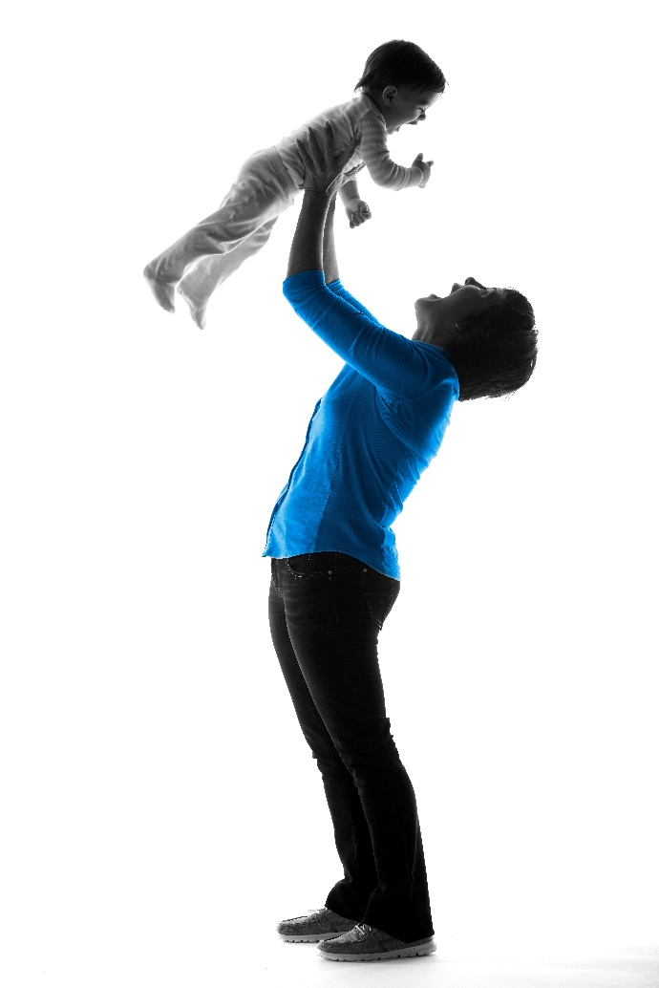
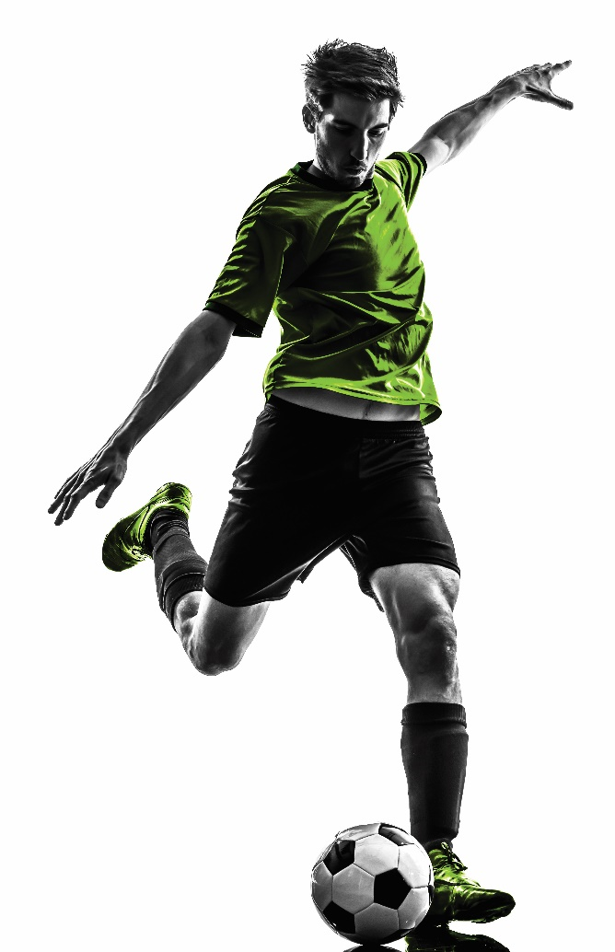
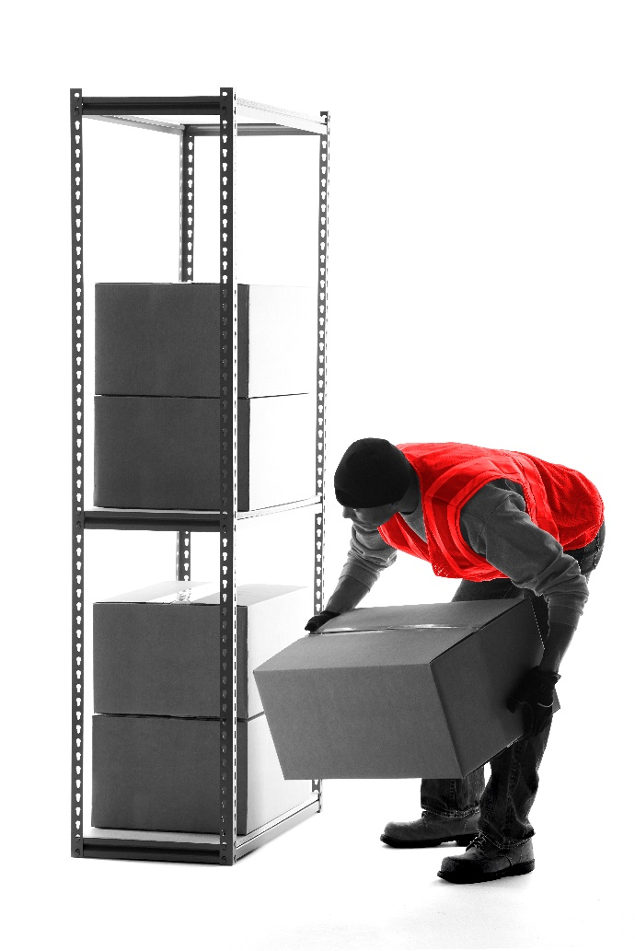
dorsaVi work across three sectors
Notes:
DorsaVi has 3 derivitives that their sensors are utilized:
ViMove – Clinical product used in physical therapy clinics & orthopedic groups for monitoring patient outcomes & interventions
ViPerform – Professional Sport model that is used all over the world to determine athletes pre-performance capabilities & return to sport capabilities following injury.
ViSafe – Occupational product bringing the same tech from ViPerform to the workplace to objectively quantify a dynamic task with a dynamic measurement for the physical demands of the job/task. This allows for targeted solutions aimed at reducing workplace risk.

Slide 8
ViSafe in the field…
http://www.dorsavi.com/us/en/visafe/

