Slide 1
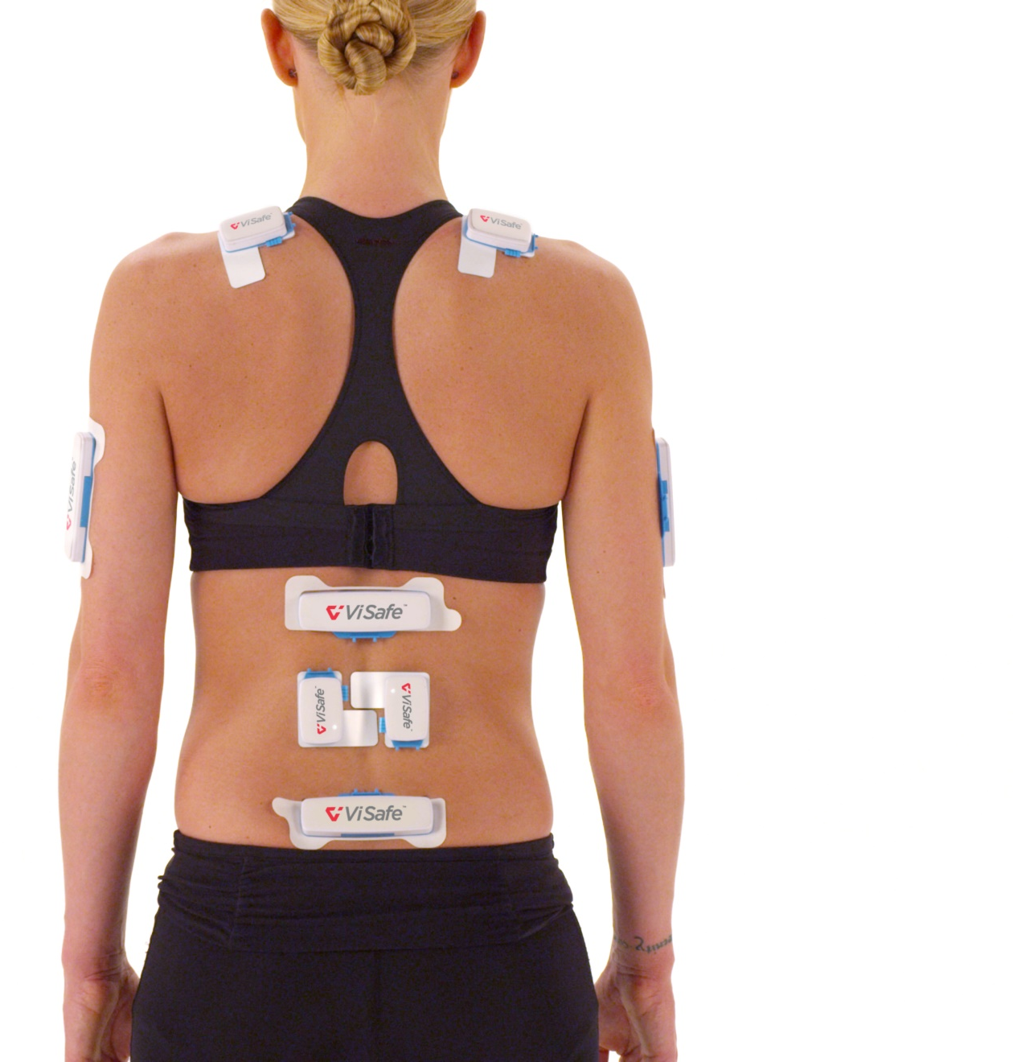
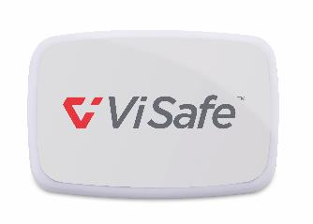
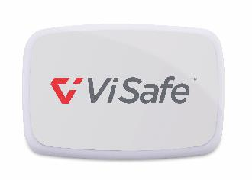
Assessment tool for complex movement
Multiple sensors
Precise measurement
Real-time data
In real-life situations
Identify issues
Organization-wide visibility
Intuitive Dashboard to track myViSafe assessments across locations, business units, tasks and employees
ViSafe Muscle Activity Sensors
ViSafe Movement Sensors
Notes:
The ViSafe sensors are a medical grade solution with FDA and TGA approval and the CE mark.
They accurately assess movement, muscle activity and vibration
Analyze movement across 3 planes of movement & capture EMG data to quantify the physical demands of a job on the worker
Tracks at 200 frames per second & pairs the data with real-time video of the job

Slide 2
Risk Matrix
 |  | Consequences
 |  | Trivial | Minor | Moderate | Major | Severe
Likelihood | Almost Certain | L | H | H | E | E
 | Likely | L | M | H | H | E
 | Possible | L | M | M | H | E
 | Unlikely | L | M | M | H | H
 | Rare | L | L | M | M | H
E – Extreme risk, requiring immediate action.
H – High risk issue requiring research or some immediate action
M – Moderate risk issue that is likely to benefit from adaptation measures
L – Low risk issues that can be dealt with as and when they happen or they are considered acceptable should they happen
Notes:
Discuss the differences in types of risk:
Sliver may be almost certain to occur in logging, but low on the severity
Compared to rotator cuff injury being “possible” on the likelihood, but “severe” on the consequences. This scenario will result in a higher risk classification and drive more action as a result.

Slide 3
Task | Subtask
 | Back | Left Shoulder | Right Shoulder
ROM % time outside preferred movement zone | Preferred | Attention 33% | Attention 53%
Repetitions per minute | Attention 2 reps | Alert 5 reps | Alert 4 reps
Sustained positions | Preferred | Preferred | Attention 1 sustained
EMG | Alert | Alert | Alert
Score | 3 | 6
Task Score | 9
Notes:
Outline the different measures taken into account:
Back Score
Shoulder Score (both Left & Right)
Apply alerts and attentions in each category
Count number of alerts and attentions for each body part to generate Back and Shoulder scores, with the total Shoulder score being the higher of the Left and Right individual Shoulder scores:
Alert = 2, Attention = 1
0: Score Green
1 – 4: Score Amber
5 – 8: Score Red
Add Back and Shoulder scores to generate total Task Score, representing the number of alerts and attentions:
0 – 1 : Score Green
2 – 8: Score Amber
9 – 16: Score Red

Slide 4
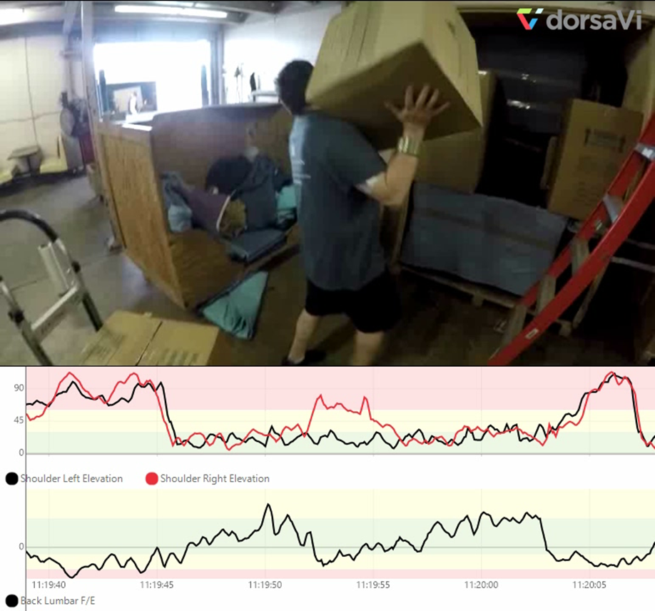
ViSafe Scoring Example
Move boxes | Load boxes
 | Back | Left Shoulder | Right Shoulder
ROM % time outside preferred movement zone | Attention 32% | Alert 21% | Alert 29%
Repetitions | Attention 2 reps | Alert 5 reps | Alert 7 reps
Sustained positions | Preferred | Preferred | Attention 1 sustained
EMG | Alert | Preferred | Alert
Score | 4 | 7
Total Score | 11

Slide 5
SHIP Project Overview
20 ViSafe Assessments
15 Month Duration from Start to Finish
Professionals Involved:
17 different loggers
3 Physical Therapists
1 Professional Ergonomist
A team of data analysts

Slide 6
Process Outline
Baseline Assessments
Rigging Men
Equipment Operators
Analyze the Data
DorsaVi analyzes the data and presents it in a workshop setting
Workshop to Plan Interventions
Evaluate the recommended interventions to ensure benefit to the workforce in the true work environment
Timber Cutters
Evaluate Solutions Effectiveness
Team comprised of Chilton Logging, Work Right & Professional Ergonomist meet to look through the data and determine recommended interventions
Pairs the data summaries with real-time video of the job

