Slide 1
Pulling Chokers Over the Shoulder Best Practice
Demonstrates the benefit of using the over-the-shoulder technique when pulling chokers.

Slide 2
Behind the body technique
Notes:
Pulling chokers with the elbow pinned at the side was also assessed, however it also had similar values to pulling behind the body. Reasoning for this may be:
Shoulder ROM remains high despite elbows being pinned. Possible explanations for this:
- R) arm is heavily involved in maintaining balance and generating momentum over tough terrain
- L) arm is likely related to trunk movement across the uneven surface
- Worker may have naturally high carrying angles
Keeping the arm pinned by their side may be difficult for the worker. On this uneven terrain, the worker uses arms to maintain balance and generate momentum. It may require a lot of muscle activity and increase stress on back when trying to minimize the shoulder movement.

Slide 3
Over the shoulder technique

Slide 4
Best Practice Conclusion: Over-the-shoulder technique
Reasoning for analyzing:
Baseline analysis of choker setters demonstrated consistent (nearly constant) risk factors for the dominant shoulder. Further, we noted multiple different techniques between the workers when pulling chokers. We wanted to identify if there was one method that placed less stress on the shoulders.
Recommendations:
Pulling the chokers over the shoulder demonstrated a significantly less extensive risk profile based on the collection of data.
Notes:
Considerations should be taken related to potential hazard of having “jaggers” close to the neck when operating. There should be care taken to make sure the chokers are well maintained and offer no risk for laceration when holding close to the neck.
Alternative solutions could be to also wear the shoulder pad that timber cutters use to reduce the potential impact of jaggers on the shoulder/neck as well.

Slide 5
Pulling Haywire with the Hindu Eye Best Practice
Demonstrates the benefit of using the hindu eye for haywire as opposed to the occasionally used spliced Eye

Slide 6
Pulling Haywire – Hindu Eye
Notes:
Each cable is 2 x 150 foot length
Although the two RAG tables are identical in value, the Hindu eye showed lower average EMG and Shoulder elevations (effort was much higher for the Spliced Eye). The difference between the two conditions wasn’t detectable using existing criteria.
Worker also mentioned that the cable with the Hindu eye snagged less frequently on grass and shrubs as it was being pulled downhill.
Difference in EMG:
Shoulder: Hindu eye used 25% less muscle activity than Spliced eye (516 counts vs 684 counts for Hindu and Spliced respectively)
Back: Hindu eye used 25.2% less muscle activity than Spliced eye (363 counts vs 485 counts)
Recommendations: Hindu eye is better than spliced eye as it requires less EMG effort in both the back & the shoulder.

Slide 7
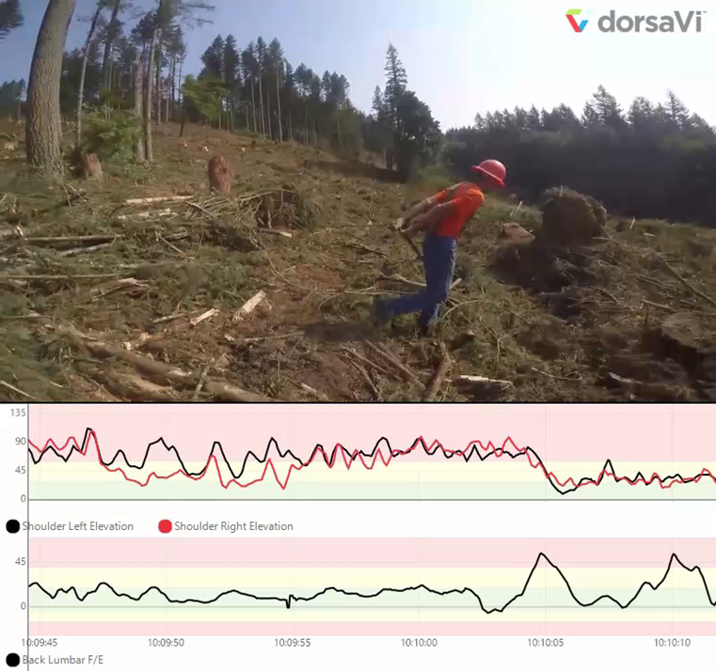
Pulling Haywire – Spliced Eye
Notes:
Each cable is 2 x 150 foot length
Although the two RAG tables are identical in value, the Hindu eye showed lower average EMG and Shoulder elevations (effort was much higher for the Spliced Eye). The difference between the two conditions wasn’t detectable using existing criteria.
Worker also mentioned that the cable with the Hindu eye snagged less frequently on grass and shrubs as it was being pulled downhill.
Difference in EMG:
Shoulder: Hindu eye used 25% less muscle activity than Spliced eye (516 counts vs 684 counts for Hindu and Spliced respectively)
Back: Hindu eye used 25.2% less muscle activity than Spliced eye (363 counts vs 485 counts)
Recommendations: Hindu eye is better than spliced eye as it requires less EMG effort in both the back & the shoulder.

Slide 8
Best Practice Conclusion: Pulling Haywire with a Hindu Eye
Reasoning for analyzing:
This was a study that was brought to us at the Washington Contract Loggers Association Safety Meeting from a hook tender in the field. He wanted to know what equipment would be best for him to purchase for his guys.
Recommendations:
Hindu eye haywire had significantly less EMG activity compared to the spliced eye. Using a hindu eye is recommended.

Slide 9
Pulling Haywire with Mountain Climbing Harness
Demonstrates the benefit of using a centralized pulling point when stringing haywire

Slide 10
Outline the Process:
Began with a controlled trial
3 reps of pulling 1 coil uphill
3 reps of pulling 1 coil downhill
Started looking at 3 different interventions:
Behind the back pull
Using tubular webbing over the shoulder
Using a fall protection harness

Slide 11
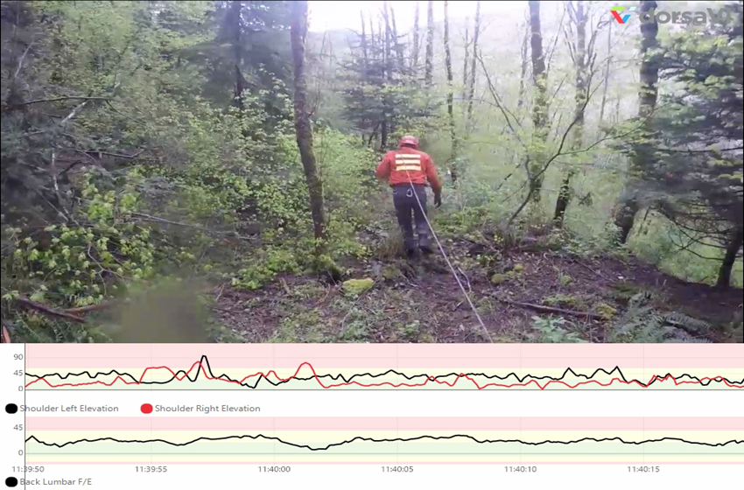
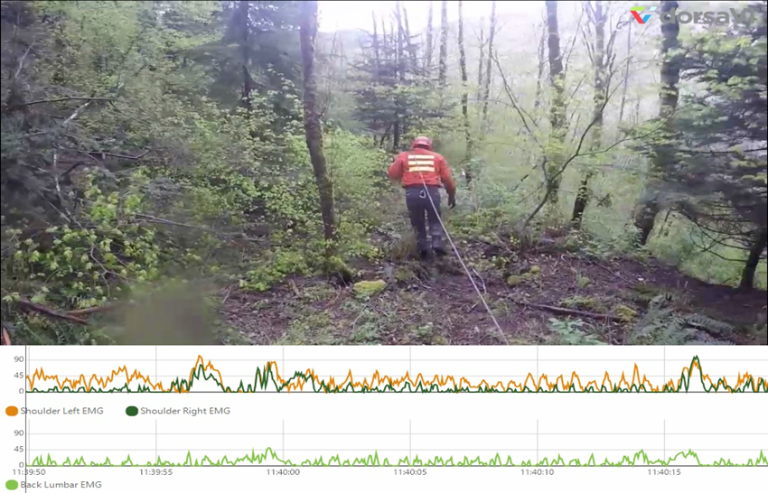
Pulling Haywire – Without Harness
Pull haywire | Without harness
 | Back | Left Shoulder | Right Shoulder
ROM % time outside preferred movement zone | Attention | Attention | Preferred
Repetitions per minute | Attention | Attention | Attention
Sustained positions | Preferred | Preferred | Preferred
EMG | Alert | Alert | Alert
Score | 4 | 4
Task Score | 8

Slide 12
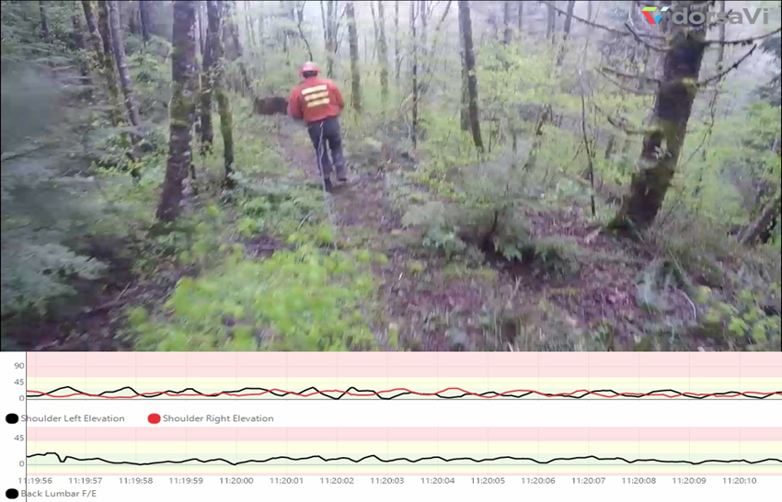
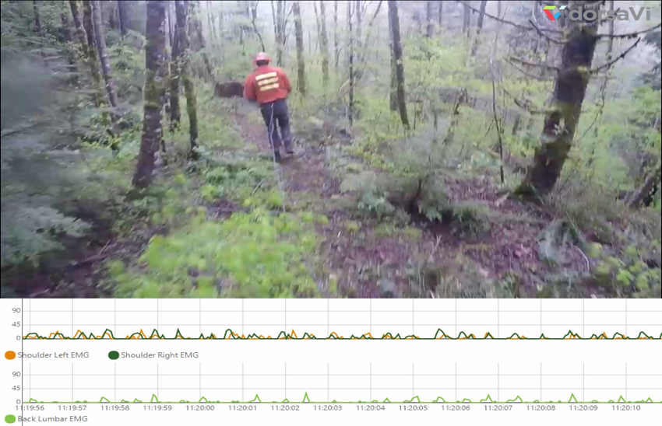
Pulling Haywire – With Harness
Notes:
Recommended Best Practice: Pulling haywire with a mountain climbers harness (Link for harness below) was a best practice centralizing the force and reducing the impact both positionally and via EMG data on both the shoulder and spine.
(https://www.rei.com/product/670761/black-diamond-bod-harness?CAWELAID=120217890002116661&CAGPSPN=pla&CAAGID=15877503040&CATCI=pla-284416484153&cm_mmc=PLA_Google|404_33439|6707610033|none|8094c4e7-624f-4573-bdc5-7d28ab325277|pla-284416484153&lsft=cm_mmc:PLA_Google_LIA|404_33439|6707610033|none|8094c4e7-624f-4573-bdc5-7d28ab325277|pla-284416484153&gclid=EAIaIQobChMIzcXlq5XB1gIVE4l-Ch1ZAAJjEAQYASABEgL6Q_D_BwE)

Slide 13
Best Practice Conclusion: Pulling Haywire with a Mountain Climbing Harness
Reasoning for analyzing:
In our baseline studies, we found the Shoulder to be in the “yellow zone” 45% of the time & in the high risk “red zone” 55% of the time during our baseline assessments. Because of this, we sought out opportunities to reduce shoulder impact with modifications of the work demands.
Recommendations:
Using a lightweight harness centralized the pull of the haywire and exponentially reduced the EMG forces on the shoulder & lumbar spine.
Notes:
Key Point:
One major cause for consideration with this best practice is that the hands will now be free for the rigging man that is pulling haywire with the harness. This intervention does not warrant the rigging man to carry more equipment (in effect increasing the load to the body) because their hands are now free. The recommendation is to not carry anything in the hands, but rather to use the hands to maintain balance and support when hiking.

Slide 14
Carrying Blocks & Coils With Bull Pack
Demonstrates the benefit of spreading the force of the load across the shoulders and back & reducing the variability of an unstable load

Slide 15
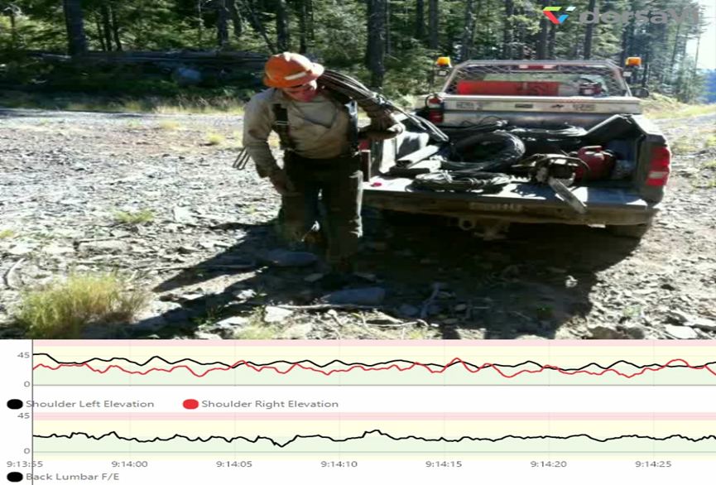
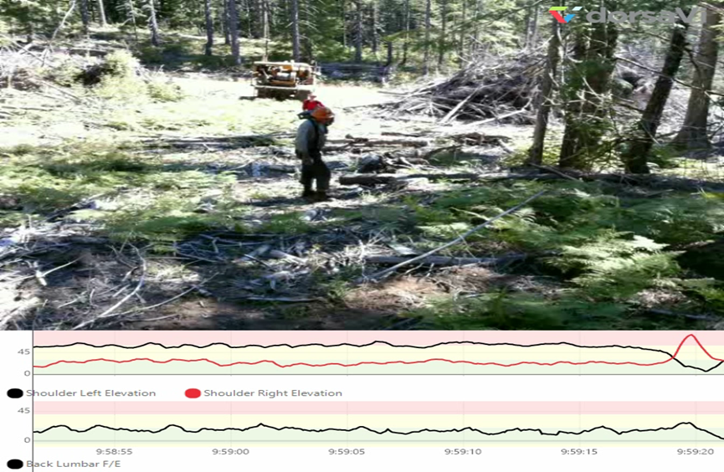
Carrying Gear Traditional Method
Traditional coil | Hike
 | Back | Left Shoulder | Right Shoulder
ROM % time outside preferred movement zone | Alert | Attention | Attention
Repetitions per minute | Attention | Alert | Alert
Sustained positions | Preferred | Preferred | Preferred
EMG | Alert | Alert | Alert
Score | 5 | 5
Task Score | 10

Slide 16
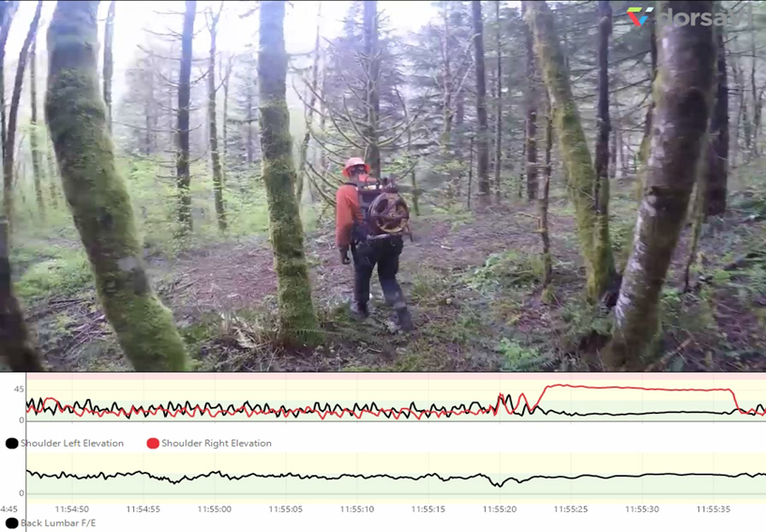
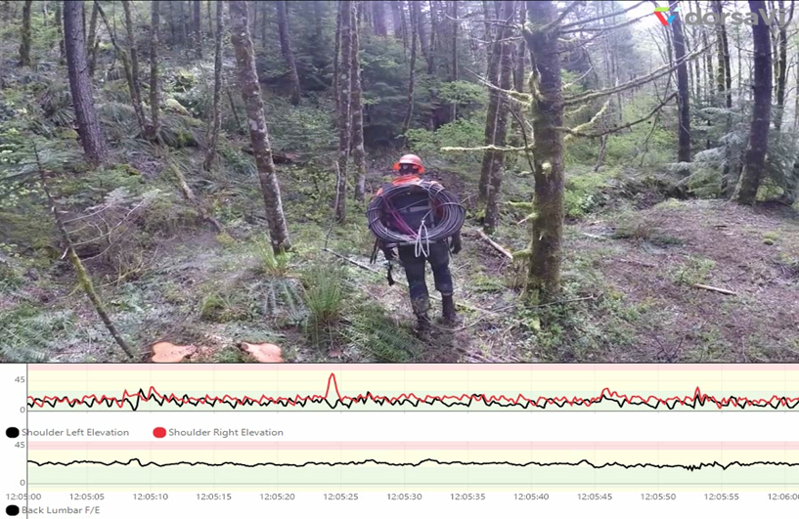
Carrying Gear with Bull Pack
Bullpack with block | Hike
 | Back | Left Shoulder | Right Shoulder
ROM % time outside preferred movement zone | Attention | Preferred | Preferred
Repetitions per minute | Preferred | Preferred | Attention
Sustained positions | Preferred | Preferred | Preferred
EMG | Preferred | Alert | Alert
Score | 1 | 3
Task Score | 4
Bullpack with coil | Hike
 | Back | Left Shoulder | Right Shoulder
ROM % time outside preferred movement zone | Attention | Preferred | Preferred
Repetitions per minute | Preferred | Preferred | Attention
Sustained positions | Attention | Preferred | Preferred
EMG | Alert | Alert | Alert
Score | 4 | 3
Task Score | 7

Slide 17
Best Practice Conclusion: Carrying Gear with Bull Pack
Reasoning for analyzing:
In our baseline study it was identified that carrying blocks and coils are two of the most frequently carried & heaviest tools handled in the brush. We wanted to seek solutions for reducing the potential risk for these tasks.
Recommendations:
Using a light weight backpack for transporting gear was significantly less impactful. Further R&D would be recommended for a customized pack that can be worn all day by the rigging men to increase compliance and efficiency for the workers.
Notes:
This solution does reduce the physical impact on the workers back & shoulder, but has some challenges:
The pack is not light enough, or efficient enough for the hook tender to wear the pack all day. Thus the ability to have the pack in the back of the job (where the gear is) requires them to plan ahead and remember the pack.
Possible R&D would be beneficial to construct a pack that is efficient enough to be worn all day (also would incorporate the central pull point for pulling haywire), yet stable enough to protect the back/head for when the rigging man falls with the heavy gear on their back.

