Slide 1
Human Performance Recommendations
How can we physically prepare ourselves to handle the physical demands of the job most effectively?

Slide 2
Exercise Disclaimer
Work Right NW, DorsaVi or SHIP Grant Program strongly recommends that you consult with your physician before beginning any exercise program.
You should be in good physical condition and be able to participate in the exercise.
Work Right NW, DorsaVi or SHIP Grant Program are not presenting this information as licensed medical care providers and represents that it has no expertise in diagnosing, examining, or treating medical conditions of any kind, or in determining the effect of any specific exercise on a medical condition.
You should understand that when participating in any exercise or exercise program, there is the possibility of physical injury. If you engage in this exercise or exercise program, you agree that you do so at your own risk, are voluntarily participating in these activities, assume all risk of injury to yourself, and agree to release and discharge FreeTrainers.com from any and all claims or causes of action, known or unknown, arising out of Work Right NW, DorsaVi or SHIP Grant Program negligence.

Slide 3
What does human performance recommendations mean?
Key Terms:
Movement Terms
Movement quality
Symmetry
Endurance
Power
Agility
Speed
Functional Movement Screen
Performance Training
Notes:
It is recommended that employees receive coaching from a qualified professional to optimize movement quality, symmetry, endurance, strength, power, agility and speed. In order to achieve optimal outcomes, employees should undergo Functional Movement Screening and Motor Control Screening. The results of the screens should be used to design a corrective program to address and correct any dysfunction that was identified. Employees should be trained to use functional movement patterns at work until dysfunctional patterns are corrected. For example, if an employee is found to hip hinge well, and squat poorly, the employee should avoid using the squat technique at work, and should instead receive training and job coaching on the deadlift for lifting heavy objects at work until they correct their squat pattern. Employees should be re-screened frequently to track progress and modify corrective programs. Once employees achieve symmetrical, average quality or better movement, they can begin performance training. Performance training should begin with suitable testing for endurance and strength to design a periodized program which builds upon itself while integrating enough recovery to prevent overtraining. Exercises should be geared towards improving upon individual weaknesses identified in testing.
Once a solid, well balanced base of fitness is achieved, employees should focus on targeted goals for making difficult work tasks easier. This can be achieved by training to improve endurance, strength, power, agility and speed. For example, if lifting a block is a difficult task, exercises including but not limited to deadlifts, squats, lunges, kettlebell swings, power cleans, hanging cleans, bench press, overhead press, push press, pull ups/pull downs, bent over rows, upright rows, and Turkish get-ups are appropriate choices for training. Consult a professional such as a Certified Strength and Conditioning Specialist, Physical Therapist, Certified Athletic Trainer, or Certified Personal Trainer to deliver the above recommendations.

Slide 4
Why is this important for me?
Notes:
Use the analogy of training to run a mile:
If I train to run a mile & only ever run 1 mile, what happens when something goes wrong? If I have to run an extra ½ mile one day because I got lost? How effective will I be when I have to run that little bit extra?
Instead, when we train to run a mile, we often train at greater than 1 mile so that when we race, we are not exhausting every last resource that we have. In effect, we want to make sure that we are not running on fumes at the end of the race, but instead are still operating on “premium gasoline” when we are competing.
This is the same with our bodies, if all we ever do is operate at the extent of our resources, when something changes (i.e. upset conditions at work, come down with a cold, have poor weather to work in, etc.) we are more inclined to have injury. It is key that we are working in a blended state of ideal strength, power, agility & movement quality to ensure proper functioning.

Slide 5
What are the general challenges that were observed?
Equipment Operator
Prolonged Sitting
Protracted Shoulder Posture
Cervical/Thoracic Tightness
Rigging Men
Prolonged postures on side hills
Frequent reaching overhead
Unstable surfaces to walk on
Timber Cutter
Prolonged postures on side hills
Routine looking up (i.e. cervical extension & rotation)
Frequent reaching & bending with the weight of the saw in the arms
Notes:
Equipment Operator
Prolonged Sitting:
General deconditioning is common due to the sedentary aspect of the job.
Challenges associated with long duration, whole body vibration
Tightness into the hip flexors & general weakness in the entire core
Protracted Shoulder Posture
Due to the position of the joy sticks in the cab of the machines, it is frequent to have protracted scapula bilaterally
Weakness noted in the scapular stabilizer musculature
Cervical/Thoracic Tightness
Forward head posture from routinely looking down at their work
Also correlates with the aforementioned weakness in the scapular stabilizers
Rigging Men
Prolonged postures on side hills
Because of the nature of their job, they operate on side hills continuously. This will result in uneven forces throughout the LE’s, hips & spinal column. It would be recommended to ensure that rigging men are rotating sides that they exit the rigging throughout the day to equalize the forces throughout the body.
Also, it is important to maintain good flexibility throughout the hips (i.e. hip flexors, hamstrings, IT Bands) to ensure shared forces throughout the hips and spine
Good proprioception & core control will improve stability for the body when operating on side hills
Frequent reaching overhead
Reaching up for the chokers, reaching over and under logs, etc. all require routine overhead reaching in the shoulder
It would be recommended to alternate arms that you reach with, rather than always using your dominant shoulder
Also, regular maintenance for the rotator cuff and scapular stabilizers will improve shoulder endurance and strength
Unstable surfaces to walk on
Proper training to improve core strength, lower extremity strength, along with proprioceptive exercises will improve the bodies ability to manage uneven and unexpected changes in terrain.
Timber Cutter
Prolonged postures on side hills
Because of the nature of their job, they operate on side hills continuously. This will result in uneven forces throughout the LE’s, hips & spinal column. It would be recommended to ensure that rigging men are rotating sides that they exit the rigging throughout the day to equalize the forces throughout the body.
Also, it is important to maintain good flexibility throughout the hips (i.e. hip flexors, hamstrings, IT Bands) to ensure shared forces throughout the hips and spine
Good proprioception & core control will improve stability for the body when operating on side hills
Routine looking up (i.e. cervical extension & rotation)
Because they are constantly watching the top of the trees that they are cutting, there is constant postures of cervical extension & rotation
Recommend trying to rotate the direction you are facing when cutting trees to alternate the rotational component on the neck from side to side
Possible integration of stretching to the thoracic spine into extension to improve mobility throughout the entire spinal segment reducing forces on the neck
Cervical stabilization exercises to improve endurance & stability
Frequent reaching & bending with the weight of the saw in the arms
Requires constant reaching, lifting and carrying of the saw while not always able to be in ideal lumbosacral posture
Recommend core strengthening program and hip flexibility exercises to build a solid base of support

Slide 6
General Recommendations – Equipment Operator
Take micro-stretch breaks
Always adjust your seat
Work on hip flexibility
Strengthen your scapular stabilizers
Stretch your neck
Notes:
Take micro-stretch breaks
Encourage the rule of 20 (every 20 minutes take 20 seconds to change positions)
Every time you load a truck, take 2 minutes to do micro-stretches
Every time the CB squaks – evaluate your neck posture
Always adjust your seat
Review proper sitting posture
Discuss the importance of re-assessing every morning
Encourage them to always tighten their belt to assist with ideal posture
Work on hip flexibility
Demonstrate hip flexor stretch, piriformis stretch & standing hamstring stretch
Strengthen your scapular stabilizers
Scap squeezes, Tubing Rows, Horizontal Abduction & Bilateral ER
Stretch your neck
Median nerve glides, Posterior Capsule Stretch, Upper Trap Stretch & Chin Tucks

Slide 7
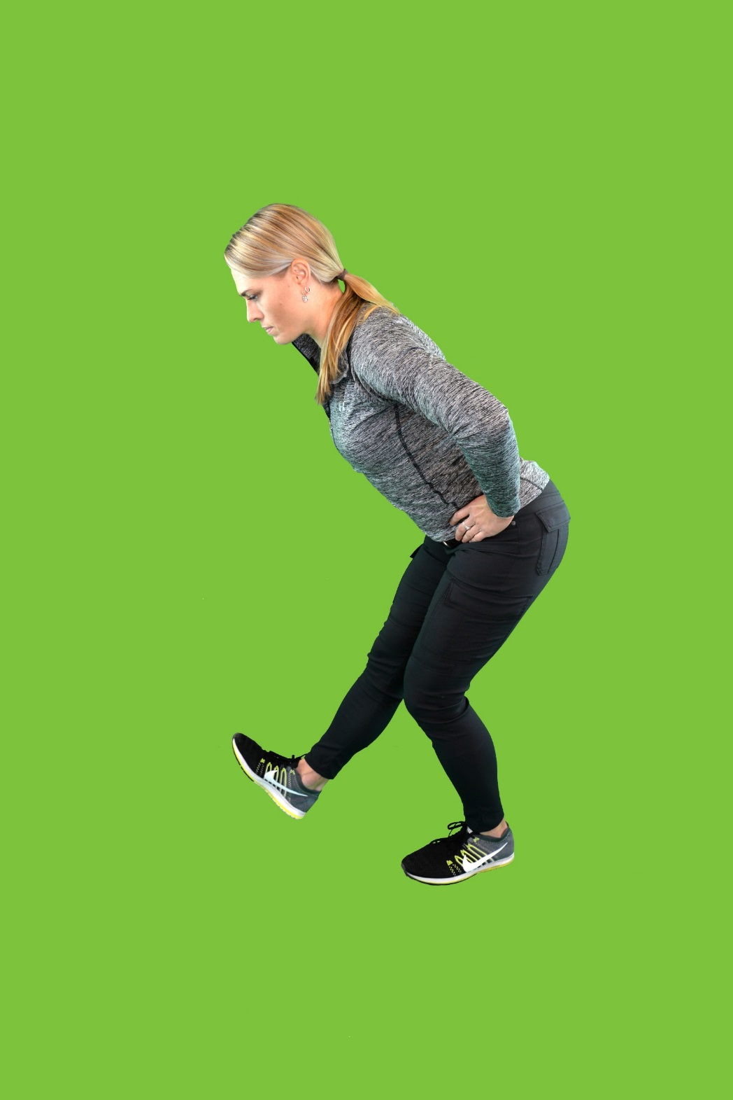
Equipment Operator – Hip Stretches
Notes:
Take micro-stretch breaks
Encourage the rule of 20 (every 20 minutes take 20 seconds to change positions)
Every time you load a truck, take 2 minutes to do micro-stretches
Every time the CB squaks – evaluate your neck posture
Always adjust your seat
Review proper sitting posture
Discuss the importance of re-assessing every morning
Encourage them to always tighten their belt to assist with ideal posture
Work on hip flexibility
Demonstrate hip flexor stretch, piriformis stretch & standing hamstring stretch
Strengthen your scapular stabilizers
Scap squeezes, Tubing Rows, Horizontal Abduction & Bilateral ER
Stretch your neck
Median nerve glides, Posterior Capsule Stretch, Upper Trap Stretch & Chin Tucks

Slide 8
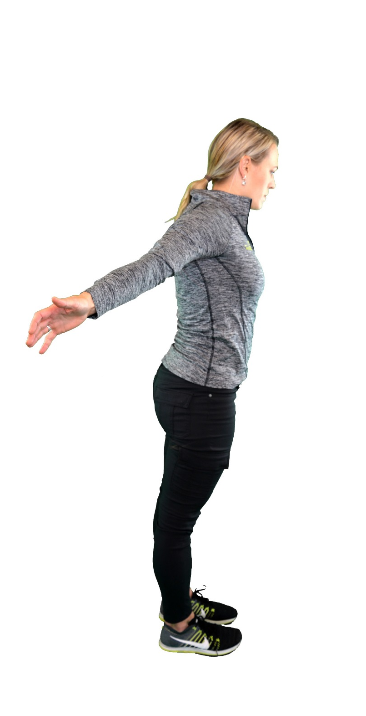
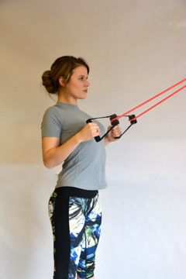
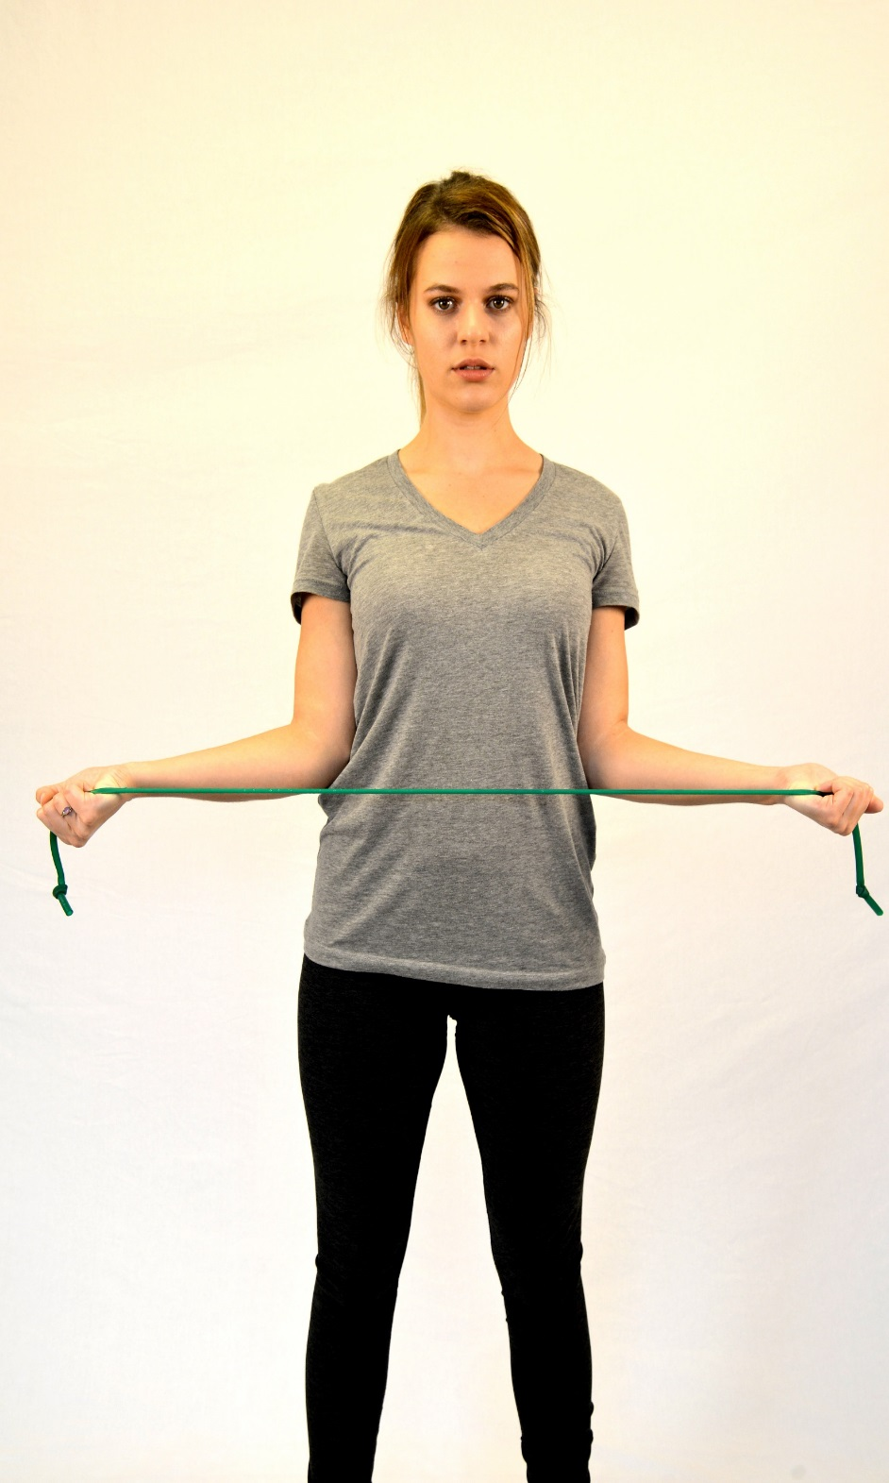
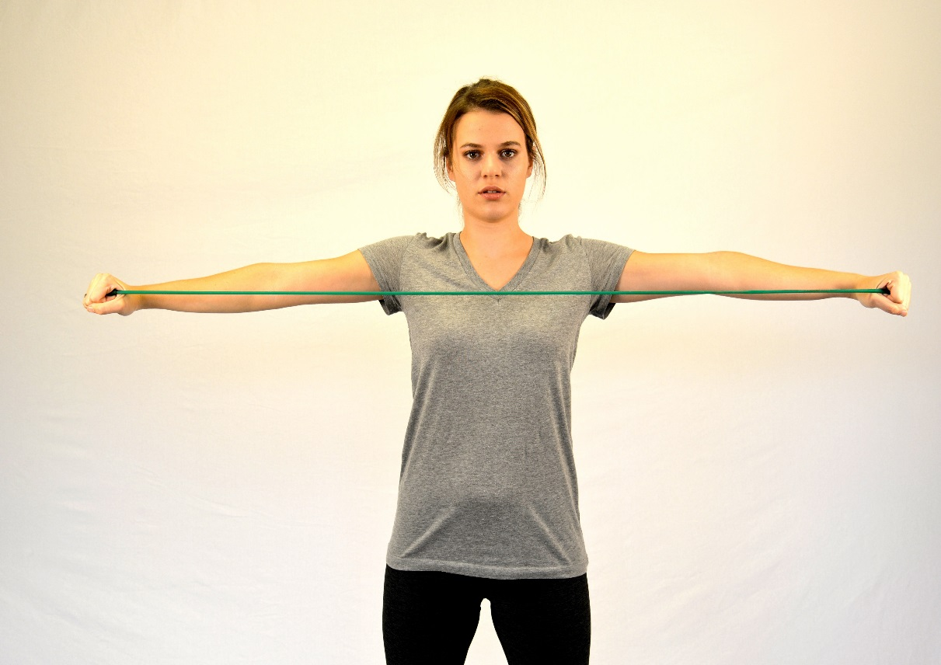
Equipment Operator – Scapular Stabilization
Notes:
Take micro-stretch breaks
Encourage the rule of 20 (every 20 minutes take 20 seconds to change positions)
Every time you load a truck, take 2 minutes to do micro-stretches
Every time the CB squaks – evaluate your neck posture
Always adjust your seat
Review proper sitting posture
Discuss the importance of re-assessing every morning
Encourage them to always tighten their belt to assist with ideal posture
Work on hip flexibility
Demonstrate hip flexor stretch, piriformis stretch & standing hamstring stretch
Strengthen your scapular stabilizers
Scap squeezes, Tubing Rows, Horizontal Abduction & Bilateral ER
Stretch your neck
Median nerve glides, Posterior Capsule Stretch, Upper Trap Stretch & Chin Tucks

Slide 9
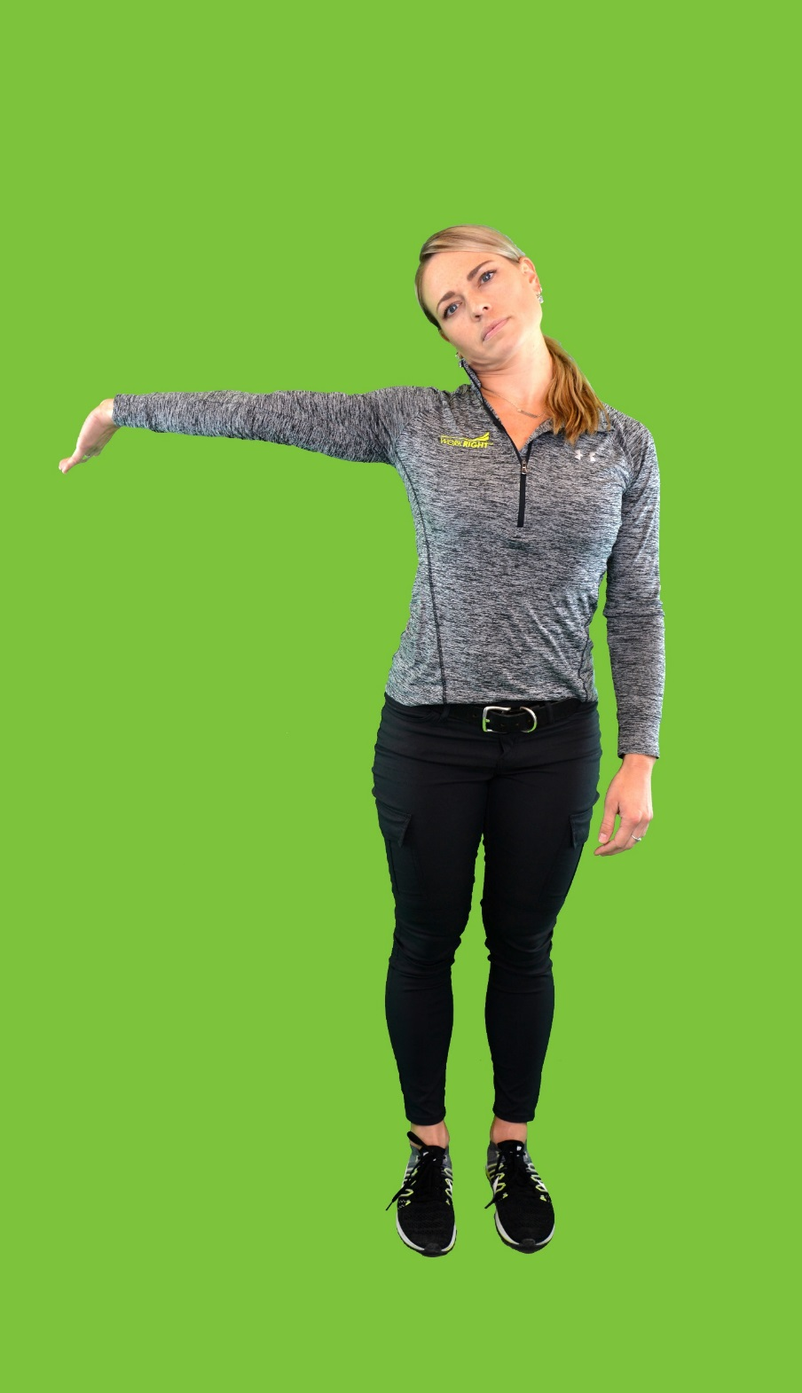
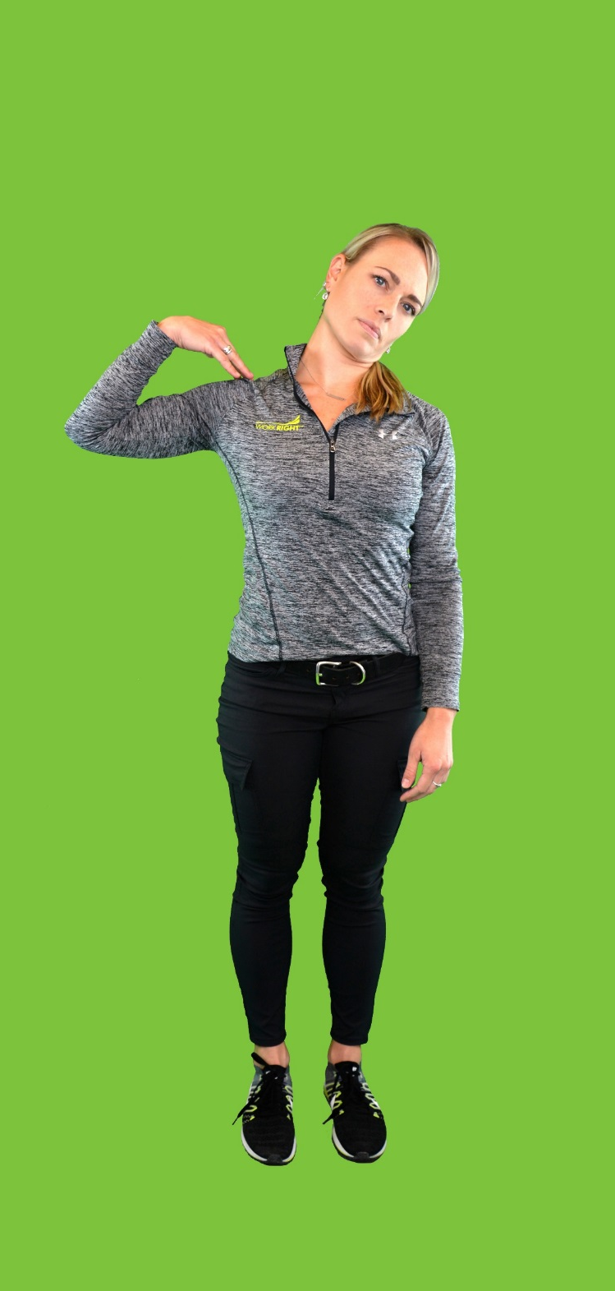
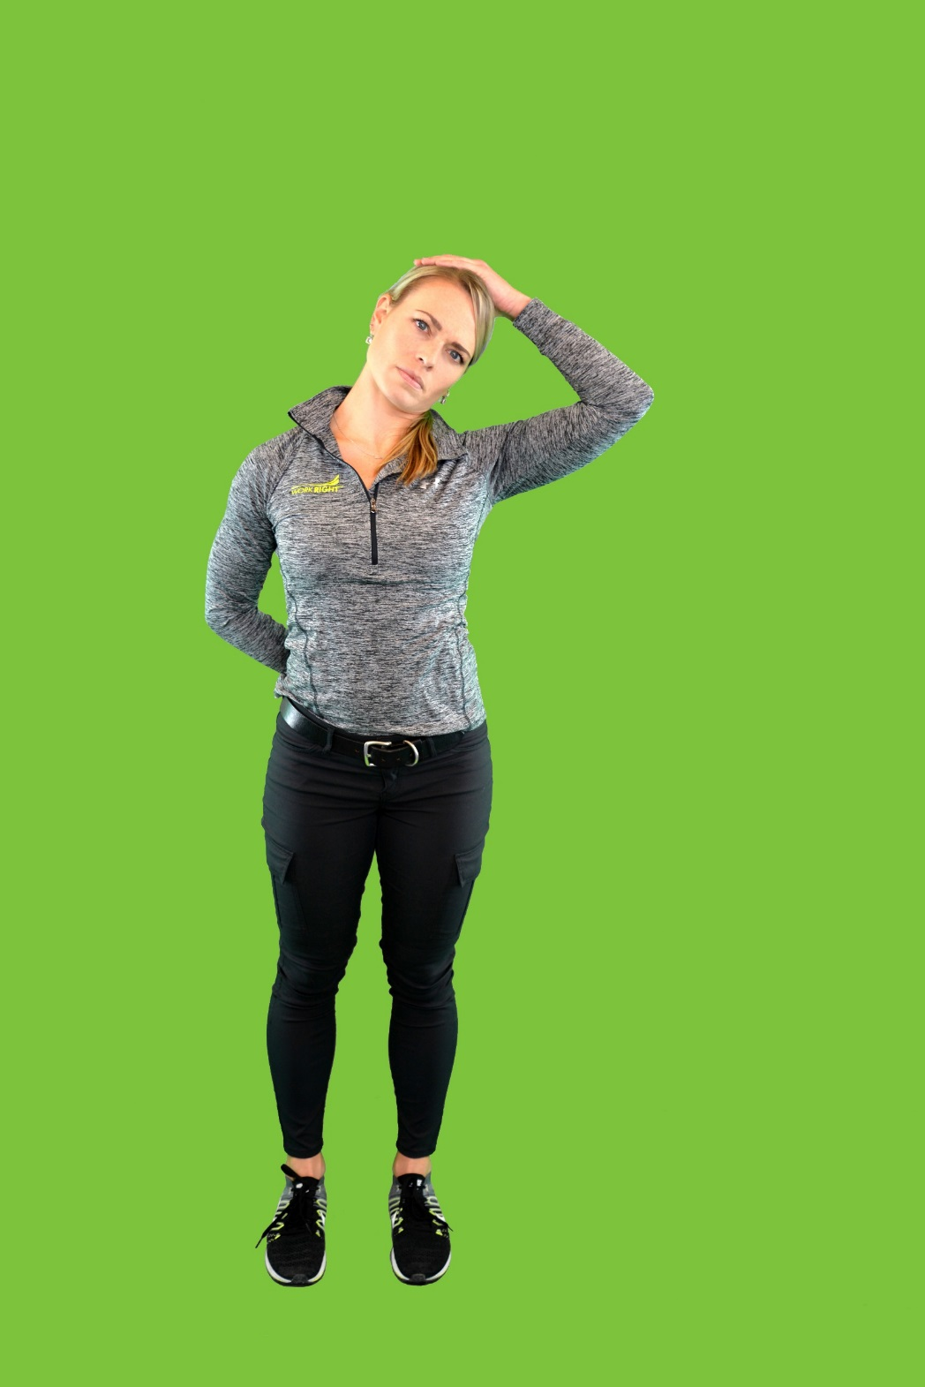
Equipment Operator – Neck Stretches
Notes:
Take micro-stretch breaks
Encourage the rule of 20 (every 20 minutes take 20 seconds to change positions)
Every time you load a truck, take 2 minutes to do micro-stretches
Every time the CB squaks – evaluate your neck posture
Always adjust your seat
Review proper sitting posture
Discuss the importance of re-assessing every morning
Encourage them to always tighten their belt to assist with ideal posture
Work on hip flexibility
Demonstrate hip flexor stretch, piriformis stretch & standing hamstring stretch
Strengthen your scapular stabilizers
Scap squeezes, Tubing Rows, Horizontal Abduction & Bilateral ER
Stretch your neck
Median nerve glides, Posterior Capsule Stretch, Upper Trap Stretch & Chin Tucks

Slide 10
General Recommendations – Rigging Men
Maintain proper footwear
Alternate sides that you move into the clear
Strengthen your core
Strengthen your scapular stabilizers
Work on your balance
Notes:
Maintain proper footwear
3 Part Test of Proper Footwear: (heal squeeze, twist rule & fold rule)
Alternate sides that you move into the clear
Strengthen your core
Focus on ab stabilization (planks, bird dogs, side planks, etc)
Target hips (bridges, bridge w/abd, bicycle kicks, etc)
Strengthen your scapular stabilizers
Scap squeezes, Tubing Rows, Horizontal Abduction & Bilateral ER
Work on your balance
General LE strengthening (squats, lunges, side lunges)
Integrate proprioceptive challenges (i.e. ex’s on BOSU ball, ex’s on pillow, etc)

Slide 11
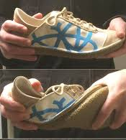
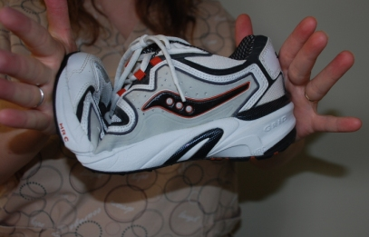
Identifying Proper Footwear
3 Part Test for your boots
Heel Test
Twist Test
Fold Test
Notes:
Heel Test: This is the top image on the slide. The test is searching for heel cup stability to ensure proper support of the heal bone (calcaneus) with the ankle joint (subtalar joint). A properly fitting shoe should be able to maintain good stability in the heel cup without allowing the heel box collapse on itself. For tall shoes (i.e. boots) this test is completed by squeezing the sides of the heel cup.
A positive test would mean that when compressing the heal cup your fingers will touch each other with the support of the shoe collapsing between your fingers.
Twist Test: This test is looking at the rotational stability of the shank of the shoe, meaning it is looking at the rotational stability of the shoe when transitioning from initial contact of gait, through the stance phase of gait. A properly fitting shoe will have some rigidity to twisting and will not twist easily.
A positive test would mean that the shoe will roll over in your hands easily, similar to wringing out a wet towel.
Fold Test: This test is looking at the longitudinal stability of your shoe. It also gives insight into the structural stability of the arch of the shoe/boot. A properly fitting shoe should bend at the point where the toes meet the forefoot (metatarsal/tarsal joint) only & should maintain some rigidity.
A positive test would have the shoe folding over at a place different than where the toes meet the forefoot, or will have the shoe/boot folding completely in half with minimal resistance.
Positive test on any of the three screening tools would lead one to consider new shoes that will provide better support and safety with their footwear.

Slide 12
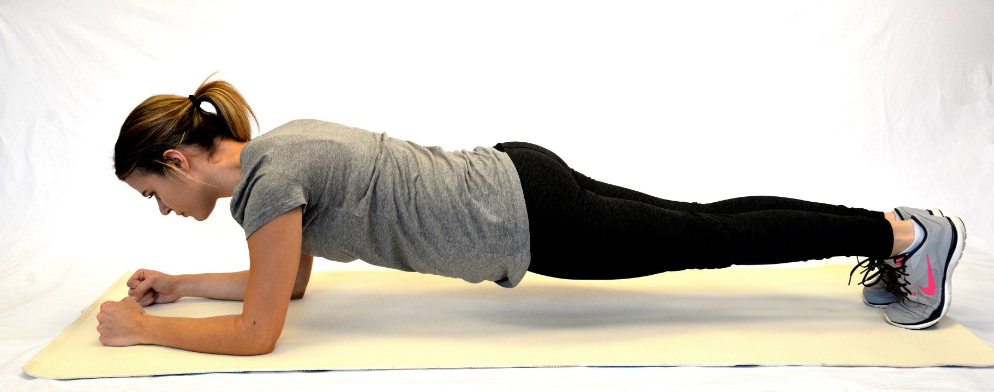
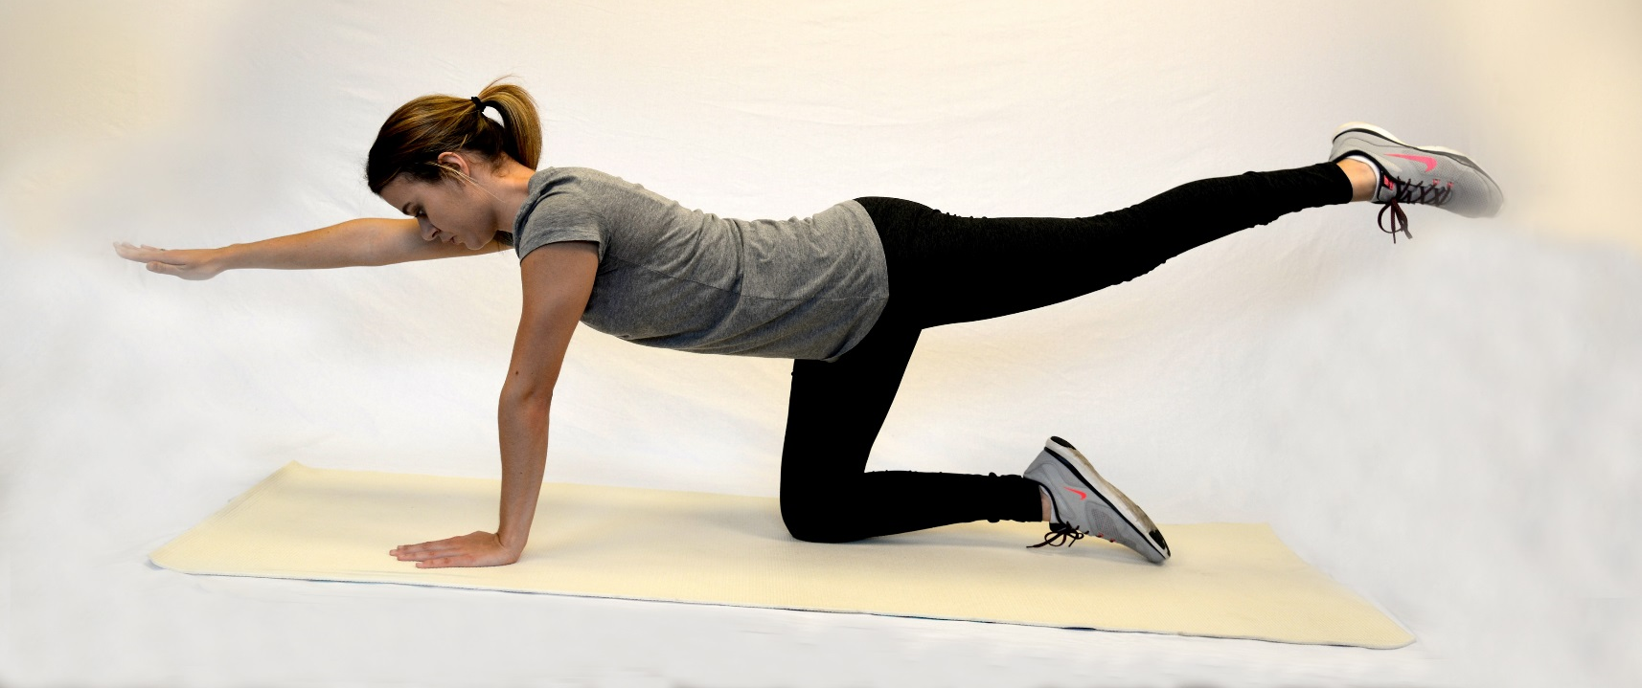
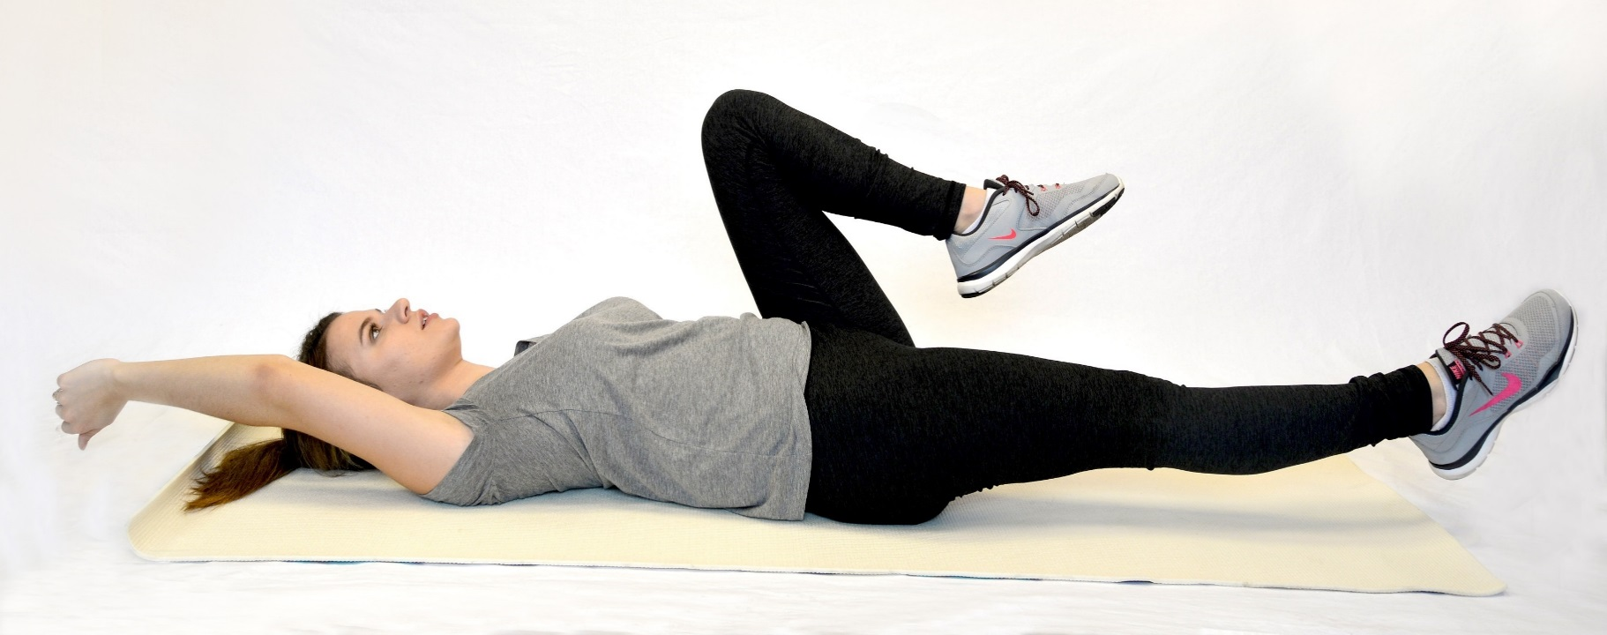
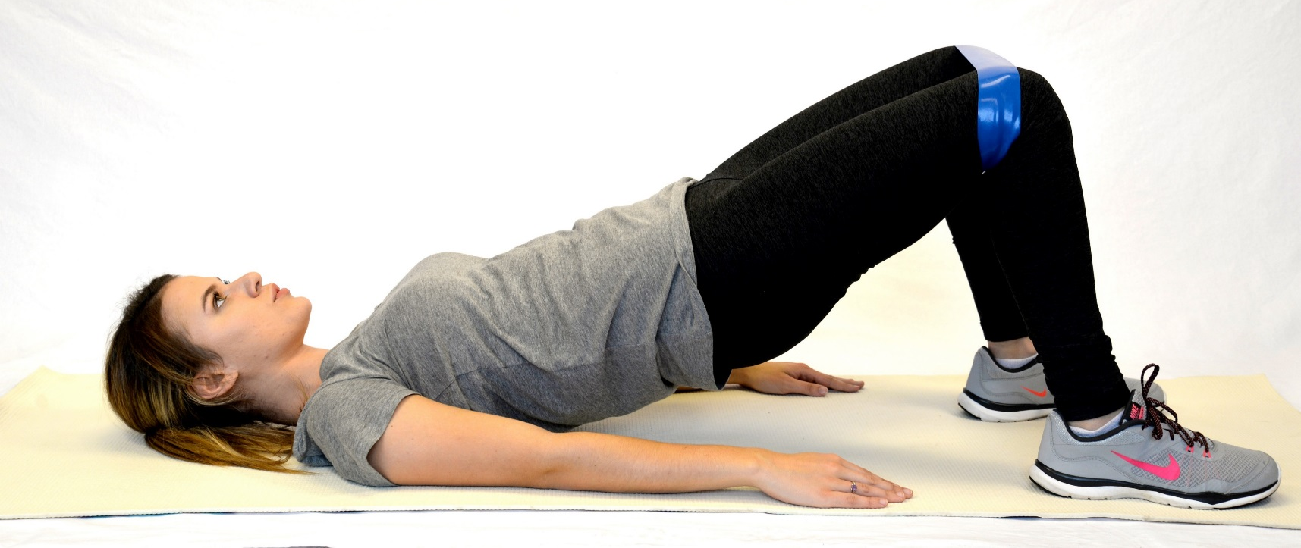
Rigging Men – Strengthen your core
Notes:
Maintain proper footwear
3 Part Test of Proper Footwear: (heal squeeze, twist rule & fold rule)
Alternate sides that you move into the clear
Strengthen your core
Focus on ab stabilization (planks, bird dogs, side planks, etc)
Target hips (bridges, bridge w/abd, bicycle kicks, etc)
Strengthen your scapular stabilizers
Scap squeezes, Tubing Rows, Horizontal Abduction & Bilateral ER
Work on your balance
General LE strengthening (squats, lunges, side lunges)
Integrate proprioceptive challenges (i.e. ex’s on BOSU ball, ex’s on pillow, etc)

Slide 13
Rigging Men – Scapular Stabilization
Notes:
Maintain proper footwear
3 Part Test of Proper Footwear: (heal squeeze, twist rule & fold rule)
Alternate sides that you move into the clear
Strengthen your core
Focus on ab stabilization (planks, bird dogs, side planks, etc)
Target hips (bridges, bridge w/abd, bicycle kicks, etc)
Strengthen your scapular stabilizers
Scap squeezes, Tubing Rows, Horizontal Abduction & Bilateral ER
Work on your balance
General LE strengthening (squats, lunges, side lunges)
Integrate proprioceptive challenges (i.e. ex’s on BOSU ball, ex’s on pillow, etc)

Slide 14
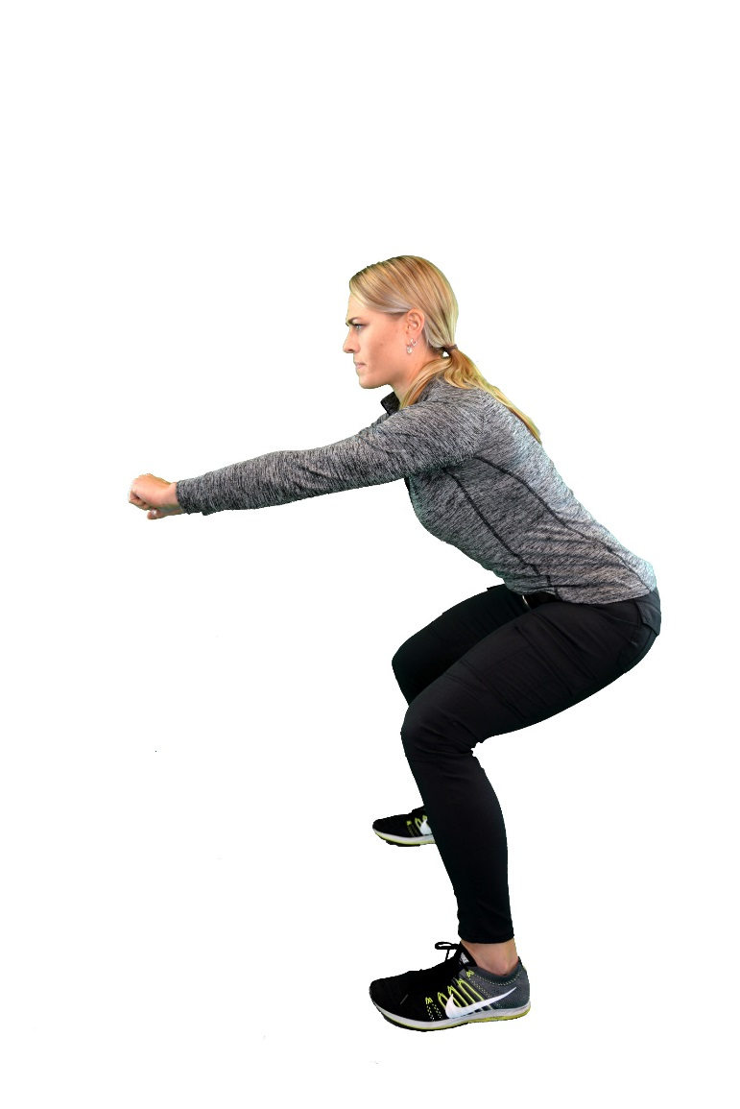
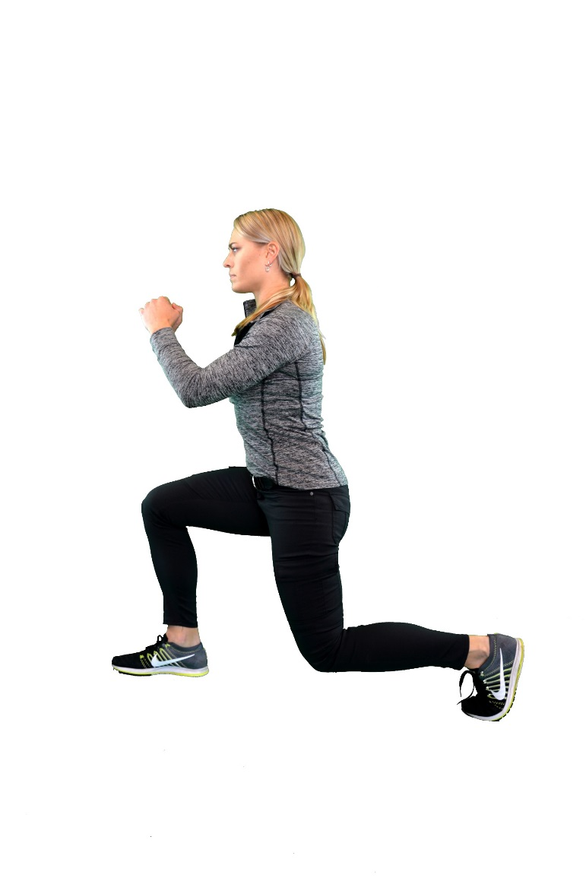
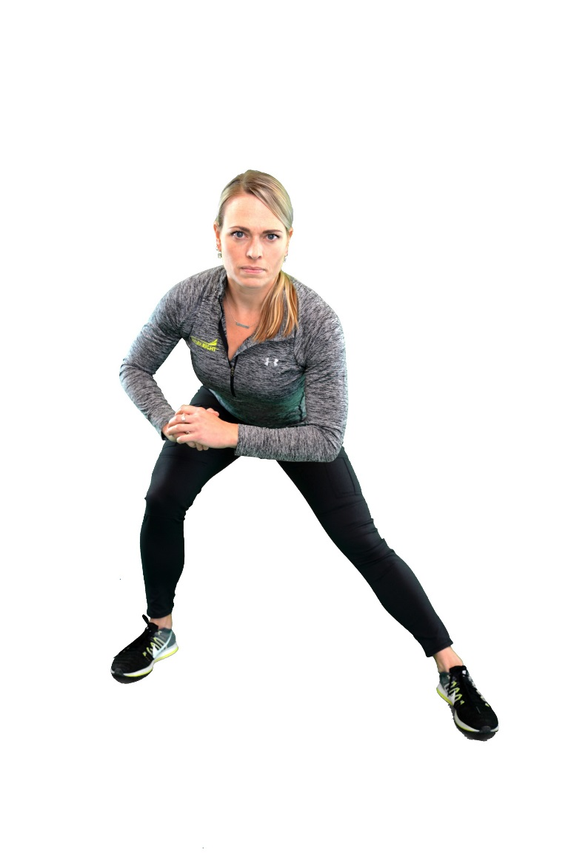
Rigging Men – Balance Exercises
Notes:
Maintain proper footwear
3 Part Test of Proper Footwear: (heal squeeze, twist rule & fold rule)
Alternate sides that you move into the clear
Strengthen your core
Focus on ab stabilization (planks, bird dogs, side planks, etc)
Target hips (bridges, bridge w/abd, bicycle kicks, etc)
Strengthen your scapular stabilizers
Scap squeezes, Tubing Rows, Horizontal Abduction & Bilateral ER
Work on your balance
General LE strengthening (squats, lunges, side lunges)
Integrate proprioceptive challenges (i.e. ex’s on BOSU ball, ex’s on pillow, etc)

Slide 15
General Recommendations – Timber Cutter
Maintain Proper Footwear
Alternate sides that you cut from (when safely applicable)
Hip Stretches
Neck Stretches
Core Strengthening
Scapular Stabilization
Notes:
Timber Cutter
Prolonged postures on side hills
Because of the nature of their job, they operate on side hills continuously. This will result in uneven forces throughout the LE’s, hips & spinal column. It would be recommended to ensure that rigging men are rotating sides that they exit the rigging throughout the day to equalize the forces throughout the body.
Also, it is important to maintain good flexibility throughout the hips (i.e. hip flexors, hamstrings, IT Bands) to ensure shared forces throughout the hips and spine
Good proprioception & core control will improve stability for the body when operating on side hills
Routine looking up (i.e. cervical extension & rotation)
Because they are constantly watching the top of the trees that they are cutting, there is constant postures of cervical extension & rotation
Recommend trying to rotate the direction you are facing when cutting trees to alternate the rotational component on the neck from side to side
Possible integration of stretching to the thoracic spine into extension to improve mobility throughout the entire spinal segment reducing forces on the neck
Cervical stabilization exercises to improve endurance & stability
Frequent reaching & bending with the weight of the saw in the arms
Requires constant reaching, lifting and carrying of the saw while not always able to be in ideal lumbosacral posture
Recommend core strengthening program and hip flexibility exercises to build a solid base of support

Slide 16
Identifying Proper Footwear
3 Part Test for your boots
Heel Test
Twist Test
Fold Test

Slide 17
Timber Cutter– Hip Stretches
Notes:
Maintain Proper Footwear
3 Part Test of Proper Footwear: (heal squeeze, twist rule & fold rule)
Alternate sides that you cut from (when safely applicable)
Hip Stretches
Demonstrate hip flexor stretch, piriformis stretch & standing hamstring stretch
Neck Stretches
Median nerve glides, Posterior Capsule Stretch, Upper Trap Stretch & Chin Tucks
Core Strengthening
Focus on ab stabilization (planks, bird dogs, side planks, etc)
Target hips (bridges, bridge w/abd, bicycle kicks, etc)
Scapular Stabilization
Scap squeezes, Tubing Rows, Horizontal Abduction & Bilateral ER

Slide 18
Timber Cutter – Neck Stretches
Notes:
Maintain Proper Footwear
3 Part Test of Proper Footwear: (heal squeeze, twist rule & fold rule)
Alternate sides that you cut from (when safely applicable)
Hip Stretches
Demonstrate hip flexor stretch, piriformis stretch & standing hamstring stretch
Neck Stretches
Median nerve glides, Posterior Capsule Stretch, Upper Trap Stretch & Chin Tucks
Core Strengthening
Focus on ab stabilization (planks, bird dogs, side planks, etc)
Target hips (bridges, bridge w/abd, bicycle kicks, etc)
Scapular Stabilization
Scap squeezes, Tubing Rows, Horizontal Abduction & Bilateral ER

Slide 19
Rigging Men – Strengthen your core
Notes:
Maintain Proper Footwear
3 Part Test of Proper Footwear: (heal squeeze, twist rule & fold rule)
Alternate sides that you cut from (when safely applicable)
Hip Stretches
Demonstrate hip flexor stretch, piriformis stretch & standing hamstring stretch
Neck Stretches
Median nerve glides, Posterior Capsule Stretch, Upper Trap Stretch & Chin Tucks
Core Strengthening
Focus on ab stabilization (planks, bird dogs, side planks, etc)
Target hips (bridges, bridge w/abd, bicycle kicks, etc)
Scapular Stabilization
Scap squeezes, Tubing Rows, Horizontal Abduction & Bilateral ER

Slide 20
Rigging Men – Scapular Stabilization
Notes:
Maintain Proper Footwear
3 Part Test of Proper Footwear: (heal squeeze, twist rule & fold rule)
Alternate sides that you cut from (when safely applicable)
Hip Stretches
Demonstrate hip flexor stretch, piriformis stretch & standing hamstring stretch
Neck Stretches
Median nerve glides, Posterior Capsule Stretch, Upper Trap Stretch & Chin Tucks
Core Strengthening
Focus on ab stabilization (planks, bird dogs, side planks, etc)
Target hips (bridges, bridge w/abd, bicycle kicks, etc)
Scapular Stabilization
Scap squeezes, Tubing Rows, Horizontal Abduction & Bilateral ER

Slide 21
Example of Pre-Shift Warmup
This routine should take 10 minutes to complete
Addresses dynamic movements, general strengthening & static stretching
Targets high risk body regions & nerve mobilization
This is a general program that is not specified to the specific needs of an individual

Slide 22
Human performance is like logging… you don’t go from greenhorn to side rod in 4 weeks, it takes hard work and motivation to achieve your goals

Slide 23
Opportunities for Further Development
Improved seating in cabs
Integration of more cost effective exoskeleton suits
Utilization of drones for stringing haywire
Lighter gear

