Slide 1
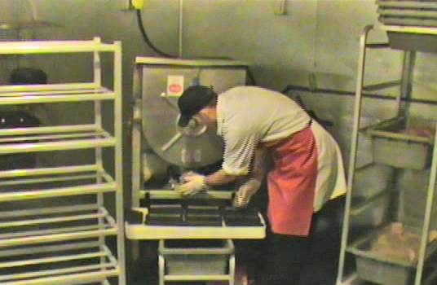
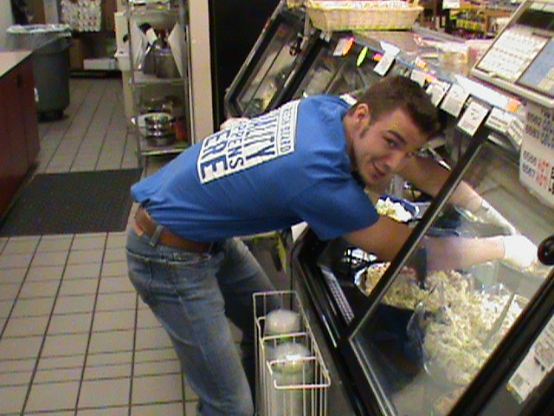
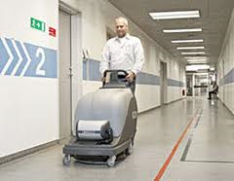
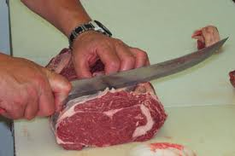
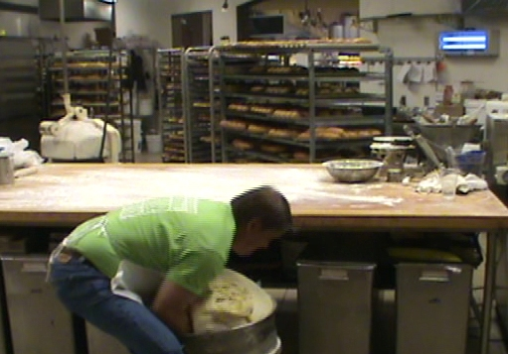
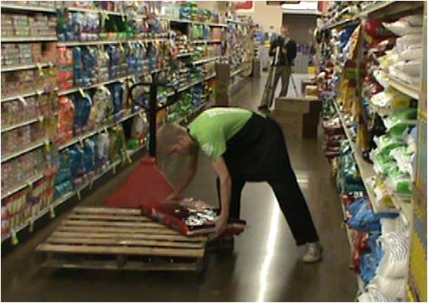
Participatory Ergonomics Program to Address
Musculoskeletal Disorder Risk in the Grocery Industry
Stephen B. Goldrick, SPT, CSCS
Co-Authors: Samantha Modderman, SPT; Dan Anton, PT, PhD, ATC; Dan Hansen, DC; Douglas Weeks, PhD
Background and Purpose
Exposure Assessment
Participatory Ergonomics Process
Importance of Topic
Work-related musculoskeletal disorders (WMSDs) are conditions affecting various soft and bony tissue and can impact the ability to perform work tasks.⁶
WMSDs are prevalent within all sectors of industry
WMSDs have the highest percentage of compensation and disability
Causes of WMSDs^{1,6}
Physical risk factors
Awkward/sustained postures (Figure 1)
Heavy lifting (Figure 2)
Hand arm/whole-body vibration (Figure 3)
Forceful/repetitive exertion of the hand (Figure 4)
Participatory Ergonomics
Ergonomics is the study of designing workspaces and equipment to fit the worker
Active problem solving process, entire workplace is involved
Shown to be effective in other industries such as newspaper, meat packing, kitchen, and automotive manufacturing.²⁻⁵
Exposure Assessment Methods
Quantitative assessments that allow the research team to evaluate physical risk factors for developing WMSDs
Rodger’s Fatigue Index
Used for assessing muscular
fatigue (Figure 5)
Typically longer tasks, 10-30 min
Specific anatomical regions are
assessed based on the risk factors
associated with the task
Hand Activity Level
Used for assessment of hand
“busyness” or speed of hand
movement (Figure 6)
Pauses in hand motion as well
as amount of activity is considered
when evaluating a task
Ovako Work Posture Analyzing
System
Used for evaluation of posture
while completing work tasks
(Figure 7)
Shoulder, low back, and lower
extremity posture are evaluated
Evaluations are made every
15-30 sec.
Utah Back Compressive Force Scale
Used for assessment of spinal
compression force during lifting
(Figure 8)
Compression > 700 lb is
considered hazardous
Participatory Ergonomics Program
Train workers to identify and analyze workplace hazards
Utilization of the Ergonomics Process⁵ (Figure 9)
Problem Identification
Identify activities that may
precipitate or exacerbate WMSD
Observe work and interview workers
Analysis
Better understand the job tasks
Collect quantitative and qualitative
data using exposure assessment
methods
Solution Development
Solutions to reduce MSD risk
Brainstorming sessions
Rely on the workers’ expertise of
their department to come up with solutions
Implementation
Implement solution within a department with high exposure to risk factors
What is required to initiate the solution? How will the solution be re-assessed?? Who will be involved? How long will it be tested?
Evaluation
Short-term feedback on the benefit/drawbacks to implementing the new solution
Long term outcomes assessment
Did the solution reduce injury rates? Employee job satisfaction?
Reassess the new solution with the same exposure assessment methods as analysis and compare
Benefits of PE programs
Takes advantage of worker knowledge
Workers share responsibility
Acknowledgments
This project was funded by Washington State Department of Labor & Industries Safety and Health Investments Project SHIP grant 2008XH00097
Thank you to Yoke’s Fresh Markets and associated staff for their participation in this research project
References
1. Corrasco C, Coleman N, Healey S. Packing products for customers: An ergonomics evaluation of three supermarket checkouts. Appl Ergon. 1995;26(2):101-108
2. Laing AC, Frazer MB, Cole DC, Kerr MS, Wells RP, Norman RW. Study of the effectiveness of a participatory ergonomics intervention in reducing worker pain severity through physical exposure pathways. Ergonomics. 2005;48(2):150-170.
3, Moore SJ, Garg A. Use of participatory ergonomics teams to address musculoskeletal hazards in the red meat packing industry. Am J Ind Med. 1996;29:402-408
4, Pehkonen I, Takala EP, Ketola R, et al. Evaluation of a participatory ergonomic intervention process in kitchen work. Appl Ergon. 2009;40:115-123.
5, Rosecrance JC, Cook TM. The use of participatory action research and ergonomics in the prevention of work-related musculoskeletal disorders in the newspaper industry. Appl Occup Environ Hyg. 2000;15(4):255-262.
6, Silverstein B, Viikari-Jentura E, Kalat J. (2000). Work-related Musculoskeletal Disorders of the Neck, Back, and Upper Extremity in Washington State, 1990-1998. Technical Report Number 40-4a-2000. Olympia, WA: SHARP Program.
Figure 1. Awkward/sustained posture.
Figure 5. Meat grinding, meat department.
Figure 9. Ergonomics Process – the foundation of PE assessment
Figure 2. Heavy lifting
Figure 3. Hand arm/whole-body vibration
Figure 4. Forceful/repetitive exertions
Methods
Figure 6. Cashiering, front end department
Study Design
Two grocery stores from a medium sized grocery chain in Eastern Washington participated in the study
Employees from all departments were asked to participate
One store received a participatory ergonomics program to address risk factors for the development of WMSDs, the other received no intervention
Comparisons were made between stores using demographic and health related surveys and ergonomic exposure assessment methods.
Surveys
Demographic – age, gender, weight, job history, among others
Modified Nordic – musculoskeletal symptom survey with questions about job related aches/pain in the past 12 months and whether or not a physician was seen
SF-36 – a health related quality of life survey about functional health and well-being from the subjects perspective.
References
Figure 7. Lifting dough to prep table, bakery department.
Figure 8. Downstacking dog food pallet, freight department.

