Slide 1
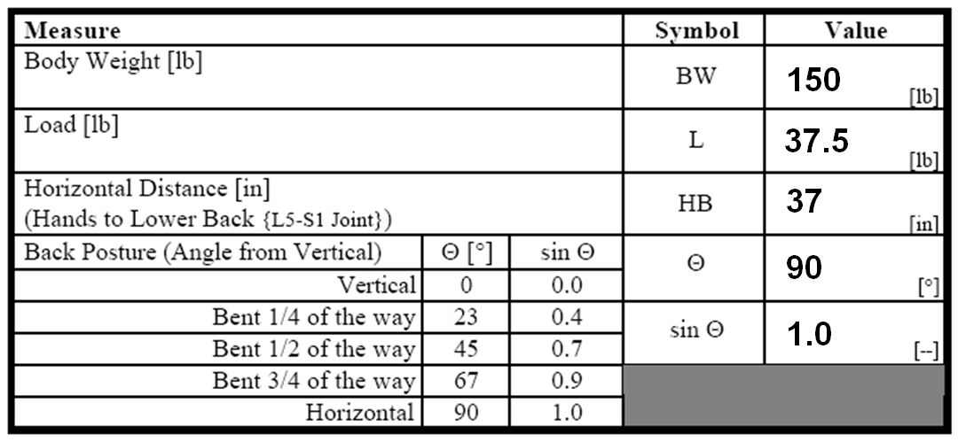
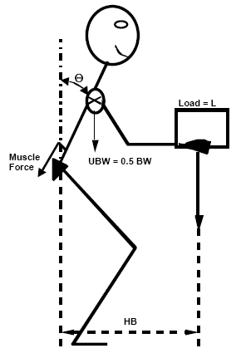
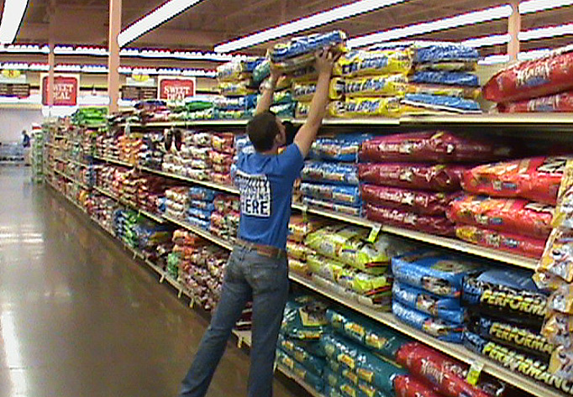
Ergonomic Exposure Assessment:
A Case Report from the Grocery Industry
Samantha Modderman, SPT
Dan Anton, PT, PhD, ATC; Steve Goldrick, SPT; Douglas Weeks, PhD; Daniel Hansen, DC
Introduction
WISHA Lifting Analysis⁴
Analyzes tasks requiring heavy, frequent, and/or awkward lifting
Calculates a weight limit for objects lifted
Utah Back Compressive Force Scale⁸
Assesses spinal compression at L5-S1 joint associated with heavy lifting
Compressive forces >700 lb considered hazardous
Utah Back Compressive Force Scale Results
Work-Related Musculoskeletal Disorders (WMSDs)
Injuries of muscles, bones, and tendons that result from a single large force applied at one time or a series of smaller forces repeated over time
Highest percentage of compensation/disability cases among workers¹
Washington compensation rate for grocery industry is 1.8x state rate²
Physical Risk Factors
Specific risk factors associated with WMSDs in the grocery industry:
Musculoskeletal fatigue
Heavy lifting
Awkward or static postures
Forceful hand exertions
High repetition
Hand-arm vibration
Ergonomic Exposure Assessment Methods
Determine WMSD risk and prioritize tasks needing change
Universal; can be used to evaluate work tasks in any industry
Can be used by personnel without formal ergonomic training
Observational Assessment Methods
Simple, non-invasive, and efficient
Task selection based on worker report of fatigue or analyst observation of difficult tasks
Use two video cameras to record tasks at 90° angles
Table 1. Utah Back Compressive Force Scale Components Measured by Analyst
Example of Exposure Assessment in Grocery Industry: Utah Back Compressive Force Scale
Example of Utah Back Compressive Force Scale used to analyze freight crew task of unloading dog food pallet (Figures 1-2, Tables 1-2)
Three major force vectors contribute to spinal
compression during lifting tasks (Figure 3, Table 2)
A: Back muscle reacting to upper body weight
B: Back muscle force reacting to load moment
C: Direct compressive component of upper
body weight and load
Analyst measures the following components of the lifting task (Table 1):
Body weight of worker
Weight of the load being lifted
(e.g. bag of dog food)
Horizontal distance from hands to low back
Low back flexion angle of worker
Values of each component used to calculate estimated compressive force (Table 2)
Table 2. Utah Back Compressive Force Scale Calculations Using Component Values
Table 3. Outcome Measure results
Interpretation of Utah Back Compressive Force Scale results from example
Estimated compressive force of 1233.75 lb considered hazardous
Load moment force (B) contributes most to compression
Freight crew task, specifically load moment, in need of change
All previously mentioned exposure assessment methods available at: http://personal.health.usf.edu/tbernard/ergotools
Figure 3. Representation of force vectors used to assess spine compression for the Utah Back Compressive Force Scale (adapted from Bernard¹⁴)
Common Exposure Assessment Methods
Rodgers Fatigue Index³
Calculates effort, duration, and frequency of a task-related exertion
Option to evaluate any major joint/body part
Used to prioritize tasks in need of change based on musculoskeletal fatigue
Hand Activity Level (HAL)⁴
Used to analyze tasks with highly repetitive hand activity
Assesses combination of hand rest periods and speed of movement
Higher scores indicate faster pace or higher repetition of hand activity and are associated with WMSDs of the distal upper extremity⁷
Ovako Working Posture Analyzing System (OWAS)⁵
Work sampling method to assess for awkward postures of the shoulders, low back, and lower extremities
Task placed into 1 of 4 categories that reflects risk level for WMSD
References
National Research Council - Institute of Medicine (NRC/IOM). Musculoskeletal Disorders and the Workplace. Washington, DC: National Academy Press; 2001.
Silverstein B, Adams D. Work-related musculoskeletal disorders of the neck, back, and upper extremity in Washington state, 1997-2005. Technical Report Number 40-11-2007; 2007.
Rodgers SH. Job evaluation in worker fitness determination. Occ Med. 1988;3(2):219-239.
Latko WA, Armstrong TJ, Foulke JA, Herrin GD, Rabourn RA, Ulin SS. Development and evaluation of an observational method for assessing repetition in hand tasks. Am Ind Hyg Assoc J. 1997;58(4):278-285.
Karhu O, Kansi P, Kuorinka I. Correcting working postures in industry: a practical method for analysis. Appl Ergon. 1997;8:199-201.
Washington State Department of Labor & Industries. Rule Documents. Olympia, WA: Washington State Department of Labor & Industries, 2001. http://www.lni.wa.gov/Safety/Topics/ Ergonomics/ History/Documents/default.asp. Accessed May 18, 2011.
Spielholz P, Bao S, Howard N, et al. Reliability and validity assessment of the hand activity level threshold limit value and strain index using expert ratings of mono-task jobs. J Occ Environ Hyg. 2008;5:250-257.
Thomas E. Bernard. Analysis Tools for Ergonomists. 2002. http://personal.health.usf.edu/tbernard/ ergotools/index.html. Accessed May 18, 2011.
Figure 1. Freight crew member stocking the top shelf with dog food
Figure 2. Freight crew member unloading a dog food bag from the pallet
Acknowledgments: This project was funded by Washington State Department of Labor & Industries Safety and Health Investments Project SHIP Grant 2008XH00097. Thank you to Yoke’s Fresh Markets and associated staff for their participation in this research project.

