Slide 1
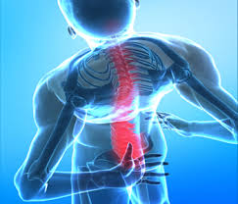
BACK SAFETY
EHS

Slide 2
Learning Objectives
After completing this lesson, you will know how to…..
List some general causes of back injuries
Describe what the power and danger zone is
Describe some ways to reduced heavy lifting
Demonstrate proper back lifting technique
Notes:
If someone in the class feels comfortable to read the learning objectives.
Also, remind the class that the learning objectives will be reviewed after this lesson.

Slide 3
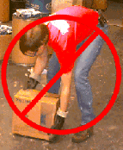
Background Information
Back injuries are the second most common cause of days away from work
80% of Americans will have a back injury that requires medical attention
Overexertion
Notes:
Raise of hands, how many have had back pain, missed worked from it? Does not matter what type of work you do, everyone needs to pay attention to their back.
The main reason for back injuries is overexertion.

Slide 4
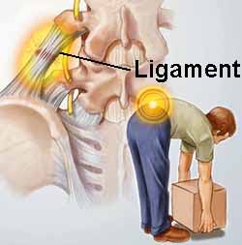
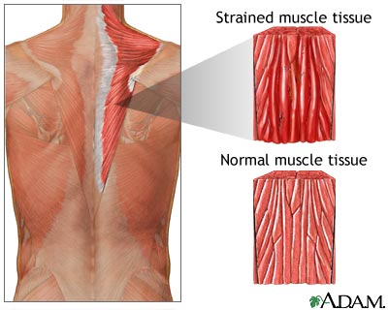
Overexertion Injuries
Sprains
Sprains
Stretching or Tearing
Ligaments -
Very tough connective tissue which connect bone to bone, hold the tendons in place and stabilize the joints.
Stretching or Tearing
Muscles/Tendons -
The tissue responsible for movement of joints. They are attached to bone by tendons, and shorten to create movement of a joint.
Notes:
Overexertion injuries may lead to the most common injures: sprains and strains.

Slide 5
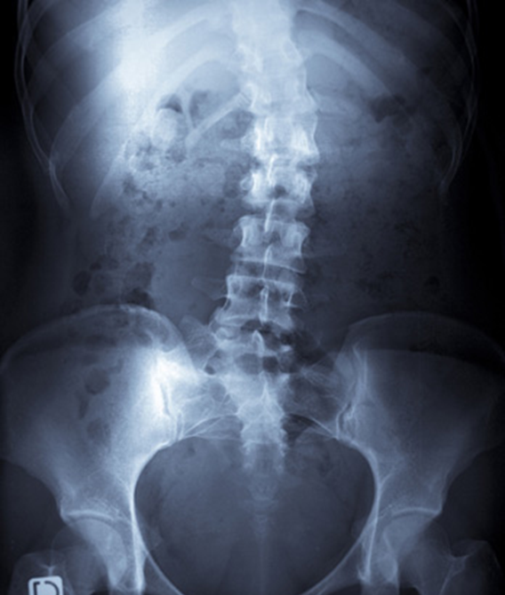
General Causes Of Back Injury
Usually a combination of causes:
Poor posture
Unconditioned back
Excess weight and potbellies
Bad lifting techniques
Underlying medical condition
No exercises regiment
Notes:
General causes of back injury can be a combination of all above.
Prevention for strengthening of the back is to strengthening your core.

Slide 6
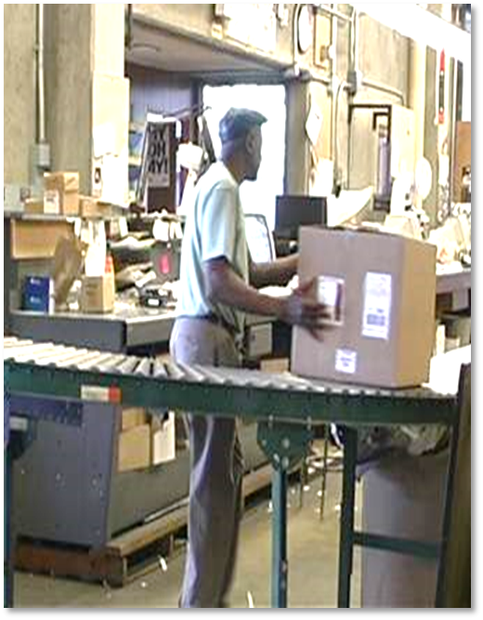
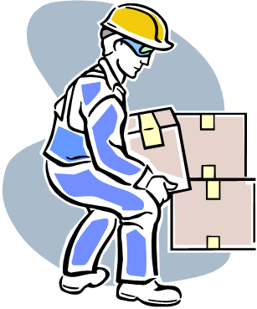
Pay Special Attention To….
Twisting
Heavy Lifting
Frequent Lifting
Awkward Lifting
Notes:
When lifting boxes pay attention to: Twisting, Heavy Lifting, Frequent Lifting, and Awkward Lifting, all may lead to back injuries.
Now, go into a little more detail of each.

Slide 7
Twisting
Twisting at the waist while lifting or holding a heavy load.
Notes:
Twisting: You want to make sure you are right in front of the load you are lifting. Twisting may lead to back injuries.

Slide 8
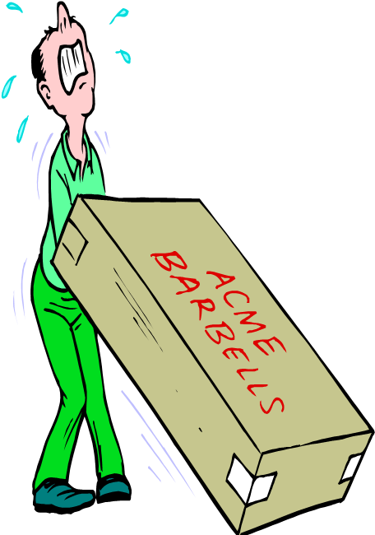
Reducing Heavy Lifting
Use Mechanical Assistance
Reduce the Weight
Slide Instead of Lift
Team Lifting
Notes:
Ways to reduce lifting heavy loads

Slide 9
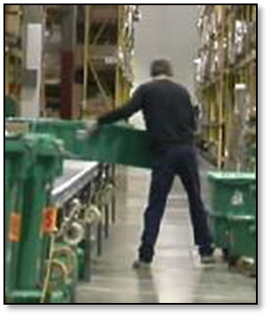
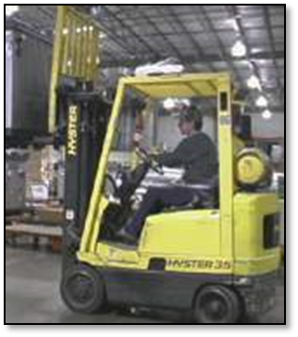
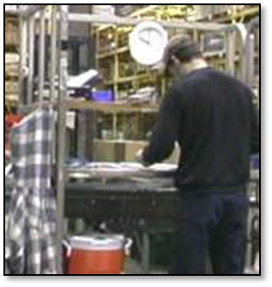
Frequent Lifting
Notes:
It's important to remember that job rotation alone does not change the risk factors present in the workplace.

Slide 10
Reducing Awkward Lifting
Use Mechanical Assistance
Reduce Package Size
Reduce Shelf Depth
Remove Obstacles
Team Lifting
Job Rotation
Slide Closer
Notes:
Reduce the reach. Use mechanical assistance. Team lift if possible.

Slide 11
Notes:
The “power zone” for lifting is close to the body and between knuckle and shoulder height – like the strike zone in baseball.

Slide 12
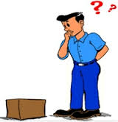
Safe Lifting
https://www.youtube.com/watch?v=RuhroEh31i0
Notes:
Right click to open up hyperlink

Slide 13
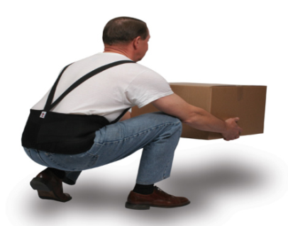
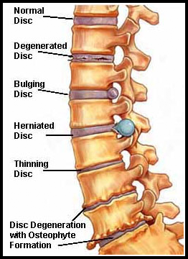
Should You Be Wearing a Back Brace?
Bring about the weakness of your spine.
Wear it too excessively or rely on it.
Best if you try to develop and strengthen your spine through the proper exercise.
Notes:
Back braces may offer temporary pain relief but there is also a risk ... Wear your brace only as prescribed by your doctor.

Slide 14
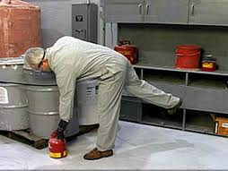
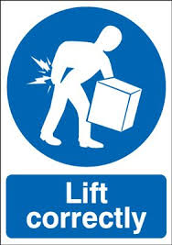
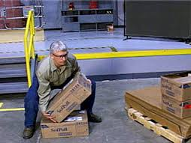
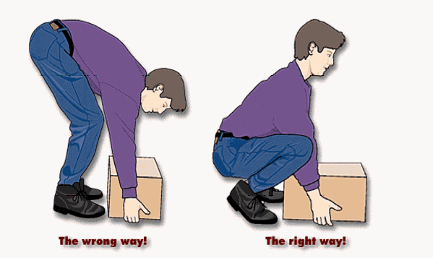
Notes:
1st picture is called golfer
2nd picture: if there is not a good grip on the load, tilt the load to get a good handle on the load.

Slide 15
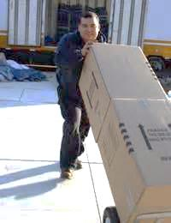
Prevention
Should you push or pull?
What can you do?
Push rather than pull
Pacing/Job Rotation
Reducing reaching
Mechanical devices
Raise Pallets
Limit Repetitiveness
Breaks
Stretch
Body Positions
Early Identification
Therapy
Notes:
Ways to help reduce back injuries.

Slide 16
Lifting Practice
Notes:
Get difference size and shape of boxes and have the class practice lifting techniques. This is a great hands-on learning opportunity for the class to teach each other and discuss the right and wrong ways of lifting.

Slide 17
Learning Objectives
1. List some general causes of back injuries
2. Describe what the power and danger zone is
3. Describe some ways to reduced heavy lifting
4. Demonstrate proper back lifting techniques
QUESTIONS?
Notes:
Have the class answer the learning objectives. It will help them prepare for the test at the end.

