Slide 1
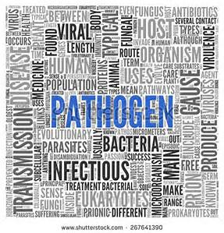
Information on the Hazards of Bloodborne Pathogens in the Workplace
Chapter 296-823 WAC
Notes:
The purpose of Bloodborne pathogens (BBP) standard is to increase awareness about BBP, reduce the risk and occurrence of exposure, and provide guidelines on recognition and management in the workplace.

Slide 2
Learning Objectives
After completing this lesson, you will know how to…
Explain what Bloodborne Pathogens are
Define what OPIM is
Explain Universal Precaution and PPE
Explain common ways workers are exposed
Preventing the Spread of Infectious Diseases
Notes:
Ask if someone in the class feels comfortable to read the learning objectives.
Also, remind the class that the learning objectives will be reviewed after this lesson.

Slide 3
What would you do?
and What Would Other Employees Do?
Notes:
After this lesson, you will learn how to use feasible controls to eliminate or minimize occupational exposure to blood or other potentially infectious materials.

Slide 4
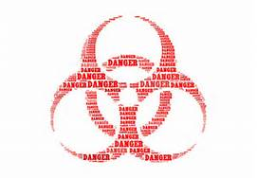
Washington State Department of
Labor and Industries
Chapter 296-823 WAC
OCCUPATIONAL EXPOSURE TO BLOODBORNE PATHOGENS
http://faonly.profirstaid.com/en/training_video/reduce-risk-of-bloodborne-pathogens
Notes:
Right click on link to open hyperlink

Slide 5
Bloodborne Pathogens (BBP)
Pathogenic microorganisms are present in human blood or other potentially infectious materials, and can cause disease in humans.
Microorganisms present in Blood, or……
Other
Potentially
Infectious
Materials
Notes:
Microorganisms can be in human blood or other potentially infectious materials (OPIM)
Human blood, human blood components, and products made from human blood

Slide 6
Other Potentially Infectious Materials (OPIM) are:
Semen
Vaginal Secretions
Body fluids
Pleural
Cerebrospinal
Synovial, and
Amniotic
Saliva in dental procedures
Any body fluids visibly contaminated with blood.
Body fluid where it is difficult to differentiate
Any unfixed tissue or organ (other than intact skin) from a human (living or dead)
HIV or HBV containing cultures (cell, tissue, or organ) culture mediums, or other solutions
Blood, organs, and tissues from animals infected with HIV, HBV, or BBPs.
Notes:
Blood fluids and tissues other than blood are considered to be OPIM and are to be treated as same as blood.

Slide 7
Occupational Exposure
Reasonably anticipated skin, eye, mucous membrane, or parenteral contact with blood or other potentially infectious materials that may result from the performance of an employee’s duties.
Duties may include:
Direct Patient Care
Phlebotomy/Laboratory
Environmental Services
Waste Management
Other?
Notes:
Have class discuss what other occupations may have bloodborne pathogens?

Slide 8
Pathogen:
Any Microorganism That Can Cause Disease
Examples of Pathogens Caused Illnesses
Viruses- AIDS, Hepatitis B, Colds, Flu, Herpes
Bacterial- Intestinal Diseases, Tuberculosis, Gonorrhea
Fungi- Athlete’s Foot, Farmer’s Lung, Asthma/Allergies
Parasites- Giardiasis, Malaria, Trichinosis
Notes:
A list of some BBP that can cause disease in humans.

Slide 9
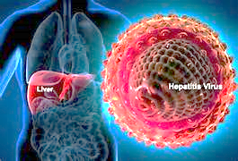
HEPATITIS B VIRUS
Chance of getting HepB from syringe infected with HebB – 30%
Virus is extremely infectious and can stay alive in dried blood up to a year.
HepB can cause cirrhosis and the leading cause of liver cancer in the world.
HEPATITIS C VIRUS
Chance of getting HepC from syringe infected with HepC – 3 to 5%
Attacks the liver
More than 80% of those infected become chronic carriers, and 1/5 of those will develop cirrhosis within 10 to 40 years. Smaller % develop liver cancer.
HIV/AIDS VIRUS
Chance of getting HIV from a syringe infected with the HIV virus - .03%
The AIDS virus attacks the immune system, allowing other disease to develop.
HIV is transmitted primarily through sexual contact.
Transmission risk from a needle is low.
Notes:
Most common form of transmission of BBP is needle sticks.

Slide 10
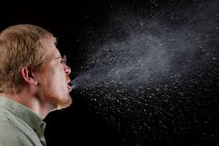
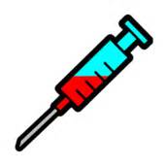
Routes of Transmission
Organisms can enter the body by:
Inhalation
Ingestion (contaminated food, water)
Direct Blood Contact (Bloodborne)
Notes:
Infectious materials contacting open wounds, cuts, or broken or damaged skin.

Slide 11
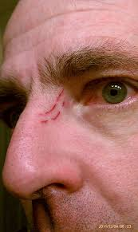
Transmission of BBPs
Bloodborne pathogens can enter the body through:
Contaminated instrument injuries
A break in the skin, cut lesion, etc.
Mucus membranes - eyes, nose, and mouth
Other modes
Notes:
Most common is needle sticks transmission of BBP.
Cuts from other contaminated sharps (scalpels, broken glass, etc.)
Contact of mucous membranes (for example, the eye, nose, mouth) or broken (cut or abraded) skin with blood or other potentially infectious material.

Slide 12
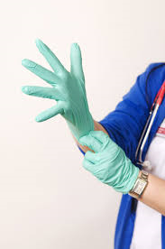
Method of Compliance
Standard (universal) Precautions
…shall be observed to prevent contact with blood or other potentially infectious materials.
…all body fluids shall be considered potentially infectious materials.
http://faonly.profirstaid.com/en/training_video/glove-removal-and-disposal
Notes:
Treat all human blood and bodily fluids as if they are infected with HIV, HBV, HCV and other bloodborne pathogens.
Encourage self-care
Before donning protective gloves, check for holes or tears in gloves. Also bandage any cuts on your fingers.

Slide 13
http://faonly.profirstaid.com/en/training_video/wash-your-hands
Notes:
Wash hands for a least 20 seconds. Wash hands before and after universal precaution.
Right click on link to open hyperlink.

Slide 14
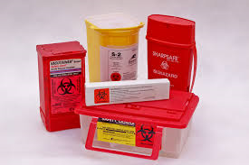
Safe Disposal
Precautionary measures include:
Use PPE & Universal Precautions
Cover spill or area with paper towel or rags
Pour disinfectant solution over towels or rags
Leave for at least 10 minutes
Place materials in appropriate container
Arrange for pick-up and disposal
“SATURATION”
Notes:
Biohazard labeled red bags or containers may be substituted for sticker labels.
If the material is saturated with blood or OPIM then it needs to be placed in biohazard containers.

Slide 15
Learning Objectives
Explain what Bloodborne Pathogens are
Define what OPIM is
Explain Universal Precaution and PPE
Explain common ways workers may be exposed
Notes:
Have the class answer the learning objectives. It will help them prepare for the test at the end.

