Slide 1
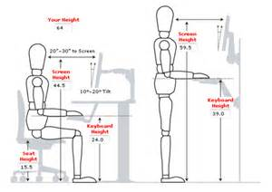
Ergonomics
Notes:
Designing jobs, equipments, and work tasks to fit human physical characteristics and energy limitations. Ergonomics considers body dimensions, mobility, and the body’s stress behavior.

Slide 2
Learning Objectives
After completing this lesson, you will know how to…
Define ergonomics
Explains ways to prevent work-related musculoskeletal disorders
Name environmental factors that may affect you while working
Name physical stressors that may put pressure or stress on parts of the body
Notes:
If someone in the class feels comfortable to read the learning objectives.
Also, remind the class that the learning objectives will be reviewed after this lesson.

Slide 3
OSHA defines ergonomics as:
The science of “designing the job to fit the worker, instead of forcing the worker to fit the job.”
Notes:
40% of all Workers Compensation Claims in Washington State among office workers. (L&I website)
Visit: http://www.lni.wa.gov/ for more ideas on how to reduce WMSD’s injuries.

Slide 4
What is ERGONOMICS?
ERGO= “work”
NOMICS= “rules” or “laws”
Ergonomics literally means –
“the laws of work”
Notes:
Ergonomists study human capabilities in relationship to work demands.

Slide 5
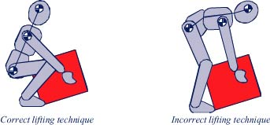
Makes the job safer by preventing injury and illness
Makes the job easier by adjusting the job to the worker
Makes the job more pleasant by reducing physical and mental stress
Saves money $$$
Notes:
Some ways a company can benefit when having a ergonomic program: decrease absenteeism, increase productivity, morale and reduce turnover.

Slide 6
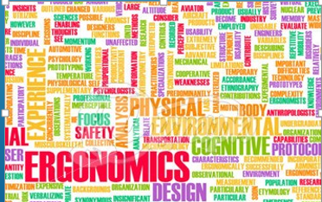
Ergonomic Factors
Two Categories of Ergonomic Factors
Environmental
2. Physical
Notes:
Understanding risk factors and practicing basic ergonomic principles are the first defense against possible injury and lost productivity.

Slide 7
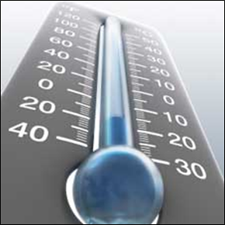
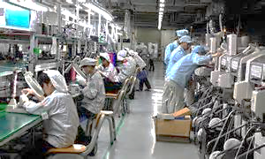
Environmental
Environmental factors may include:
Noise (Hearing)
Lighting (Vision)
Temperature (General comfort and health)
Stress
Notes:
Next, will take a look at each one.

Slide 8
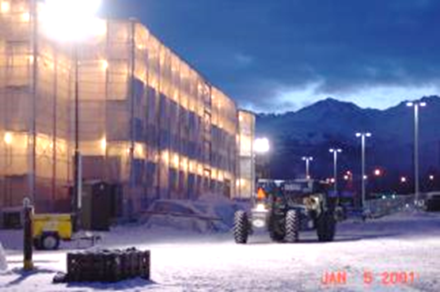
Extreme Temperatures
Do you work in cold or hot conditions for extended periods of time?
Working in excessive temperatures may:
Lead to muscle fatigue, which may lead to increase risk of sprains and strains.
Reduce blood flow to your hands and fingers creating numbness, which may cause loss of grip and may damage your hands and wrists.
Notes:
People are more prone to ergonomic injuries in cold environments. Muscles and other tissues are more tense, because of decreased circulation.
Dress appropriately
Do some warm up exercises

Slide 9
Lighting and Noise
LIGHTING
NOISE
Designed for the task
Factors that may contribute to
hearing damage:
Noise levels
How long the exposure
Notes:
Lighting should be indirect and adequate: not too much light, or it may cause a glare, headaches, and eye fatigue .
Noise may cause ear damage, but constant noise can create extra muscle tension in the body, causing fatigue and making it easier for ergonomic injuries to occur.
Use of most power equipments, machineries, lawn mowers, and blowers should require ear plugs.

Slide 10
Stress
Notes:
Practice wellness at work and home: exercise, nutrition, and relax.

Slide 11
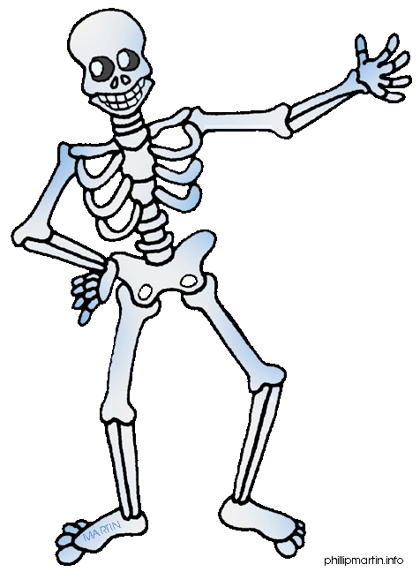
Physical Stressors
Physical stressors place pressure or stress on parts of the body such as joints, muscles, nerves, tendons, bones and ligaments
Examples:
Force
Contact Stress
Vibration
Repetition
Awkward Posture
Notes:
Ask participants to share the aspects of their jobs that involve these risks.

Slide 12
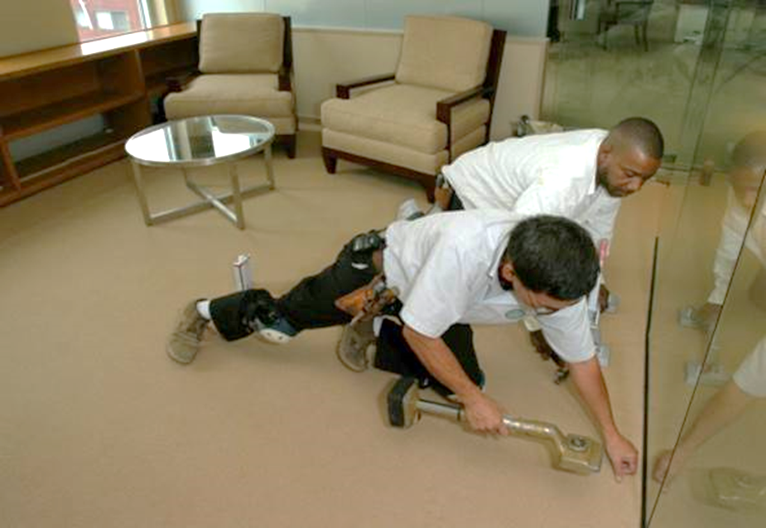
Force
Lifting something heavy and carrying it.
Pushing or pulling heavy objects.
Using a tool handle that is too small.
This may result in pinching, squeezing or gripping the handle, which can cause tension
on the hand.
Using a glove that is too large and doesn’t fit properly.
This will require more force to hold onto a tool.
This can especially affect those with smaller hands.
Using a heavy tool that is not balanced may require a lot of force to control.
Notes:
Force: amount of tension our muscles generate
Example: tilting your head forward or backward from a neutral, vertical position quadruples the amount of force acting on your lower neck vertebrae.

Slide 13
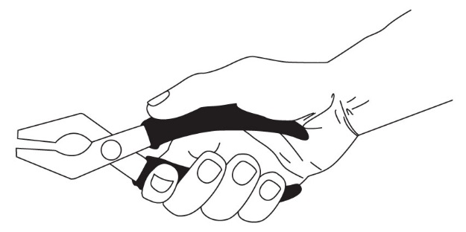
Contact Stress
A hard or sharp surface or object pressing into the soft tissues, the tendons, nerves and blood vessels.
What are some contact stresses at your work?
Notes:
Contact stress results from continuous contact between a hard object and sensitive tissues. Force and repetition combine to produce mechanical friction on soft tissue and tendons that is increased when forceful exertion is used.

Slide 14
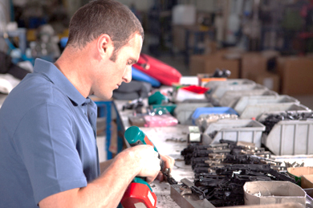
Repetition
Repeating the same motion over and over places stress on your muscles and joints.
The amount of stress depends on these factors:
How quickly the job is done
How long the job takes
How much force the job requires; and
How much recovery time there is between motions
What are some jobs that require repetition?
Notes:
Repetition is the frequency at which a motion or task is repeated with little variation in movement. High repetition is a similar motion performed every few seconds. The risk of WMSD’s are due to repetition increase and sustained over a significant period of time and combined with force, awkward postures, acceleration and velocity.

Slide 15
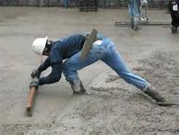
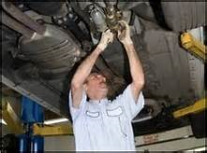
Awkward Posture
Working with the arms raised
Bending at the back
Bending at the neck
Twisting
Reaching
Bending the wrists
Kneeling or squatting
What about
Static Posture?
What awkward postures do you work in?
Notes:
Awkward posture refers to positions of the body that deviate significantly from the neutral position while job tasks are performed, it may increase the risk of injury. The greater the deviation from neutral position, the greater the risk of injury. Awkward postures increase the exertion and muscle force required to perform the task and compress soft tissues like nerves, tendons and blood vessels.

Slide 16
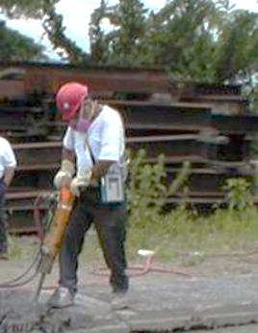
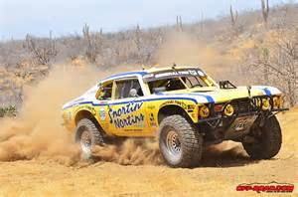
Vibration
The two main types of vibration that may lead to musculoskeletal injuries are:
1) Hand/arm vibration
2) Whole body vibration
If you don’t encounter these at work, what about other activities?
Example:
Whole body vibration
Notes:
Hand-arm vibration (hand power tools) may damage the blood vessels in your hands. Raynaud’s syndrome or called “white finger.”
Whole body vibration (driving rough off roads).
Exposure to whole body vibration occurs when your body comes into contact with a vibrating surface, like a seat, pedal or floor of heavy vehicles or machinery. Whole body vibration exposure has been shown to be a strong contributor to lower back injuries.
Even if these do not occur in your work environment, what about home activities?

Slide 17
Work-Related Musculoskeletal Disorders (WMSDs)
Notes:
Workers who required to maintain body positions for long periods of time developed musculoskeletal problems.
Video link : https://www.youtube.com/watch?v=PTDrLN3wc8c&feature=player_embedded

Slide 18
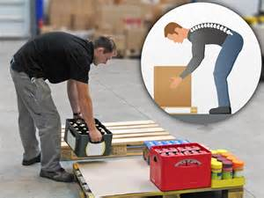
WMSDs Prevention Strategies
Watch your posture!
Avoid leaning forward, bend with your knees.
Maintain natural “s” curve of your spine.
Get help if load is over 35 pounds
Use mechanical devices
Notes:
Minimize key risk factors and balance time spent exposed to risks with adequate recovery time.
Time – Frequency, Duration & Recovery.

Slide 19
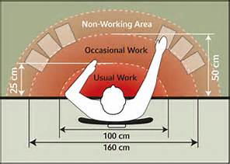
Reach Zone
Notes:
Keep frequently used items within close reach. Most frequently used items should be at approximately a forearm’s reach away, with lesser-used items up to arm’s reach away. Items you are currently working with should be directly in front of the body.

Slide 20
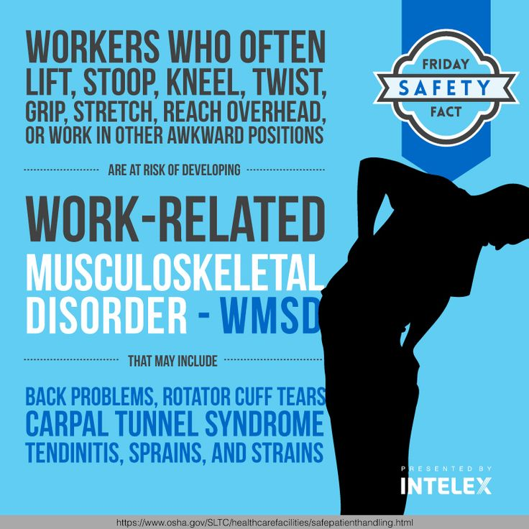
WMSDs Prevention Strategies
Job Design
Job Rotation
Job Enlargement and Enrichment
Team Work
Workplace Design
Tools and Equipment Design
Work Practices
Notes:
Static positions are your enemy!
Whenever you think of it, change position
Small frequent stretches go a long way in preventing MSD’s.
Stretch breaks

Slide 21
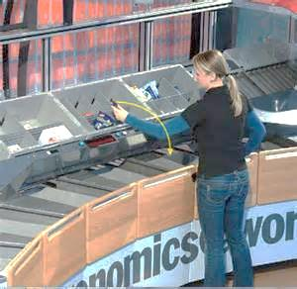
Pay Attention
Pay attention to signals your body is telling you. Watch for the following signs:
Tingling, numbness or discomfort in the hands or fingers.
Pain in fingers, hands, wrists or shooting pain in arms or forearms.
Loss of strength or coordination in the hands.
Notes:
Pay attention to your overall posture.
Prevention is the key.

Slide 22
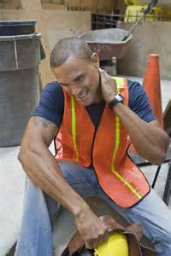
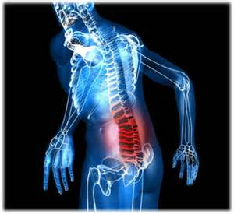
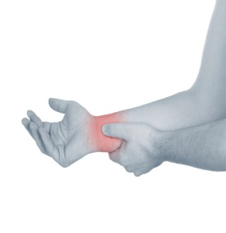
Identified Disorders, Occupational Risk Factors and Symptoms
Disorders | Occupational Risk Factors | Symptoms
Tendonitis/tenosynovitis | Repetitive wrist motions Repetitive shoulder motions Sustained hyper extension of arms Prolonged load on shoulders | Pain, weakness, swelling, burning sensation or dull ache over affected area
Epicondylitis (elbow tendonitis) | Repeated or forceful rotation of the forearm and bending of the wrist at the same time | Same symptoms as tendonitis
Carpal tunnel syndrome | Repetitive wrist motions | Pain, numbness, tingling, burning sensations, wasting of muscles at base of thumb, dry palm
De Quervain's disease | Repetitive hand twisting and forceful gripping | Pain at the base of thumb
Thoracic outlet syndrome | Prolonged shoulder flexion Extending arms above shoulder height Carrying loads on the shoulder | Pain, numbness, swelling of the hands
Tension neck syndrome | Prolonged restricted posture | Pain
Notes:
Non-occupational activities we do outside of work that may cause stress to the body: driving, sleeping, playing and household chores.

Slide 23
No ONE Solution For All
People come in all shapes and sizes. What works for one person may not work for another.
What works today may not work tomorrow. We all change due to time and other circumstances.
Notes:
People come in all shapes and sizes - what works for one person may or may not work for another.
Ergonomics is a puzzle to be put together for each individual.
What works today may or may not work later. We all change due to time and other circumstances.

Slide 24
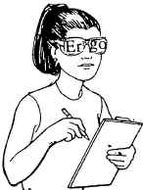
Meet the Challenge!
Individuals must take responsibility for their own ergonomic concerns.
Listen to your body--pay attention to those aches and pains!
Contact your Safety Officer (SO) or Human Resource Office (HRO) with any question or concerns.
Contact the above SO or HRO to request a basic ergonomic evaluation of your work station.
Notes:
Discuss concerns and possible solutions with your supervisor:
Adjusting work schedules
Modifying job design
Rearranging task order
Changing task assignments
Consult a physician, if warranted

Slide 25
Thank you!
Learning Objectives
Define ergonomics
Explains ways to prevent work-related musculoskeletal disorders
Name environmental factors that may affect you while working
Name physical stressors that may put pressure or stress on parts of the body
Notes:
Have the class answer the learning objectives. It will help them prepare for the test at the end.

