Slide 1
Introduction to OSHA
Directorate of Training and Education
OSHA Training Institute

Slide 2
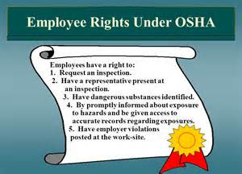
Lesson Objectives
Purpose:
To provide workers with introductory information about OSHA
After completing this lesson, you will be able to ...
Explain why OSHA is important to workers
Explain workers rights under OSHA
Discuss employer responsibilities under OSHA

Slide 3
Intro to OSHA
http://www.bing.com/videos/search?q=intro+to+osha&FORM=HDRSC3#view=detail&mid=562977DDD3DF897636DD562977DDD3DF897636DD

Slide 4
Topic 1: Why is OSHA Important to You?
4,585 workers were killed on the job in 2013
An average of nearly 12 workers die every day
797 Hispanic or Latino workers were killed from work-related injuries in 2013
Nearly 3 million serious workplace injuries and illnesses were reported by private industry employers in 2012
OSHA Makes a Difference
On Average, worker deaths in America are down 66%.
1970 – 38 worker deaths per day
2013 – 12 worker deaths per day
Worker injuries and illnesses are down.
1972 – 10.9 per
100 workers
2013 – 3.0 per
100 workers

Slide 5
History of OSHA
OSHA
Occupational Safety and Health Administration, an agency of the U.S. Department of Labor
OSHA’s responsibility is to improve worker safety and health protection
On December 29, 1970, President Nixon signed the OSHA Act.
This Act created OSHA, the agency, which formally came into being on April 28, 1971

Slide 6
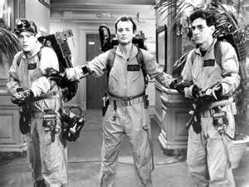
OSHA’s Mission
The mission of OSHA is to
assure safe and healthful working conditions
for working men and women by setting and enforcing standards, and by providing training, outreach, education, and assistance.
Some of the things OSHA does to carry out its mission are:
Worksite inspections
Training programs

Slide 7
Federal & State OSHA
OSHA (the Occupational Safety and Health Administration, which is a federal agency)
L&I (the Department of Labor and Industries, which is a state agency)
WISHA (the Washington Industrial Safety and Health Act of 1973, which is a state law) - empowers L&I to create and enforce safety and health regulations
DOSH (the Division of Occupational Safety and Health, which is part of L&I) – enforces the WISHA law by developing safety and health rules, including inspecting worksites for unsafe working conditions
RCW/RCWs stands for the “Revised Code of Washington”
http://www.lni.wa.gov/safety/basics/About/default.asp

Slide 8
Temporary Workers
Temporary labor continues to be prevalent nationwide.
An assessment of workplace injury data performed by the federal Occupational Safety and Health Administration found that temporary employees suffer on-the-job accidents and injuries more often than those who are permanently employed.
https://www.osha.gov/temp_workers/

Slide 9
Brain Check
Worker protection is law: True or False?
OSHA was created in what year? _____________
OSHA stands for _____________
It is the duty of the _________ to provide workplaces that are free of known dangers that could harm their employees.

Slide 10
Topic 2: What Rights Do You Have Under OSHA?
You have the right to:
A safe and healthful workplace
Know about hazardous chemicals
Report injury to employer
Complain or request hazard correction from employer
Training
Hazard exposure and medical records
File a complaint with OSHA
Participate in an OSHA inspection
Be free from retaliation for exercising safety and health rights
Notes:
Chain of command

Slide 11
Worker Rights

Slide 12
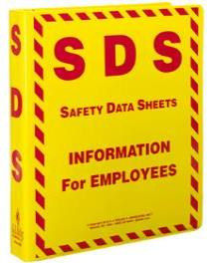
Know about Hazardous Chemicals
Your Right to…
Hazard Communication Program
Appropriate labeling of chemical containers
Safety Data Sheets (SDSs)
Worker training
Physical and health hazards of the chemicals, and how workers can protect themselves

Slide 13
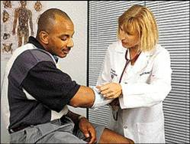
Your Right to…
Information about Injuries/Illnesses
Log of injuries and illnesses
Workers have the right to report an injury* and review current log
OSHA 300A
*It is against the OSHA law to retaliate or discriminate against a worker for reporting an injury or illness

Slide 14
Hazards in the workplace
Your Right to…
http://wn.com/funny_workplace_accident

Slide 15
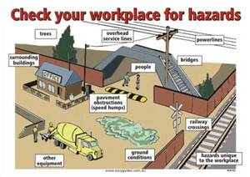
How to Raise a Concern
Safety and Health Problems in the Workplace

Slide 16
Training
Your Right to…
Workers have a right to get training from employers on a variety of health and safety hazards and standards that employers must follow
Chemical hazards, equipment hazards, noise, confined spaces, fall hazards in construction, personal protective equipment
Language and vocabulary

Slide 17
Your Right to…
Complain or Request Corrections
Workers may bring up safety and health concerns in the workplace to their employers without fear of discharge or discrimination
OSHA rules protect workers who raise concerns to their employer or OSHA about unsafe or unhealthful conditions in the workplace

Slide 18
Your Right to…
Examine Exposure & Medical Records
1910.1020: right to examine & copy records
Examples of toxic substances and harmful physical agents are:
Metals and dusts, such as, lead, cadmium, and silica
Biological agents, such as bacteria, viruses, and fungi
Physical stress, such as noise, heat, cold, vibration, repetitive motion, and ionizing and non-ionizing radiation

Slide 19
Your Right to…
Participate in an OSHA Inspection
Employee representative can accompany OSHA inspector
Workers can talk to the inspector privately
Workers may point out hazards, describe injuries, illnesses or near misses that resulted from those hazards and describe any concern you have about a safety or health issue
Workers can find out about inspection results, abatement measures & may object to dates set for violation to be corrected

Slide 20
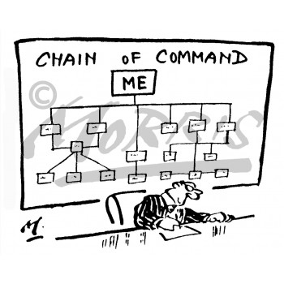
Your Right to…
File a Complaint with OSHA
Workers may file a confidential complaint with OSHA
Workers may request that their name not be revealed to the employer
If a worker files a complaint, they have the right to find out OSHA’s action on the complaint and request a review if an inspection is not made
Note:
Often the best and fastest way to get a hazard corrected is to notify your supervisor or employer.

Slide 21
Your Right to…
Be Free from Retaliation
Workers have the right to be free from retaliation for exercising safety and health rights
Workers have a right to seek safety and health on the job without fear of punishment
This right is spelled out in Section 11(c) of the OSH Act
Workers have 30 days to contact OSHA if they feel they have been punished for exercising their safety and health rights
https://osha.gov/pls/oshaweb/owadisp.show_document?p_table=STANDARDS&p_id=11333

Slide 22
Topic 3:
What Responsibilities does Your Employer have Under OSHA?
Provide a workplace free from recognized hazards and comply with OSHA standards
Provide training required by OSHA standards
Keep records of injuries and illnesses
Provide medical exams when required by OSHA standards and provide workers access to their exposure and medical records
Not discriminate against workers who exercise their rights under the Act (Section 11(c))
Post OSHA citations and hazard correction notices
Provide and pay for most PPE

Slide 23
Employer Responsibilities (cont.)
REPORTING AND RECORDING CHECKLIST
Employers must: Report each worker death to OSHA Report each work-related hospitalization, amputation, or loss of an eye Maintain injury & illness records Inform workers how to report an injury or illness to the employer Make records available to workers Allow OSHA access to records Post annual summary of injuries & illnesses

Slide 24
Topic 4: What are OSHA Standards?
OSHA standards are:
Rules that describe the methods employers must use to protect employees from hazards
Designed to protect workers from a wide range of hazards
Four Groups of OSHA Standards
General Industry*
Construction
Maritime
Agriculture
*General Industry is the set that applies to the largest number of workers and worksites
Where there are no specific standards, employers must comply with the General Duty Clause of the OSH Act.

Slide 25
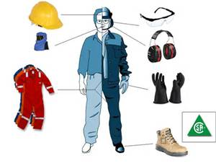
OSHA Standards (cont.)
These standards also:
Limit the amount of
hazardous chemicals
noise
PPE
Require employers to monitor certain hazards and keep records of workplace injuries and illnesses

Slide 26
Before you get hired
https://www.osha.gov/pls/imis/establishment.html

Slide 27
Washington State Department - L&I

Slide 28
Topic 5:
How are OSHA Inspections Conducted?
The OSH Act authorizes OSHA compliance safety and health officers (CSHOs) to conduct workplace inspections at reasonable times
OSHA conducts inspections without advance notice, except in rare circumstances (e.g. Imminent Danger)
In fact, anyone who tells an employer about an OSHA inspection in advance can receive fines and a jail term

Slide 29
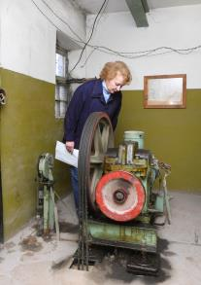
Different Types of OSHA Inspections
Imminent danger
Fatality or hospitalizations
Worker complaints/referrals
Targeted inspections—Local Emphasis Program (LEP), National Emphasis Program (NEP), particular hazards or industries
Follow-up Inspections

Slide 30
Citations & Penalties
VIOLATION TYPE | PENALTY
WILLFUL A violation that the employer intentionally and knowingly commits or a violation that the employer commits with plain indifference to the law. | OSHA may propose penalties of up to $70,000 for each willful violation, with a minimum penalty of $5,000 for each willful violation.
SERIOUS A violation where there is substantial probability that death or serious physical harm could result and that the employer knew, or should have known, of the hazard. | There is a mandatory penalty for serious violations which may be up to $7,000.
OTHER-THAN-SERIOUS A violation that has a direct relationship to safety and health, but probably would not cause death or serious physical harm. | OSHA may propose a penalty of up to $7,000 for each other-than-serious violation.
REPEATED A violation that is the same or similar to a previous violation. | OSHA may propose penalties of up to $70,000 for each repeated violation.

Slide 31
Questions for Review
Give an example of a reason why might OSHA would conduct an inspection at your workplace
What are the types of OSHA violations?

Slide 32
Topic 6:
Where Can You Go for Help?
Sources within the workplace/worksite
Sources outside the workplace/worksite
How to file an OSHA complaint

Slide 33
Sources within the Workplace/Worksite
Employer or supervisor, co-workers and union representatives
Safety Data Sheet (SDS) for information on chemicals
Labels and warning signs
Employee orientation manuals or other training materials
Work tasks and procedures instruction

Slide 34
Sources Outside the Workplace/Worksite
OSHA website: http://www.osha.gov and OSHA offices (you can call or write)
Compliance Assistance Specialists in the area offices
National Institute for Occupational Safety and Health (NIOSH) http://www.cdc.gov/niosh/
OSHA Training Institute Education Centers
Doctors, nurses, other health care providers
Public libraries
Other local, community-based resources

Slide 35
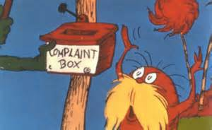
Filing an OSHA Complaint
Download the OSHA complaint form from OSHA’s website
File the complaint online
Workers can file a complaint
A worker representative can file a complaint
Telephone or visit local regional or area offices to discuss your concerns
Complete the form – be specific and include appropriate details
OSHA determines if an inspection is necessary
Workers do not have to reveal their name

Slide 36
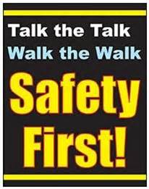
Session Summary
This lesson covered:
The importance of OSHA, including the history of safety and health regulation leading to the creation of OSHA and OSHA’s mission
Worker rights under OSHA
Employer responsibilities
OSHA standards
OSHA inspections
Safety and health resources, including how to file a complaint.

Slide 37
Safety Ambassadors
Promote and monitor job-site safety

Slide 38
Questions for Review
Explain why OSHA is important to workers
Explain workers rights under OSHA
Discuss employer responsibilities under OSHA

