Slide 1
LADDER SAFETY
Chapter 296-876 WAC
Notes:
Ladders are important and essential tools that are used widely in a variety of industries. They help us move up and down and work at different heights.
Learn how to work safely when using portable ladders to avoid falling and getting injured. It is designed to promote safe work practices.

Slide 2
Learning Objectives
After completing this lesson, you will be able to…
Explain what to do before using a ladder
Discuss how to use a ladder safely
Discuss ways of setting up a ladder
Explain how to care for a ladder
Notes:
Ask if someone in the class feels comfortable to read the learning objectives.
Also, remind the class that the learning objectives will be reviewed after this lesson.

Slide 3
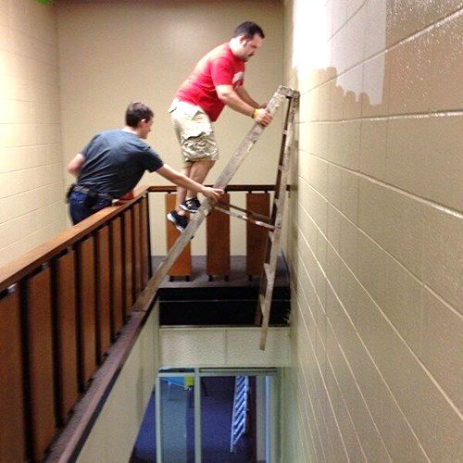
Although ladders are easy to use, they are often misused or abused, causing serious injuries and death. These deaths and injuries could have been significantly reduced or eliminated with proper care and use.
Notes:
You don't have to fall far to get hurt. Workers injured in falls from ladders are usually less than 10 feet above the ladder's base of support.

Slide 4
Ladder Safety Training
Employers have a responsibility to make sure that each employee who uses a ladder understands how to use the ladder correctly on the job.
They must provide training to employees in recognizing hazards related to ladders and in the procedures they must follow to minimize these hazards.
Employees have a responsibility to observe the rules and follow the procedures established by their companies' programs, and to work safely when using ladders.
Notes:
Common mistake: the problem with ladder is that everyone assumes it’s so simple to use, training is not needed on how to use it safely.

Slide 5
Selecting a Ladder
Ladders are manufactured for a specific uses; e.g., jobs that can be safely performed with step ladders could become dangerous if extension ladders are used instead.
You must evaluate the work environment and know what ladders are available before you can choose the right ladder for the job. Keep in mind all potential hazards
Notes:
To begin with, a ladder must be the right height for the job so that you don’t have to overreach. A stepladder should be tall enough so that you don’t have to stand on the top two steps, which would leave you nothing to hold on to. A straight or extension ladder should be tall enough so that you don’t have to stand on the top four rungs.
Secondly, a ladder must have the capacity to support the weight that will be on it. Remember that the total weight a ladder has to support is your weight plus the weight of any tools and materials you use while working on the ladder. Weight capacity is displayed on a label affixed to the ladder.

Slide 6
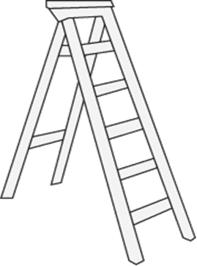
Selecting a Ladder
You must keep in mind the physical requirements of the job:
How much room will there be to position the ladder?
How much weight – combining the user, tools, and materials – will be on the ladder?
How long should the ladder be to safely perform the job?
Notes:
Additionally, the material the ladder is constructed of may be a safety issue. Never use a metal ladder around:
Electricity. Also check for metal parts and pieces and never use a ladder that is wet around electricity.
Aluminum, steel, and acids are not compatible, so never use a metal ladder around corrosives.
Finally, do not use metal ladders around flammables - the ladder could potentially cause a spark that could ignite around flammables.

Slide 7
Duty Rating
Duty Rating is the maximum weight that a ladder can safety support, as shown in the table below. This maximum load includes the weight of the worker, tools and the materials.
RATING | MAXIMUM LOAD | USES
Type I-AA | 375 lbs | Special duty industrial use, such as CATV, utilities, contractors, and higher capacity needs
Type I-A | 300 lbs. | Extra-heavy-duty industrial use, such as utilities and contractors
Type I | 250 lbs | Heavy-duty industrial use, such as utilities and contractors
Type II | 225 lbs | Medium-duty work, such as painting, offices for building maintenance, and light industrial use
Type III | 200 lbs | Light duty work, such as household use
Notes:
I-A means the ladder can hold a maximum weight of 300 pounds;
I means a maximum weight of 250 pounds;
II means a maximum weight of 225 pounds; and
III means a maximum weight of 200 pounds.

Slide 8
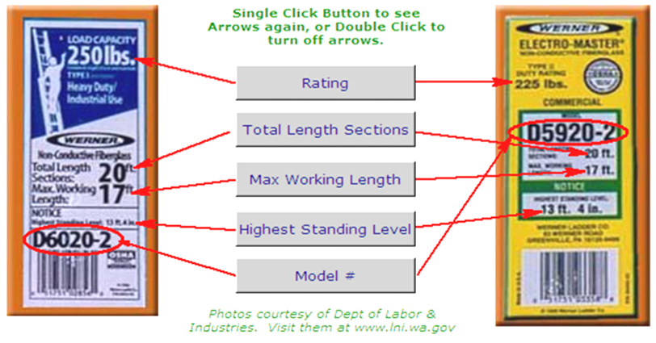
These ratings must meet certain American National Standards Institute (ANSI) standards and must be indicated on the duty rating sticker or manufacturer’s label. ANSI requires that every ladder be labeled with this information so users can determine if they have the correct type of ladder for the task/job.
Ladder Ratings and Labels
Notes:
Besides their ratings, labels and markings found on manufactured ladders contain product information, such as:
manufacturer’s name, ladder’s model number/name, month and year of manufacture, ladder’s size/length, maximum working length, and highest standing level.

Slide 9
Labels
Notes:
Manufactured ladders have warning markings and labels, such as "CAUTION" and "DANGER," which are usually in red or yellow. They often also have "SAFETY" labels which give information on how to use the ladders safely.

Slide 10
Injuries
Why do people fall from ladders if they are so easy to use?
Setting up the ladder on an unstable or slippery surface.
Overreaching by the user.
Setting up the ladder improperly.
Loss of balance.
Notes:
Don’t use a ladder if you are feeling dizzy, light-headed, excessively tired, on medication, have recently consumed alcohol, or otherwise temporarily impaired.

Slide 11
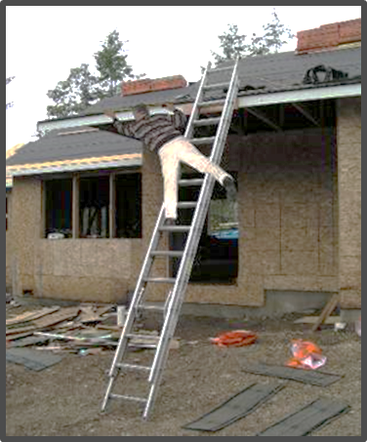
Injuries
Improperly getting on or off of the ladder.
Mis-stepping or a slipping of the foot while climbing or descending.
Being bumped by a cart or other object.
Having a vehicle run into or bump you.
People not paying attention to where they're walking.
Notes:
Other injuries that may occur: failure to secure ladders, climbing one-handed, standing on the top rung or platform, using worn or damaged ladders, and leaving tools on ladders.

Slide 12
Before You Use a Ladder
Check its rating to see if you have the right ladder for the job.
Be sure not to subject the ladder to a work load greater than its rated capacity.
Always read manufacturers' labels and follow their recommendations.
Inspect the ladder.
Do yourself a favor and avoid a fall and injury.
Notes:
Is it safe to place a ladder on a stack of pallets to gain height?

Slide 13
Inspecting Ladders
Ladders must be inspected prior to each use.
What to look for
Defective or Damaged
Recommended before each use:
Check for broken, split, cracked, corroded or missing rungs and side rails
Check carefully for cracks (hard to see cracks weaken ladders)
Check for rungs or side rails with excessive bends (bent areas are greatly weakened and may fail during use)
Check for loose, corroded or weakened fasteners and hardware
Notes:
When you uncover a safety problem with a ladder during an inspection, don’t use it. Instead, remove it from service and tag it to make sure nobody else uses it.

Slide 14
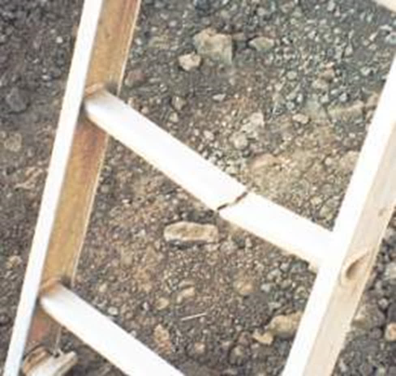
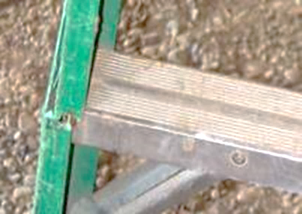
Inspecting Ladders
Check for oil, grease, moisture or other slippery materials before use, and clean as necessary.
Also check for:
Cracks
Splits
Dents
Bends
Corrosion
Missing hardware
Notes:
All ladders should be inspected before each use. It doesn’t take long to check out a ladder to make sure it’s safe to use. Those few minutes could be the most important time of your life.

Slide 15
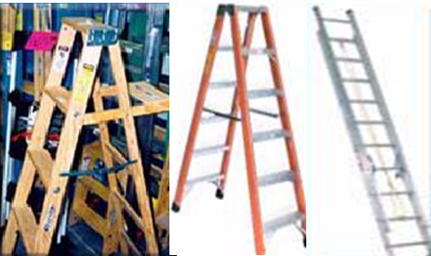
General Characteristics
Notes:
Each material has specific care, maintenance, and storage requirements and may be preferred for specific uses, or under certain conditions.

Slide 16
Safe Use of Ladders
Make sure the ladder is strong enough and long enough for the job.
Carefully inspect your ladder before you use it.
Place the ladder on a firm, level surface with its feet parallel to the wall it is resting against.
When ascending or descending, the climber must face the ladder.
Notes:
Place the ladder on a firm, level surface, and check to make sure the ladder is stable.

Slide 17
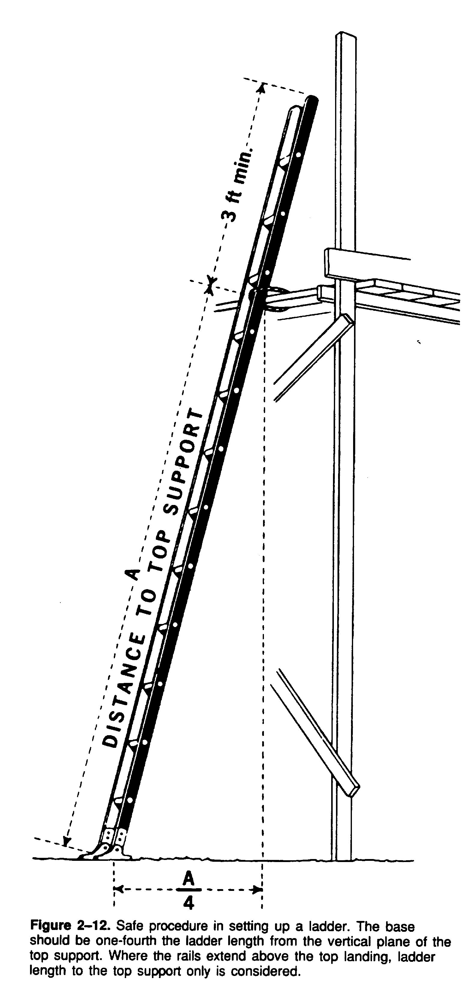
Setting Up a Ladder Safely
No ladder should be used to gain access unless it extends 3 feet above the point of support.
Your ladder must be tied off or placed to prevent slipping.
When setting a ladder against a wall use the 4-to-1 ladder rule.
Can we use a ladder under 3 feet?
Notes:
ladders that don’t extend at least 3’ for access can still be used as long as they secure the top, and hand holds are provided so persons can safely transition from the ladder to the surface being accessed, and vice versa.

Slide 18
Safe Use of Ladders
Rail Bent
Bracket Bent & Shelf Missing
Any safety issues here?
Notes:
What are the safety issue here?

Slide 19
Safe Ladder Set Up
Determine angle climb
Notes:
One way to ensure proper angle is to stand with your feet at the base of the ladder and extend your arms straight out. If your hands just touch, the ladder will be very close to the 4 to 1 ratio. Warning: Improper placement of ladders may causes injuries.

Slide 20
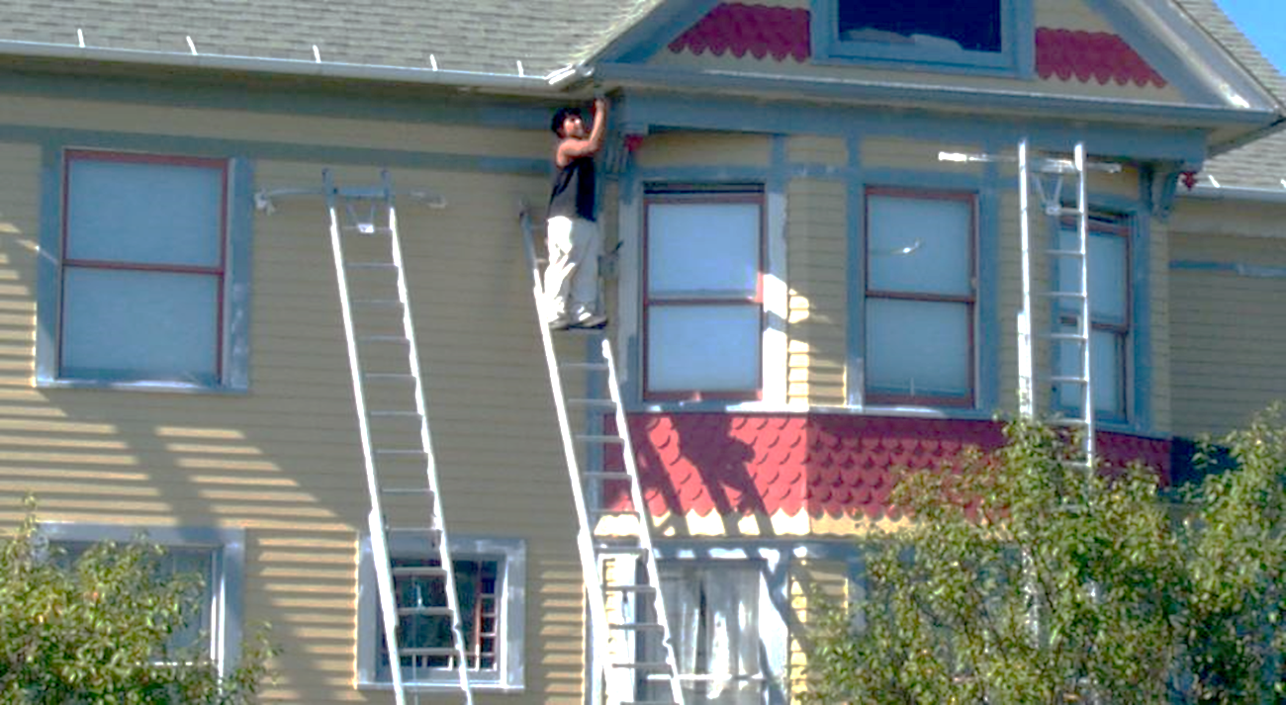
Climbing a ladder
You must have both hands free and face the ladder.
You must have 3 points of contact with the ladder at all times and reduces the chances of falling.
The three point contact is two hands and one foot or one hand and two feet.
Is this a safety practice?
Notes:
When climbing a ladder, you must have both hands free and face the ladder. This allows for three points of contact with the ladder at all times and reduces the chances of falling. The three point contact is two hands and one foot or one hand and two feet. Is the worker in the picture has 3 points of contact while painting, anything else that's not a safe practice?

Slide 21
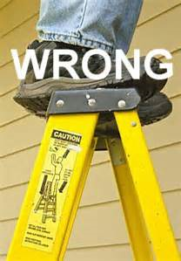
Never Use the Top of a Step Ladder
Notes:
The top or top step of a stepladder shall not be used as a step.

Slide 22
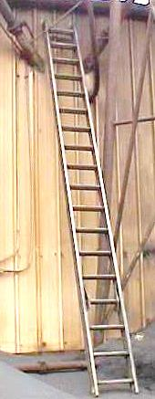
Ladders and Electricity
Metal ladders conduct electricity
Use care when placing
What’s the hazards?
Notes:
Great care should be taken for metal ladders around electricity. When working with electricity: Do not use metal or wet wooden ladders, use ladders with non-conductive side rails, keep 10 feet away from electrical sources, and check for overhead hazards.

Slide 23
Care and Maintenance of Ladders
Ladders must be maintained in good condition at all times:
Joints must be tight.
Metal bearings of lock, wheels, pulleys, etc., must be lubricated.
Frayed or badly worn rope must be replaced.
Safety feet and other auxiliary equipment must be in good condition.
Ladders must be inspected frequently.
Notes:
If a ladder tips over, inspect the side rails for dents or bends, or excessively dented rungs; check all rung-to-side-rail connections; check hardware connections. check rivets for shear.
If ladders are exposed to oil and grease, equipment should be cleaned for oil, grease or other slippery materials. This can be done with a solvent or steam cleaning.
Portable ladders are designed as a one-man working ladder based on a 200-pound load. The ladder base section must be placed with a secure footing.

Slide 24
Other Care and Use Issues
Make sure ladder is stable, held or latched in place.
Tops of step ladders shall not be used/prohibited.
Make sure top of ladder extends 3 feet above support.
Ladder angle: ladder base must be 4:1 of working length from the vertical support.
Follow manufacturer’s specifications.
Notes:
Most ladder accidents are the result of careless or improper ladder usage.

Slide 25
Questions?
Learning Objectives
Explain what to do before using a ladder
Discuss how to use a ladder safely
Discuss ways of setting up a ladder
Explain how to care for a ladder
Notes:
Have the class answer the learning objectives. It will help them prepare for the test at the end

