Slide 1

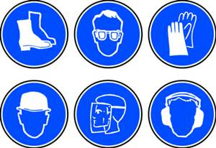
Personal Protective Equipment (PPE)
WAC 296-800-160
Notes:
Employers must protect employees from workplace hazards and dangerous work procedures that can cause injury, illness and fatalities.
PPE is just one way to protect workers from hazards in the workplace.

Slide 2
LEARNING OBJECTIVES
After completing this lesson, you will be able to…
Identify PPE that may be used to protect the eyes,
face, head, feet, hands, body, and hearing.
List the 3 primary means of protecting employees
from the workplace hazards prior to considering PPE
Explain what should be included in PPE training
Notes:
Ask if someone in the class feels comfortable to read the learning objectives.
Also, remind the class that the learning objectives will be reviewed after this lesson.

Slide 3
Protecting Employees from Workplace Hazards
Employers must protect employees from workplace hazards such as machines, hazardous substances, and dangerous work procedures that can cause injury.
Employers must:
  Consider other ways to get hazardous jobs done
  Reduce hazards materials or process
  Apply engineering controls to reduce or eliminate hazards
Remember, PPE is the last level of control!
Notes:
PPE along should not be relied on to provide protection for your employees. PPE should be used after all other reasonable means of reducing hazards have been carried out.
Hazard Assessment checklist can be a helpful tool. Train your employees on how to use PPE effectively.

Slide 4
Provide PPE to Your Employees
Employer must provide at no cost to employees
if the PPE is:
The type that would not reasonable or normally by worn
from the workplace, such as single use or disposable.
Required to comply with a safety and health standard to
protect employees wherever hazards exist from:
- Processes
- Environmental hazards
- Physical, chemical, or radiological hazards or
- Mechanical irritants that could cause injuries or
impairment to the function of any body part through
absorption, inhalation, or physical contact.
Notes:
Exceptions to payment see table x in WAC 296-800-16020.

Slide 5
Engineering Controls
If . . .
The machine or work environment can be physically changed to prevent employee exposure to the potential hazard,
Then . . .
The hazard can be eliminated with an engineering control.
Notes:
Engineering controls reduce or eliminate exposure to chemical or physical hazards through the use of equipment or devices.

Slide 6
Engineering Controls (cont’d)
Examples . . .
Initial design specifications
Substitute less harmful material
Change process
Enclose process
Isolate process
Ventilation
Notes:
Engineering controls function with minimum user input and do not rely on the skill of individuals.

Slide 7
Work Practice Controls
If . . .
Employees can be removed from exposure to the potential hazard by changing the way they do their jobs,
Then . . .
The hazard can be eliminated with a work practice control.
Notes:
Work Practice Controls reduce the likelihood of exposure by altering the way in which a task is performed. Administrative controls include following all training, legal requirements, policies and procedures related to infection control at your facility.

Slide 8
Work Practice Controls (cont’d)
Examples . . .
Use of wet methods to suppress dust
Personal hygiene
Housekeeping and maintenance
Job rotation of workers
Notes:
Job rotation of workers only reduces exposure; it does not eliminate the hazard.
Example:
A milling operation produces large quantities of metal chips that fly all over the surrounding work areas. Recognizing that flying metal chips were a potential hazard to employees in the surrounding areas, the machine shop owner had to decide how best to protect the workers.
Option 1—Engineering and work practice controls:
Engineering control - Enclose the milling operation or install a deflector to contain the metal chips and prevent them from flying into the surrounding areas.
Work practice control - Operate the machine only at certain times of the day when adjacent operations have stopped.
Option 2—PPE:
Provide employees with safety goggles or safety glasses with side shields.
Which option protection is best for workers?

Slide 9
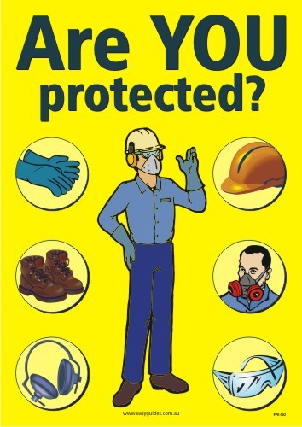
Examples of PPE
Eye - safety glasses, goggles
Face - face shields
Head - hard hats
Feet - safety shoes
Hands and arms - gloves
Bodies - vests
Hearing - earplugs, earmuffs
Notes:
Respirators and electrical protective equipment (gloves, sleeves, blankets, etc.) are also considered PPE. However, because OSHA has specific requirements for them, special training is required.

Slide 10
Establishing a PPE Program
Sets out procedures for selecting, providing, and using PPE as part of an employer’s routine operation
First -- assess the workplace to determine if hazards are present, or are likely to be present, which necessitate the use of PPE
Once the proper PPE has been selected, the employer must provide training to each employee who is required to use PPE
Notes:
Employers are required to conduct an assessment to determine the various physical hazards that may be present in your work area.
When all reasonable engineering and work practice controls are in place, but employees are still exposed to potential hazards, PPE must be provided.

Slide 11
Training
Employees required to use PPE must be trained to know at least the following:
When PPE is necessary
What type of PPE is necessary
How to properly don, doff, adjust, and wear PPE
Limitations of the PPE
Proper care, maintenance, useful life and disposal
Notes:
Each affected employee must demonstrate an understanding of the required training, and the ability to use PPE properly, before being allowed to perform work requiring the use of PPE.

Slide 12
Eye Protection
Notes:
Employers must provide eye protection for employees whenever they are exposed to potential eye injuries during their work if engineering or work practice controls do not eliminate the risk of injury.

Slide 13
What are some of the causes of eye injuries?
Dust and other flying particles, such as metal
shavings or sawdust
Molten metal that might splash
Acids and other caustic liquid chemicals that
might splash
Blood and other potentially infectious body fluids
that might splash, spray, or splatter
Intense light such as that created by welding
and lasers
Notes:
Small particles of matter can enter your eyes and damage them.
Operations such as grinding, chiseling, sanding, hammering, and spraying can create small airborne particles.

Slide 14
Safety Spectacles
Made with metal/plastic safety frames
Most operations require side shields
Used for moderate impact from particles produced by such jobs as carpentry, woodworking, grinding, and scaling
Notes:
Safety Glasses are much stronger and more resistant to impact and heat than regular glasses.
There equipped with side shields that give you protection from hazards that may not be directly in front of you.

Slide 15
Welding Shields
Protect eyes from burns caused by infrared or intense radiant light, and protect face and eyes from flying sparks, metal spatter, and slag chips produced during welding, brazing, soldering, and cutting
Notes:
Welding helmets provide both face and eye protection.
Use special absorptive lenses that filter the intense light and radiant energy that is produced during welding operations.

Slide 16
LASER Safety Goggles
Protect eyes from intense concentrations of light produced by lasers.
Notes:
LASER is an acronym: Light Amplification by Stimulated Emission of Radiation. The laser produces an intense, highly directional beam of light.
Relatively small amounts of laser light can lead to permanent eye injuries.

Slide 17
Face Shields
Protect the face from nuisance dusts and potential splashes or sprays of hazardous liquids
It does not protect employees from impact hazards
Notes:
Face shields are used around operations which expose you to metal, chemical splashes, or flying particles.

Slide 18

Head Protection
http://www.bing.com/videos/search?q=PPE&FORM=HDRSC3#view=detail&mid=A155F6204C6CE7D84901A155F6204C6CE7D84901
Notes:
Inspect the shell of your hard hat for cracks, gouges, and dents. Inspect the suspension system for frayed or broken straps.
Never paint, scratch or drill "air holes" in your hard hat.

Slide 19
What are some of the causes of head injuries?
Falling objects
Bumping head against fixed objects, such as exposed pipes or beams
Contact with exposed electrical conductors
Notes:
Injuries to the head are very serious. For this reason, head protection and safety are very important .

Slide 20
Classes of Hard Hats
Class G
General service (e.g., mining, building construction, shipbuilding,
lumbering, and manufacturing)
Good impact protection but limited voltage protection
Class E
Electrical work
Protect against falling objects, high-voltage shock/burns
Class C
Designed for comfort, offer limited protection
Protects heads that may bump against fixed objects, but do not protect
against falling objects or electrical shock
ANSI Z89.1-1997
Notes:
Hard hats require a hard outer shell and a shock-absorbing lining. The lining should incorporate a head band and straps that suspend the shell from 1 to 1-1/4 inches away from the user’s head to provide shock absorption during impact and ventilation during wear.

Slide 21
Hearing Protection
Notes:
Determining the need to provide hearing protection is complicated. Employee exposure to excessive noise depends on duration and noise level.

Slide 22
Examples of Hearing Protectors
Earmuffs
Earplugs
Canal Caps
Notes:
Employers must implement reasonable engineering controls and work practices before resorting to PPE such as earmuffs, earplugs, or canal caps.
If engineering and work practice controls do not lower employee noise exposure to acceptable levels, then employers must provide employees with appropriate PPE.
If the earplugs are not put in properly, they will not protect your hearing.

Slide 23

HEARING TEST
http://www.noiseaddicts.com/2009/03/can-you-hear-this-hearing-test/
http://www.bing.com/videos/search?q=hearing+and+how+it+workd&&view=detail&mid=9BB546CB073415B251359BB546CB073415B25135&rvsmid=9BB546CB073415B251359BB546CB073415B25135&fsscr=0&FORM=VDFSRV
Notes:
Two videos:
The 1st one is a hearing test.
The 2nd video shows how the sounds works in the ear, and how the hair cells are damage when exposed to loud noise over time.
The hair cells do not grow back.
Getting a base line audiogram is necessary when working with noise.

Slide 24
Foot Protection
http://www.bing.com/videos/search?q=PPE&FORM=HDRSC3#view=detail&mid=25371F34F97EAB64204225371F34F97EAB642042
Notes:
Safety footwear must meet the minimum compression and impact performance standards and testing requirements established by ANSI Z41-1991, if purchased after July 5, 1994.
The American National Standards Institute (ANSI) has served as administrator and coordinator of the United States private sector voluntary standardization system

Slide 25
What are some of the causes of foot injuries?
Heavy objects such as barrels or tools that might roll
onto or fall on employees’ feet
Sharp objects such as nails or spikes that might pierce
the soles or uppers of ordinary shoes
Molten metal that might splash on feet
Hot or wet surfaces
Slippery surfaces
Notes:
Food injuries can be from impact injuries or from spills and splashes.
Heavy objects can fall on your feet. If you work around sharp objects, you can step on something sharp and puncture your foot.
Spills and Splashes Liquids such as acids, caustics, and metals can spill into your shoes and boots. These hazardous materials can cause chemical and heat burns.

Slide 26
Safety Shoes
Have impact-resistant toes and heat-resistant soles that protect against hot surfaces common in roofing, paving, and hot metal industries
Some have metal insoles to protect against puncture wounds
May be designed to be electrically conductive for use in explosive atmospheres, or nonconductive to protect from workplace electrical hazards
Notes:
Electrically conductive shoes protect against the buildup of static electricity. Essentially, these shoes ground the employees wearing them. Employees working in explosive and hazardous locations such as explosives manufacturing facilities or grain elevators must wear conductive shoes to reduce the risk of static electricity buildup on an employee’s body that could produce a spark and cause an explosion or fire.

Slide 27
Hand Protection
Notes:
Select and use the right kind of glove for the job you are going to be performing.
Check fit, always use correct size. Employers must provide chemical-resistant gloves for employees who work with potentially hazardous chemicals.

Slide 28

What are some of the hand injuries you need to guard against?
Burns
Bruises
Abrasions
Cuts
Punctures
Fractures
Amputations
Chemical Exposures
Notes:
Never wear gloves around powered rotating equipment!!

Slide 29
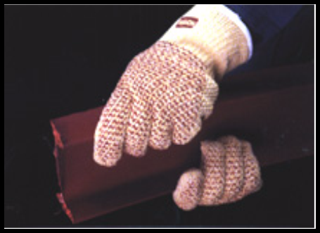
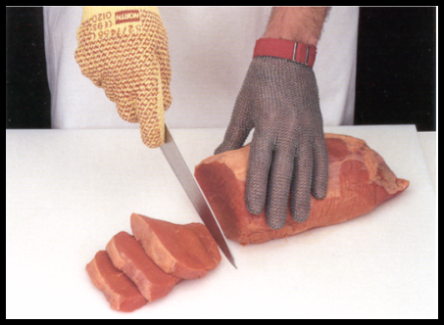
Types of Gloves
Kevlar protects against cuts, slashes and abrasion.
Stainless steel mesh protects against cuts and lacerations.
Nitrile provides protection against a wide variety of solvents, harsh chemicals, fats and petroleum products and also provides excellent resistance to cuts, snags, punctures and abrasions.
Notes:
Metal mesh gloves: resist sharp edges and prevent cuts
Leather gloves: shield your hands from rough surfaces
Vinyl and neoprene gloves: protect your hands against toxic chemicals
Rubber gloves: protect you when working around electricity

Slide 30
Body Protection
Notes:
Body protection: physical, electrical, heat, chemicals, biohazards, radiation, and airborne particulate matter.

Slide 31
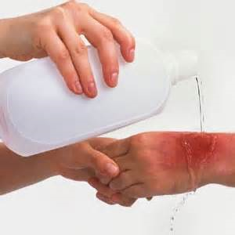
What are some of the causes of body injuries?
Intense heat
Splashes of hot metals and other hot liquids
Impacts from tools, machinery, and materials
Cuts
Hazardous chemicals
Contact with potentially infectious materials, like blood
Radiation
Notes:
A list of some body injuries that may occur from working with radiation, hazardous waste, and chemicals.

Slide 32
Body Protection
Cooling Vest
Sleeves and Apron
Notes:
Protective clothing comes in a variety of materials, each suited to particular hazards. If the possibility of bodily injury still exists, provide protective clothing constructed of material that will protect against the specific hazards in your workplace.
Different materials will protect against different chemical and physical hazards. When chemical or physical hazards are present, check with the clothing manufacturer to make sure that the material selected will provide protection from the specific chemical or physical hazards in your workplace.

Slide 33
Body Protection
Full Body Suit
Coveralls
Notes:
Examples of body protection include laboratory coats, coveralls, vests, jackets, aprons, surgical gowns and full body suits.

Slide 34
Summary
Employers must implement a PPE program where they:
Assess the workplace for hazards
Use engineering and work practice controls to eliminate
or reduce hazards before using PPE
Select and provide appropriate PPE at no cost to employees
to protect them from hazards that cannot be eliminated
Inform employees why the PPE is necessary and when it
must be worn
Train employees on how to use and care for their PPE and
how to recognize deterioration and failure
Require employees to wear selected PPE in the workplace
Notes:
Highlights of PPE

Slide 35


Questions?
Learning Objectives
Identify PPE that may be used to protect the
eyes, face, head, feet, hands, body, and hearing.
List the 3 primary means of protecting employees
from the workplace hazards prior to considering
PPE
Explain what should be included in PPE training
Notes:
Have the class answer the learning objectives. It will help them prepare for the test at the end.

