Slide 1
SAFETY PROGRAMS
Notes:
A good safety program is the success for developing a solid, comprehensive approach that protects your employees from potential hazards in the workplace.

Slide 2
Learning Objectives
After completing this lesson, you will be able to ...
Discuss the benefits of an effective safety program
Describe Engineering Controls
Describe Administrative Controls
Explain why PPE is the last resort
Think Safety First
Safety Glasses
Safety Boots
Hearing Protection
Correct PPE to be worn at all times
Mesh & Cut
Resistant
Gloves
Notes:
Ask if someone in the class feels comfortable to read the learning objectives.
Also, remind the class that the learning objectives will be reviewed after this lesson.

Slide 3
Good Safety Program
Reduce injuries and illnesses
Improve morale and productivity
Reduce workers’ compensation costs
Show good faith efforts
Notes:
The first safety practice that needs to be in place is management commitment. It is essential for a good safety program.
Once management commitment practices are in place, management can be involved in: reducing injuries and illnesses, improving Morale, reducing workers’ compensation cost, and instilling trust.

Slide 4
Safety Inspections
Conduct regular site inspections
Establish daily work area inspection procedures
Develop and use a checklist
Provide a reliable hazard reporting system
Employees notify management
No fear of reprisal
Timely and appropriate corrections
Notes:
Having a routine inspection of jobs, processes, and phases of work will help reduce recognized hazards and keep in compliance with rules and regulations.

Slide 5
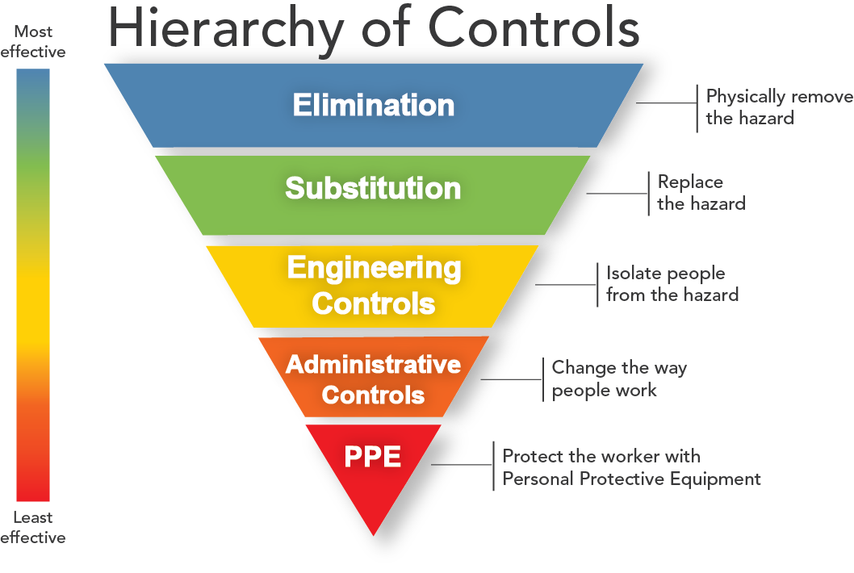
Hazard Prevention Controls
Notes:
A hierarchy of hazard control is a systematic step by step process used in workplaces to minimize or reduce exposure to hazards. Elimination is the first and the best way to remove the hazard. It is the most effective way to control a risk because the hazard is no longer present.

Slide 6
Substitution
Substitution could also eliminate the hazard but most often it reduces the risk of exposure to the hazard.
Substitution, the second most effective hazard control, involves replacing something that produces a hazard (similar to elimination) with something that does not produce a hazard.
Example, replacing lead based paint with acrylic paint. To be an effective control, the new product must not produce another hazard.
Notes:
Substitute hazardous working condition with an alternative non-hazardous or less hazardous material, machine or process.

Slide 7
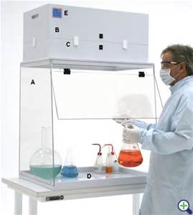
Engineering Controls
Engineering controls are considered the first line of defense
For controlling existing worker exposures in the workplace because they are designed to remove the hazard at the source, before it comes in contact with the worker.
What are some other engineering controls at your job-site?
Notes:
If a hazard cannot be eliminated or there is no alternative that can be found, then the next step is to use engineering controls, such as a machine guard.

Slide 8
Administrative Controls
Administrative controls are changes in work procedures such as written safety policies, rules, supervision, schedules, and training with the goal of reducing the duration, frequency and severity of exposure to hazardous chemicals or situations.
Administrative controls and PPE are frequently used with existing processes where hazards are not particularly well controlled.
Notes:
Examples of Administrative controls: warnings, labeling, signs, alarms, training.

Slide 9
PPE
Employers are required to conduct a PPE hazard Assessment
Eye Protection
Skin Exposure
Hearing Protection
Protective Clothing
Hand Protection
Head Protection
Feet Protection

Slide 10
Training
Train all employees before allowing them to perform any new or untrained task
Workplace Hazards Basics
Job Hazard Analysis
Accident Prevention
Accident Reporting Requirements
Safety Orientation training must be given to:
Site Workers
Contract Workers
Temporary Workers
Notes:
If someone asked you why safety training is important, how would you respond?

Slide 11
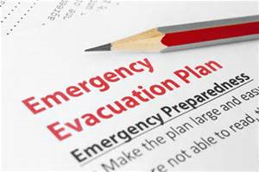
Health Protection Plan
Facility and Equipment maintenance
Emergency planning
Physician and emergency care
Training and drills, as needed
Medical program
First aid
Notes:
Workplace health protection is necessary for the well-being of both employers and employees. Health concerns also affect a worker's ability to effectively perform his job duties.
Picture 1: cdc.gov
Picture 2:

Slide 12
Safety Programs Identify the hazards of your workplace Develop the program that works for you
Accident Prevention Program
Hazard Communication
Walking and Working Surfaces
Ergonomics
Back Safety
PPE
Bloodborne Pathogens
Emergency Preparedness
Tools and Ladders
Fall Protection
Notes:
Companies need to customize their own programs, tailor the safety programs to their specific workplaces and hazards.

Slide 13
Questions?
Learning Objectives
Discuss the benefits of an effective Safety Program
Describe Engineering Controls
Describe Administrative Controls
Explain why PPE is last resort
Notes:
Have the class answer the learning objectives. It will help them prepare for the test at the end.

