Slide 1

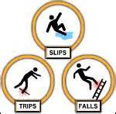
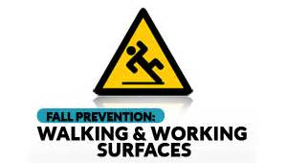
See something, say something, do something
Washington State Department of Labor & Industries. Washington Code of Regulations
WAC 296-24 and WAC 297-800
Notes:
In general industry, slip, trip, and fall hazards are through walking and working surfaces and housekeeping. They also include: protection from falls to lower levels, guardrails, maintaining floors, clean, and dry surfaces, safe ladder and scaffold.

Slide 2
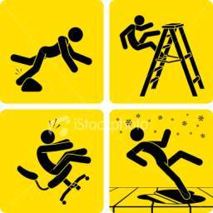
Learning Objectives
After completing this lesson, you will be
able to…
Define circumstances of slip, trips and falls.
Explain the cost of a injury to the employee.
Explain ways human factors can contribute to
a slip, trip or fall.
Explain what to do if have a slip, trip or fall.
Notes:
Ask if someone in the class feels comfortable to read the learning objectives.
Also, remind the class that the learning objectives will be reviewed after this lesson.

Slide 3
Slips, Trips and Falls –
General Industry
Slips, trips, and falls constitute the majority of general industry accidents.
Slips, trips and falls:
Cause 15% of all accidental deaths, and are second only to motor vehicles as a cause of fatalities.
Can occur anywhere in your work environment.
Can result in permanent disability and even death.
Notes:
Workplace slips, trips, and falls have the potential to be a major cause of injury for employees and visitors.

Slide 4

Cost of Injury
To the employee:
To the employer:
  Lost wages
  Pain and suffering, embarrassment
  Temporary or permanent disability
  Reduced quality of life
  Death
  Loss of productivity
  Costs for overtime or training for replacement worker
  Increased insurance premiums
Notes:
Workplace injuries and illnesses have a major impact on an employer's bottom line. The costs of workplace injuries and illnesses include direct and indirect costs.

Slide 5
Hazards Associated With
Walking and Working Surfaces
Slips - Lack of friction or traction between footwear and walking or working surface that results in loss of balance
Trips - Foot or lower leg hitting an object and the upper body continues to move forward resulting in loss of balance
Two Types of Falls:
Falls from Same Level
  Fall to same walking or working surface, or
  Fall into or against objects above the same surface.
Falls from Height
  Fall to level below walking or working surface.
Notes:
Differences between slips, trips, and falls.

Slide 6
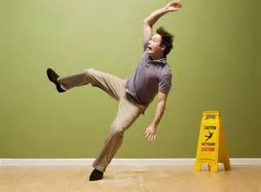
Slip Circumstances
Wet areas on walking surfaces
Dry products on walking surface
Freshly waxed surfaces
Icy walk ways
Transitioning from one surface to another
Sloped walking surfaces
Mounting and dismounting vehicles and equipment
Loose, irregular surfaces such as gravel
Notes:
Ask the class to share examples of slips they have experienced, or if they saw someone slip at work.

Slide 7
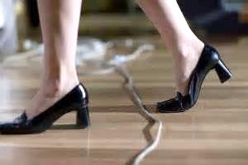
Trip Circumstances
Uneven surfaces
Sidewalk/curb drops
Wheelchair ramps and curbs
Uncovered cables, wires or extension cords across aisles or walkways.
Clutter or obstacles in aisles or walkways
Open file cabinet or desk drawer
Irregularities in walking surfaces
Damaged steps on stairways
Elevator not level
Notes:
Most common reason why employees trip is because they are not paying attention.

Slide 8
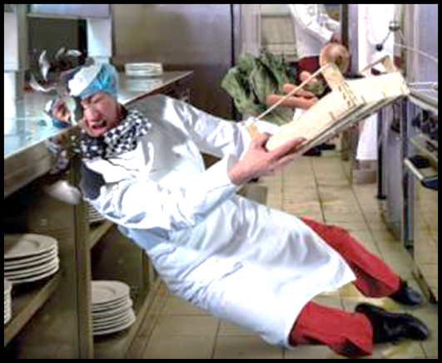
Slips and Trips can lead to Falls
Slipping or tripping
Not wearing fall protection while working
Inattention to surroundings
Loss of balance
Unprotected edges
Loose, irregular surfaces such as gravel
Wet areas on walking surfaces
Dry products on walking surface
Freshly waxed surfaces
Icy walk ways
Transitioning from one surface to another
Sloped walking surfaces
Mounting and dismounting vehicles & equipment
Notes:
Sometimes slips and trips may lead to falls.
Be aware: when working in the kitchens at the stadiums, there can be oil and water on the floor.
PPE: slip resistant shoes, and making sure they are maintained. The entire sole of the shoe must be slip resistant.

Slide 9
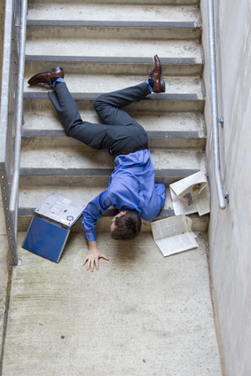
Injuries
Contusions
Broken Bones
Fractures
Concussion
Back Injury
Strains and Sprains
Death
Notes:
Slips, trips, and falls do not always lead to injuries. A good safety practice is to report a near miss, so that future accidents may be prevented.

Slide 10

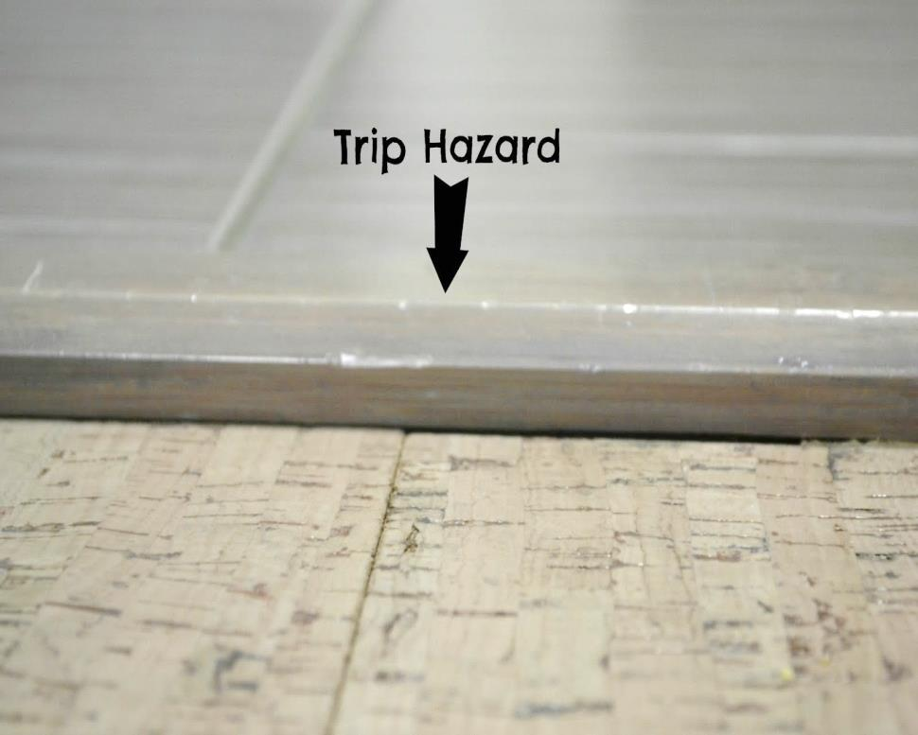
Slips, Trips, and Falls Video
https://www.youtube.com/watch?v=H_iYaQSJTdc
Notes:
Anything more than a 1/2 “ may lead to a slip, trip, or fall.

Slide 11

Carrying objects:
  Obstruct your view
  Do not leave a free hand
Lack of situational awareness
  Listening to music
  Talking or texting on cell
  phone while walking
In a hurry or taking shortcuts
Failing eyesight or visual perception
Age
Physical/medical conditions
Notes:
Pay attention when walking to help reduced the risk of an injury.

Slide 12
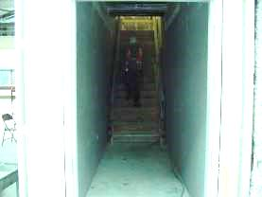
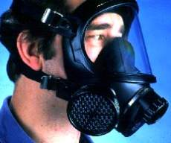
Conditions and situations that make it difficult to see potential hazards or that distract your attention can contribute toward a slip or trip such as:
Work Environment
Poor lighting
Glare
Shadows
Bulky or awkward personal protective equipment (PPE)
Excessive noise, temperature
Notes:
PPE can get in the way of what you are working on. That is why PPE is the last resort of protection.
The hazard is still present when PPE is implemented.
(Elimination, Substitution, Engineering, Administration, PPE)

Slide 13

Human Factors
Health and physical condition can impair a person’s vision, judgment, and balance.
  Eyesight, visual perception
  Age
  Physical state, fatigue
  Stress, illness
  Medications, alcohol, drugs
Notes:
When your on the job, come to work alert and free from alcohol and drugs.
If your taking any medicine and it impairs your judgement, talk to your supervisor.

Slide 14
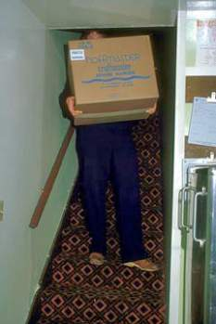
Human Factors (Continue)
Behaviours - actions you choose and control - can contribute to a slip, trip, and fall injury if you practice careless work habits.
Carrying or moving oversized objects, or too many objects, that may:
Obstruct your view
  Impair your balance
  Prevent you from holding onto handrails
Notes:
Practice good work habits for every job task.
If moving oversized boxes, material handling tool is the best. If not available, do a walkthrough of your path to make sure nothing will be in your way.
Also good to get a coworker to assist you.

Slide 15
Human Factors (Continue)
Inattentive walking, distractions (using cell phone, talking and not watching where you’re going, etc.)
Taking shortcuts; not using walkways or designated cleared pathways
Being in a hurry, rushing around; moving too fast for safe practices in work environment
Poor housekeeping (allowing clutter to accumulate, not maintaining clean dry floors.)
Using improper cleaning methods (e.g., incorrectly using wax or polish, or trying to clean up grease spills with water).
Not using signs when slip or trip hazards exist.
Notes:
More ways to continue safe practice and prevention.
Be proactive in keeping your workplace safe, for safety is everyone responsibility.

Slide 16
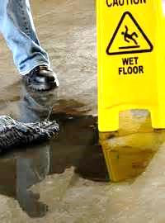
General Requirements
Definition of Floor Hole - An opening measuring less than 12 inches but more than 1 inch in its least dimension, in any floor, platform, pavement, or yard, through which materials but not persons may fall; such as a belt hole, pipe opening, or slot opening.
Workplace must be clean, orderly, and sanitary
Work floors must be maintained as clean and dry as possible
Notes:
All floor holes into which persons CAN accidentally walk on, must be guarded.

Slide 17
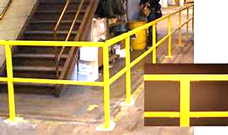
General Requirements
(Continued)
Floor Openings - An opening measuring 12 inches or more in its least dimension, in any floor, platform, pavement, or yard, through which persons may fall; such as a hatchway, stair or ladder opening, pit, or large manhole. Floor openings occupied by elevators, dumb waiters, conveyors, machinery, or containers are excluded from this part.
Notes:
Covers and guardrails shall be provided to protect workers from the hazards of open pits, tanks, vats, ditches, etc.

Slide 18
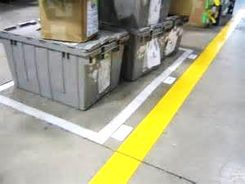
General Requirements (Continued)
Aisles & Passageways
Safe clearances/Clear & good repair/ No obstructions in aisles
Aisles/passageways marked
Covers & Guardrails
Open pits, tanks, vats, ditches, etc.
Notes:
Aisles and passageways shall be kept clear and in good repair.
Permanent aisles and passageways shall be marked.

Slide 19
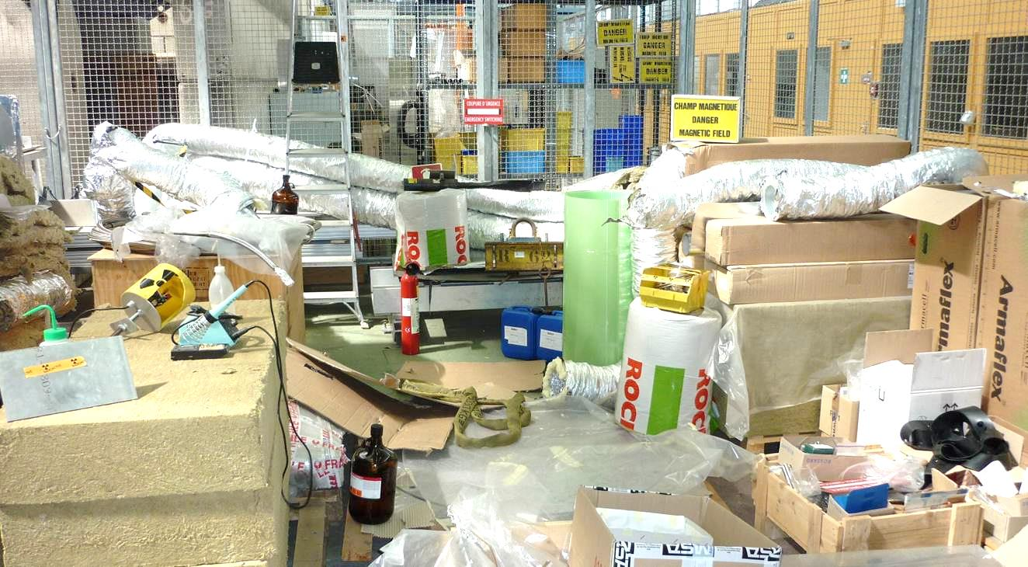
https://www.youtube.com/watch?v=wr8GJytDjZo
Notes:
Housekeeping workplaces shall be kept clean, orderly, and sanitary.
If companies have good housekeeping, then most often the company has a good safety program.

Slide 20
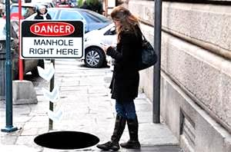
What Can You Do to Reduce Risk?
Pay attention to your surroundings. Look where you are going when you walk. Watch for slip and trip hazards in your work area and wherever you walk.
Walk, don’t run or rush. Give yourself enough time.
Do not engage in activities that distract your attention.
Do not read, write, or work while you are walking.
Use the handrails when climbing or descending the stairs. Do not rush and skip steps.
Use a flashlight when entering a dark room, and
Ensuring that things you are carrying or pushing do not prevent you from seeing any obstructions, spills, etc.
Notes:
Pay attention and look where you are walking.
When working on job tasks, do one task at a time.
For example, if your driving, your job is to drive, not to eat, mess with the radio, etc.
Do not use cell phone while driving.
Trying to multitask in some cases can lead to accidents.

Slide 21
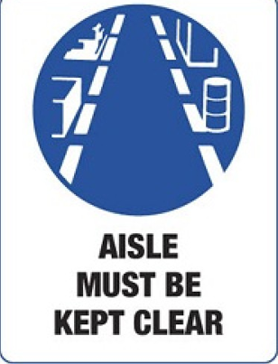
Prevention
Check that your pathway is clear and your view is not blocked before you lift anything.
Don’t carry a load you can’t see over or around. Use a cart. Carry small loads close to your body.
When going to another floor/level, take the
elevator if you are carrying a load requiring
both hands.
Report any missing or broken stair rails and
slippery or damaged flooring, loose or
deteriorating carpeting. Repair or report
floor problems, such as missing tiles.

Slide 22
Prevention (Continue)
Wear high traction footwear
Take short, slow steps
Point your feet slightly outward to keep your center of balance under you
Pay attention to the surface you are walking on
Hold on to railings or other stable objects
Notes:
Except above ways to prevention slip, trips, and falls. Can you think of any other ways to prevention a slip, trip, and fall?

Slide 23
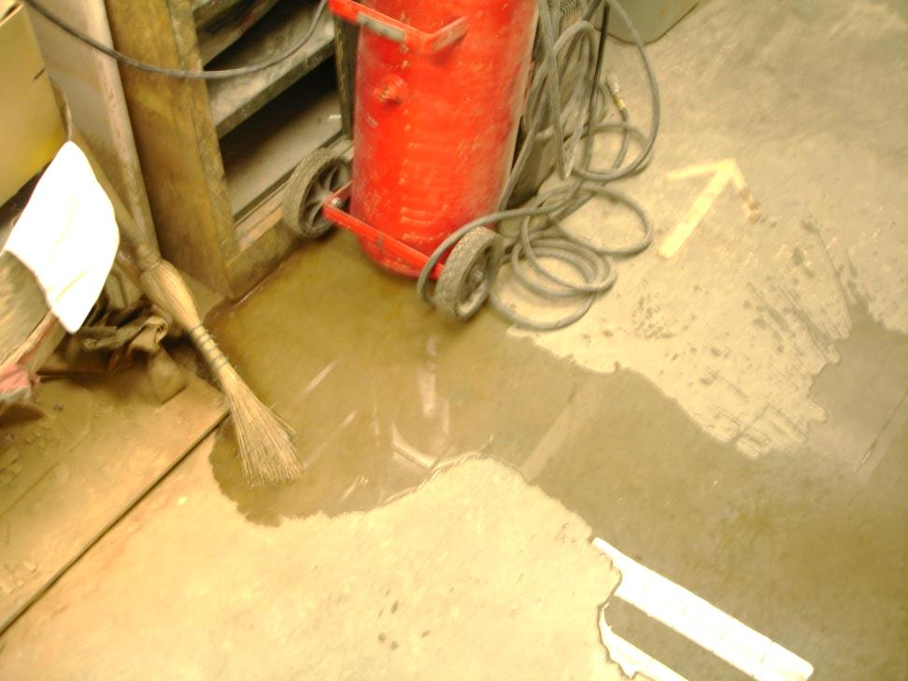
Prevention:
Identify the Hazards in the Photo
Notes:
Workroom floors shall be maintained as clean and dry as possible.
Every floor, working place and passageway shall be kept free from protruding nails, splinters, holes, or loose boards.

Slide 24
When Falling…
    Roll with the fall; don’t reach out. Let your body crumple and roll.
    Bend your elbows and knees and use your legs and arms to absorb the fall.
    Get medical attention after a fall to treat anything torn, sprained, or broken.
Notes:
Example:
An employee tried to stop his fall by stretching his arm out to prevent the fall.
It caused more injury by tearing his rotator cuff.

Slide 25

Reporting
Let immediate supervisor know right away.
To report accident/injury or near misses, use the Incident Report
Notes:
In the event of an incident, be sure that it is documented and reported. This information can help prevent future incidents.

Slide 26
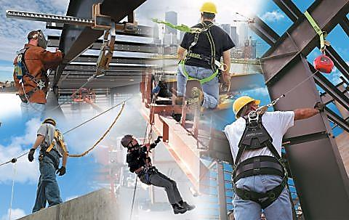
Summary
Report identified hazards – unsafe condition report
Wear proper footwear with good traction
Use hand rails when using stairways
Complete required training
Be aware of your surroundings
Utilize fall protection
Notes:
Routine inspection and maintenance should be a regular part of your safety program.

Slide 27



Learning Objectives
Define circumstances of slip, trips and falls.
Explain the cost of a injury to the employee.
Explain ways human factors can contribute to a slip, trip or fall.
Explain what to do if have a slip, trip or fall.
Questions?
Notes:
Have the class answer the learning objectives. It will help them prepare for the test at the end.

