Slide 1
Combustible Dust
Overview and Mitigation Solutions
DOSH Directive 12.85
& App Training
Notes:
Introduce TPM as a whole, 100 Year anniversary providing Safety and other Services like HR and Legal to the wood products industry.

Slide 2
Why?
Dust has the potential to cause dust deflagrations
Fires
Explosions
Injury
Death
Stories, Examples, Videos,
Discussion

Slide 3
Background
Employer did not recognize the hazards posed by combustible dust.
A number of recent combustible dust incidents have resulted in deaths and serious injuries.
A dust deflagration occurs when the right concentration of finely divided dust suspended in air contacts a source of ignition. If the deflagration is in a confined area, an explosion potential exists.

Slide 4
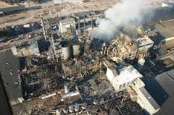
Background
Combustible dust is often either organic or metal dust finely ground into very small particles.
The actual quantity of dust that may accumulate in an affected area may vary, depending upon air movement, particle size, or any number of other factors.

Slide 5
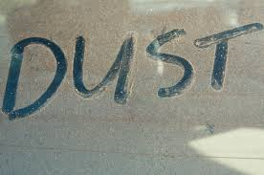
Types of Dust
Metal dust such as aluminum and magnesium
Wood dust
Coal and other carbon dusts
Plastic dust and additives
Biosolids
Organic dust such as sugar, flour, paper, soap, and dried blood
Dust from certain textile materials

Slide 6
Industries with Combustible Dusts
Agriculture
Food Products
Chemical
Textiles
Forest and furniture products
Metal processing
Tire and rubber manufacturing plants
Paper products
Pharmaceuticals
Wastewater treatment
Recycling operations (metal, paper, and plastic.)
Coal dust in coal handling and processing facilities.

Slide 7
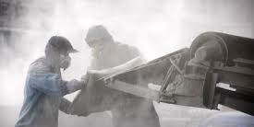
Class II Locations
Class II locations are those that are hazardous because combustible dust is present. Class II locations are divided by the source and quantity of dust into the following divisions:
Class II, Division 1
Class II, Division 2

Slide 8
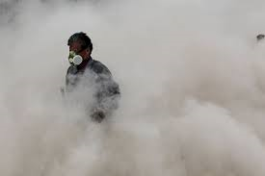
Class II Locations
Class II, Division 1. A location in which:
Combustible dust is or may be in suspension in the air under normal operating conditions, in quantities sufficient to produce explosives or ignitable mixtures; or
Mechanical failure or abnormal operation of machinery or equipment might cause such explosive or ignitable mixtures to be produced, and might also provide a source of ignition through simultaneous failure of electric equipment, operation of protection devices, or from other causes;
or
Combustible dusts of an electrically conductive nature may be present.

Slide 9
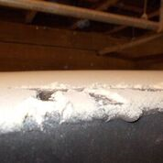
Class II Locations
Class II, Division 2. A location in which:
Combustible dust will not normally be in suspension in the air in quantities sufficient to produce explosive or ignitable mixtures; and dust accumulations are normally insufficient to interfere with the normal operation of electrical equipment or other apparatus;
or
Dust may be in suspension in the air as a result of infrequent malfunctioning of handling or processing equipment, and dust accumulations resulting may be ignitable by abnormal operation or failure of electrical equipment or other apparatus.

Slide 10
Class II Locations
Class II locations with combustible dust atmospheres further divide by the type of dust into the following groups:
Group E. Atmospheres containing combustible metal dusts, including aluminum, magnesium, and their commercial alloys, and other combustible dusts whose particle size, abrasiveness, and conductivity present similar hazards in the use of electrical equipment.
Group F. Atmospheres containing combustible carbonaceous dusts that have more than 8 percent total entrapped volatiles (see ASTM D 3175, Standard Test Method for Volatile Matter in the Analysis Sample of Coal and Coke, for coal and coke dusts) or that have been sensitized by other materials so that they present an explosion hazard. Coal, carbon black, charcoal, and coke dusts are examples of carbonaceous dusts.
Group G. Atmospheres containing other combustible dusts, including flour, grain, wood flour, plastic and chemicals.

Slide 11
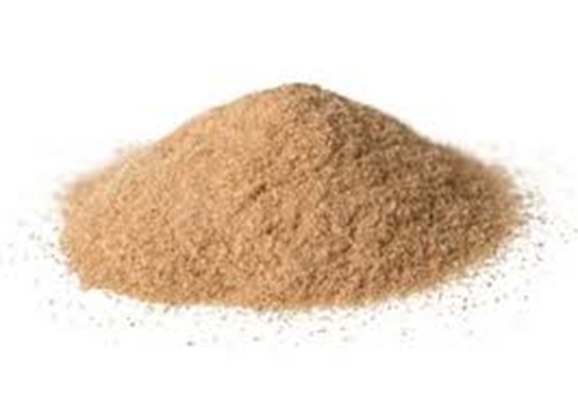
Definitions
Combustible dust: A combustible particulate solid that presents a fire or deflagration hazard when suspended in air or some other oxidizing medium over a range of concentrations, regardless of particle size or shape.
Less than 420 microns – flour or powder sugar.

Slide 12
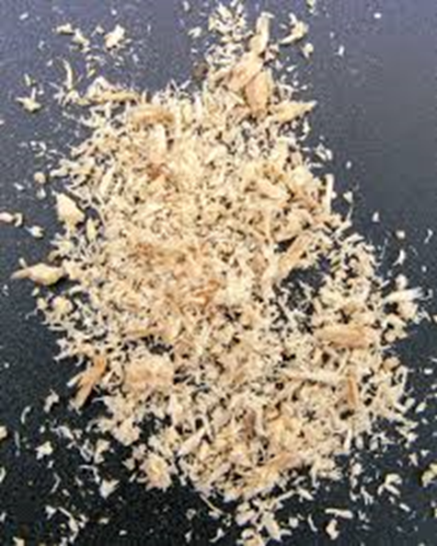
Definitions
Combustible Particulate Solid: Any combustible solid material composed of distinct particles or pieces, regardless of size, shape, or chemical composition.

Slide 13
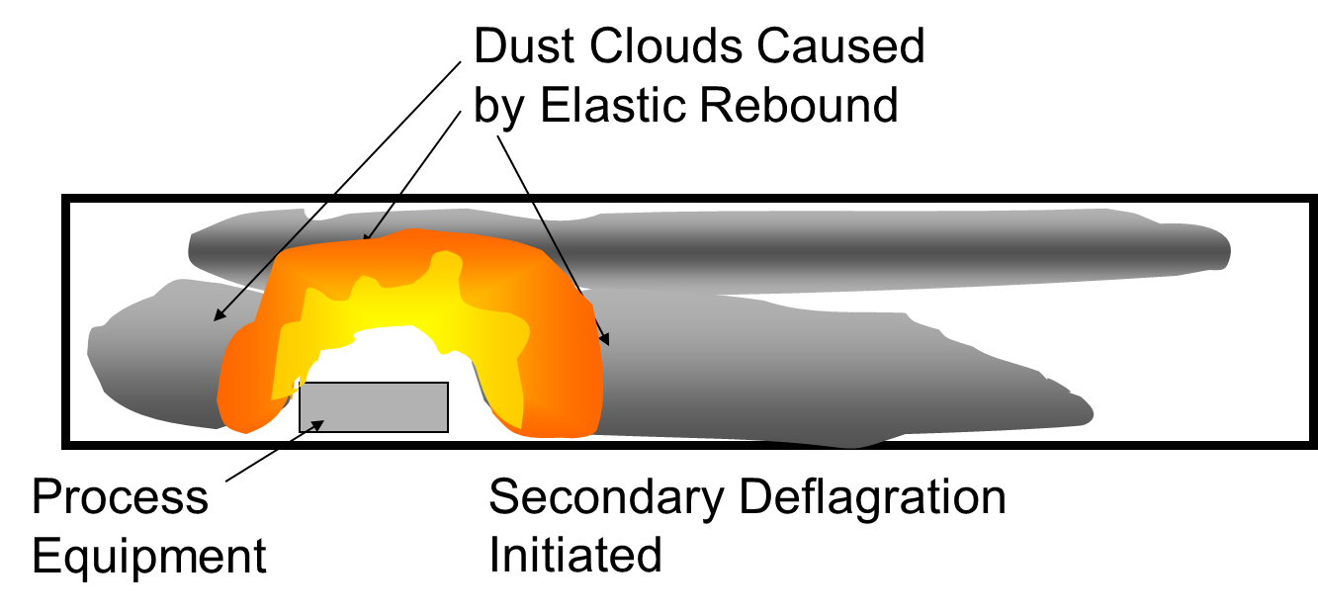
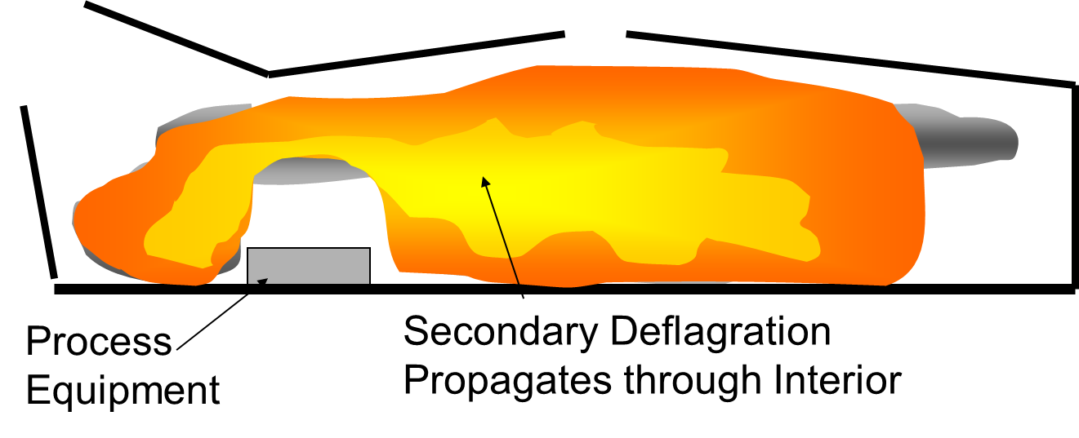
Definitions
Deflagration: Propagation of a combustion zone at a speed that is less than the speed of sound in the un-reacted medium.

Slide 14
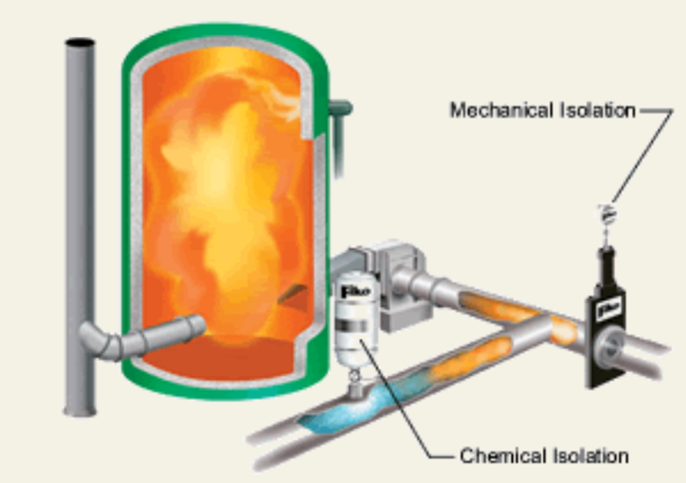
Definitions
Deflagration Isolation: A method employing equipment and procedures that interrupts the propagation of a deflagration flame front, past a predetermined point.

Slide 15
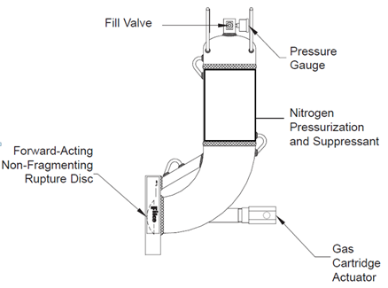
Definitions
Deflagration Suppression: The technique of detecting and arresting combustion in a confined space while the combustion is still in its incipient stage, thus preventing the development of pressures that could result in an explosion.

Slide 16
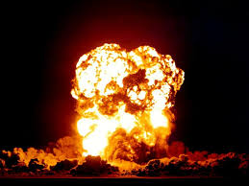
Definitions
Explosion: The bursting or rupture of an enclosure or a container due to the development of internal pressure from deflagration.

Slide 17
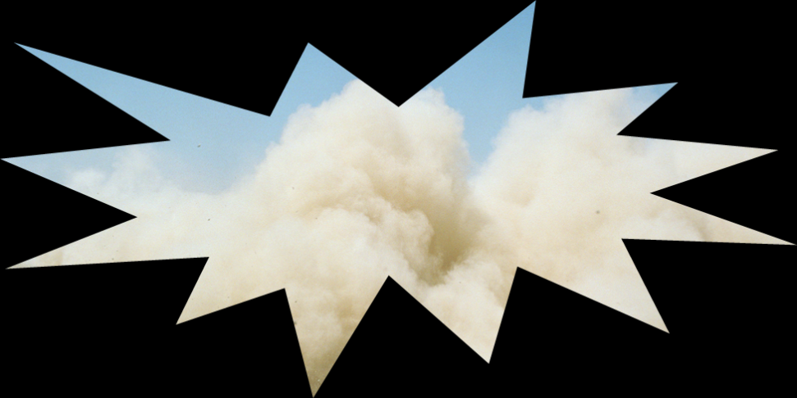
Definitions
Minimum Explosible Concentration (MEC): The minimum concentration of combustible dust suspended in air, measured in mass per unit volume that will support a deflagration.

Slide 18
EXPLOSION PENTAGON
1. Oxygen
2. Fuel
3. Ignition
4. Dispersion
5. Confinement

Slide 19
Laws
Federal OSHA National Emphasis Program (NEP) OSHA CLP 03-00-008
DOSH Directive 12.85
WAC 296-24-95601
OSHA 1910.22 Housekeeping
WAC 296-800-22005 Housekeeping
WAC 296-800-11010 Safe Place
Reference NFPA provides evidence of industry recognition of the hazard.

Slide 20
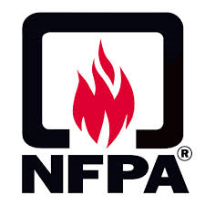
National Fire Protection Association (NFPA)
NFPA 61, Standard for the Prevention of Fires and Dust Explosions in Agricultural and Food Processing Facilities (2002 Edition).
NFPA 68, Guide for Venting of Deflagrations (2002 Edition).
NFPA 69, Standard on Explosion Prevention Systems (2002 Edition).
NFPA 70, National Electrical Code (2005).
NFPA 77, Recommended Practice on Static Electricity.
NFPA 85, Boiler and Combustion Systems Hazards Code (2007 Edition).
NFPA 91, Standard for Exhaust Systems for Air Conveying of Vapors, Gases, Mists, and Noncombustible Particulate Solids (2004 Edition).

Slide 21
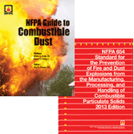
NFPA
NFPA 86, Standard for Ovens and Furnaces.
NFPA 484, Standard for Combustible Metals, Metal Powders, and Metal Dusts (2006 Edition).
NFPA 499, Recommended Practice for the Classification of Combustible Dusts and of Hazardous (Classified) Locations for Electrical Installations in Chemicals Process Areas (2004 Edition).
NFPA 654, Standard for the Prevention of Fires and Dust Explosions from the Manufacturing, Processing, and Handling of Combustible Particulate Solids (2006 Edition).
NFPA 664, Standard for the Prevention of Fires and Explosions in Wood Processing and Woodworking Facilities (2007 Edition).
NFPA 2113, Standard on Selection, Care, Use and Maintenance of Flame-Resistant Garments for Protection of Industrial Personnel Against Flash Fire.

Slide 22
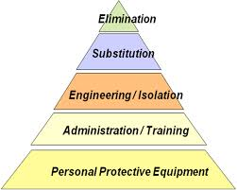
Combustible Dust Hazard
Reduce the risk of combustible dust incidents:
Establish a Hazard Assessment
What are we looking for?
Establish Hazard Controls
Engineering Controls
Administrative Controls
Personal Protective Equipment

Slide 23
Hazard Assessment
Technology Tools

Slide 24
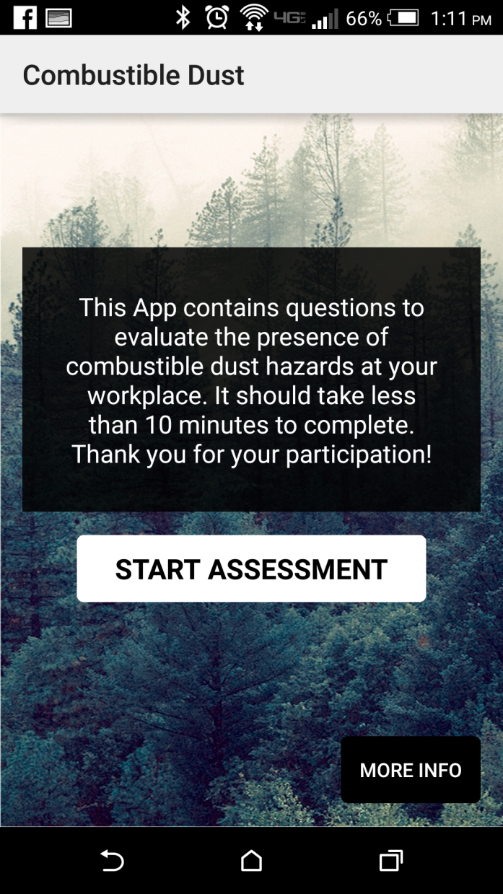
Smart Phone & Tablet Application
TPM Built a smart phone and tablet application w/ SHIP grant
Combustible Dust Hazard Assessment
30 Questions
Enter Hazard Specifics
Add Photos
Publish Report as time and date stamped PDF
Mitigation Techniques for identified hazards

Slide 25
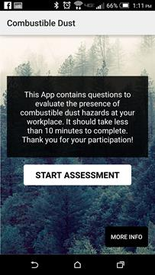
Smart Phone & Tablet Application
Icon
Splash
Main

Slide 26
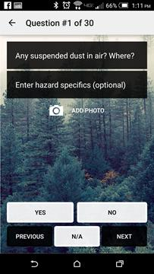
Smart Phone & Tablet Application
Company
Info
More Info
Questions

Slide 27
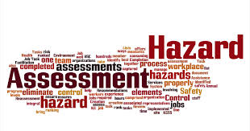
Hazard Assessment
1. Any suspended dust in air? Where?
Control accumulation and apply housekeeping.
NFPA 664 or 654.
2. Is equipment electrically grounded?
Test & Ground all electrical equipment as needed. NFPA 664 or 654.
3. Any energized damaged electrical conduits?
Repair or Replace.

Slide 28
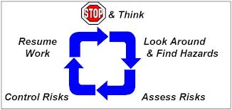
Hazard Assessment
4. Any exposed wiring that could short, or cause a spark.
Repair and Upgrade to Code.
5. Is HOT WORK controlled by a permit system?
Implement written program, formulate procedures, acquire equipment & train employees.
6. Are there any ENCLOSURES where combustible dust is present.
Review NFPA 68, 69, 664, 654 depending on dust type.

Slide 29
Hazard Assessment
7. Are there any ignition sources that can possibly reach the inside of a process enclosure?
NFPA 664 for methods of preventing ignition source transmission.
8. In the past has there been a deflagration or explosion event involving combustible dust?
Implement controls specified under NFPA 664 and other codes.
9. Do you have engineering controls in place for combustible dust?
Engineering should be used to control an explosion and to collect dust. They must be on a periodic maintenance and testing schedule.

Slide 30
Hazard Assessment
10. Do you have administrative controls in place for combustible dust?
Perform a dust accumulation rate assessment and set up a housekeeping plan to control the dust according to NFPA code 664 or 654.
11. Does a DEFLAGRATION hazard exist?
Review and implement NFPA 69.
12. Are deflagration suppression and explosion venting components used?
Component indicated as present-verify if appropriate, Check NFPA 69 to verify if component is needed.

Slide 31
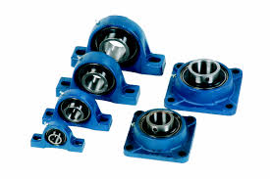
Hazard Assessment
13. MANAGEMENT of CHANGE (MOC) - Are there written procedures to manage the change of process materials, technology, equipment, procedures, and facilities?
Establish an MOC Program & Training.
14. HOT SURFACES - Are exterior surfaces of heated process equipment in contact with wood prevented from a MAXIMUM allowable temperature of 400 degrees?
Dust exposed to HOT SURFACES exceeding the auto-ignition temperature of dust at 399 degrees may ignite.
15. BEARINGS - Are they monitored for adequate lubrication and excessive wear?
Inadequate lubrication & wear leads to frictional heating and auto-ignition dust.

Slide 32
Hazard Assessment
16. POWERED INDUSTRIAL TRUCKS - If they operate in areas with a deflagration hazard, are they the correct classification?
Powered Industrial Trucks are sources of ignition-CHECK Classification. NFPA 505
17. STATIC ELECTRICITY - Does equipment contain design features that include - Conductivity, bonding & grounding, grounded metal combs, other effective controls?
Consult electrician for Static Electricity minimizations.
18. FRICTION - Is all equipment designed, installed, and operated to maintain alignment and lubrication to avoid frictional heat ignition?
CHECK equipment to minimize frictional heating.

Slide 33
Hazard Assessment
19. Does the dust collection system at your location meet the NFPA requirements?
Inspect and maintain dust collection system according to manufacturer's recommendations and NFPA 664 & 654
20. Is foreign material (AKA, Tramp metal), removed by self-cleaning magnets, air separators, or BOTH?
Install system. Review NFPA 664 or 654 and correct.
21. Does equipment meet NFPA requirements for FIRE or DEFLAGRATION hazards?
NFPA 664 or 654.

Slide 34
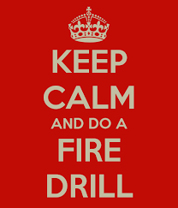
Hazard Assessment
22. EMERGENCY PLANNING & RESPONSE - Does it meet the requirements of WA WAC Code 296-24-567 or OSHA 29 CFR 1910.38?
(Consult 29 CFR 1910.38 - Emergency Action Plan) Meet requirements for Emergency Planning & Response.
23. Is the Housekeeping & Inspection program DEVELOPED, MAINTAINED, & DOCUMENTED?
Develop, maintain & document Housekeeping & Inspection program.
24. Is Production Equipment maintained and operated to minimize debris & dust escape (AKA - Fugitive Dust)?
Seal breaches in system to collect fugitive dust to prevent buildup.

Slide 35
Hazard Assessment
25. Is DUST ACCUMULATION equal to or greater than 1/32 (1/8 for wood) of an inch?
Control dust accumulation to less than max accumulation.
26. Is there VISIBLE DUST ACCUMULATION at the following areas? Slopes, Overhead beams, Joists, Ducts, and Equipment tops.
Control accumulation
27. Are DUST ACCUMULATIONS on all surfaces GREATER THAN 5% of horizontal surface area?
Calculate area square footage and control to less than 5%.

Slide 36
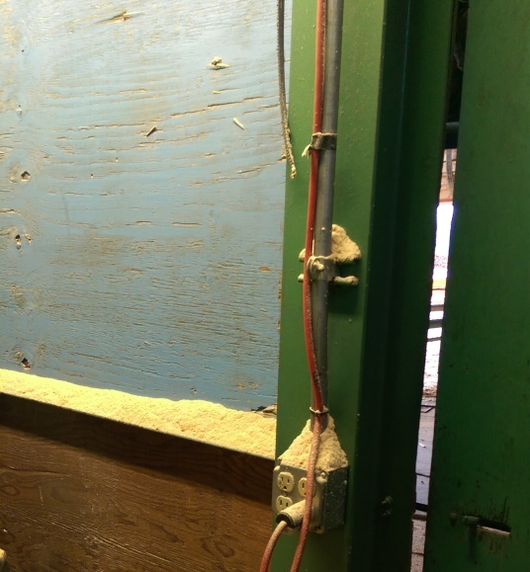
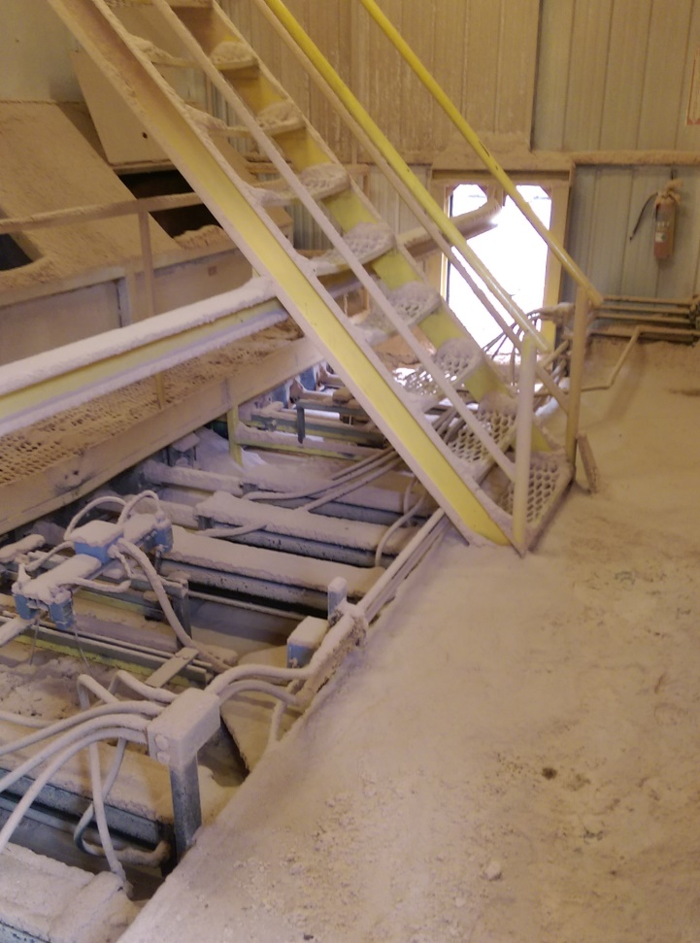
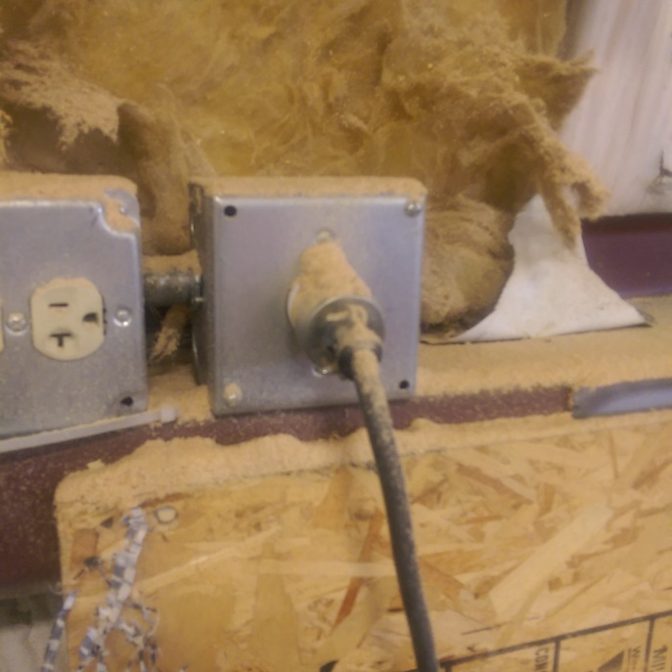
Photos

Slide 37
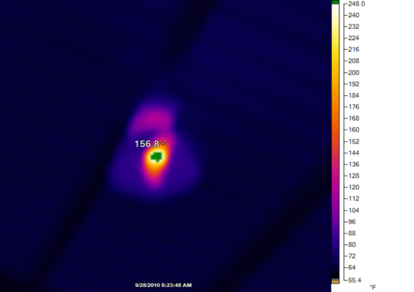
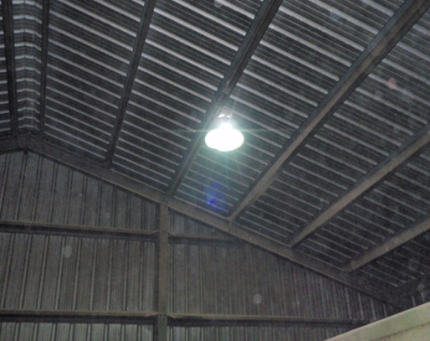
Hazard Assessment
28. Are DUST ACCUMULATIONS CONTROLLED under the Housekeeping standard?
(WA WAC Code 296-800-22005 or OSHA 29 CFR 1910.22)
Consult OSHA NEP or DOSH Directive standard and minimize dust accumulation.
29. DETERMINE if IGNITION SOURCES are present anywhere in the inspection area. Auto-ignition temperature (> 399 *F) as verified by DIRECT MEASUREMENT or Thermographic Imagery?
Remove or prohibit DEVICES in area when deflagration or explosion conditions exist.
30. Could dust become dispersed in air due to vibration, other disturbances, OR a primary explosion?
Control by minimizing accumulation

Slide 38
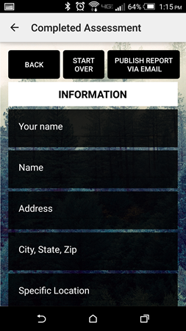
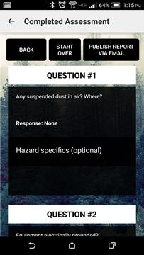
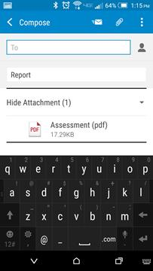
Smart Phone & Tablet Application
Review Assessment
Publish
Report

Slide 39
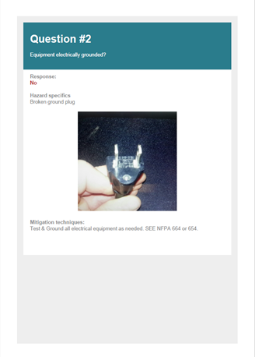
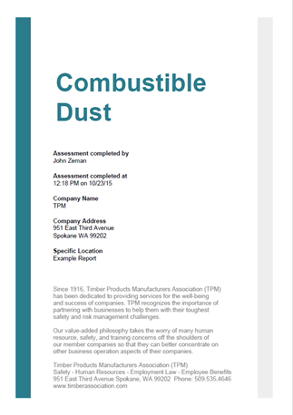
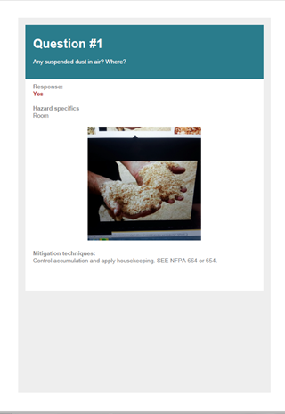
Smart Phone & Tablet Application
PDF Report

Slide 40
Summary
Hazard Assessment – App tool?
Set up a time table for establishment of controls
Prioritize controls
Abate hazards
Risk reduction
Compliance achieved!

Slide 41
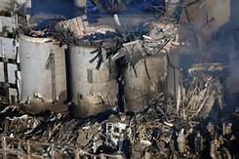
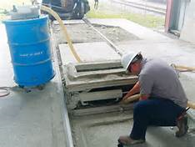
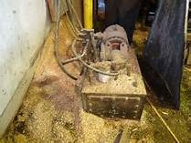
What Decisions Will You Make?

Slide 42
Timber Products Manufacturers Association SAFETY Specialist Contact Information: tpm@tpmrs.com 509-535-4646

