Slide 1
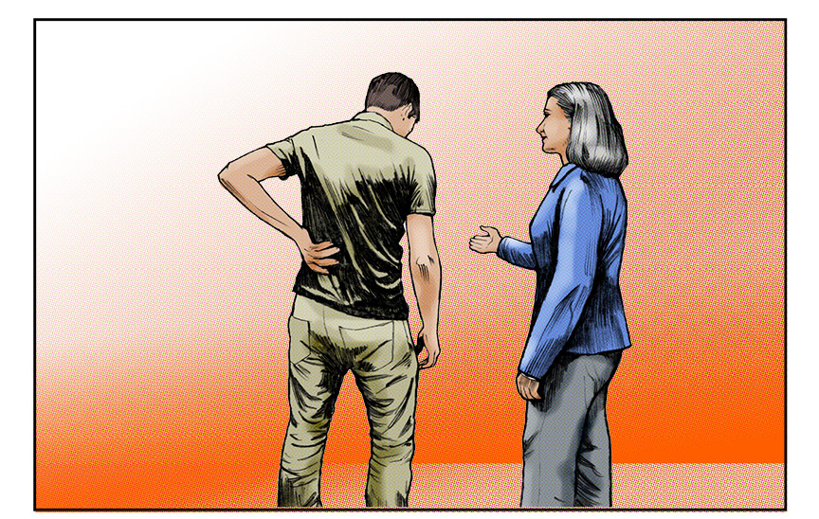
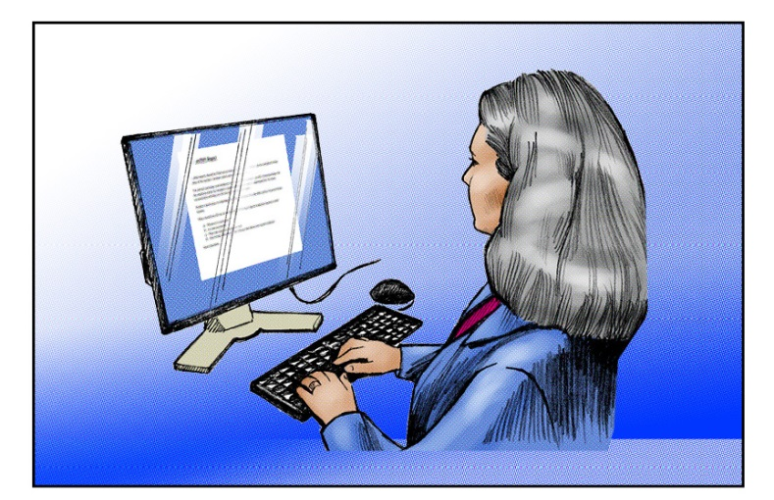
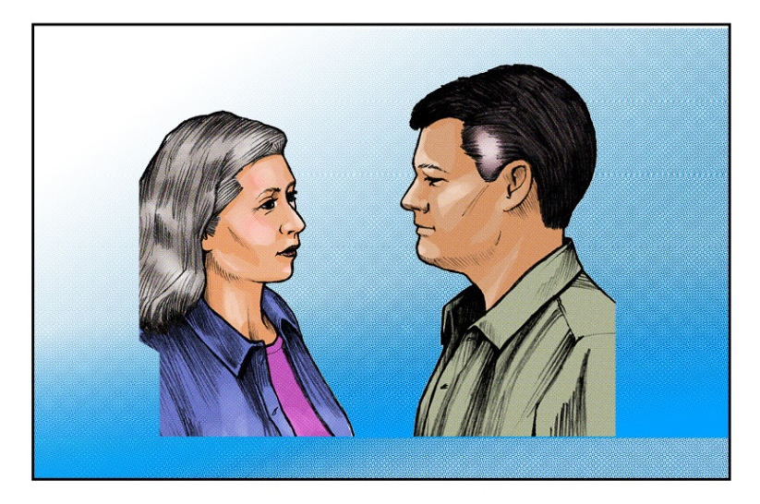
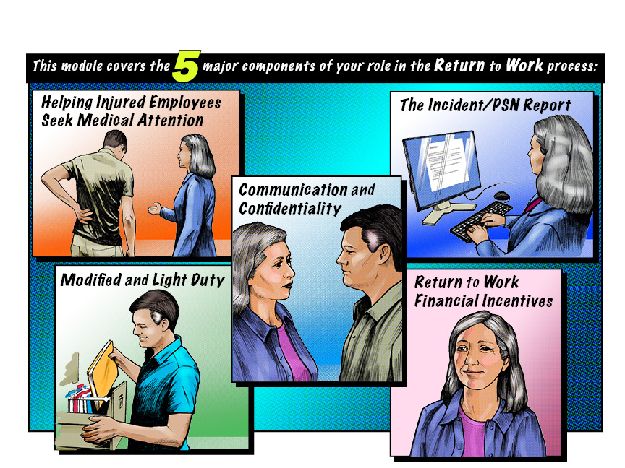
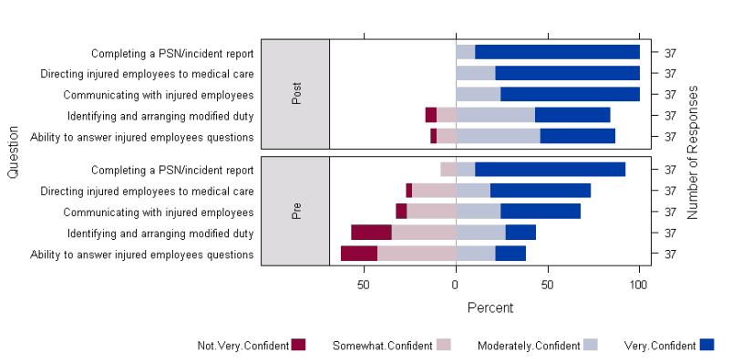
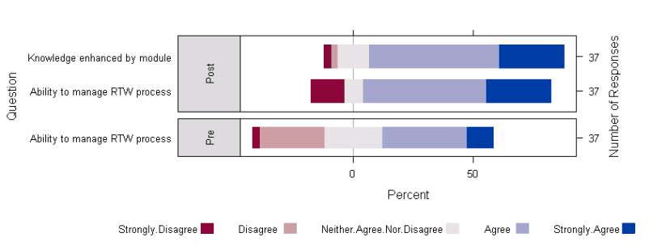
Improving Early/Safe Return to Work for Your Injured Healthcare Employees
Project Team: June Spector, Michael Oberg, Nicholas Reul, Lisa Hart
Return to Work for Healthcare Employees is Challenging
Supervisors working with injured employees may lack the information and resources needed to effectively manage their injured employees and facilitate their return to work.
Here is an Intervention to Overcome the Barriers of Returning Injured Employees to Work
Determine the Process
Create and Implement Training Module
The return to work process can be confusing. To understand this process, talk to key stakeholders involved in the process and develop a plan for improvement. We spoke with and obtained buy-in from the following stakeholders:
Individual Supervisors/Managers
The Office of Risk Management/Institutional Claims Specialists
Human Resources
Centers of Occupational Health and Education (COHE)
Employee Health
Hospital Administration
Washington State Department of Labor and Industries
Based on stakeholder feedback, create a training module including essential components of the work injury/return to work process for managing injured employees and facilitating their
recovery/return to work.
Our module focuses on 5 components determined essential to the return to work process by our stakeholders.
Evaluate
Use Evaluation Data to
Improve Module and Process
We used a series of surveys before and after administration of the module to determine its effectiveness.
We used data collected from the evaluation to improve the training module as well as provide feedback for how the return to work process can be improved.
Confidence in Return to Work Process Pre/Post Module Implementation
Module Delivery
This module and other information will be publicly available at http://www.lni.wa.gov/Safety/Topics/AtoZ/Grants/
Contact for more information: Michael Oberg
mdo2@uw.edu 206-616-4213
Funding Source : Washington Department of Labor and Industries Safety & Health Investment Projects (SHIP), 2012RH00198

