Slide 1
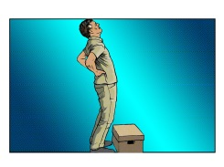
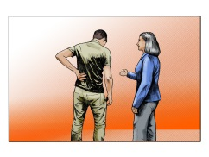
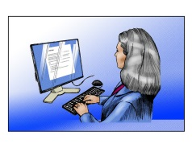
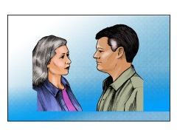

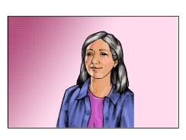
How to apply best practices when managing an injured employee’s early return to work
The return to work training module illustrates best practices when managing an employee that has been injured at work. The module focuses on 5 major components:
Helping employees seek medical attention,
Filling out an incident report
How to communicate with injured employees
Navigating modified and light duty
Obtaining financial incentives.
A link to the module is posted below, along with links to valuable resources.
Module link: http://faculty.washington.edu/spectj/RTW%20Module%20Final.pptx
Resources
Injury
L&I Find a Provider: https://secure.lni.wa.gov/provdir/
HMC Employee Health: (206) 744-3081 https://hmc.uwmedicine.org/BU/EH/Pages/default.aspx
Risk Management Provider Resources: http://f2.washington.edu/treasury/riskmgmt/wc/seek
Incident report
https://psn.medical.washington.edu/Login.aspx
Communication and Confidentiality
UW Confidentiality Policy: http://www.washington.edu/admin/hr/polproc/accommodation/accomrequestproc.html
Modified and Light Duty
Human Resources: (206) 744-9220 http://f2.washington.edu/treasury/riskmgmt/wc/supervisors
Office of Risk Management: (206) 543-0183 http://f2.washington.edu/treasury/riskmgmt/wc
L&I General Info: http://www.lni.wa.gov/ClaimsIns/Insurance/Injury/LightDuty/Default.asp
HMC Administrative Policies and Procedures: https://hmc.uwmedicine.org/PolicyProcedure/Pages/Return_to_Work_Light-Modified_Duty_105-15.aspx
Financial Incentives
Return to Work Incentives: http://f2.washington.edu/treasury/riskmgmt/wc/saw

