Slide 1
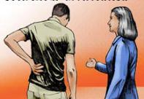
Direct supervisor engagement in injured workers’ early, safe return to work
NAOEM Annual Scientific and Clinical Education Conference
September 27, 2013
June Spector, MD MPH
Assistant Professor

Slide 2
Motivating Case ….how often has this happened to you?

Slide 3
A medical assistant with low back pain
35 medical assistant in ambulatory surgery
Acute low back pain after assisting a patient transfer from stretcher to wheelchair
Seen in ED:
No red flags by history or exam
Given NSAIDS
Removed from work for 1 week, then sent back full duty

Slide 4
A medical assistant with low back pain
Seen in OEM clinic after returning to work
Worse low back pain
Exam:
No red flags by history or exam
Conservative treatment
APF with restrictions

Slide 5
COHE best practices
ROA completed/submitted to L&I within 2 business days
APF completed
HSC involved in case
Employer contacted regarding patient’s restrictions
COHE = Centers of Occupational Health & Education;
ROA = Report of Accident; HSC = Health Services Coordinator

Slide 6
Supervisor indicates: “no light duty”
Supervisor contacted regarding
patient’s restrictions

Slide 7
Supervisor indicates: “no light duty” AND This is your own institution!!
Supervisor contacted regarding
patient’s restrictions

Slide 8
Learning Objectives
I. Describe how direct supervisors can help facilitate injured workers’ early, safe return to work (RTW)
II. Apply knowledge of barriers and facilitators to supervisor engagement in injured workers’ early, safe RTW to the successful management of injured worker patients

Slide 9
Outline
I. The Problem: Supervisor Assessment
II. The Intervention
Stakeholder Input
Evidence Review
Training Module
Evaluation
III. Relevance & Future Directions

Slide 10
I. The Problem

Slide 11
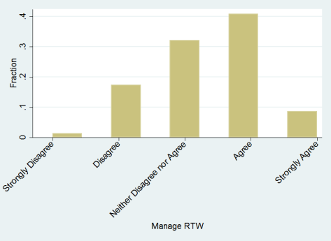
Supervisor Survey
N=81/108 (75% response rate)
“I feel that I can manage an injured employee’s return to work process”

Slide 12
Supervisor Survey
“When assisting an injured employee back to work light or modified duty,
what part of the process do you find to be the most difficult?”
Barrier | %
Fitting light/modified duty into schedule | 25
Fitting light/modified duty into budget | 15
Communicating with administration | 4
Communicating with injured employee | 2
Other | 49
84% don’t know who to contact about stay at work financial incentives
www.StayAtWork.Lni.wa.gov
“There is not light duty available. The technician must be cleared to work without restriction.”
“The actual process itself.”
“Is there is a formal process?

Slide 13
Existing Process/Policy
Complex process map!!
http://f2.washington.edu/treasury/riskmgmt/sites/default/files/WCProcessMap.pdf
New policy

Slide 14
II. The Intervention
Funding Source: Washington Department of Labor and Industries Safety & Health Investment Projects (SHIP), 2012RH00198
Project Team: June Spector (PI); Michael Oberg (Project Manager); Nicholas Reul (Co-Investigator); Lisa Hart (Co-Investigator); Shari Spung (University of Washington Office of Risk Management); Paula Minton-Foltz (Harborview Medical Center)

Slide 15
II. The Intervention Stakeholder Input

Slide 16
Stakeholder Input
Providers
COHE
Human Resources
Consensus: Brief Supervisor Training Module on Return To Work Best Practices + Supporting Content
Employee Health
Administration
Supervisors
Institutional Claims
Specialists

Slide 17
II. The Intervention Evidence Review

Slide 18
Evidence Review: Qualitative Studies
Holmgren 2007: supervisors acknowledge their key roles in RTW
E.g. 1st point of contact, facilitate finding modified work & access to healthcare, interpret institutional policies, monitor worker’s function, communicate support

Slide 19
Evidence Review: Qualitative Studies
Holmgren 2007: supervisors acknowledge their key roles in RTW
E.g. 1st point of contact, facilitate finding modified work & access to healthcare, interpret institutional policies, monitor worker’s function, communicate support
Shaw 2003: workers identify most valued aspects of supervisor: accommodation, responsiveness, concern, support, respect, fairness, coordination, enlist coworker support

Slide 20
Evidence Review: Prospective Epidemiologic Studies
Wood 2005 : Good evidence for an association between poor social support and an increased risk of musculoskeletal morbidity.
Study | Pop | Outcome | Findings
Macfarlane 2000 | 1953 UK population | New forearm pain | RR 4.7, 95% CI 2.2–10, those occasionally or never satisfied with coworkers/supervisors
Kaergaard 2000 | 243 F sewing machine operators, Denmark | Neck–shoulder disorders in last 3 months | RR 3.7, 95% CI 1.2–11.3, those with low social support from colleagues/supervisors

Slide 21
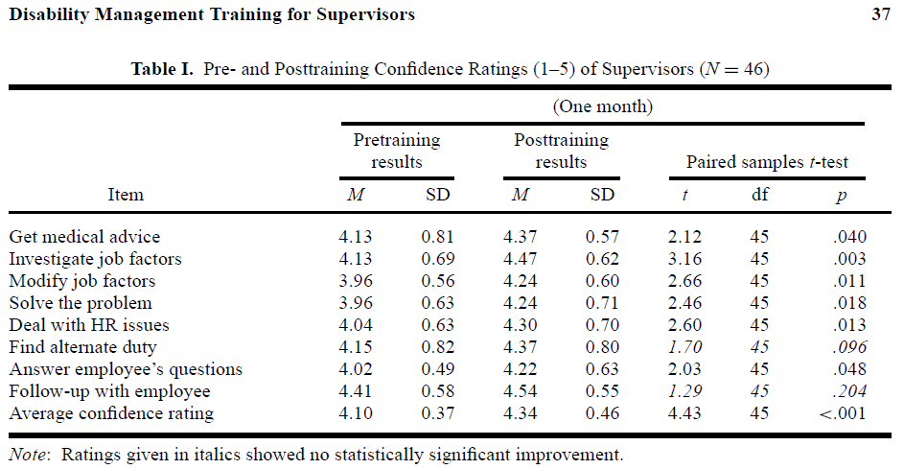
Evidence Review: Intervention Studies
McClellan 2001

Slide 22
II. The Intervention Training Module

Slide 23
Training Module: General Features
Social Cognitive Theory (SCT):
observational learning (e.g. avatar, scenario);
environmental factors (e.g. RTW resources);
individual factors (e.g. self-efficacy).
PowerPoint as practical/inexpensive hospital Learning Management System input
Multimedia – audio, visual/animation

Slide 25
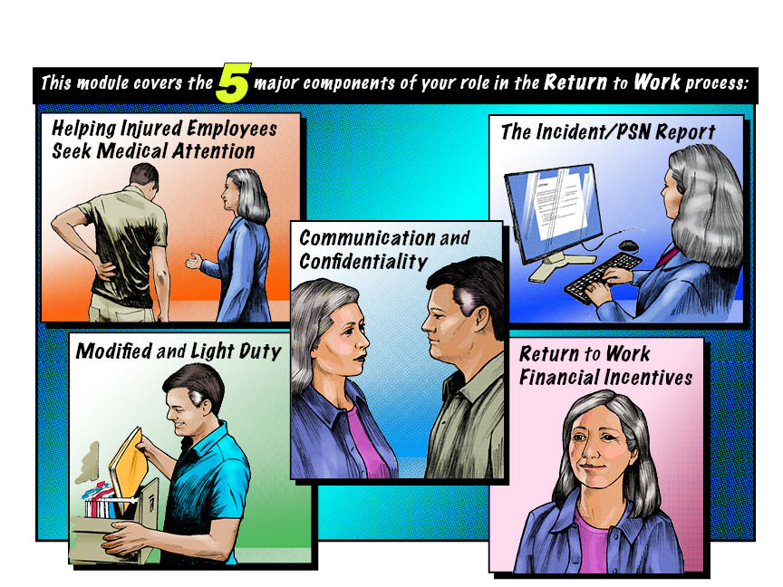

Slide 29
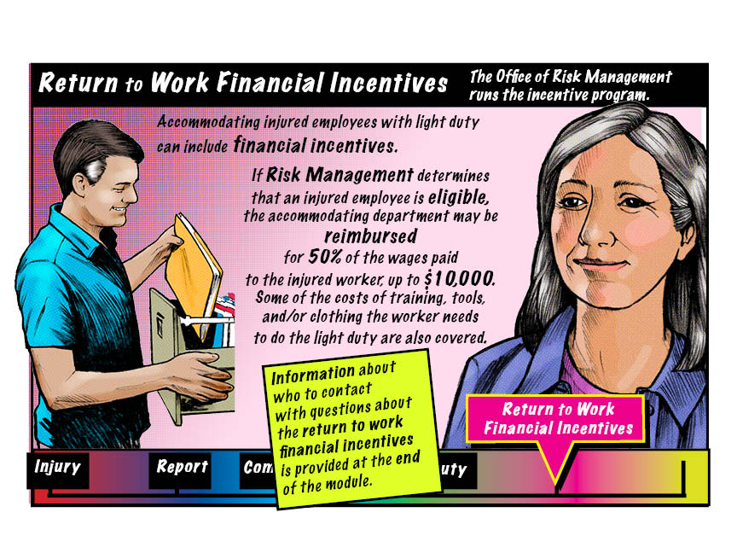

Slide 30
https://secure.lni.wa.gov/provdir
http://f2.washington.edu/treasury/riskmgmt/wc/seek
https://psn.medical.washington.edu/Login.aspx
http://www.washington.edu/admin/hr/polproc/accommodation/accomrequestproc.html
http://f2.washington.edu/treasury/riskmgmt/wc/supervisors/offwork
http://www.lni.wa.gov/ClaimsIns/Insurance/Injury/LightDuty/Default.asp
http://f2.washington.edu/treasury/riskmgmt/wc/saw

Slide 31
II. The Intervention Evaluation

Slide 32
Evaluation: Study Design
N=81
Baseline survey
Demographics
Knowledge
Beliefs
Practices (past 3 months)
Randomization
N=37
N=37
Usual Practice
Module & Immediate post-module survey
Knowledge
Beliefs
Module Feedback
Knowledge
Beliefs
Practices (past 3 months)
3 Month Survey
3 Month Survey, Time-loss Days & $

Slide 33
Evaluation: Study Design
N=81
Baseline survey
Demographics
Knowledge
Beliefs
Practices (past 3 months)
Randomization
N=37
N=37
Usual Practice
Module & Immediate post-module survey
Knowledge
Beliefs
Module Feedback
Knowledge
Beliefs
Practices (past 3 months)
3 Month Survey
3 Month Survey, Time-loss Days & $

Slide 34
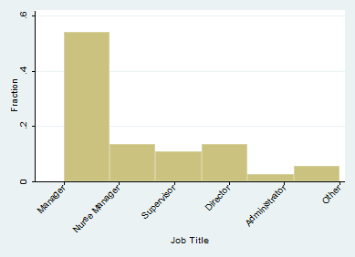
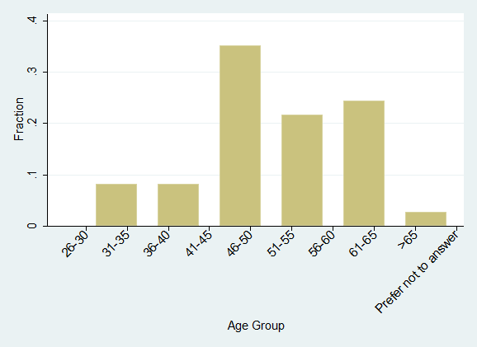
Evaluation: Demographics
65% clinical, 35% nonclinical departments
Median (range) direct reports: 19 (1-165); mean 42, SD 42
Median (range) years as healthcare supervisor/manager: 10 (1-30); mean 10, SD 7.6

Slide 35
Evaluation
Beliefs
P-value
0.536
0.027
<0.001
0.001
<0.001
Knowledge
P-value
<0.001
<0.001

Slide 36
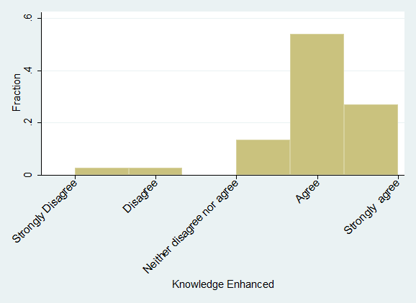
Evaluation: Module Feedback
Changes based on module:
“Communicate with employees more”
“Be vigilant of light duty positions”
“Encourage injured employee to turn in restrictions ASAP”
Most beneficial aspects of
module:
“Communication importance and techniques”
“Resources, including financial incentives”
Areas for improvement:
“Still some questions about light duty”
“My….knowledge of what to do….was enhanced by this module.”

Slide 37
Evaluation: Stay Tuned!
Baseline survey
Demographics
Knowledge
Beliefs
Practices (past 3 months)
Randomization
Usual Practice
Module & Immediate post-module survey
Knowledge
Beliefs
Module Feedback
Knowledge
Beliefs
Practices (past 3 months)
3 Month Survey
3 Month Survey, Time-loss Days & $

Slide 38
III. Relevance & Future Directions

Slide 39
Relevance: OEM Providers
When talking to healthcare supervisors:
Understand & address potential barriers
Limited knowledge about who to contact (multiple players)
Limited knowledge about modified/light duty
Concerns about staffing, budget
Concerns about confidentiality
Complex, confusing institutional processes/policies
Leverage potential facilitators
Stay at Work incentives
Healthcare professionals!

Slide 40
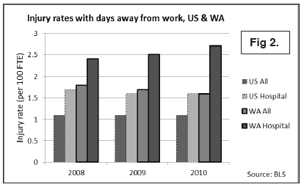
Relevance: Healthcare
Injury rates involving days away from work higher in hospitals and nursing/residential care compared to all industry
Clinical hospital workers (nursing aids, RNs) at particularly high risk for non-fatal musculoskeletal disorders

Slide 41
Future Directions
Dissemination of information on development process, module itself, and evaluation results
http://www.lni.wa.gov/Safety/Topics/AtoZ/Grants/Approvals.asp
Multi-site study (healthcare)?
Adaptation for other sectors?

Slide 42
Supervisor indicates: “light duty is available”
Supervisor contacted regarding
patient’s restrictions

Slide 43
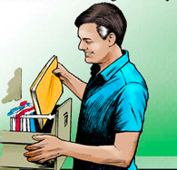
Questions & Comments?

