Slide 1
Preventing Work Disability
Through returning to work and Remaining at work
Reducing the Human, Social, and Economic Costs of Work Disability
Presented by Jason Parker, B.HK
Centrix Disability Management Inc.
Notes:
Welcome to the Preventing Work Disability web session. My name is Jason Parker and I will be hosting this session for you today.
This session is about how to help DOC employees, who have been injured on the job, return to work. This web session is supported by a grant provided by Labor and Industries through the Safety and Health Investment Projects also called the SHIP Grant.

Slide 2
Training Goals
Why should we care about Work Disability?
Findings from the DOC Focus Groups and In-depth Interviews
Why the worker’s experience matters
Insights from Correctional Officers and Administrators
The First 5 Steps to help employees remain at work and return to work successfully
Notes:
So what are we going to cover today.
We are going to cover this thing called Work Disability and why it is important to focus on.
I am going to share with you some findings we have from focus groups and in-depth interview with Correctional officers and Administrators.
Then we are going to talk about a simple, 5 step process to ensure things get started off right and help DOC employees return back to the work place.

Slide 3
RESULTS DOC
Engaged and Respected Staff
Engaged and Respected Staff
Engaged and Respected Staff
Employee satisfaction
Employee engagement
Safer Operations
Safer Operations
Safer Operations
Employee on the job injuries
Employee assaults by offenders in prison
Innovative, Efficient and Sustainable Business practices
Innovative, Efficient and Sustainable Business practices
Innovative, Efficient and Sustainable Business practices
Supporting Successful Transition
Supporting Successful Transition
Supporting Successful Transition
Promoting Positive Change
Promoting Positive Change
Promoting Positive Change
Notes:
To start off we need to reference DOC larger goals and initiatives.
In particular the first 2 goals of engaged and respected staff and safer operations.
I would like you to keep these 2 goals on your mind as we continue as they are relevant to what we are talking about.

Slide 4
Which claims cost the most?
Office of the Medical Director - L&I
5% of injured workers are associated with 80% of cost and lost time in workers’ compensation systems.
Majority of these workers end up on long term disability following injuries that would not be considered serious at their outset.
Notes:
So why are you here and why is this topic relevant to you as a supervisor? To put some context around this it is good to reference a joint letter by Dr. Gary Franklin the medical director at Labor and Industries and Dr. Kathryn Meuller from Colorado Workers’ Compensation that talked about which claims cost the most.
In that letter they noted that 5% of injured workers cost 80% of all the dollars. More importantly, when looking at these claims, that cost 80% of all the dollars, they commented that the majority of them were not catastrophic claims. In fact, the majority of them started out with fairly straightforward injuries and the initial injury would not be considered serious at its outset.
For example, these are claims that started out with a back strain, or shoulder strain, and after 6 or 12 months or longer people are wondering why this person is still off work.

Slide 5
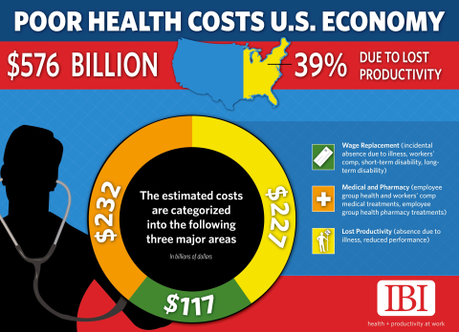
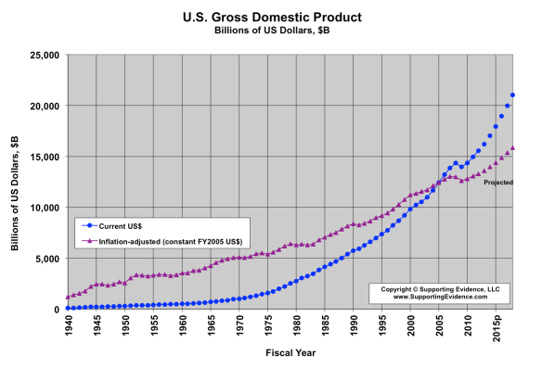
the costs of Work disability
Integrated Benefits Institute estimates the total cost of work disability in the US
$576 Billion
Mercer estimates 9-15% of payroll
3.6% of US GDP
Notes:
So, what about the overall costs of work disability? Why even focus on this?
The Integrated Benefits Institute estimates that the total cost of disability to the US economy is 576 billion dollars per year. Consulting firm Mercer estimates it to be 9-15% of payroll, and the impact to the US turns out to be 3.6% of the US GDP.
These are staggering numbers.
Now these numbers include the direct costs such as wage replacement, medical costs, replacement worker costs and they also include the indirect costs such as lost productivity. It is estimated that replacement workers are about 70% as productive as the worker that is now out of work.

Slide 6
What is Work Disability?
Occurs when a worker is unable to remain at or resume work because of a health problem or the status of their ability to work is altered.
The focus of Preventing Work Disability is helping workers stay productive at work, or return to a healthy productive work life.
“[We should] address the work disability problem as a central issue independent from condition.”
Handbook of Work Disability – Loisel and Anema 2013
Notes:
So what is this thing we have been talking about? What is work disability? Simply put, work disability means a person is unable to remain at work or return to work due to a health event such as an injury or illness. Which puts the prevention of work disability focused on helping workers retain a healthy and productive work life by remaining at work when they can and returning to work as soon as there is no risk of harm to do so.
Why focus on preventing work disability? Well we, as an industry, have learned a lot over the last 10 years about why some people recovery and rtw and why some take longer. One of the most important lessons is that we should address the work disability problem as a central issue that is independent of the condition. Essentially, Work Disability is its own separate condition, with its own set of causes, and has its own set of interventions.
This is a very important concept in our understanding of work disability and I want you to remember when we think about preventing work disability we need think about it as being separate from the actual diagnosis.

Slide 7
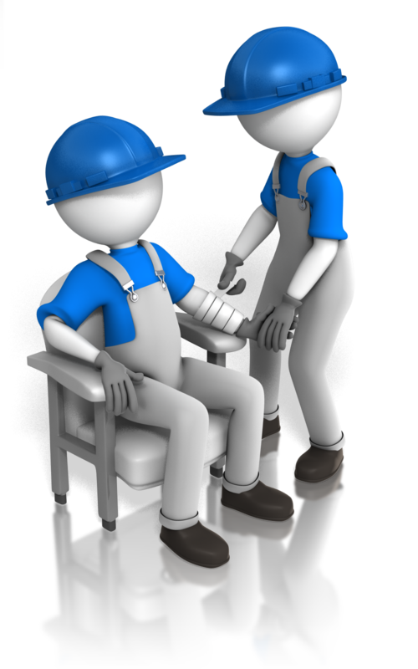
A TALE OF TWO INJURIES
Motivation
Doctor
Don’t like their job
Work Ethic
Notes:
Consider for a moment 2 injuries that are exactly same. And let’s control for type of injury, age, gender, ethnicity, socioeconomic, education, and job types. Let’s control all the factors so that we are comparing apples to apples. Consider person A who breaks an arm, goes to the hospital, gets a cast on it, and after a couple of days on pain medication calls his employer an says, “hey listen, I can do something. I just can’t lift, but you could give me some manuals to read or review, or that project that needs to get started. I can do something.” Now consider person B. Same injury. We have controlled for all the other factors so they are the same. Person B waits 6 weeks for the cast to come off, goes through 6 weeks of physical therapy, followed by 6 weeks of transitional duties (or what was formally known as modified duties). What is the difference between these two people?
PAUSE
If you are like most people you probably had words come to mind like: motivation, work ethic, the doctor, they don’t like their job, etc.
If you pause and think about this for a moment: most people think of words that have nothing to with the diagnosis as the reason for the difference.

Slide 8
WORK DISABILITY
Medical does not predict duration.
Clinical severity is not predictive of work disability.
Notes:
In fact, the second most important lesson we have learned with regards to work disability is that:
Medical, the actual diagnosis, does not predict duration. The actual diagnosis does not tell you when a person will return to work. We have guidelines of when we can expect a certain amount of recovery but it does not tell us when a person will actually return to work.
And also it is important to note, clinical severity, as in how significant is the illness or injury, is not predictive of work disability.
Everyone knows who Stephen Hawking is. Here is a person with significant impairment and disability. But is he work disabled? “No, he has a disability but he is not work disabled…”
This is why it is it is so important to separate the work disability problem from the actual diagnosis and for us to stop thinking that the diagnosis is what is keeping someone from returning to work. The impairment caused by the injury or illness may be keeping them from doing certain duties or certain jobs and we must stop thinking that the diagnosis is what is keeping someone from returning to work and remaining work disabled.

Slide 9
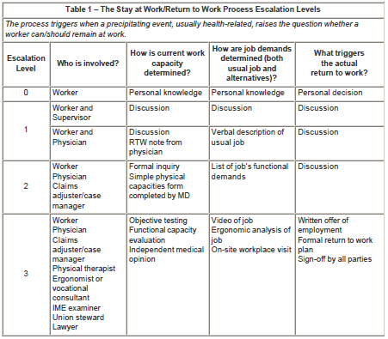
THE REMAIN AT WORK OR RETURN TO WORK PROCESS
What actually prompts the employee’s Return To Work?
Create an environment that helps the worker “decide” to RTW.
Notes:
So what actually prompts an employee to remain at work or return to work? If you think about a person who suffers an injury and is off work. They are off, off, off..and then back. Off off off…and then back. So what actually prompts the RTW process?
The American College of Occupational and Environmental Medicine, or ACOEM, set out to try and answer this question. 21 occupational physicians reviewed the available research and findings and concluded that there are various escalation levels and each level has an increasing amount of involvement from various stakeholders. If you take a look at their chart they note that at level zero, the very first level, you can see the only person involved is the….worker. On the far right hand side, take a look at what actually prompts the rtw process. The “personal decision” of the worker. You see, it is not until the worker decides to return to work that anything actually ever happens. It is not until the worker decides to return to work that actually anything….ever….happens.
This is a very important point to consider. One of you colleagues considered this and said, “ if that is true, then we have to create an environment to help them decide to return to work.” You can now see the link to the bigger picture of DOC goals of engaged and respected staff, and safer operations. Consider for a minute a staff member who is not engaged as an employee, what is the likelihood of them being engaged once they become injured or ill?

Slide 10
Three types of Work Disability
The lost workdays you are out to prevent are NOT the ones that are medically-required.
Dr. Jennifer Christian
Medically
REQUIRED
Disability
Medically
DISCRETIONARY
Disability
Medically
UNNECESSARY
Disability
Notes:
So now that we have defined work disability. Now that we have determined that it isn’t until the worker decides to rtw that anything ever happens. It is important to have a framework of the 3 different types of work disability so we have a common language.
The first type is what is called “ Medically Required Disability.” Meaning it is medically required for you to be out of work due to risk of harm to self or others. This is a really important point again. Essentially, being at work would cause harm to a person or possibly harm to others. For example, you have the Ebola virus. It is medically required for you to be out of the workplace due to risk of harm to self, as in you would die, and risk to others, as in you will infect everyone else. That is what is called medically required disability.
The second type is what is called Medically Discretionary Disability. This means that a person is not at risk of harm if they were at work but there is a discretionary decision being made on the part of the worker, employer, or doctor to delay the return to work. For example, not feeling ready, no transitional duties, cautious of prognosis. These are all reasons that may not necessarily indicate if there is risk of a person being at work, risk of harm, but there is a discretionary decision to delay the return to work.
The last type is what is called Medically Unnecessary Disability. This is where there are non-medical decisions being made to delay the return to work such as fear of reinjury, anger, avoidance of activity. Also, we often see workplace issues masquerading as medical issues. We also see poor information flow or inadequate communications, or administrative and procedural delays all contributing to unnecessary work disability.
From a work disability prevention perspective, the lost work days we are out to prevent are not the ones that are medically required. In fact, if you remember the 5% that cost 80% of the dollars are not the ones are not coming from the medically required disability but are from the discretionary and unnecessary decisions to keep people from coming back to work when there is no risk of harm.

Slide 11
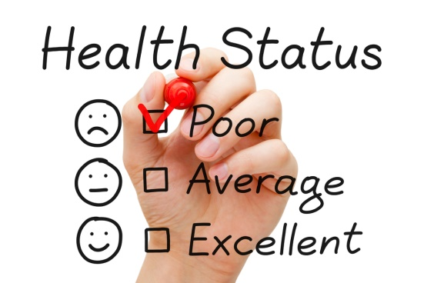
WHY FOCUS ON WORK DISABILITY PREVENTION?
Medically Required Disability is rarely necessary
Urgency is Required because prolonged time away from work is harmful
Long-term work disability contributes to 2–3 times increased risk of poor general health, 2–3 times increased risk of mental health problems, and 20% excess mortality.
Notes:
So why make the distinction between these types of work disability?
ACOEM notes that it is important for all stakeholders to know how rarely medically required disability occurs. In the grand scheme of things, there are few situations that medically require a person to be out of work.
The second point that ACOEM makes is that urgency is required to prevent work disability because time away from work is actually harmful to people. Some may think it is the lottery or a benefit to being off work but the reality is that people have poor health outcomes by being out of work. We are actually 2-3x more at risk of developing depression or anxiety if we are not working, and the worst outcome is we have a 20% increase in mortality. Meaning, we are at risk of dying sooner. Urgency is required. And the focus of work disability prevention is to prevent people from being out of work due to discretionary and unnecessary reasons.

Slide 12
Doc Experience AFTER AN injury
Qualitative assessment
Groups with COs, individual interviews, questionnaires
When the experience is bad, it tends to continue to be bad and people become remarkably passive, and ultimately disengaged in the process.
2005-2016 ©Copyright – CentriX Disability Management Services Inc. – Used with permission
Notes:
One of the things DOC did as part of the SHIP grant was to explore the DOC employee experience after an injury and the process of returning to work. We travelled around the state and talked to COs, Sgts, LTs, Superintendents, HR consultants, supervisors. These were done in groups of 3 to 6 or one on one in-depth interviews. The reason for this qualitative assessment was to gain an understanding of what it is like to go through the injury, recovery, and return to work process. What we found are called touchpoints or points of the interaction that seem to stand out as being more significant than others.
We also found that experience matters and when the experience is bad it tends to continue to be bad and people become remarkably passive, and ultimately disengaged in the process.

Slide 13
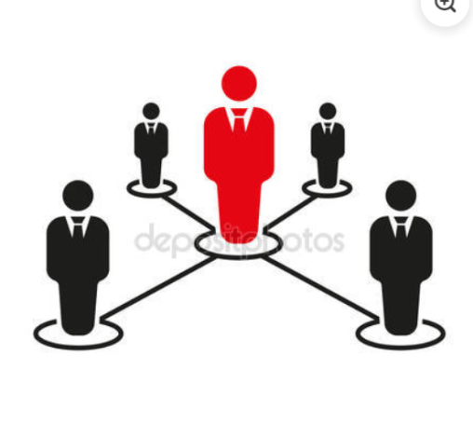
Creating Positive Experiences
Making sure there is a Clear and Understandable Process
Demonstrating Care and Compassion
Explaining the Process
Answering their questions
Ask them how they are doing.
Check-in Calls
Ensuring Ongoing Contact
Supervisor Involvement is important
Keep them on the ‘grid’
Feeling wanted back
Feeling connected with the department and workplace
Notes:
In this assessment of the experience we found 4 main touchpoints of the interaction.
The first being: most employees find the workers compensation process overwhelming and confusing. Making sure there is a clear and understandable process is an important part of the experience. This can be done by a simple checklist of important steps, a verbal discussion explaining the process, or answering questions that may arise.
The second touchpoint was care and compassion. Demonstrating care and compassion by asking them if they are ok after an injury, how they are doing if they are out of work, and checking in with them periodically all seem to demonstrate care. This touchpoint is significant and goes a long way to engaging employees who are experiencing an injury or illness.
Thirdly, relationships are important. In particular, the supervisor’s involvement was identified by employees as being important, which is why you are participating in this session. Ongoing supervisor involvement helps them feel and stay connected to the workplace, it creates feelings of being wanted back and maintains the ongoing relationship.
The last of our 4 touchpoints was ensuring ongoing contact. One of the things we found is that there is a lot of contact at the beginning of a claim and time loss. However, as time goes on and the employee remains out of work the amount of contact tends to drop off and as one employee said “once you leave this place you are off the grid. I was off the grid.”

Slide 14
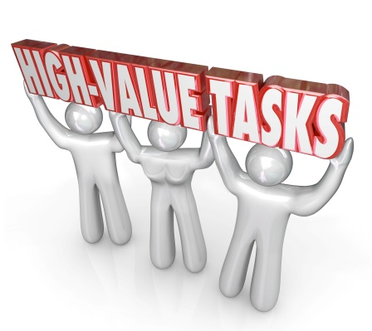
CRITICAL SUCCESS FACTORS
Day Zero Reporting is the goal.
Reporting of all injuries is encouraged and welcomed – “It is the way we do it.”
How would you approach a CO that was not following Safety Procedures?
Follow up with the CO - The goal is Day ZERO reporting
Are they able to continue working?
Remain at work if safe to do so and if the employee feels they can
Make sure it gets started out right
Notes:
We also identified a few critical success factors in order to prevent unnecessary work disability.
The first being “Day Zero reporting.” This means that all injuries and accidents are reported on the day they occur. This is identified as a critical success factor for a number of reasons. Think about it for a moment. If an employee does not report an injury right away and then 2 weeks later reports it, what is your first response? Most of your colleagues made comments that they viewed the incident with skepticism, wondered “why did they not report it at the time of the injury.” The impact, many commented, is that it influenced their response to the employee and the care they would normally feel. So an easy solution then is to just take it off the table as an issue. Day zero reporting, “it is just the way we do it.”
Its important to know why an employee may not immediately report the injury. There are many reasons why a person may not report an injury/accident right away. The most common reasons we heard from DOC employees was “1. I didn’t think it was as bad as I thought. 2. I was embarrassed it happened. 3. I felt ashamed and 4. I feel I will be judged.”
The significance of not reporting the injury right away is because treatment ends up being delayed, transitional duties can’t be offered, and one study showed that you can have an increase of up to 51% of workers compensation costs with delays of up to 2 weeks in reporting. And you may have an employee working that is less than a 100%. Day Zero reporting is the goal.
Think about how you would deal with an employee that wasn’t following safety procedure or was engaged in unsafe acts. How would you respond? What would you do? Most of your colleagues said they would address it directly with the employee. Reinforce the good behaviour and follow-up. Same goes for Day Zero reporting. Its just the way we do it.
The next critical success factor involves you asking two questions at the time of the injury or accident. Lead with compassion – ask first if they are okay. Next simply ask if they can continue working. If it is safe for them to do so AND the employee feels they can, remaining at work is the best option.
Lastly, the 4th critical success factor is making sure things get started out right. Remember, from the focus group and in-depth interview findings that most employees find the process confusing and overwhelming. So ensuring things get started out right not only reduces the confusion about the process but also makes sure the necessary things that need to get done…get done.

Slide 15
A NEW TERM
What was once referred to at DOC as ‘light duties’ OR ‘modified duties’ is now Transitional duties.
Transitional Duties are temporary – up to 12 weeks in duration.
Transitional duties can not be offered without a completed Activity Prescription Form (APF) or approved Employer Job Description (EJD).
Supervisors cannot approve Transitional Duties; only the Appointing Authority can approve Transitional Duties.
Human Resources and the DOC Claims Consultant are your “go to” people for questions.
Notes:
Before we go any further it is important to make a note that we have a new term to use. Most employees were familiar with the terms light duties or modified duties. In our interviews, many used these terms interchangeably and some had different meanings for these terms. These terms are now replaced by the term transitional duties.
The general consensus from our grant work is that the word “ transitional” has a temporary feel to it. That it has the notion of transitioning from one thing to another, which is a more accurate description of those work assignments. Even if you may hear the older terms from other agencies or L&I, the new term going forward at DOC will be Transitional Duties.
A few additional important points about Transitional Duties:
Transitional duties are temporary and are for a period of UP TO 12 weeks in duration. Note that transitional duties are not for 12 weeks but the period of transitional duties can be up to 12 weeks.
An offer of transitional duties requires a completed Activity Prescription Form, or APF, or an approved Employer Job Description, or EJD. So if one of your staff members feels they are able to return to transitional duties, they need to have one or the other submitted to proceed.
Supervisors cannot approve Transitional Duties; only the Appointing Authority can.
Lastly, the DOC Human resources and Claims consultants are your go to people for your questions and communication.

Slide 16
DOC’S WORK DISABILTY PREVENTION TEAM
Supervisor
Facility
DOC Employee
Human Resources
DOC Claims Consultant
Notes:
A quick word about the DOC Work Disability Prevention team. As you can see there are multiple people that are part of the team. The claims consultant, human resources, the facility, and you as the supervisor have a significant role in helping improve the prevention of work disability. However, as you can see from the diagram, who is at the center of it? It is the DOC employee. The employee is the only constant among all the various stakeholders.
This only highlights that the approach DOC is taking moving forward is a very employee centric approach. Meaning, that the employee needs to be involved in the return to work process.

Slide 17
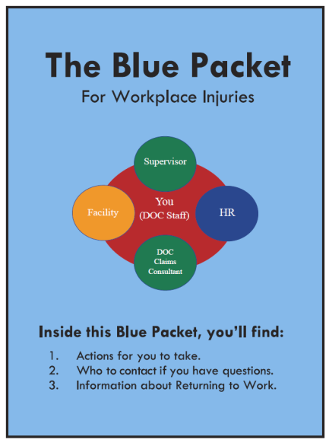
5 STEPS TO PREVENTING WORK DISABILITY
Supervisor Role and Responsibilities
First 5 Steps to take following your Employee’s Workplace Injury
Once the injury or illness is reported
Care and Compassion first – Are you okay?
Can you stay at work?
Provide the “Blue Packet”
Make sure they know to see their Doctor
Call your HR Consultant
Immediately plan your follow-up call with the employee
Notes:
So in keeping with the idea that the supervisor has a significant role in the outcomes then we need to define what that role is and what responsibilities the supervisor has.
For the supervisor there are 5 simple steps and ensuring that these steps are completed will go along way to the prevention of work disability.
So here is a quick overview of each step, and we will go through each step in more detail.
The very first step is that:
Once the injury or illness is reported, we want to make sure we demonstrate care and compassion and, also, Can they continue working?
Second step
Provide them with a “Blue Packet”
Third, make sure they know to see their Doctor
Fourth, call your HR Consultant
Fifth, immediately plan your follow-up call with the employee

Slide 18
STEP 1 – ONCE THE INJURY OR ILLNESS IS REPORTED
Step 1 - Once the injury or illness is reported
How you respond can make all the difference.
Supervisors have a critical role in disability prevention.
(McLellan et al 2001)
Negative employer response and lack of employer contact while on disability leave have been cited by several authors as correlates of prolonged disability.
(Akabas et al 1992, Shrey 1996)
“Responsiveness of the supervisor” is a major determinant in their decision to return to work.
(MacEachen, Clarke, Franche, Irvin, & the Workplace-Based Return to Work Literature Review Group, 2006)
Care and Compassion first – Are you okay? How are you?
Can you stay at work?
Notes:
So the very first step and this may be the most important step is about how you respond to your employees when they become injured or ill. There is a large amount of evidence to support the role and response of the supervisor.
For example:
Supervisors have a critical role in disability prevention.
In another study:
Negative employer response and lack of employer contact while on disability leave have been cited by several authors as correlates of prolonged disability.
And the:
“responsiveness of the supervisor” is a major determinant in their decision to return to work.
(MacEachen, Clarke, Franche, Irvin, & the Workplace-Based Return to Work Literature Review Group, 2006)
Remember from before, the American College of Occupational and Environmental Medicine said is that it is not until the worker DECIDES to return to work that actually anything ever happens. As one of your colleagues pointed out, we want to be able to create an environment that helps the employee decide to rtw and certainly the responsiveness of the supervisor has been linked to that decision.
So the very first step does 2 things. Remember one of the critical success factors was to have day zero reporting. This is your opportunity to ensure employees are day zero reporting and following best practice. The second important thing that is accomplished is providing care and compassion. Simply asking after the injury “how are you?” “Are you ok?” were the 2 questions identified in the focus groups and in-depth interviews as being the easiest way to demonstrate care and compassion.

Slide 19
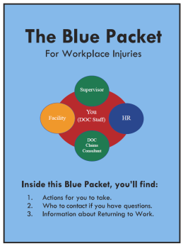
STEP 2 – THE BLUE PACKET
Step 2 - Provide the employee the “Blue Packet”
The “Blue Packet” has Actions and Information for the Employee:
Actions:
The employee’s “Injured on the job? Your first 5 Steps to your to your workplace injury”
The L&I “Activity Prescription Form” (APF) to take to their doctor
Information:
“Returning to Work after a workplace injury” brochure (800-BR005)
“Returning to Work after a workplace injury” flow chart to guide them through the process
Information for employees taking part in Transitional Duties
Notes:
Step 2 is about providing the employee with the blue packet. So what’s in the blue packet?
Well, one of the things we identified in the focus groups and in-depth interviews is how confusing the process can be. Many COs observed that in their day to day activities they have checklists for almost every aspect of their job. However, when it came to a time they experienced an injury there was no checklist to navigate them through the system.
So the “Blue Packet” has Actions and Information for employees.
The items that require action on the part of the employee are:
The employee’s “Injured on the job? Your first 5 Steps to your to your workplace injury”
The L&I “Activity Prescription Form” (APF) to take to their doctor
Information for the employee includes:
“Returning to Work after a workplace injury” brochure (800-BR005)
“Returning to Work after a workplace injury” flow chart to guide them through the process
Information for employees taking part in Transitional Duties
This is a packet that has all the necessary information for the employee to get started out right.

Slide 20
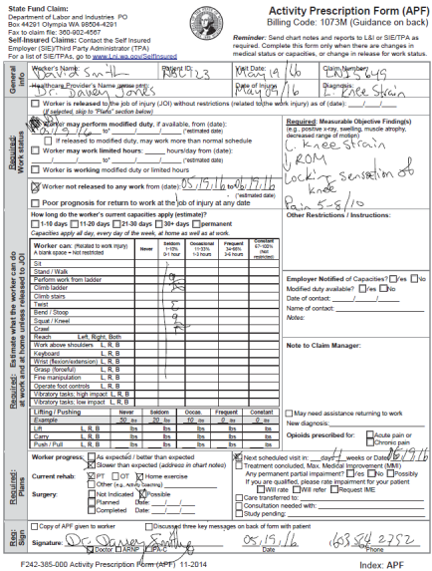
STEP 3 - MAKE SURE THEY KNOW TO SEE THEIR DOCTOR
Step 3 – Make sure they know to see their doctor
If an employee is unable to remain at work, they will need to have a release from their doctor to return.
The Blue Packet contains the APF and is the surest way to get the necessary documentation to allow DOC to offer transitional duties.
Early Return to Work is the best early intervention and the APF is the best tool to assist with this.
Notes:
Step 3 – Make sure they know to see their doctor.
If an employee is unable to remain at work, they will need to have a release from their doctor to return. And in order to participate in transitional duties they need to have a completed APF.
Remember The Blue Packet contains the APF and is the surest way to get the necessary documentation to allow DOC to offer transitional duties.
And early return to work is the best early intervention. The evidence is pretty clear on this. The best early intervention is simply offering transitional duties and the APF is the best tool to assist with this.

Slide 21
STEP 4 – CALL YOUR HR CONSULTANT
Step 4 - Call your local/designated HR Consultant
Notifying your HR Consultant helps ensures the claim starts of right and helps Day Zero Reporting.
HR is able to respond in a timely manner to offer Transitional Duties.
HR can ensure there is a clear and understandable process and the employee starts out right.
Notes:
Step 4 – Call you local or designated HR Consultant.
One of the things we know is that preventing any unnecessary delays can go a long way to preventing unnecessary work disability. And, a simple call to your local or designated HR consultant to let them know the employee had an accident/injury prompts the HR Consultant to begin their first 5 steps and follow-up with the employee if necessary.

Slide 22
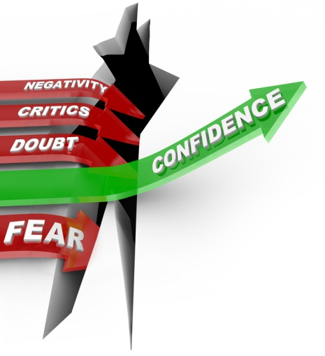
STEP 5 – PLAN YOUR FOLLOW-UP
Step 5 - Immediately plan your follow-up call with the employee
Ongoing contact is a critical success factor
If the claim is ongoing – schedule regular 5 minute check ins. (i.e. every 2 weeks) whether they remain at work or are off work.
Check in with your Staff
How are you doing?
We want you back when you are able to.
Is there anything you need?
Are you able to get your questions answered?
Listen for:
Concerns about returning to work.
Concerns about doing the job/duties.
Fear of coming back.
Avoiding daily activities.
Notes:
Step 5 – Plan your follow-up
Step 5 is about keeping them on the grid.
In order to keep employees “on the grid”, you need to immediately plan your follow-up with the employee. If they are remaining at work, check-in with them the next day and see how they are doing. Any troubles? Can they continue? If they are unable to work and are off of work, then check in with them periodically. You can simply ask them “I would like to stay in touch with you, is it ok to give you a call in a couple of days?”
By keeping them on the grid we do three of things:
First, we demonstrate care and compassion by staying in touch and letting employees know they are wanted back
Second, we make sure they are not ‘lost’ in the process or confused by anything.
And third, listen for cues that can suggest risk of work disability
When it comes to work disability, the best predictors of work disability outcomes have very little to do with the actual diagnosis. In fact the two most robust, the most reliable predictors of duration, and potential prolonged work disability are expectations and fear/avoidance.
Whether a worker expects to recover and rtw is by far the best predictor of rtw. Another way of looking at this is do they think they will be returning. Do they think they will they be successful?
The second factor is about fear and avoidance. Many workers have fears and concerns about rtw and will avoid activities and returning to work if these are not addressed.
As a supervisor, you have the unique ability to know and understand your employees. When you are following up with your employee it is important to listen for potential cues of at risk work disability. Things to listen for are:
Concerns about RTW
Concerns about doing the job or their duties
Fear of coming back
Avoiding activities in their daily life
If you hear anything like this, it is critical that you contact human resources and alert them. It is not your responsibility to manage this risk factors but because you have a role in preventing unnecessary work disability you can pay attention to the warning signs.

Slide 23
NOTES ABOUT CONTACTING THE EMPLOYEE
Contact should never involve discussing injury causation or blame.
If the worker feels you are mainly concerned about finances and not their health, this can poison the RTW process.
The worker’s general perception about the workplace and its concern for workers will influence how they respond to employer contact. (Think DOC Key Goals).
Early contact is most successful when it builds on a workplace environment characterized by a shared sense of goodwill and confidence.
Notes:
Now a few notes about contacting the employee. Sometimes supervisors express concerns about contacting employees; concerned about what to say, what not to say, “what should we talk about?” In its simplest form, you are just keeping them on the grid. You want to maintain contact, support, and care.
Contact should never involve discussing injury causation or blame.
If the worker feels you are mainly concerned about finances and not about their health, this can poison the RTW process.
The worker’s general perception about the workplace and its concern for workers will influence how he/she responds to employer contact. So think about the connection to DOC Key Goals. In a larger context this is about creating an environment that helps the employee to decide to rtw. The 2 key goals we talked about earlier are engaging and respected staff and safer operations.
Early contact is most successful when it builds on a workplace environment characterized by a shared sense of goodwill and confidence.

Slide 24
WHAT NOT TO SAY…AND SAY INSTEAD
Never say
“When are you coming back?” It tends to invoke resistance.
Instead say:
How are you doing?
Is there anything you need help with?
We are eager to have you back when you are medically ready.
Is it ok if I call you next week to check in and see how you are doing?
Notes:
The most important thing to never say or ask is “When are you coming back to work?” In our eagerness to want employees to return, there is an inclination to ask “when are you coming back?” However this question tends to have the opposite effect of what it is intended to do. Rather than show support the question of “when” tends to cause resistance or push back.
Instead, focus on saying things that convey care, concern, and support.
Things like:
How are you doing?
Is there anything you need help with?
We are eager to have you back when you are medically ready.
Is it ok if I call you to check in and see how you are doing?

Slide 25
THE BEST PRACTICES
Adopt a Culture that Prevents Work Disability.
Ensure a welcoming environment.
Get Day Zero Reporting.
Early Return to Work is KEY.
Demonstrate Care and Compassion.
Maintain ongoing contact – “Keep them on the Grid.”
Supervisor involvement – Follow the 5 Steps.
Notes:
DOC has updated their transitional return to work program with the most up to date best practices. With your support as a supervisor, DOC can achieve their objectives of engaged and respected staff and safer operations by preventing unnecessary work disability.
Adopting a culture of preventing work disability:
Ensures a welcoming environment
Expects and reinforces day zero reporting
Focuses on early rtw as a key factor
Demonstrates care and compassion
Keeps employees on the grid
And has the Supervisor complete the First 5 Steps to take following your Employee’s Workplace Injury
By following these best practices, we go a long way to preventing unnecessary work disability, while at the same time creating safer operations and engaging and respecting our staff.

Slide 26
CONTACT FOR QUESTIONS AND HELP
For more information or if you have questions about the Transitional Return to Work Program, contact:
Occupational Health and Wellness Unit
DOCOccupationalHealthandWellness@doc.wa.gov
1-888-833-3726
Notes:
For more information or if you have questions about the transitional return to work program, please contact the Occupational Health and Wellness Unit
Thank you for taking the time to listen to this web session.

