Slide 1
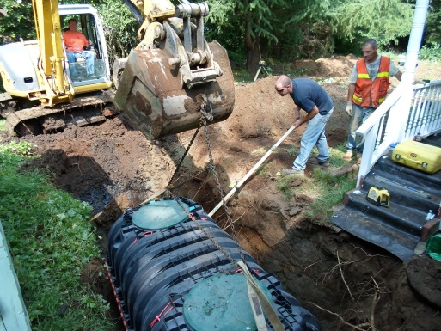
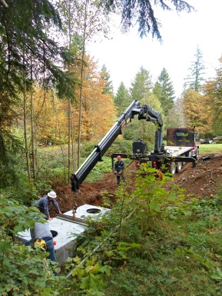
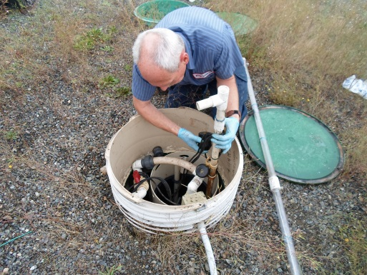
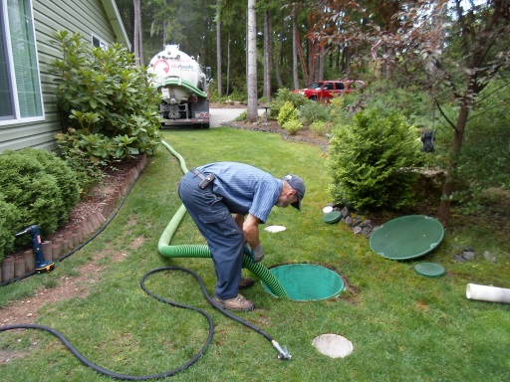
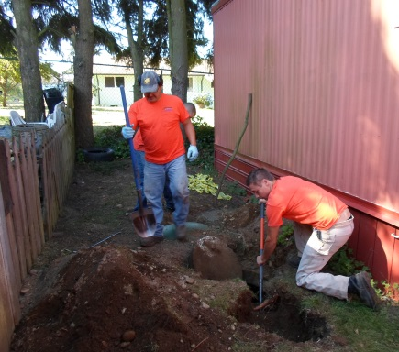

“Safety in Your Workplace”
Washington On-Site Sewage Association
“Voice of the Industry”
Pathogen Exposures in Wastewater
to Workers in the OSS Industry
Notes:
Introduction of topic to class, the speaker.
Depending on class size, the presenter should have participants introduce themselves and the industry segment they work in.
The ideal class size for interactive participation should not exceed 25.
Alternatively, this presentation with minor modification will work well as a simple presentation with limited participation up to several hundred.

Slide 2

Program Recognition
Funding and support for this project has been provided by the State of Washington, Department of Labor & Industries, Safety & Health Investment Projects
Notes:
Presenter should recognize the SHIP program as the funding source to develop this program, and the Washington Onsite Sewage Association for the deliverables of the grant milestones that included:
A literature review
Field practice and observations
PPE evaluations
Hazard assessments and field sampling in various workplaces
(These will also be discussed in more detail in upcoming slides).

Slide 3



Program Recognition
WOSSA Board Members
WOSSA Association Members
On-Site Industry Professionals
and Service Providers
Water Management Laboratories, Inc.
This training curriculum was prepared by WOSSA in collaboration with the Dept. of Labor and Industries SHIP Grant Staff. WOSSA would like to thank all who were involved in the research, writing and review of this curriculum.
Notes:
Recognition is given to the member companies that participated and were open to learn.
They were willing to have their operations evaluated in real time and without this support, this project would not have been as comprehensive as it has been.

Slide 4
Purpose of the Grant and Outcomes
To study pathogen exposures to workers in the On-Site Industry
Numerous studies have been done on wastewater workers in “Treatment Plant” situations but never in the field work that we do.
An extensive literature review was completed in the first phase
Field observations and workplace sampling were conducted in the next phase
Notes:
Discuss this slide as an overview of the program and what will be discussed…..
The first bullet point establishes why the study was undertaken.
The next is a relational point that explains that while sewage studies have been done in Treatment Plant settings, the work tasks from a safety perspective are really unrelated to the exposures that workers in OSS (On-Site Systems) encounter and while those studies have identified some exposures, they miss many of them as they relate to OSS.
Include in the discussion of bullet point three that exposures were reviewed in the wastewater industry, that many more were also conducted outside of the WW(waste water) industry and included parallels to the healthcare industry when considering the appropriate PPE (personal protective equipment).

Slide 5
Purpose of the Grant and Outcomes
Quantify the actual exposures to workers on the OSS industry.
Identify current risk mitigation with commonly used tools and PPE (Personal Protective Equipment).
Raise awareness to the exposures through education and training
Provide useful tools and recommendations to identify and manage pathogen exposures in the workplace.
Notes:
This slide outlines what are Key Learning Areas for the presentation.
Instructor should review the program and what will be discussed….. Provide specifics that they will learn in the class and what will be the take away.
i.e.: Bullet point number two – “The field study evaluated both the various work activities and the specific PPE used”.
A key discussion point later in the presentation will be, if the current PPE commonly used in the industry is, “fit for use”.

Slide 6
Quantifying the Exposures
Washington On-Site Sewage Association
“Voice of the Industry”
to Workers in the OSS Industry with field sampling and Lab Testing
Notes:
Pathogen exposure in wastewater has largely been identified through work in large wastewater treatment plants.
Over 100 known virus’s and pathogens have been identified.
In the literature review at the start of the project, we found no documented evidence of a study specific to the actual exposure of pathogens, evaluation of best practice work procedures or a related review of “fit for use” issues with typical PPE issued and used (or not) by the OSS industry service providers.

Slide 7
Purpose of the Grant and Outcomes
Quantify the actual exposures to workers on the OSS industry
Field sampling was done in a variety of workplace settings with several methods.
Three different labs with same protocols were used to ensure valid results.
Notes:
This slide reveals the “purpose statement” in the presentation as to “why’ the study was done.
While work has been done on sewer treatment plants, to the project teams knowledge, and based on the literature review, this study for OSS and worker exposure has never been done in the United States.
Blanks, cross lab sample testing, duplicate samples to same labs were some of the techniques used to validate results and will be further detailed in coming slides.

Slide 8
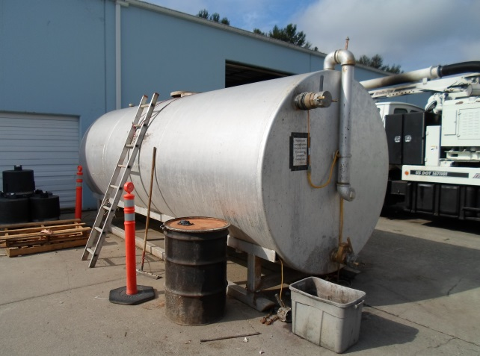
Purpose of the Grant and Outcomes
Sampling was done on:
Offices, Shops, Storage areas, Equipment, Clothing, Cell phones, Smokers, Chew, Truck Cabs and more.
Pumping, jetting, system repairs
Wastewater in tanks
Sewer lines
Drainfield components
Notes:
These examples represent most, but not all common tasks and work areas that service providers perform on OSS.
Sewer work that is also done by the same service providers were reviewed in the field study.
Depending on the industry segment matrix of attendee’s, the presenter should be prepared to go with the flow and discussions of the group and to encourage interactive discussion with work tasks, not specifically reviewed in the presentation but that can be related.

Slide 9
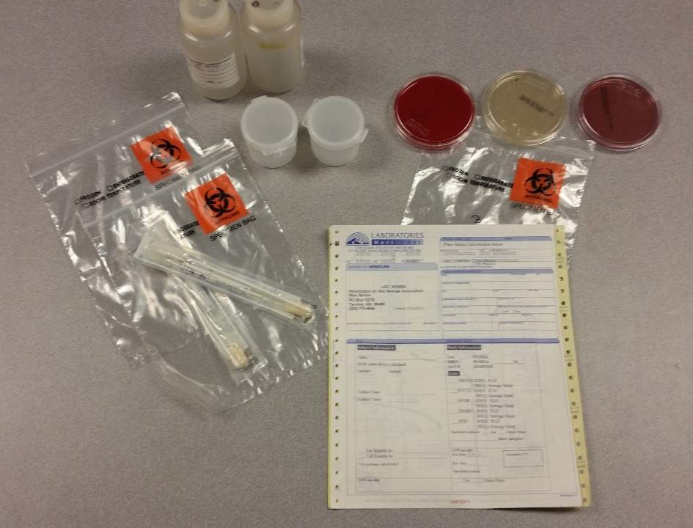
Purpose of the Grant and Outcomes
Laboratory testing procedures:
Fluid testing.
Contact surface /
swab testing.
Aerosol / vapor testing
Controls
Testing laboratories:
  Laboratories NW (MultiCare)
  Water Management Lab
  WSU Food Safety Lab
Notes:
Different pathogens are identified using different lab protocols.
This slide also can be used to discuss methods used in field sampling and the utilization of three labs to evaluate the samples and were used to back check testing procedures against one another.
They were:
Plate tests for aerosols and splashing
Liquid samples drawn from septic trucks, storage and pump tanks
Swab sampling on contaminated contact surfaces

Slide 10

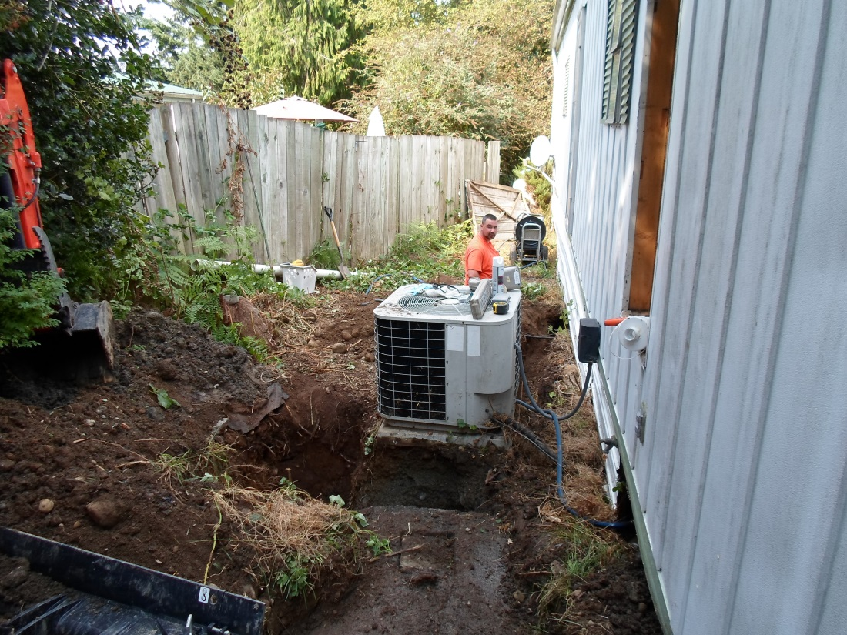
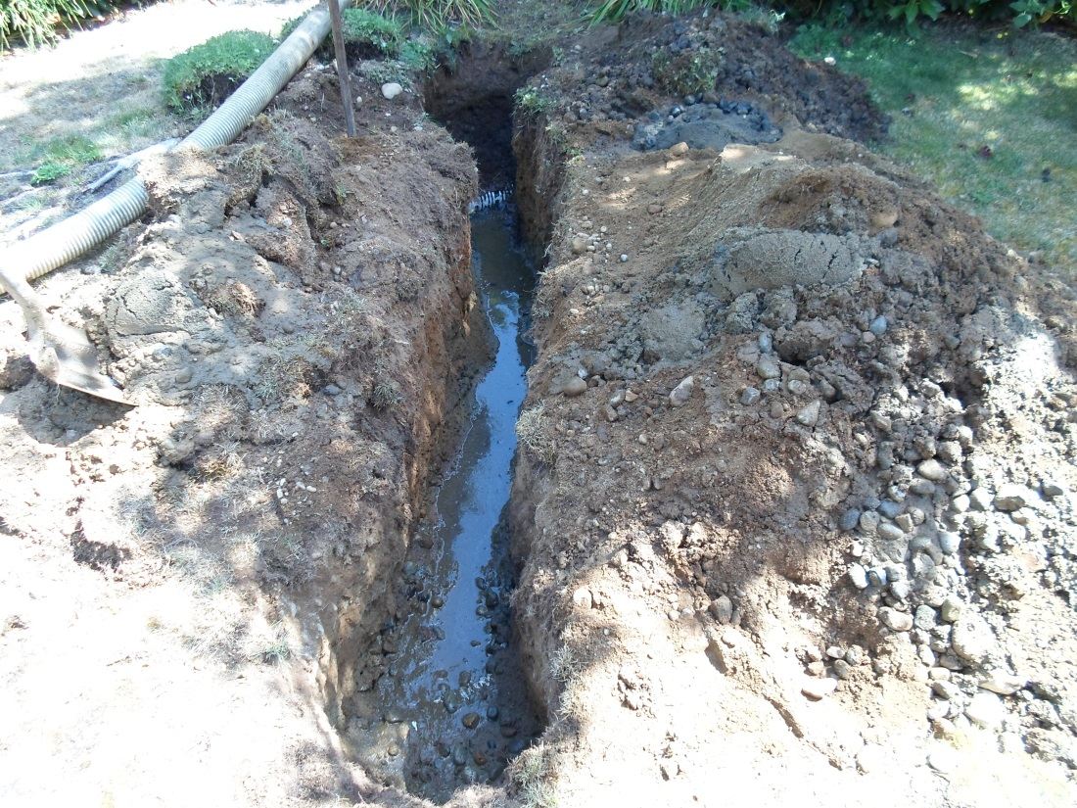

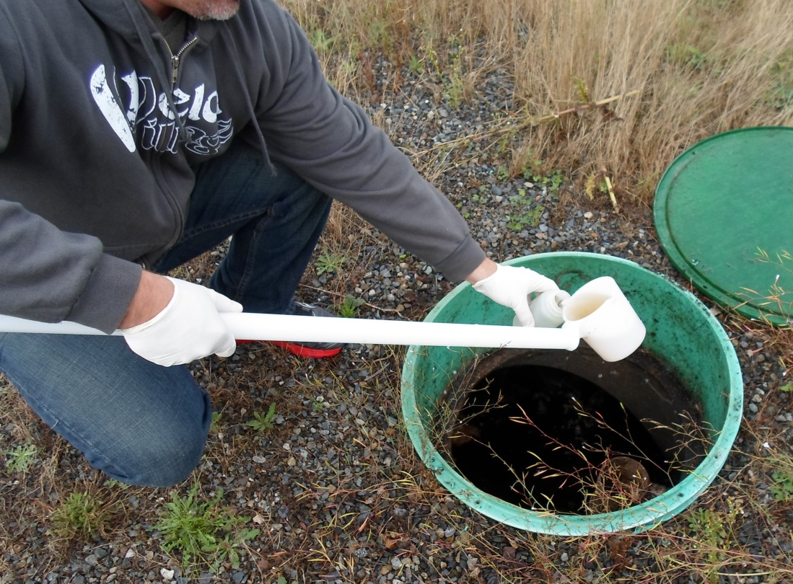
Fluid Testing
Notes:
Fluid samples were taken to represent common work or wastewater handling procedures/exposures including:
Repairs
Storage/transfer
Standard maintenance and pumping
Typical residential and commercial sewage

Slide 11
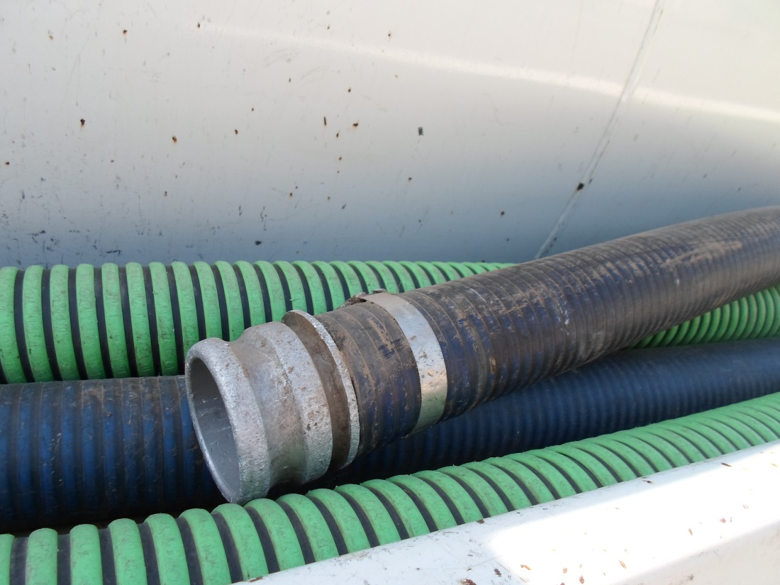
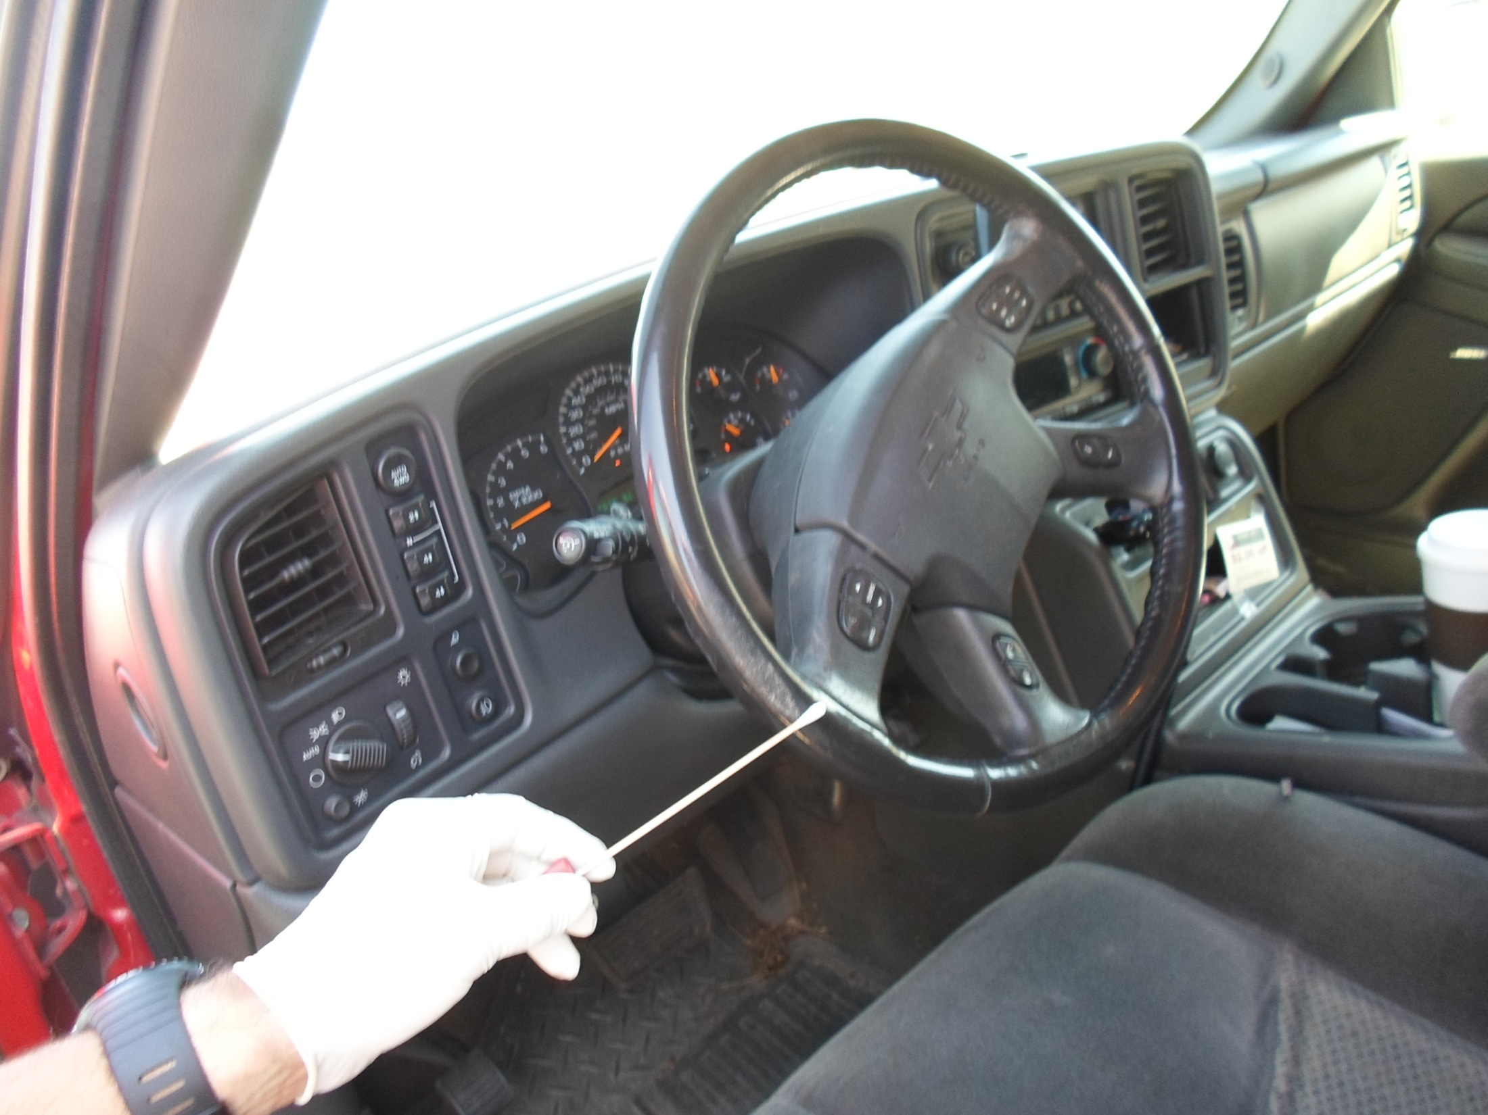
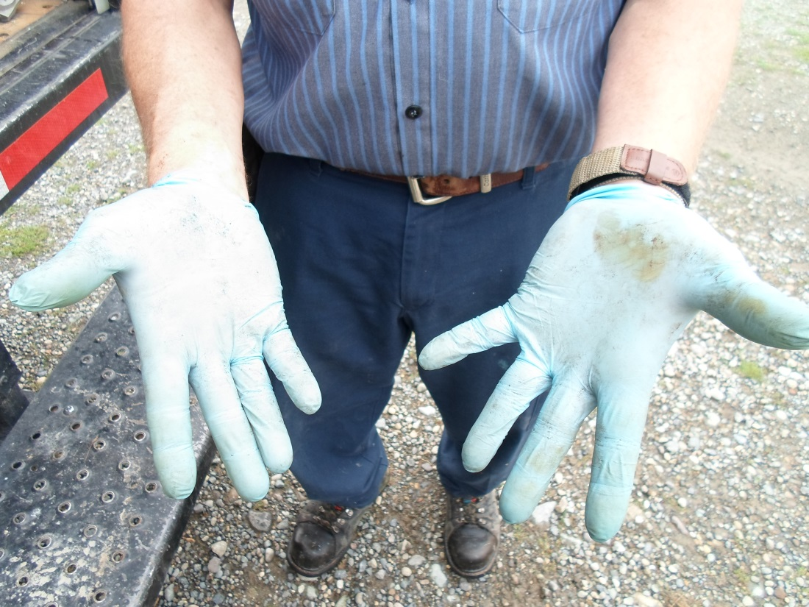
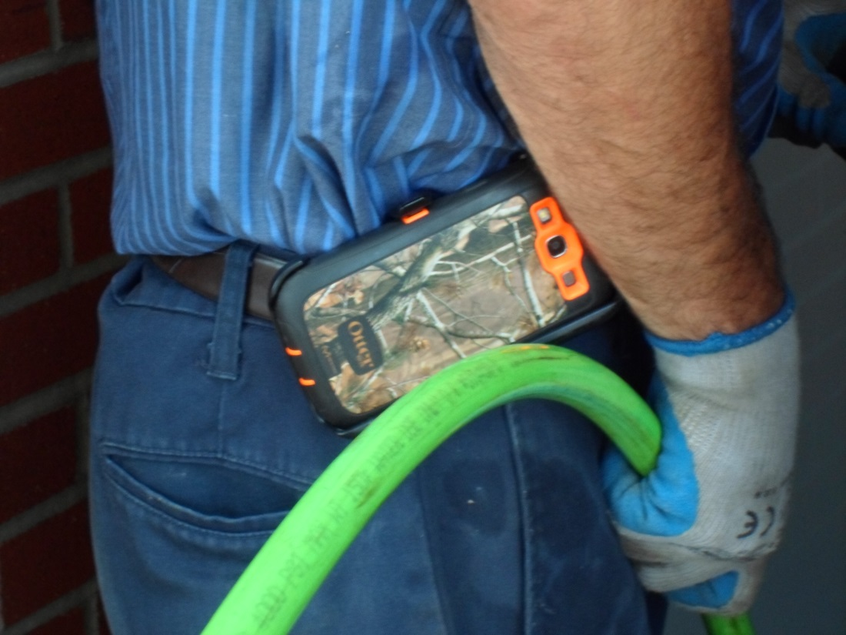
Contact Surface Testing
Notes:
Contact surface testing was done to understand both the level of contamination and how it migrated through the work process to advance exposures or minimize them.
Non industry equipment (top right picture) was surface contact tested as a control for contact testing of other work activities and equipment.

Slide 12
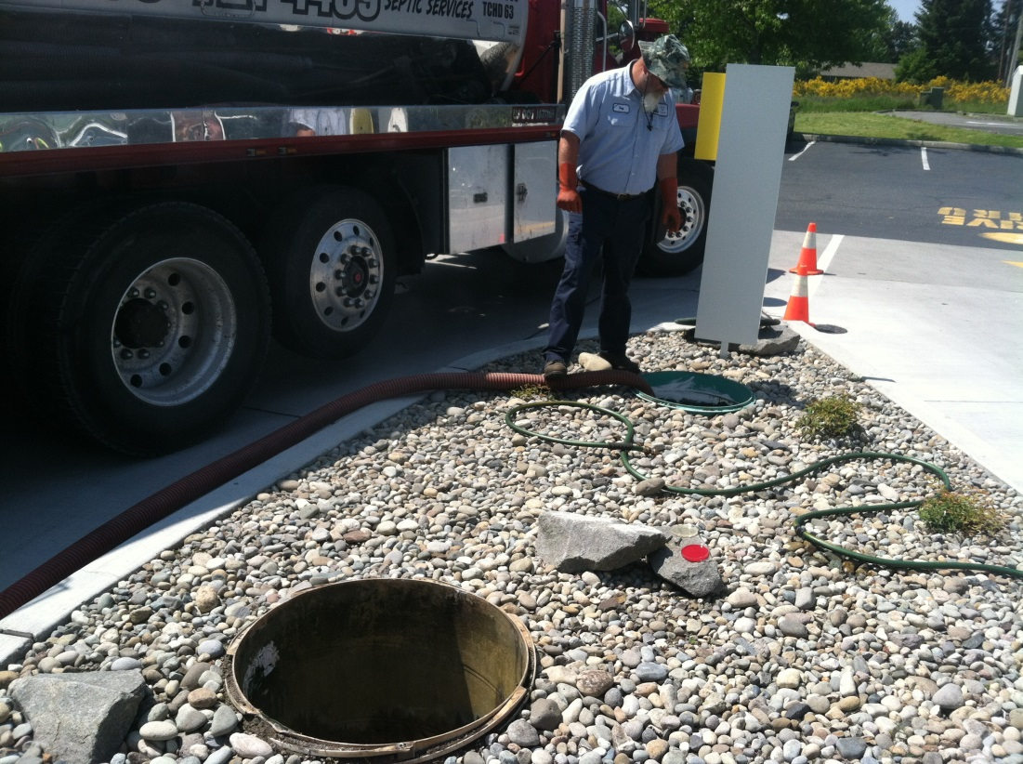
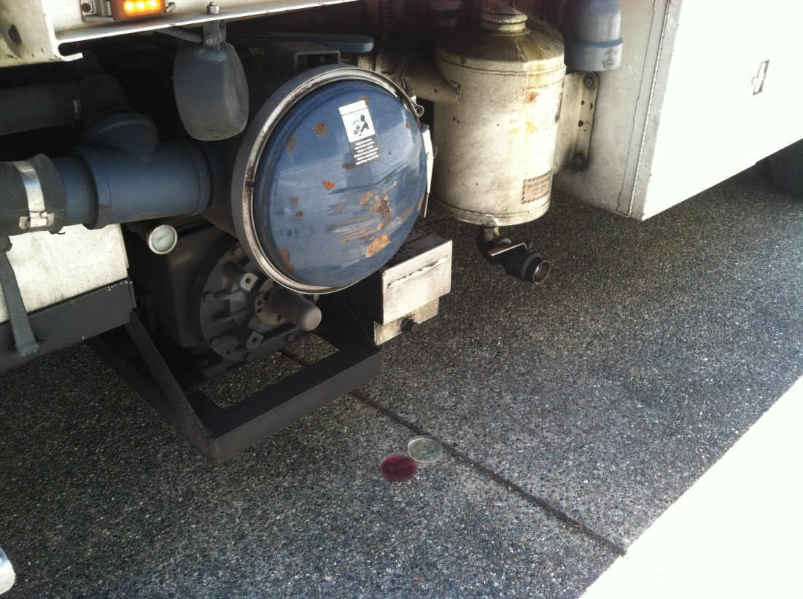
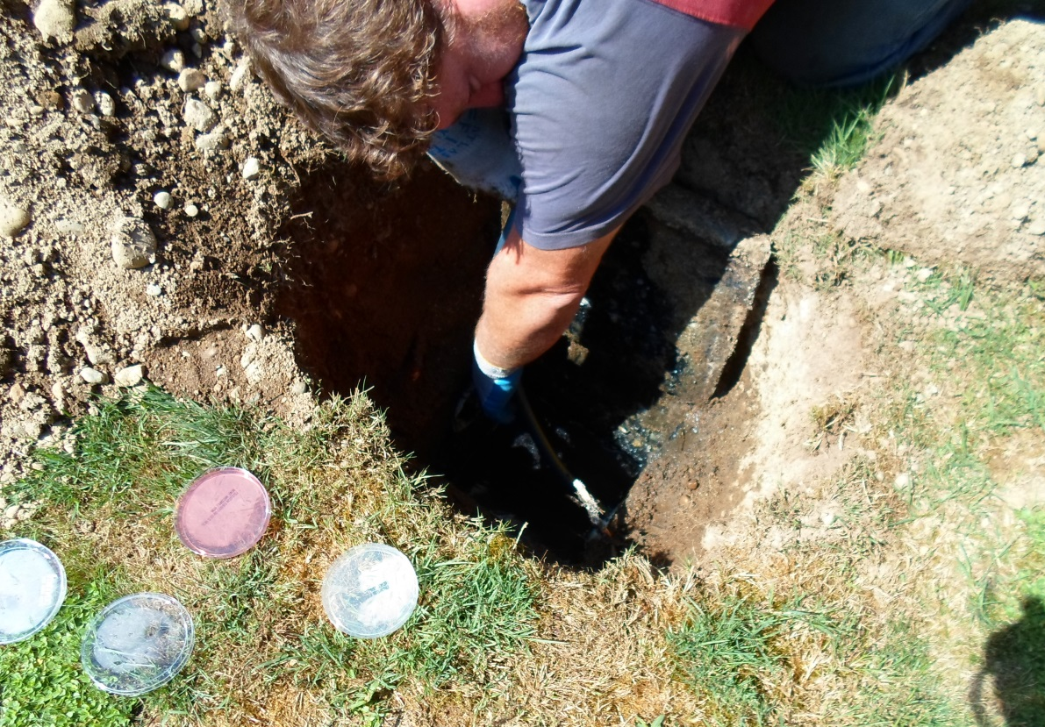
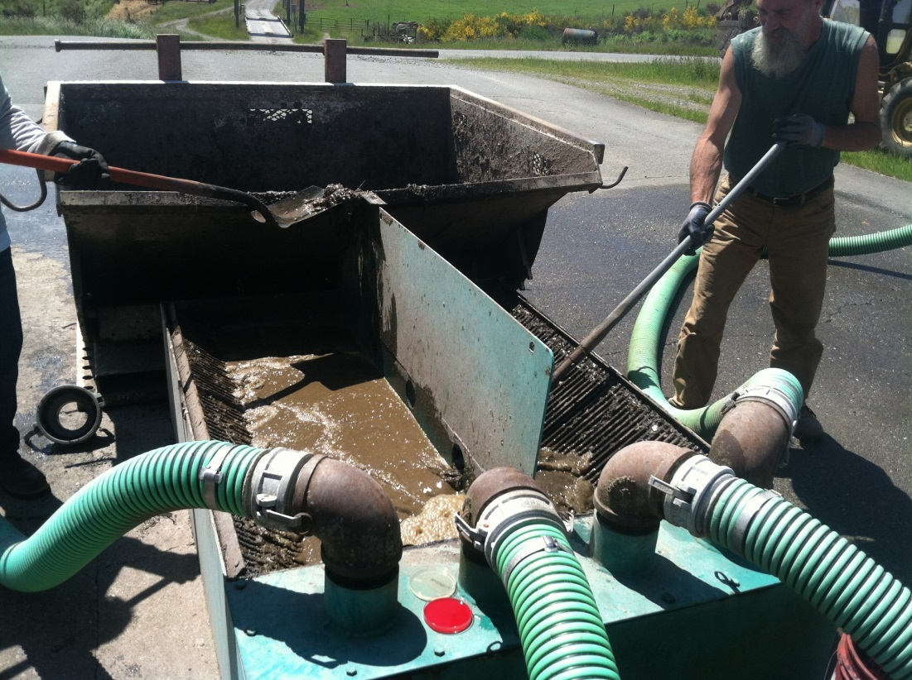
Aerosol Testing
Notes:
Most common vectors of exposure were:
Direct Contact
Splash back
Aerosols….Contamination and the level of exposure in aerosols created by work activities have been previously unrecognized to the level demonstrated in field sampling.
In addition to confirmation of exposure near the workplace activity, we also found positive plate tests as far as 30 feet from equipment.

Slide 13
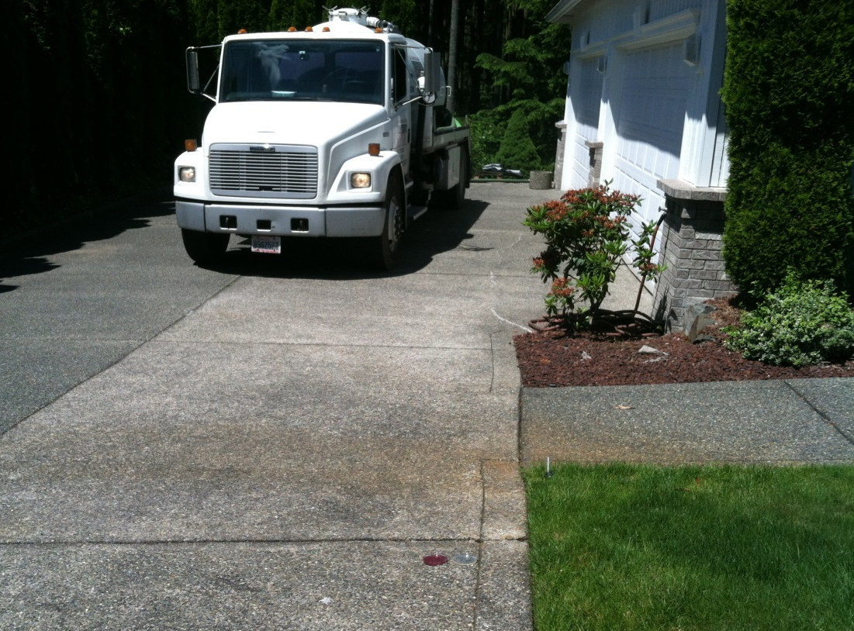
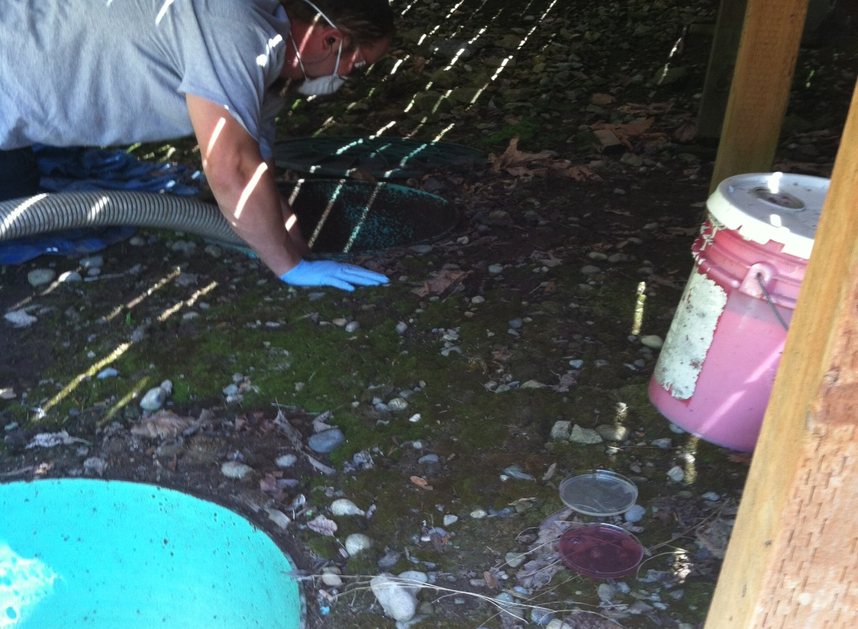
Field Sampling Controls
Testing Controls
Quality Control Blanks
  Trip Blanks
  Field Blanks
  Duplicates
  Split Samples
Environmental Control
Notes:
Several methods used to ensure the validity of the sampling and testing were established and used throughout the study.

Slide 14
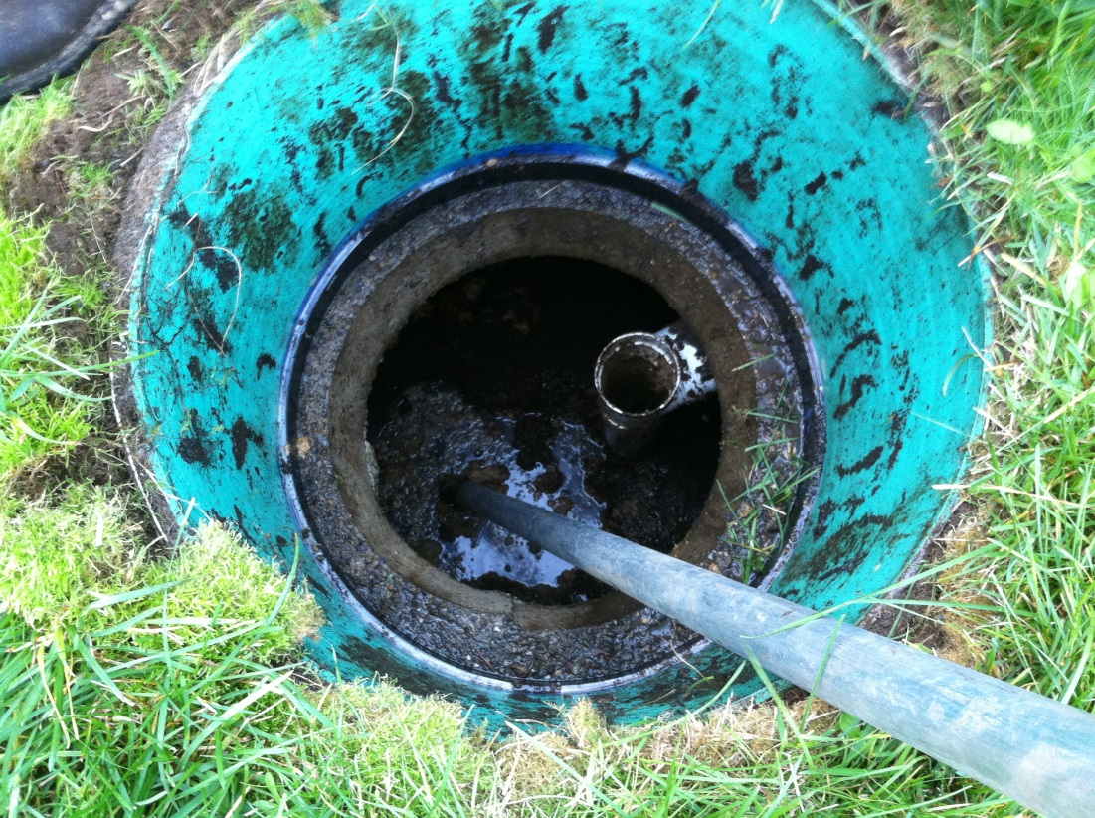
Purpose of the Grant and Outcomes
What we found….
ALMOST
EVERYTHING IS
CONTAMINATED!
Notes:
Although it should be obvious, the field observations of service providers demonstrated that either they are not aware of the exposures or they have rationalized the exposure to minimize the perceived risk.

Slide 15
Purpose of the Grant and Outcomes
We also know that …
You are NOT SURPRISED!
Up until now ... You know that it’s DIRTY!
Today, you will learn how it’s UNHEALTHY!
Notes:
This slide expands on the previous slide’s perception of the exposure.
Most commonly, use nitrile gloves along with the use of over gloves by the service provider are typically focused on keeping sewage off the hands, but it was apparent the level of awareness to pathogen exposure was not in consideration of barrier protection for exposure mitigation.

Slide 16
Field Sampling Controls
Laboratory results
Mixed Bacterial flora
Bacillus
Gram negative Rods
Gram positive Cocci
Aeronmonas Hydrophila
Aeromona Caviae
Streptococcus
Fungus
Yeasts
Enteric type gram negative rods
Staphylococcus, Coagulase Negative
Gram positive Coryneform rods
Aeromonas Sobria
Escherichia Coli O157:H7
Fecal Flora
Spore forming gram positive rods
Propionibacterium gram positive rods
MRSA
Diptheroieds
Molds and Rare Molds
Notes:
This list provides a level of detail of many specific pathogens and information previously identified in our industry. It also adds these following “new” players to the list that were not known.
MRSA
Molds and rare molds
Fungus/Yeasts
Specifics on E.Coli O157-H7l
In the field studies, samples tested positive for a bacterium family at the dump site directly related to Chlamydia. These were captured on a plate test from aerosolized wastewater during the truck unloading sequence…

Slide 17
Where Do We Go from Here?
Washington On-Site Sewage Association
“Voice of the Industry”
General Management Principles of
Safety in the OSS Industry
Notes:
Safety begins as process management. While we don’t always fall under a specific set of rules and guidelines, it appears that for this issue there is much that can be gleaned from Blood Borne Pathogen rules and methods.
Small businesses are obligated to ensure a safe workplace under the “General duty” clause of both WISHA and OSHA.
Having an APP (accident prevention plan), PPE evaluation and use and a commitment from management to protect workers health is a minimum.

Slide 18
What we are going to talk about today
General Management Principles of Safety
Discuss Safety Management vs Safety Programs
Characterize Accidents and Illness’
Management Tools for Risk in Your Workplace
Notes:
This and the next slides sets the detail of content for the rest of the class. These are specific “learning objectives” of the training resource.

Slide 19
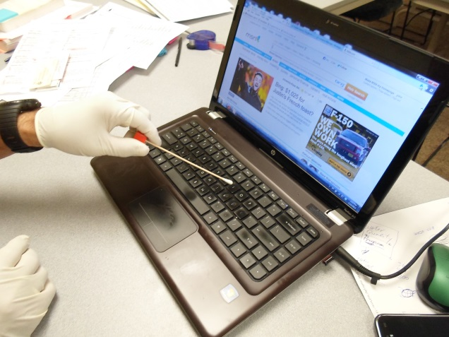
What we are going to talk about today
Pathogen Exposures in Wastewater
Work activities with Greatest Exposure
The Best Things You Can do to Protect Yourself
Notes:
This and the next slides sets the detail of content for the rest of the class. These are specific “learning objectives” of the training resource.

Slide 20

Overview of Course Handout & Materials
Power Point presentation
WISHA Occupational Blood Borne Pathogen Summary
Personal Protective Equipment (PPE) Guide
Eye and Face Protection
Hand and Arm Protection
Foot and Leg Protection
Torso and Body Protection
Job Safety & Hazard Assessment tools
Notes:
The presenter should review the outline of the handout materials to orient the class participants to the materials to be used in the presentation.
It can also be referenced as a future basis for use as a safety management plan.

Slide 21
Why Should You Care?
“Our Goal is to give you information
that helps you stay healthy and protect others while you’re working…”
Question: What is the difference between….
“Managing safety”
Owner Level….It has to do with a developing a safe
“Company Culture”
“Working safely”
Personal Level…. Your decisions in Practice
Notes:
Management of safety is a process that looks at all elements: Safety, Health, and Environmental issues in the workplace.
It should be stated that “working safely” is both an activity and behavior based process in the workplace.

Slide 22
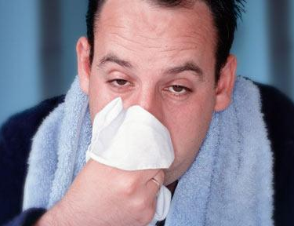
Learning the “Lingo”
Terms Used by the On-Site Industry:
Baptism by Sewage (drenched)
Swim Jobs
Digester/Poop Flu
Notes:
These are a few terms used by industry:
Swim Jobs = larger release of sewage in the crawlspace of a house, under a deck or anywhere that access is limited. Service providers suit up in rain suits, duct tape (not watertight), and dive in.
Digester/Poop Flu = An industry term used by those who are new to the industry. Common flu like symptoms that resolve in a week to ten days.
Baptism by Sewage = Obvious, but any sudden release of sewage from a truck, storage or even the release of a clogged pipe with sewage backed up to the second floor of the home.

Slide 23
Learning the “Lingo”
Terms Used by Healthcare Providers:
MDROs (Multi-Drug Resistant Organisms)
Transmission Vectors
Direct and Indirect contact
Infective Dose
OPIM’s (Other Potentially Infectious Material)
Notes:
MDRO’s will come up later in the presentation along with the discussion on MRSA that was found in sewage.
Common transmission vectors are direct immersion, splash back’s and aerosols through cuts, abrasions and inhalation.
Infective dose is another important element as it varies, there will be several slides that address this later in the presentation for survival in soil, ground water and surface water of the various pathogens known and found.
OPIM: In context to the Blood Borne Pathogen rules under OSHA or local State rules, This “cover” language may have a direct or indirect application to rule application to the On-Site Industry, as it may be applied. Other presenters should review the BBP rules for a broader understanding.

Slide 24
Learning the “Lingo”
Terms Used by Labor and Industries:
Job Safety Analysis (JSA)
Personal Protective Equipment (PPE)
Confined Space Entry (CSE)
Notes:
JSA’s are critical tools for task assessment. The participants will work through both abstract examples of JSA application as well as review basic application of JSA techniques for specific job tasks by industry segment for Designers, Regulators, Installers, O&M inspectors and Pumpers.
PPE: Self explanatory but many employee level participants may not be familiar with the “lingo” of “Personal Protective Equipment”.
CSE (confined space entry) is an important part of the discussion for this program in particular to “supplied” air to repairs in a septic tank which is grossly contaminated. By following the standard CSE procedure, the likelihood of the creation of contamination of aerosols actually creates another hazard that isn’t always recognized that must be mitigated.

Slide 25

How do we compare to other work settings?
Notes:
Transition slide: In the development of the program and PPE fit for use issues to the known and discovered pathogen exposures, the health care setting provided the closest parallel to “best practice” for PPE mitigation procedures.

Slide 26
UNIVERSAL PRECAUTIONS
In 2007 A Guideline for Isolation Precautions: Preventing Transmission of Infectious Agents in Healthcare Settings was published by the CDC
It addressed “Best Practice” techniques applied to the Health Care Industry and WOSSA has reviewed parallels to the benefit for wastewater workers in the On-Site Industry …
Notes:
Universal Precautions in health care settings, establishes “best practice” for PPE and procedures in health care and has cross over applications to the Onsite Industry with common pathogen exposures and vector pathways.

Slide 27
UNIVERSAL PRECAUTIONS
Some of the similarities for both industries :
Sources of Infectious Agents
Bio-aerosols and airborne transmission of Infectious agents
Transmission vectors:
  Direct/Indirect/Aerosol/Droplet
Mobility exposures to others via clothing
Notes:
Provides speaking points for cross over parallels. However, a main difference is that by the time a health care workers is interacting with a patient, they have a lot of information about the person, their illness, infection, care program, special circumstance, and have a standard of care to follow.
In the OSS industry, SP (service providers), have the “x-rays”(As-built), but don’t have the lab results. They never know what they are getting into, because they often never speak to the system operator.

Slide 28
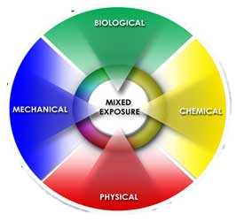
WISHA – Rules of the road
Chapter – 296-823 Occupational Exposures for Blood borne Pathogens …or OPIM’s
Occupational Exposures
Exposure Incident
Parenteral Contact
Notes:
This is the introduction to the discussion and rationalization of the relationship between BBP (Blood born pathogen) rules and the application to similar exposures in the Onsite Industry.
Part of this discussion takes into consideration that there is currently no distinct place for our industry to “be” under WA. state rules and makes the case that this could be an area that would be used in the event of serious workplace injury/loss.

Slide 29
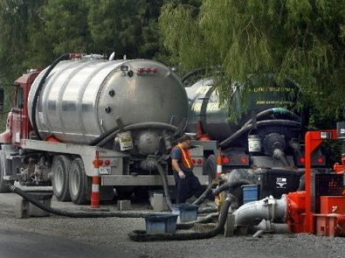
WISHA – Rules of the road
“This chapter applies to you if you have employees with occupational exposure to blood or OPIM, even if no actual exposure incidents have occurred”
Notes:
This continues the discussion taking in light of the fact that it likely be sometime before any consideration is given to changes in rulemaking and reinforces the case that this could be an area of rule that may be used in the event of serious workplace injury/loss.

Slide 30
WISHA – Rules of the road
Chapter – 296-823 Occupational Exposures for Blood borne Pathogens and Definitions
Occupational exposures means “reasonably” anticipated skin, eye, mucous membrane, or parenteral contact with blood or OPIM that may result from the performance of an employee’s duties
Notes:
The language in the existing BBP rule, in our view, has the potential to expand the scope of employer beyond the healthcare industry. The broad based language and catch all phrasing of OPIMs is something employers should take seriously.

Slide 31
WISHA – Rules of the road
Chapter – 296-823 Occupational Exposures for Blood borne Pathogens and Definitions
“Other Potentially Infectious Material”
  Human body fluids: Semen,……. any fluid visibly contaminated with blood, and all body fluids in situations where it is difficult or impossible to differentiate between body fluids
Notes:
The descriptors extend unknown or unforeseen situations for all body fluids where the employer is unable to distinguish any differences between body fluids. Certainly the case in a septic tank.

Slide 32
Real life On-Site examples from Washington
Sewage in eyes – Both with “pink eye” needing to go to the Emergency Room
2 LNI Claims for “Pink Eye” over $4,000 in paid claims – follow on infections with Sty's
MRSA infection in nose from Aerosols working in OSS with a one week hospital stay
Giardia from an open wound exposed to sewage
Case of E-Coli & Hepatitis
Employees’ less than 6 months on the job…
Notes:
These examples of real life work related illness’ support the application of the BBP rules to the industry when biologic exposures are included in the JSA’s if done and selection of appropriate PPE.

Slide 33
WISHA – Rules of the road
Chapter – 296-823 Occupational Exposures for Blood borne Pathogens and Definitions
Exposure incident means a specific eye, mouth or other mucus membrane or non-intact skin or parenteral contact with blood or “OPIM” that results from the performance of an employee’s duties.
Examples of non-intact skin include skin with dermatitis, hangnails, cuts, abrasions, chafing or acne
Notes:
Noting the examples in the previous slide, exposures and exposure incidents in the industry, the language continues to support the BBP rule applicability in the vacuum of any other more specific rule application.

Slide 34
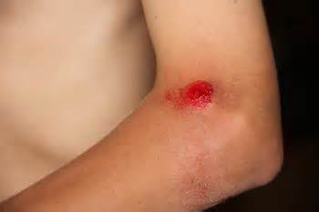
WISHA – Rules of the road
Chapter – 296-823 Occupational Exposures for Blood borne Pathogens and Definitions
Parenteral contact occurs when mucous membranes, or skin is pierced by needle sticks, human bites, cuts or abrasions
Notes:
Initially, parenteral contact (needle sticks in particular) were not specifically applicable. However, additional information on job tasks (Pump out of public facilities or remote sites like pit vaults at heavily used trailheads), were subject to dumping of used needles. We heard one story of a pump truck operator in this situation who while pumping out a tank, had a needle poke through his hose and penetrate his hand. We also were told of all these types of materials that would be observed on the “trash gate” at the dump sites, including used condoms and the like.

Slide 35
WISHA – Rules of the road
Chapter –296-823-100 – Occupations
Doctors/PA’s, Nurses, Dental Hygienists (and others)
Housekeepers in Hospitals
Nuclear medical technologists
Fire fighters and workers in laundries that service them
Employees that handle or pick up regulated waste
Notes:
This slide points out that even within the existing BBP rule that affiliated industries and workers are intended to be included in the intent of the rule (firefighters, housekeeping staff).
“Regulated” waste needs definition. While raw sewage from septic's is not a placarded waste (DOT), its collection and disposal is regulated by the state DOH and LHJ’s with tracking mechanism’s in place.

Slide 36
WISHA – Rules of the road
Chapter –296-823-100 – Occupations
Definitions : Regulated waste is any of the following:
  Liquid or semi-liquid blood or other potentially infectious material (OPIM)
  Items that are caked with OPIM and are capable of releasing these materials during handling
  Pathological and microbial wastes containing OPIM
Notes:
A clearer definition of regulated waste as defined in rule, strengthens the relationship to the OSS industry. In our industry situation, items are contaminated hoses, sampling tools, shovels and other hand tools, jetters etc.

Slide 37
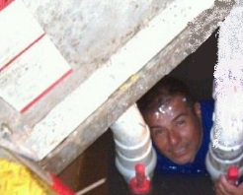
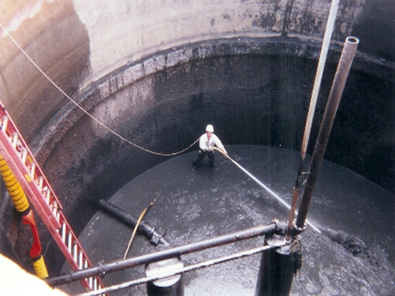
Where we Work…..
Residential systems
Commercial/Schools
Community systems
Sewer jobs
Digesters
Notes:
Transition slide to bring the discussion back to focus on the Onsite Industry.
Note: The presenter may point out the service provider in the CSE in the top picture:
Limited egress
Safety glasses on his forehead
No hand protection
No situational awareness – (he’s smiling about how “tough” he must be to be down here for the picture)

Slide 38
What are you working in ?
You JUST Don’t KNOW!!!
BUT………
Public beaches are closed when E.Coli levels hit
> 126 /100 ml
Raw Sewage in our field sample studies were commonly
> 160,000 /100 ml
Notes:
Relational slides that brings home the point of public health decisions and the gross contamination of raw human waste in septic tanks.

Slide 39
Who Manages us?
State Board of Health
Local Health Jurisdictions
What is their mission?
  Evaluate and manage risks to the environment and public health from OSS. In areas where increased risks are identified, LHJs determine the appropriate management action
Notes:
Discussion on Agency interaction and responsibilities.

Slide 40
Blackwater vs. Greywater
Parameter | Greywater | Blackwater
BOD₅ | 63 | 37
TSS | 39 | 61
Nitrogen | 18 | 82
Phosphorus | 70 | 30
Flow | 60 | 40
FC (#/100 ml) | 1,000,000 | 1,000,000
Notes:
Key focus is on FC numbers at the bottom of chart.
Fecal’s in Greywater and Blackwater are at one million.

Slide 41
Who Manages us?
Thornton Creek Bacteria Study
Public warned to stay out of Thornton Creek due to high bacteria levels; based on an intensive study done by the City of Seattle.
We recommend avoiding contact with water from the following creeks: John's Creek, Juanita Creek, Ravenna Creek, Idylwood Creek, and Thornton Creek.
Notes:
Reinforcement of the discussion on the public health issue for unprotected exposure of the public vs the typical and increased exposure frequency of wastewater workers in the Onsite Industry.

Slide 42
What should you do First?
If you’re the owner of the business...
Create a simple outline of your Accident Prevention Plan (APP)
Use the KISS method when approaching this task…
Involve your workers in workplace safety and health awareness and identification.
Give new employees job safety orientation and provide the personal protective equipment they need.
Notes:
Begins the discussion of the APP and employer responsibilities under OSHA/WISHA for employers.
This discussion also sets the stage for the tasks and accountability of the owner/manager to provide a safe work environment under the rule.
Workplace accidents usually have immediate consequences for being stupid, Workplace illness are incremental and creep up over time…can be unrecognized symptomatically, and if the employee’s don’t know what to look for, may lay the cause off to something else, only to have it repeat with a different pathogen exposure in the future.

Slide 43
The WOSSA WAC
If you’re the employee of the business….
Willingness … To take personal responsibility for your safety, your family and the homeowner!
Awareness … To pay attention to the tasks at hand!
Common Sense … If you figure it out ahead of time, its usually pretty easy to do it without increasing your exposure or getting sick!
Notes:
The “WOSSA” WAC (play on words to the Washington Administrative Code (WAC)
It is the law, but it makes sense to not put ourselves at risk unnecessarily
Everyone's responsible for their own safety, but in a company, Sr. mgt needs to “Walk the Talk” and ensure enough resources (staff, time and $$) are available to make it happen (enabling behavior).
Working in raw sewage without PPE of any kind (gloves).
a. Working with PPE’s that are not designed to protect you (sunglasses with no side shields for splashing).
b. Rinsing off equipment or dumping samples on the ground.
c. Entering a tank.
4. While your employer is responsible for certain aspects of Safety Management and reporting, you are personally responsible for your safety. In every (99.9%) accident or injury, the person involved made a conscious decision to accept a higher level of risk or demonstrated an unsafe behavior. Workplace safety is all about “Transfer of Control” in a defined risk situation. Ultimately, if you are doing the job, you have all the control and final say.

Slide 44
Understanding the Difference?
Workplace accidents and Illness’
  Your APP plan identifies them to the workplace
  Include them in your safety orientation with new employees
  Use them in your safety meetings:
    Tailgate, Weeklies, Managers
Notes:
If you don’t have a written plan, you’re not going to be nearly as effective at managing workplace safety, seeing results and building confidence that a safety attitude permeates your workforce at all levels.
Awareness programs and posters are good, but without a foundation, they lose focus pretty quickly.

Slide 45
Why Do Accidents/Illness’ Happen?
1. Rushing
  Not replacing compromised PPE
  Eating on the go…
2. Eyes not on Path
  Slips, trips and falls
  Doing too many things at once
3. Eyes not on Task
  Impact injuries in a contaminated environment
  Pay attention to the task at hand
4. Line of Fire
  Exposure to sewage by “splash back”
  Less obvious is line of fire by “aerosols”
Notes:
With a safety plan in place we next need to consider why accidents happen.
Shows the relationship between outcomes and four unsafe behaviors: Root cause of accidents:
Eyes not on Path
Line of fire
Eyes not on Task
Rushing or hurrying

Slide 46

Remind Everyone…….Everyday!
Why Do Accidents/Illness’ Happen?
Notes:
Impact slide…
This is used to challenge the general perception of industry workers that “it will never happen to me”.
Other topical discussions here would allow for safety lapses for:
Appropriate eyewear
Face mask
These discussions should avoid being judgmental but intended to introduce a change in the thought process and approach to safety and mitigation by the class participants.
Ask the participants what they think is going on here? How do these things happen?

Slide 47
How Does Illness OTJ Happen?
1. Unaware of exposures
  Not replacing compromised PPE
  Eating on the go…
2. Positive reinforcement for negative behaviors
3. Line of Fire
  Exposure to sewage by “splash back”
  Less obvious is line of fire by “aerosols”
Notes:
With a safety plan in place we next need to consider why accidents happen.
Stress the motivation discussion point in number 2. : “I’ve done this a hundred times and nothing ever happened”.
Note that accidents can also occur by a combination of more than one element noted in the speaking points

Slide 48
Claim Received Year | 2001
Accident Type | Number of Claims | Incurred Costs Total | Incurred Costs Average
BODILY REACTION | 9,273 | $ 103,997,796 | $ 11,215
CONTACT ELEC/TEMP/TOXIC BODY | 6,634 | $ 18,925,539 | $ 2,853
FALLS | 18,691 | $ 226,221,360 | $ 12,103
HIGHWAY MOTOR VEHICLE | 2,743 | $ 45,945,370 | $ 16,750
OVEREXERTION | 35,993 | $ 405,958,497 | $ 11,279
STRUCK BY OR AGAINST | 49,183 | $ 165,825,332 | $ 3,372
CLAIM COUNTS AND COSTS BY ACCIDENT TYPE
Notes:
Statistical discussion is to the cost of accidents.
It’s real, it changes your risk/rate category and in small business’ can have a significant impact to work capacity if 30% of your workforce is unavailable because they are sick and there are only three of you.

Slide 49
CLAIM COUNTS AND COSTS Z16 INJURY SOURCE
Claim Received Year | 2005
Injury Source | Number of Claims | Incurred Costs Total | Incurred Costs Average
INFECTIOUS AGNT | 686 | $ 1,238,887 | $ 1,806
LIVE ANIMALS | 1,506 | $ 3,324,104 | $ 2,207
STAIRS/STEPS | 1,515 | $ 8,462,197 | $ 5,586
TANKS/BINS | 570 | $ 3,659,209 | $ 6,420
Notes:
Highlight ‘Infectious Agents”

Slide 50
CLAIM COUNTS AND COSTS Z16 INJURY SOURCE
Claim Received Year | 2005
 | Number | Aggregate Amt | Avg per Claim
LADDERS UNS | 312 | $ 1,610,948 | $ 5,163
PRESSURE LINES | 353 | $ 2,291,970 | $ 6,493
NONPOWER KNIFE | 4,420 | $ 3,778,130 | $ 855
NONPWR TOOL | 1,937 | $ 8,568,883 | $ 4,424
SHOVEL/SPADE | 352 | $ 2,061,306 | $ 5,856
Notes:
These types of accidents when coupled with biologically contaminated equipment will make matters worse and potentially complicate the accident to a higher cost threshold for your risk exposure.

Slide 51

Safety “Management” vs. Safety “Programs”
What do you think this means?
  Safety Management breaks down management as a process
  Looks at three elements:
    People
    Planning
    Control
Notes:
Safety is not a black art, but a measured way to effectively implement this
activity into the workplace and workflow.
Just like three legs of the stool: people planning (activity) and control(of the
risk), they all support each other. If one is missing, sooner or later the stool will
tip over.

Slide 52
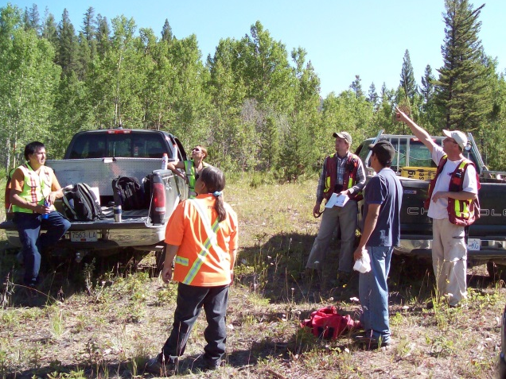
Safety Management
  This approach puts them in context of ways to create a company “Culture” considering:
    Safety Issues
    Health Issues
    Environmental Issues
Notes:
Safety issues: Communication, Hazard Identification in the workplace, mitigation (slips, trips & falls, back injury).
Health Issues: Tend to be cumulative long term or an end result (long term impact of Hepatitis infection).
Environmental Issues: Identification of critical exposures (spills, contamination).

Slide 53
Safety Management
  If Safety “Management” is the Warehouse,
  Then “Safety Programs” are the Delivery
  Trucks.
  Programs are used to focus workers attention on specific issues…
  Establishing the company “safety culture”
  Team building / Training
  Focus safety issue
Notes:
Safety “tailgate” meetings are very common, but they do not replace a well structured and thought out Management Plan.
It is very common in the OSS and small business community to do focus meetings, like “tailgate”, and think this is your “safety management program”, but it lacks the depth of management planning.

Slide 54

Safety Management
  Describe in your company “Culture” in two words……
  Needs improvement
  Pretty good
  Comprehensive
Notes:
Safety issues: Communication, Hazard Identification in the workplace, mitigation (slips, trips & falls, back injury)
Health Issues: Tend to be cumulative long term or an end result (long term impact of Hepatitis infection)
Environmental Issues: Identification of critical exposures (spills, contamination)

Slide 55
How Does Safety Happen?
  Administrative Controls: Policy, Management Programs, Training, Vaccines
    PS:…….Make sure you put these in writing!
  Elimination/Substitution: How can I do the work differently and still get it done?
  Engineering Controls: Equipment design, Operational Procedures
Notes:
Point out that in small business’, safety management doesn’t have to be cumbersome, it just needs to meet the needs of the organization.
The slide helps learners to break it down into three categories that taken one at a time, makes it more manageable.

Slide 56

Making it part of your Culture
Worker participation in safety planning
Management walking the talk
Availability of proper PPE
Influence of workplace groups
New worker orientation
Notes:
Including the people that are affected by the exposures, rules and consequences allows management to get a better “buy in” from employee’s and consequently a better opportunity for more consistent compliance to follow procedures or use of PPE.

Slide 57
Making it part of your Culture
Compliance to use of appropriate PPE by task (pumping, jetting, cleaning, repairs) was an issue from field observations in this study.
  PPE used appropriately 100% the time – Never
  Compliance varied by job task…generally the more complicated or longer the job became, appropriate use of PPE declined and exposure increased.
Notes:
This opens the discussion on the personal decisions made by workers, and consideration of the decision tree employee’s use and or replace appropriate PPE.
As the slide states, in our the field observations conducted, PPE was compromised or not used at some point in the work activities observed 100% of the time and provides for a discussion on the deterioration and cause for non-compliance.
The presenter could ask the audience for examples of why they think this happened.

Slide 58

You Can’t Anticipate an Accident
Notes:
Relational slide
May add other references depending on the organization or area.
This slide will be followed by activity slides that show recreational PPE.
You use it while you’re having fun, you make your kids use it….why would you make a different personal choice when you know about the risk in the workplace.
Question the group- Where do you want to be in this picture?

Slide 59
But you can anticipate need
Greatest risk of transmission for workers
  Close contact to contaminated sewage
  Are not trained to the exposure and mitigation (proper use of PPE)
  Do not consistently use PPE
  That N-95 or higher respirators may offer additional protection in those exposed to aerosols
Notes:
Discuss understanding the risks, and how the transmission vectors are compromised.

Slide 60
But you can anticipate need
Tools to assess Risk
What is a JSA?
Use them to anticipate work place exposures and identify appropriate mitigation for any and all jobs.
Notes:
Explain what a JSA (job safety analysis) is, and how they work.
You could use a common work task and work through an example to explain how by evaluating some of these tasks in common exposures, will provide tools for employee or workplace compliance issues.

Slide 61

Applied JSA exercise
Notes:
As previously noted the discussion of JSA and it’s approach in safety management is out of context in this slide, to stimulate the thought process in a way that is not defensible to industry arguments like “I’ve worked in this industry for 20 years and haven’t died yet!”
Use of children in the example and safety is both relational and by intent…

Slide 62
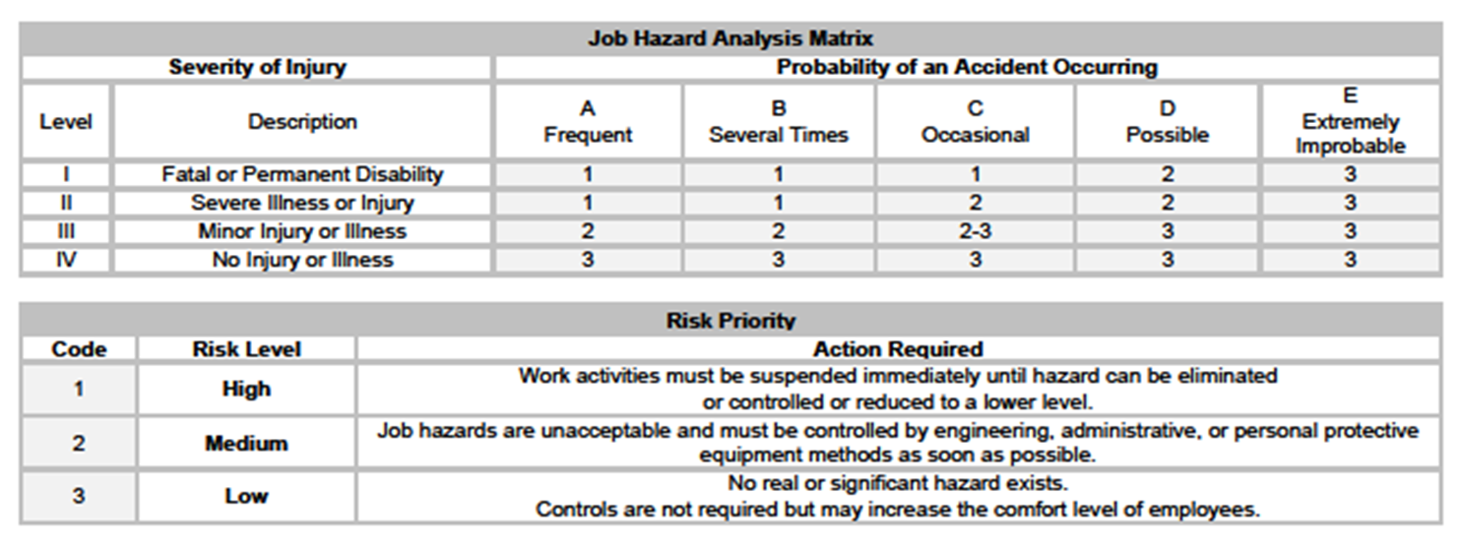
Hazard Assessment Made Specific ... Section 8
Notes:
Refer participants to this section in their workbook and explain the rational of the risk based model of the matrix.
Severity of injury + probability of accident (illness) occurring and the risk level determines the course of action.

Slide 63
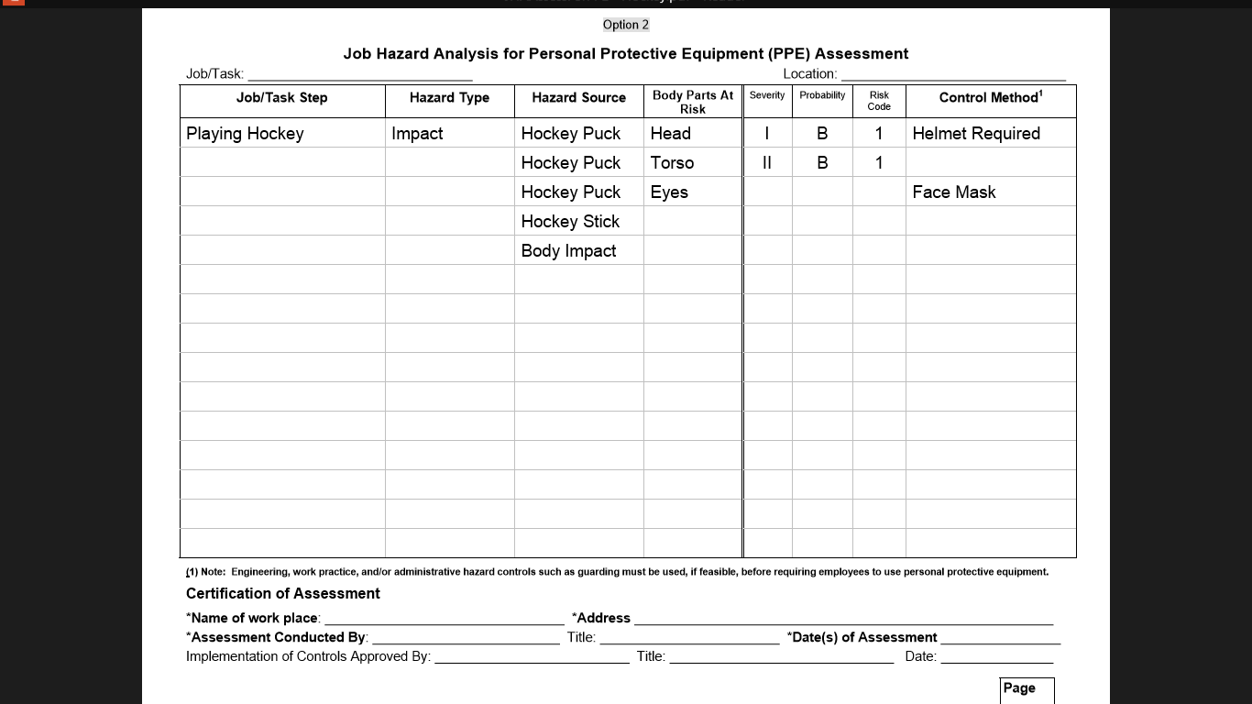
Applied JSA exercise
Notes:
Worked example using the previous Hockey slide.

Slide 64

Make sure you have the tools to do the job!
Notes:
What parent today, doesn’t take appropriate steps to protect their children that are active in sports or playground equipment.
They are the “safety managers” for their family…so why not work better at it when you’re making personal decisions at work?

Slide 65
What does this mean for you?
Personal Protective Equipment (PPE)
  What do I need?
  Is it Available?
  Is it user Friendly? (all work tasks)
  Is it “Fit for Use”?
  When needed, will I use it 100% of the time?
Notes:
Evaluative discussion for the individual that has the exposure and must take personal responsibility for protecting himself

Slide 66
How Does Safety Happen?
PPE for sewage exposure refers to a variety of different types of barriers used alone or in combination depending on the task.
Barrier protection
Working “Clean to Dirty” techniques
Clean up steps afterwards
Notes:
This slide presents both options and process for workers to use that will emphasize that these are steps that they likely normally do for clean up after any job.
With just a few minor changes to process, it is relatively simple to effectively implement some of the “best practices” techniques to mitigate pathogen exposures.

Slide 67
What are the Pathogen Exposures?
Washington On-Site Sewage Association
“Voice of the Industry”
Pathogen Exposures to Workers in
The OSS Industry
Notes:
Since each septic tank inspection or pump out is unique to the occupants, each has to be evaluated individually.
The actual pathogens found and exposed via lab testing are the culprits. In truth, there are likely many more that are yet to be identified as well as new pathogens that are yet unknown.

Slide 68
How Does Safety Happen?
What are the Pathogen exposures?
Are they really different from what your exposed to everyday at home, with kids, pets….
Short answer: Yes……….No………..Maybe
You just don’t know what pathogens will present from one job to the next.
Notes:
Proof statement and discussion to follow helps participants understand the need to mitigate exposure is rationalized by both unknown environments of each job as it is presented.
The inability to evaluate the risks of each field job (pump-out), based on any kind of homeowner interview and the results of the field samples done through this grant program, recognizes that with over 100 known virus, bacterial pathogens and worms the need to protect to the highest exposures by definition will cover all lower levels of exposures.

Slide 69
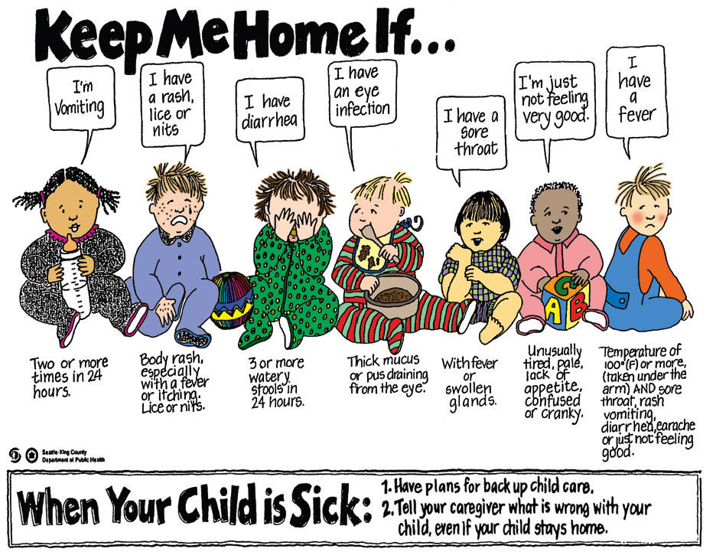
Notes:
Discussion can follow both the expectation of typical exposures found in sewage to understanding that these same illness’ can be an exposure in sewage.
Recognition that all of these exposures are everyday and common. For the sewage worker they are complicated by frequency of exposure, its concentrations (infective dose) and the follow on tasks with loading and unloading the sewage at the dump sites.

Slide 70

It Won’t Happen to Me!
It Won’t Happen to Me!
Notes:
Transition slide to highlight that even with appropriate PPE, there is the possibility of a failure of an unknown or exposure that has not been evaluated or recognized. (MRSA)…
Presenter note: A number of slides in this presentation are very much out of context to industry tasks. This is done with intent to help the participants think about safety process in very different way and “outside the box”

Slide 71

It Won’t Happen to Me!
TAMPA (CBSMiami) -
Two Tampa Bay Buccaneers players are being treated for methicillin-resistant staphylococcus aureus (MRSA) infections and neither the team nor the players know where they contracted the disease.
Notes:
MRSA survivability in sewage is now documented and a known exposure. The following slides will take it home to the workers in the Onsite industry.

Slide 72
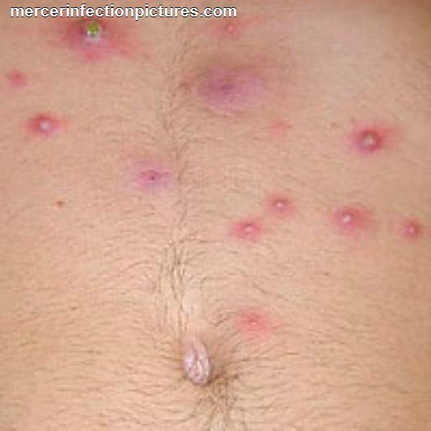
It Won’t Happen to Me!
MRSA
Methicillin resistant Staphylococcus aureus (MRSA) is a bacterium responsible for several difficult-to-treat infections in people
Notes:
This slide will transition the discussion on this exposure back to the potential for the Onsite worker.

Slide 73

Notes:
In this slide there is a collapsed line from tank to DF (gravity system).
The Septic Tank had been pumped the previous day and allowed use by homeowner.
This sewage from the septic tank sample produced a positive MRSA result from the water going into the tank from the house.
Someone inside had an active MRSA infection.
The workers had no PPE used at all.
Exposures: working with jetter to clear plugged lines (dust, aerosol's) and a potential of inhalation exposure, along with direct contact in contaminated soil and sewage.

Slide 74
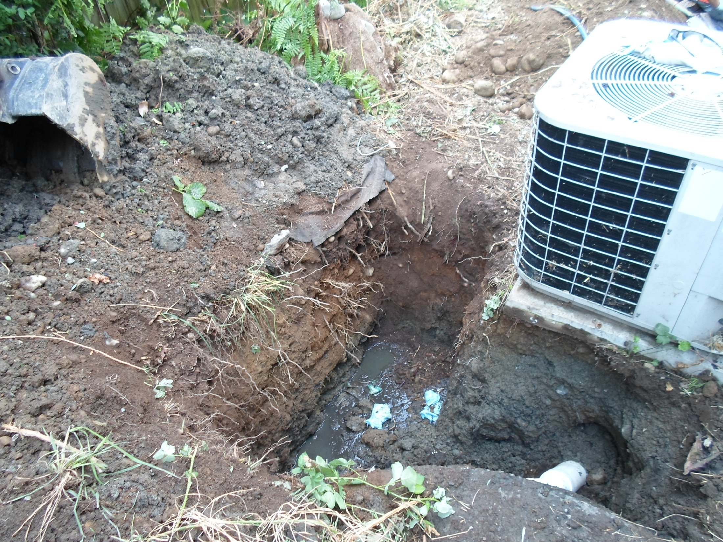
Notes:
Contaminated sewage, soil and ground, subsequent testing of sewage samples demonstrated viable MRSA.

Slide 75
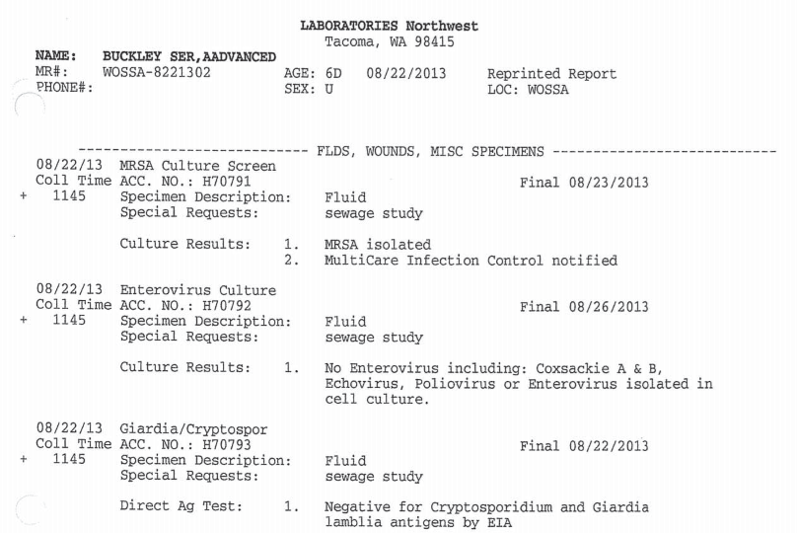
Notes:
Presenter should review and discuss Lab results.

Slide 76
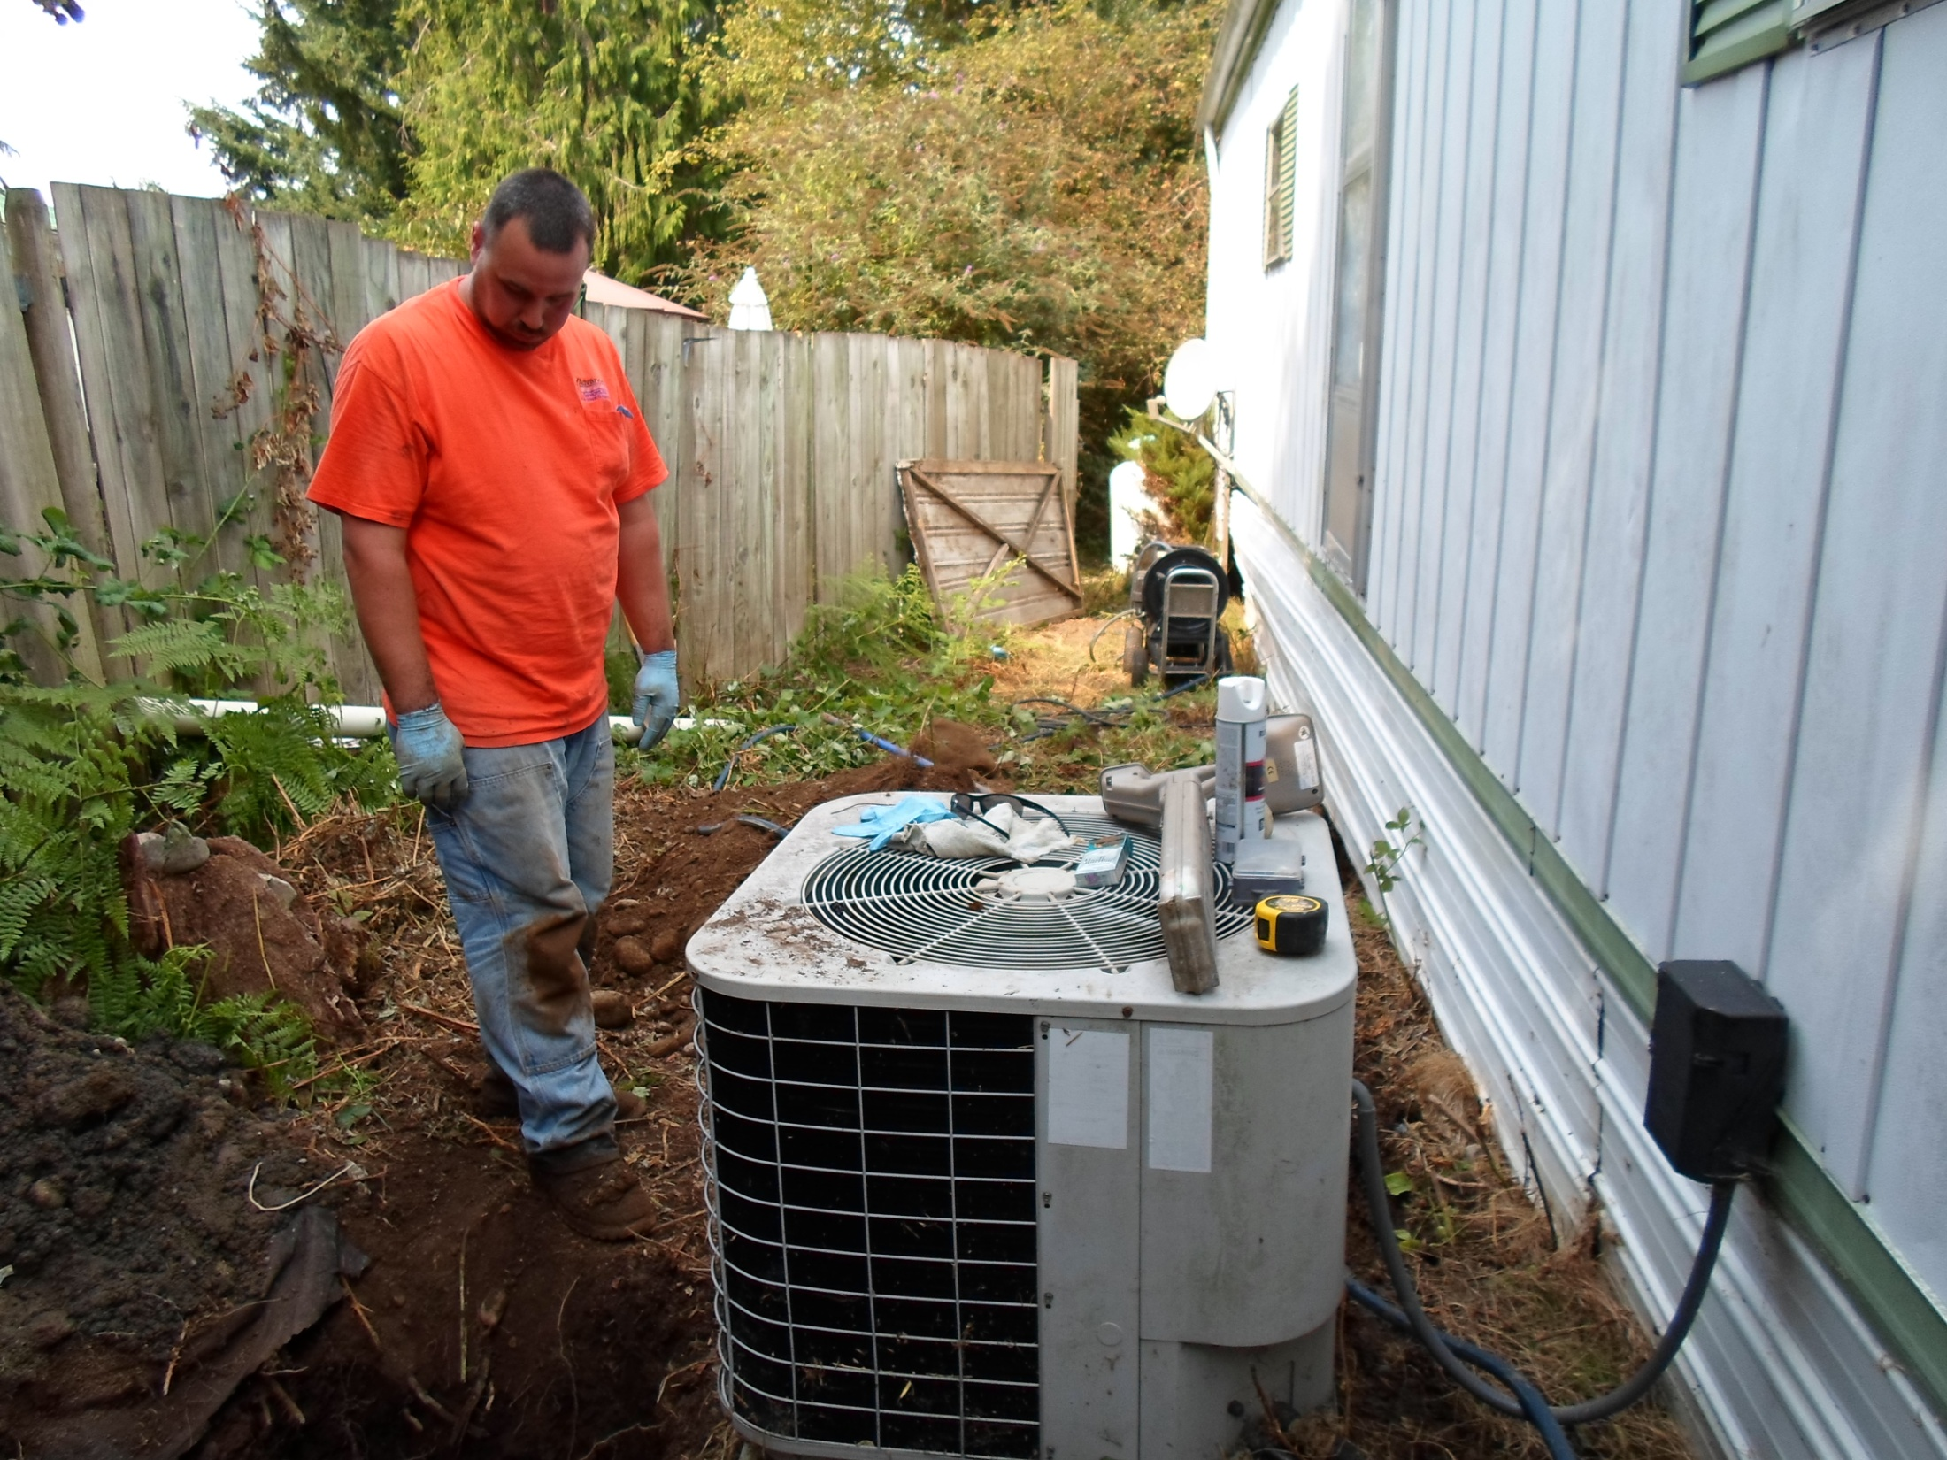
Notes:
Ask participants to identify the exposures, PPE use and the contaminated (MRSA) clothing that are going to end up in the household laundry.
Note that the jetter equipment was also in use to clear the transport pipe to the Drainfield under the front edge of the Trailer.
Exposure:
The aerosol created by its use created the potential for inhalation of MRSA contaminated material and possibility of MRSA of the lungs, nasal and other mucus (mouth) membranes.

Slide 77
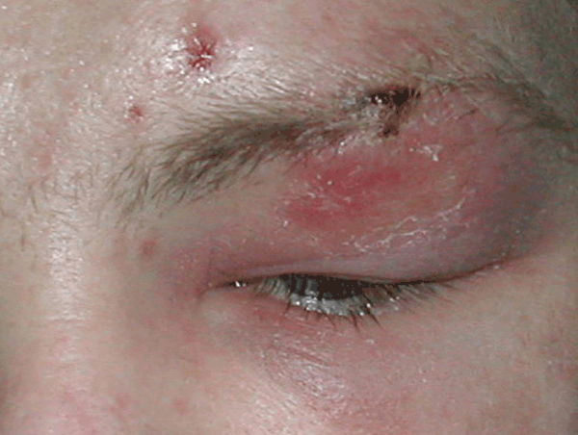
MRSA Infection in the Eye
Notes:
MRSA can impact a worker in a number of ways and vectors of exposure can include, open sores, acne, abrasion and inhalation.
All common to any of the work tasks with OSS.

Slide 78
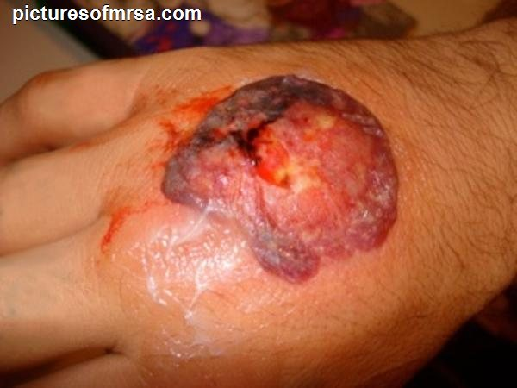
It Won’t Happen to Me!
MRSA
Methicillin resistant Staphylococcus aureus (MRSA) is a bacterium responsible for several difficult-to-treat infections in people
Notes:
Previously restricted to home health care and hospitals, this is now common in the general population.

Slide 79
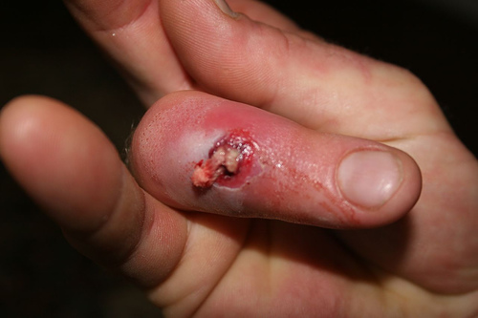
It Won’t Happen to Me!
Exposure Vectors?
Direct (examples?)
Indirect (examples?)
PPE Choices
Sunglasses ?
Splash shield?
Goggles?
N-95 mask?
Exam Grade Nitrile Gloves
Double gloves?
Anti-Bacterial lotion
Notes:
Bridges the discussion or comments from participants on vector exposures and possible PPE to mitigate the exposure.

Slide 80
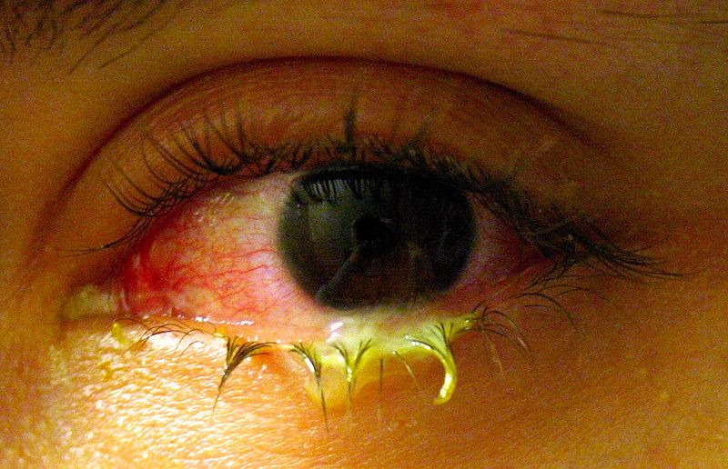
It Won’t Happen to Me!
Pink Eye
Common bacteria responsible for non-acute bacterial conjunctivitis are staph and strep and are common in wastewater.
What do you think is the most common vector route?
Notes:
Bacterial infection from splash back or aerosolization…there are demonstrated examples of this from several companies and after each of the initial presentations, someone would come up and tell their story.
Discuss how what vectors and contamination pathways would end up in this result.
Direct contact with an aerosol
Splash back of sewage
Hand to face contact on hot days/sweating into eyes

Slide 81
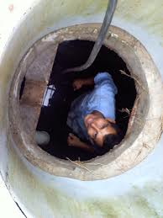
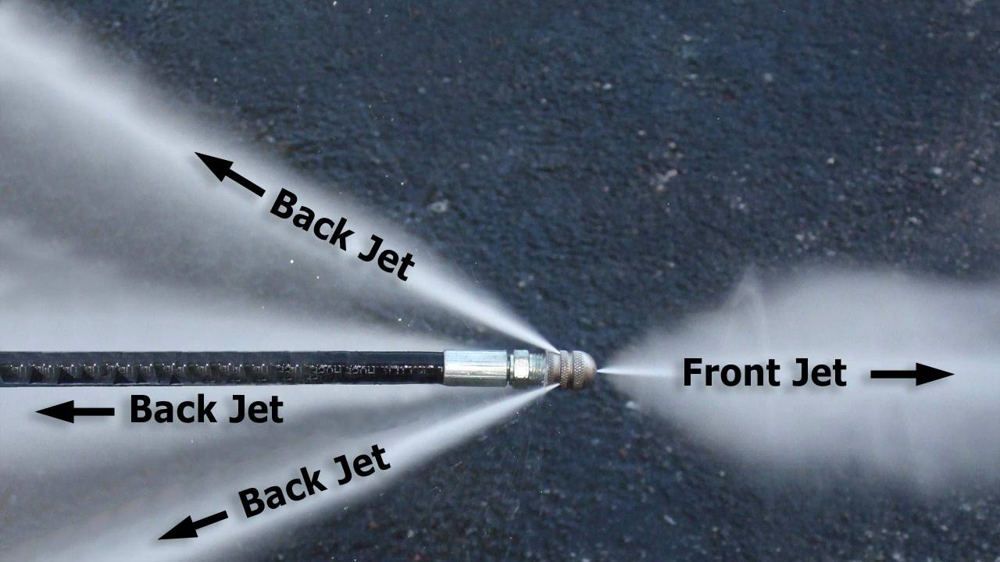
Most likely cause….
Splash back
Aerosols
Hand to face
Sweating into eyes
Notes:
Vector discussion, amplified by the inappropriate CSE, and non use of any PPE visible: eyewear, barrier protection for hands or respiratory protection.

Slide 82

What level of PPE is appropriate?
What is the appropriate level of PPE?
Notes:
Ask group to quantify extremes vs appropriate (“fit for use” issue).
Employers may not need to go the extremes of the picture on the right, but each job, each task and each company needs to evaluate the situation and choose the appropriate PPE to meet the need.

Slide 83
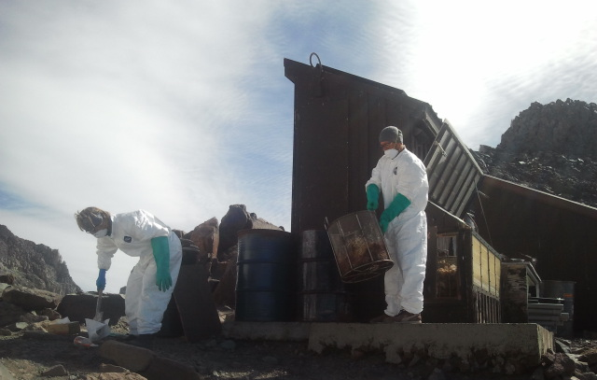
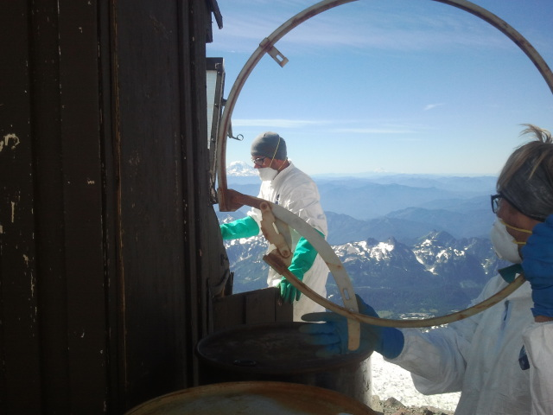
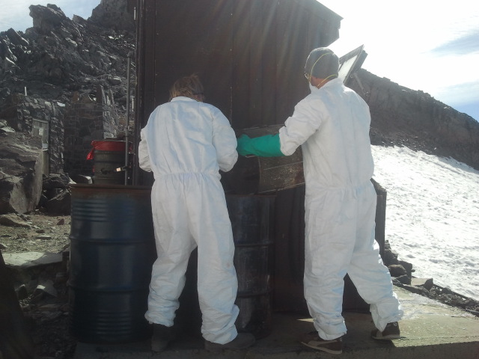
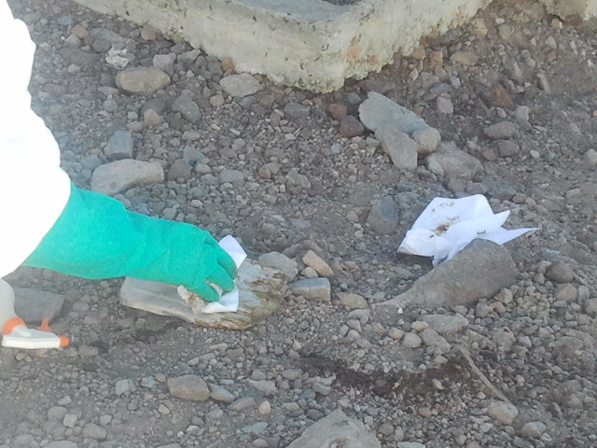
What is the appropriate level of PPE?
Notes:
Task: Rangers empty out collection baskets from the toilets immediately behind them that are full of paper, wet with urine and human excrement into 55 gallon drums to be helicoptered off the mountain.
PPE: Tyvek suits over clothing, double gloves, N-95 masks
Clean up procedure on equipment evaluated….Given the level of protection that they are affording themselves, why would they clean off and place grossly contaminated equipment in the dirt and rocks of the area that are “traffic” areas and subject to high winds that blow the dirt and dust over the snow in the next slides that is used by climbers and hikers to make drinking water….
This opens the discussion to responsibility to protect the public from aerosolized exposures in upcoming slides.

Slide 84


What is the appropriate level of PPE?
Notes:
The tents in this picture are directly below (within 75’) of the toilets and is a designated area for the climbers. They will harvest snow from within a 225’ area of the tents sites and melt it for drinking water.
As an aside, the climbers are making an effort to boil the water, but since they are at 10,200’, the boiling point of water is 194 degree’s F and should be boiled for 3 minutes minimum.
This rarely happens.
Other users may substitute the mountaineering slides with other risk based pictures of choice.

Slide 85
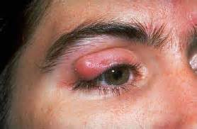
It Won’t Happen to Me!
Sty — also called a hordeolum appears as a red, sore lump near the edge of the eyelid.
It is usually caused by a bacterial infection.
A sty will develop at the base of an eyelash if the eyelash follicle (root) is infected.
Notes:
This slide introduces the concept of exposure of aerosols and splash back exposures and proper eyewear.
It can also be an introduction to the consideration of weather in the work environment and hand to face contact when it is 75-90 degree’s out and sweating is an issue on the head and face.

Slide 86
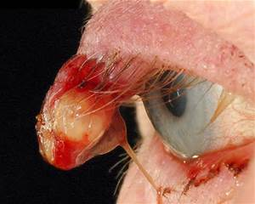
It Won’t Happen to Me!
Exposure Vectors?
Direct (examples?)
Indirect (examples?)
PPE Choices
Sunglasses ?
Safety glasses with side shields?
Splash shield?
Goggles?
Notes:
Impact slide and discussion on appropriate levels of PPE and fit for use issues.
Are standard glasses or sunglasses adequate?
The presentation going forward along with recommendations describe the context of PPE choices as:
Good
Better
Best

Slide 87
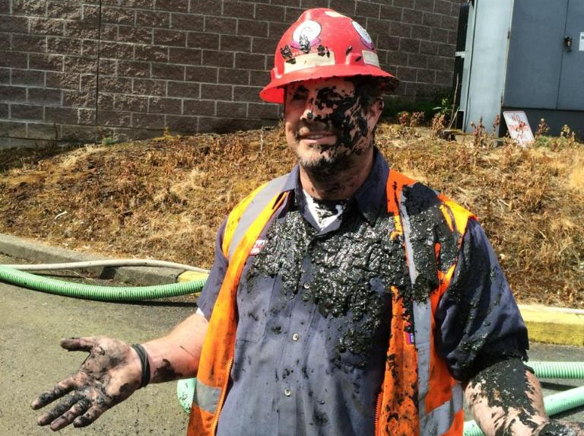
Behavioral Elements
Everyone is different, But
Behaviors are learned………
    Perception of risk
    Acceptance of risk
    Past Experience
    Current need
Notes:
A list of pathogen exposures can be handed out, but start here, because it is individual behaviors that will get the job done on a personal level, up close and personal, so the discussion should start here based on what we see in the field.

Slide 88
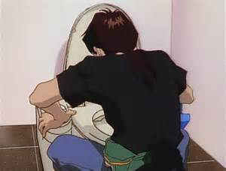
Microbiology of Sewage
Poop Flu
Did you experience an illness while on the job, when you first started working in the On-Site industry?
Notes:
New workers to the industry experience a higher frequency of sick time until acquired immunities are built up.
This has been recognized in several companies with larger workforces (100 plus) that is often unrecognized in small family operations.
It is noteworthy as a motivational statement for compliance of use, to highlight the fact that most employer’s at this level do not offer sick leave pay.
If you don’t show up, you don’t get paid.

Slide 89
Microbiology of Sewage
Over half of all Americans will be infected with an intestinal parasite at some point in their lives.
Yet, many of us do not recognize the signs and symptoms of a parasite infection because they can occur weeks or even years after the initial infection, and because a parasitic infection often mimics other similar conditions.
The most common symptoms of a parasite infection include constipation, diarrhea, gas and bloating, irritable bowel syndrome, joint and muscle aches, anemia, allergies, skin conditions, tumors, nervousness, sleep disorders, teeth grinding, chronic fatigue, and immune dysfunction
Notes:
Proof statement on statistical information from the gov’t. If even remotely accurate, a service provider has no knowledge of client health issues and can “reasonably” anticipate these exposures.
Infective dose for parasites from human waste sources and contaminated soil or effluent are:
ONE!

Slide 90
Microbiology of Sewage
Bacteria
  Extremely common in sewage
  Found naturally in human intestinal tract, sewage, soil, lakes, streams & ponds
  Three groups: aerobic, anaerobic, facultative
  Responsible for much of treatment of sewage
  Some are pathogenic – indicator organisms
Notes:
Introduction and discussion to the microbiology of OSS.

Slide 91
Microbiology of Sewage
Virus
  Extremely small infective agents – electron microscope is needed to see them.
  Depend on living host cell to supply needs
  More than 100 types found in sewage
  Must be removed or may cause illness
Notes:
Washing your hands frequently with regular soap and water is important to help prevent the spread of germs.
It is important to state that while antibacterial products may seem like a stronger cleaning option, they are no more effective in cleaning your hands than regular soap and water.
Further, they do not kill viruses like H1N1 (swine) flu. In fact, the routine use of antibacterial cleaning products has been questioned by scientists and studies have shown that triclosan, the active ingredient in many antibacterial products, may make matters worse by creating drug resistant bacteria like MRSA.
Stick with simple soap and water and if you can't wash your hands, use an alcohol-based sanitizer with at least 60% alcohol content.

Slide 92

Notes:
Overview of common sources, and part of the “over 100” virus found in sewage

Slide 93
Microbiology of Sewage
Protozoans
  About 50 times bigger than a bacterium, single cell
  Organisms should not survive passage through system, problem with cysts and eggs.
  More than 100 types found in sewage
  Must be removed or may cause illness
Notes:
Overview, but presenter should note the issue of cyst and egg forming Protozoans that may phase into survival mode until conditions that they need for life resume.
In a later slide, the presenter will have an opportunity to strengthen this point with “survivability” of these organisms in ground and surface water as well as contaminated soils.

Slide 94


Protozoans
Microbiology of Sewage
Amoeba Crypto oocysts
Notes:
visual

Slide 95


Microbiology of Sewage
Other organisms
  Worms
  Rotifers & other micro-organisms
  Other macro-organisms
Notes:
Visual
Note the infective dose of these are ONE…

Slide 96

Hookworms
Microbiology of Sewage
Notes:
Visual

Slide 97
Hookworms – Life Cycle
Microbiology of Sewage
Eggs are passed in the stool , and under favorable conditions (moisture, warmth, shade), larvae hatch in 1 to 2 days. The released larvae grow in the feces and/or the soil , and after 5 to 10 days they become larvae that are infective .
These infective larvae can survive 3 to 4 weeks in favorable environmental conditions. On contact with the human host, the larvae penetrate the skin and are carried through the veins to the heart and then to the lungs.
Notes:
Visual

Slide 98
Organism Survival Time in Soil
Entamoeba histolytica 6-8 days
Coliforms 38+ days
Salmonella 1-120 days
Cryptosporidium oocyst 60-180 days
Enteroviruses 8+ days
Ascaris ova up to 7 years
Notes:
Specifics: Note especially how long these pathogens survive until they are reintroduced into a more favorable environs.

Slide 99
Number of Organisms to Cause Illness
Worms, viral 1
Amoebic Dysentery 10-20
Giardiasis 5-100
Cryptosporidiosis 10-100
Notes:
Infectious doses: It is important to note that these colonies or organism numbers are found in very small droplets of water (including mists).

Slide 100
Incident Reported Frequency in WA. Annually
Worms - Fecal, Oral Many
Virus’- Fecal, Oral Many
Giardia Fecal, Oral 520
Crypto Fecal, Oral 100
Shigella Fecal, Oral 120
Notes:
Actual reported incidents and should be in context to “un-reported” and infected people that live in the system service providers are working on.

Slide 101
Incident Reported Frequency in WA. Annually
Cholera- Fecal, Oral Rare
MRSA- Contact, Inhalation Many
E.Coli 157:H7- Fecal, Oral 220
Campylobacter- Fecal, Oral 1500
Hep A Fecal, Oral 30 (new)
Notes:
Actual reported incidents and should be in context to “un-reported” and infected people that live in the system service providers are working on.
Also note the transmission vectors in the discussion (multiple).

Slide 102

What are some other factors?
The “Compliance” Barrier….
What are some of the
reasons that you think
the voluntary use of PPE
is so low in our industry?
Notes:
With a safety plan in place we next need to consider why illness’ happen.
Shows the relationship between outcomes and four unsafe behaviors: Root cause of accidents
Eyes not on Path
Line of fire
Eyes not on Task
Rushing or hurrying

Slide 103
What are some other factors?
The “Compliance” Barrier….
What are some of the reasons that you think the voluntary use of PPE is so low in our industry?
Cost
Peer pressure
Time
Nothing really bad has happened…
Notes:
This slide outlines some of the reasons and rational common to the decision making process workers and small business owners make to use or not use PPE that are completely outside of the actual work task or activity.

Slide 104
What are some other factors?
The “Compliance” Barrier….
Independent work group studies have shown
some other elements:
Lack of Time
Perception that use of the PPE interferes with the ability to do the job
Physical discomfort of PPE including masks
PPE not immediately available when needed
Notes:
Other behavior based rationalizations for non-compliance.

Slide 105
Behavioral Elements At Work
“Attitude” is your internal guide to Behavior
Your perception of risk allows you to lose the ability to accurately identify the risk.
If you don’t adjust to this one thing….you won’t consistently minimize your exposure…….
The result that follows is the .…”positive re-enforcement for negative behavior”
It wears away your commitment to personal safety, with justification tactics (your attitude).
Notes:
Discussion on why peoples personal behavior’s are either an expression of why they wear PPE and why they don’t.
Stress the “positive re-enforcement for negative behaviors” (when you get away with something, with no obvious consequence)
Note how in a male dominated workforce, successfully “facing down” risk without getting hurt is as often admired as it is subject to corrective action (near misses).

Slide 106
Not so “Invisible Hazards”
Exposure risks identified in the Shop or Yard
Objective Hazards: What are they?
    Transfer Storage -
    Truck Washing
    Repair Maintenance
    Personal Items
    Others?
Notes:
Focus’ on workplace settings and try to encourage discussion that will make a shift in how the participants “look” at their workplace and tasks.
What are they missing because they look at it 50 times a day or have done the same thing for 20 years.

Slide 107
Not so “Invisible Hazards”
Exposure risks you recognize in the field?
Objective Hazards: What are they?
    Pumping
    Dumping
    Jetting
    OSS Component Repair/ Maintenance
    Personal Actions (smoking, chew, eating)
    Others? (External conditions – weather: heat/cold)
Notes:
Same as previous slide

Slide 108
Not so “Invisible Hazards”
Most Common Exposures - In the Field
Objective Hazards (Hazard)
    Direct Contact
    Aerosols
    Splash back
    Inhalation
    Immersion
    Secondary (smoking, chew, sweating, clothing)
Notes:
This shifts the discussion from obvious traditional workplace hazards (pinch points, lifting, shock) to exposures that participants (and demonstrated in the field studies), are not recognizing.

Slide 109
Hazard Assessment Made Easy...
Hazardous condition + Exposure = Illness, Injury, Death
Hazardous condition + Exposure = Illness, Injury, Death
Hazardous condition + Exposure = Illness, Injury, Death
Notes:
Simple visual
Take just one thing out of the equation and you mitigate the risk…

Slide 110
How Do I Protect Myself?
Washington On-Site Sewage Association
“Voice of the Industry”
Determining what personal protective
Equipment is “Fit for Use”
Notes:
Focus on:
Personal responsibility first and foremost is on the individual who has final choice over his or her use of PPE or not.
The only thing worse than not using PPE, is having the availability of PPE that has not been evaluated on the “Fit for use” issue.
WHY?
It leads people to do things that they wouldn’t if they were just barehanded

Slide 111
Base Layer Protection
Consideration of PPE includes understanding why we use it in the first place…..
PPE means:
“Specialized clothing or equipment worn by an employee for protection against infectious materials” (OSHA)
Notes:
Simple definition

Slide 112
Base Layer Protection
Consideration of PPE includes understanding why we use it in the first place…..and is it “Fit for Use”
Uniforms – protect skin and/or clothing
Gloves – protect hands
Masks– protect mouth/nose
Respirators – protect respiratory tract from airborne infectious agents
Goggles – protect your eye
Notes:
Field studies showed that while many of the service providers had PPE, they had not been evaluated for intended use.
Many of the nitrile gloves plainly stated on the box their limitations to food handling.

Slide 113

Notes:
Common gloves used in the industry that provides protection against “dirt” but no protection against pathogens.

Slide 114

Notes:
Worker with tools:
Part of this discussion on “fit for use” goes beyond the practical ability of the PPE (nitrile gloves), to provide protection against the pathogen exposures, but also if the gloves have the durability to survive a single use in the inspection of a OSS. (see subsequent slides).

Slide 115

Notes:
Working inside the septic system with minimal PPE.
Highlight that “Exam” grade gloves are necessary for minimal protection, but that 5 mil thickness may fail the “durability” of the PPE assessment for the overall “fit for use” need.

Slide 116

Notes:
PPE not fit for use due to failure in average work activities involved with just an inspection.

Slide 117

Notes:
Big heavy over gloves are a good choice of PPE, but only used for some tasks
To get an employee to consistently use them, they also need to be comfortable.
How would these work on a 90 degree day?

Slide 118
Base Layer Protection
Exposure: Contact/Immersion/Barrier Protection
Glove Grades
Surgical Gloves: Good
As the name suggests, surgical gloves are designed primarily for use in healthcare procedures posing the highest risk for the spread of blood borne pathogens
Notes:
Discuss the vector pathway.
Fit for use/application includes barrier protection and durability.
It is important to remind everyone that when the manufacturer’s make 100,000 nitrile gloves in a run that they will subsequently test them.
The ones that pass the Exam grade protocol are separated from those that don’t…the other while they look the same, are downgraded in use to “industrial” use or “food handling” use.
Exam grade gloves are a minimum.
“Surgical grade” gloves are not needed for this industry application as the only difference between them and “Exam grade” is the surgical grade gloves are sterile to be used in the operating room or to prevent the doctor from contaminating the patient.

Slide 119
Exposure: Contact/Immersion/Barrier Protection
Glove Grades
Examination / Medical Gloves (min. 4-6ml): Better
Examination grade gloves, also sometimes referred to as medical gloves, were originally designed for non-surgical medical procedures, but are also used in a variety of other applications. Exam gloves are sold both sterile and non-sterile.
Notes:
Discuss the vector pathway.
Fit for use/application includes barrier protection and an evaluation for durability.

Slide 120
Base Layer Protection
Exposure: Contact/Immersion/Barrier Protection
Glove Grades
Food Service Gloves: Minimal to Poor
Food Service gloves, often referred to as multipurpose gloves, are designed for short-term use and frequent glove changes. No government regulations or inspection program exists for food service gloves.
Instead, the USDA requires that all glove components comply with the provisions of the FDA and Cosmetic Act.
Notes:
It is suggested that presenter have examples of labeling on common grade gloves used by participants and go through the exercise of reading the labels. A review of the use limitations is often written clearly on the box. Other times it is not.
The box needs to specifically say they are “Exam grade” or say “Examination Gloves” somewhere on the packaging.
Note on Nitrile Gloves: Most of these gloves are produced in China. Gloves then undergo various testing protocols and this determines their use. Gloves that pass the standard for “exam” grade gloves are identified. Generally, the only difference between a Surgical grade and Exam grade glove is that the Surgical grade glove is sterile. Gloves that don’t pass the testing protocol are packaged as something else (mechanics glove, etc.) and available at Home Depot or Lowe’s

Slide 121
Base Layer Protection
Exposure: Contact/Immersion/Barrier Protection
Glove Grades
Mechanics/Industrial Gloves: Poor
Offering greater protection than nothing, nitrile gloves provide resistance to most finishes, solvents, and chemicals. Nitrile material is also resistant to punctures, cuts, and snags. Gloves are pre-powdered and contain no natural rubber latex. Common in our industry but unsuitable for the exposures that we face in Sewage.
Notes:
Discussion continues: Ask if they even know what grade their gloves are?
It is a good discussion to speak/remind the issue of “positive reinforcement for negative behaviors” here.
Just because nothing bad or noticeable has immediately happened, the use of PPE that doesn’t pass muster on the “fit for use” issue doesn’t mean anything more than you just got lucky today.

Slide 122

Base Layer Protection
Mechanics/Industrial Gloves: Poor
Notes:
Presenter focus:
It is common for an employee to rely on the owners provision of PPE to assume that someone “else” has determined it fit for use. Field studies show that this is not the case in the OSS industry.
The only thing worse than not using PPE, is having the availability of PPE that has not been evaluated on the “Fit for use” issue.
WHY?
It leads people to do things that they wouldn’t if they were just barehanded

Slide 123

Base Layer Protection
Mechanics/Industrial Gloves: Poor
Notes:
Presenter focus:
This is the actual labeling from the previous slide. The lack of awareness or acceptance of the biological exposures to raw human sewage led to the decision to provide this unacceptable barrier protection to employee’s
The only thing worse than not using PPE, is having the availability of PPE that has not been evaluated on the “Fit for use” issue.

Slide 124
Base Layer Protection
Exposure: Contact/Immersion/Barrier Protection
Glove Grades
Double Exam / Medical Gloves: Best
Offering greatest protection used along with, over gloves to provide barrier protection. Nitril material is also resistant to punctures, cuts, and snags more so than latex and provides better durability for many tasks.
Notes:
Presenter should discuss in context to the task being performed,
This will help with the compliance issue for use of PPE.
In addition, understanding that as the task becomes more specific or even changes as it progress the longer the job goes into the inspection or pumping/maintenance needs of the OSS, that there is the prospect of the need of additional PPE to be added as needed.

Slide 125
Eye Protection
Exposure: Splash, Suspended Aerosol’s
Eye protection chosen for specific works depends on the task, potential exposure and personal vision needs
Personal eyeglasses and/or contact lenses are not considered adequate eye protection
Notes:
Exposure will determine the level of PPE needed.
Eye protection for aerosols should include consideration for mists and eyewear with a continuous seal around the eye is appropriate.
Eye protection for splashes may not need the same level, but if a SP is limited to one choice, and both exposure levels are commonly encountered, then the highest level is appropriate.
Note that individuals may need to have prescription safety glasses made in whatever configuration is chosen.

Slide 126
Eye Protection
Exposure: Splash, Suspended Aerosol’s
NIOSH: States that eye protection must be:
  Comfortable
  Allow for sufficient peripheral vision
  Adjustable to ensure a secure fit
  Indirectly vented goggles with a manufacturer’s anti-fog coating may provide the most reliable protection from splashes, spray and airborne droplets from multiple angles.
Notes:
Presenter should offer these considerations for management:
If you’re going to spend the money, make sure that the choice of PPE meets other needs to improve compliance and use.
Owners/management cannot rely on the excuse that “We give them the PPE, it’s out of our control if they actually use them or not!”

Slide 127



Eye Protection
Exposure: Splash, Suspended Aerosol’s
Good - but task specific
Better - all around choice
Notes:
Presenter focus:
For specific discussion on application. This eyewear is relatively inexpensive and readily available.
The “cat crap” in the upper right of the slide is an anti fogging application for the lens that is very effective in extreme weather conditions (heat and cold)

Slide 128
Eye Protection
Notes:
Presenter note: This accident (splash back) was caused by the unanticipated release of a “dog-ear” on a discharge hose, resulting in a “baptism by sewage”.
While there were no subsequent illness post accident, the SP was fortunate to be wearing eyewear at all.
The eyewear in the photo is inadequate.

Slide 129

Eye Protection
Notes:
This service provider is doing it all just about right. Note appropriate use of PPE by the SP.
Double Gloves
Eyewear
Hearing protection
Coveralls
Presenter note: This same employee is shown later at the dump site wearing no PPE at all.
The reason given was that the dumpsite operator had been putting pressure on him to get in, unload and get out. As a result he wouldn’t take the time to put back on all his PPE seen here to unload his truck.

Slide 130

Inhalation Protection
Exposure: Splash, Suspended Aerosol’s
A surgical mask, also known as a procedure mask, is intended to be worn by health care professionals during surgery and at other times to catch the bacteria shed in liquid droplets and aerosols from the wearer's mouth and nose…
Notes:
The observed practice in the field showed that when masks are used it is common to retain and use them over multiple days and accumulated contamination my defeat their functionality.
One test of an N-95 mask showed readings of over 10,000 colonies. A canister face mask may be a better choice, but a fresh mask is a minimum.

Slide 131

Inhalation Protection
Exposure: Splash, Suspended Aerosol’s
N-95 Mask: Best
It provides the greatest protection from airborne particles to the face for our work tasks.
Notes:
These are the masks used in hospital and clinical settings. Very inexpensive to purchase and easy to use.
There are “fit testing” considerations to think about. Field observation noted that a lot of SP that work in the OSS industry have beards and mustaches.
There are an additional set of rules by OSHA for fit testing these masks..

Slide 132
Belt & Suspender Approach using Immunization
Hepatitis - A – Each year 125,000 to 200,000 people become sick with Hepatitis A
Signs and symptoms of disease include fever, weakness, nausea, abdominal pain, dark urine, yellow skin and eyes
Symptoms usually last less than two months, but 10% to 15% of those infected will have prolonged or relapsing disease lasting up to six months.
This virus is most commonly spread in stool, Hepatitis A may be widely spread through contaminated food. In 1983, f 203 people became ill in a county of 7,800 in Oklahoma. Ninety-two percent of those infected had eaten at the same drive-in restaurant between two and six weeks before onset of illness.
Notes:
Many employers offer immunization to employees, others don’t.
Either way, the benefit of immunization is still apparent and if you are not going to use external PPE consistently or if they are not available to you, then these immunizations are a type of “internal barrier protection” that SP need to consider.

Slide 133
Belt & Suspender Approach using Immunization
Hepatitis B – The hepatitis B vaccine is available as a stand alone vaccine or in combination with hepatitis A vaccine.
Hepatitis B virus (HBV) is transmitted from one person to another through blood and body fluids, and primarily infects the liver. In the United States, it is most commonly spread through sexual contact or injection drug use.
Health care workers and others exposed to infected blood or body fluids are also at high risk for infection.
Symptoms of HBV infection vary and may include loss of appetite, fatigue, nausea, and jaundice (yellow eyes and skin), joint pain, and skin rashes.
Notes:
Risk exposure to Hep B is considered low by many in the industry, but it still exists in the OPIM discussion, and therefore needs to be addressed. When pumping of public or pit toilets (Parks, etc.), it should be anticipated that dirty needles may be common in the sewage.

Slide 134
Belt & Suspender Approach using Immunization
Typhoid - Typhoid fever is a serious disease caused by the bacterium called Salmonella enterica serotype Typhi (S. Typhi).
The infection is spread from person-to-person by the fecal-oral route. That means that people get typhoid from food or water contaminated with the feces of infected people.
Typhoid symptoms include high fever, weakness, stomach pains, headache, loss of appetite, and sometimes a rash. Infection can spread to many other places in the body (such as bones) and can cause rupture of the intestine. It kills up to 30% of people who get it, if they are not treated.
Some people who become infected with S. Typhi become chronic carriers—they have no symptoms but have S. Typhi in their feces
Notes:
Risk exposure to Typhoid is also considered low by many in the industry, but it still exists in the OPIM discussion, and therefore needs to be addressed.

Slide 135
Belt & Suspender Approach using Immunization
Tetanus – Renewable every 10 years
Tetanus (Lockjaw) is caused by toxin-producing spores of a bacterium, Clostridium tetani that inhabit the soil and the bowels of animals and humans.
Unlike other vaccine-preventable diseases, it is not spread from person to person. Tetanus infection is most often the result of wound contamination in an unimmunized person or someone who has not had vaccine boosters in many years.
It may also occur following puncture wounds, animal bites, burns, abrasions and surgery.
Notes:
Risk exposure to Tetanus is a higher risk in the industry, it still exists in the OPIM discussion, and therefore needs to be addressed with appropriate PPE and shots to be kept current.

Slide 136
Working in the Field
Washington On-Site Sewage Association
“Voice of the Industry”
“Best Practice” minimizing potential pathogen exposures in the field
Notes:
This is a transition slide in the presentation and shifts the discussion over to best practice in the field and a discussion of observations of a variety of work tasks.
The Presenter can facilitate feedback from the group on:
What is it that we do?
While there are commonalities, each job is different.
What is best practice?

Slide 137

Best Practice - Personal Behaviors
Personal Behaviors:
Wash hands immediately after handling wastewater
Avoid touching face, mouth, eyes, nose, or open sores and cuts
Wash your hands before eating or using the toilet
Do not smoke or chew tobacco or gum
Notes:
Exposure:
Hand to face contact: The field observations showed that in a typical 45 minute job, the average number of times workers touched their face was more than18 times.

Slide 138



Best Practice - Personal Behaviors
Notes:
Exposure: Various
Top left: Contaminated equipment stored in office space.
Top right: SP smoking during a break after significant contamination exposure.
Bottom left: Working on a hot day increased the frequency of hand to face contact while contaminated.
Bottom Right: Worker is right hand dominant, cell phone on hip which is against the company policy. During the jetting task, the hose was see-sawing against the phone back and forth and swabbed results of the phone surface found it contaminated with E coli. A secondary hand to face exposure presents itself when he calls back to the office for the next job.

Slide 139

Best Practice - Personal Behaviors
Notes:
The operator needed something from the cab of his truck. Using a ‘clean to dirty” work procedure violated the chain and created a potential for contaminants to migrate the contamination into a “clean” area (food kept here).

Slide 140

Best Practice - Personal Behaviors
Notes:
The SP in this picture was pumping out a septic tank and generally has available and is using the appropriate PPE here:
Double Gloves
Coveralls
Work boots
Note: in the bottom left hand side of the picture, a high pressure hose is being used and likely creating an aerosol.

Slide 141


Best Practice - Personal Behaviors
Why does accident /
illnesses Happen:
1. Rushing
2. Eyes Not On Path
3.Eyes Not On Task
4. Line Of Fire
Notes:
When you consider some of the things that influence personal decision along with an evaluation of accidents, most accidents include one or several of these 4 root causes for why or how the accident happened.
These “root cause” definitions can be used to expand participant understanding of how they get hurt in the workplace.
The individual in this picture, had been diligent all day about putting on and taking off “protective clothing” (coveralls), that he had available, and using most PPE (missing facemask), but when he got to the septic dump station, he abandoned all of his PPE, because of the pressure that the station operator was putting on the drivers to “hurry up” dump the load and clear the dump station for the next truck (motivation by operator to maximize through put at the expense of safety, and willingness of truck operator to be “rushed”).

Slide 142

Best Practice - Personal Behaviors
The “Compliance” Barrier:
1. Cost
2. Peer pressure
3. Time
4. Nothing really bad
has happened…
Notes:
This slide represents external influence issues that are recognized or not that end up in poor decisions being made by the SP that could result in an illness!
This is the community dump site for offloading pump trucks.

Slide 143

Best Practice – Splashing
Exposure:
Splash
Aerosol’s
Line of Fire
PPE Used:
Waterproof Boots
Additional PPE:
Double Gloves
Safety Glasses
N-95 Mask
Coveralls
Notes:
Single Family Residence (SFR) pump out and inspection
Line of fire potential to:
Aerosols
Splash back (wearing gloves, but no other PPE), in this case the operator is actually creating a hazard by his work activity

Slide 144

Best Practice – Splashing
Exposure:
Splash
Aerosol’s
Line of Fire
PPE Used:
Double Gloves
Waterproof Boots
Additional PPE:
Safety Glasses
N-95 Mask
Coveralls
Notes:
Lift Station to Sewer
In this slide, have the participants identify what the task and person is doing right and what they could improve on.
This lift station is connected directly to the sewer and is pumped out every two weeks
Issues:
Line of fire potential to: aerosol, splash back (wearing gloves, but no other PPE)

Slide 145

Best Practice – Splashing
Exposure:
Splash, Aerosol’s
Line of Fire
Direct / Indirect Contact
PPE Used:
Gloves*
Waterproof Boots
Glasses*
Additional PPE:
N-95 Mask
Coveralls
Notes:
Single Family Residence (SFR) pump out and inspection
In this slide, have the participants identify what the task and person is doing correctly and what tasks they could improve on.
Line of fire potential to:
Aerosol
Splash back (wearing gloves, but no other PPE), has eyewear on, but not “fit for use” to the exposure

Slide 146

Best Practice – Splashing
Exposure:
Splash
Aerosol’s
Line of Fire
PPE Used:
Double Gloves
Waterproof Boots
Glasses*
Coveralls
Additional PPE:
N-95 Mask
Notes:
Single Family Residence (SFR) pump out and inspection
In this slide, have the participants identify what the task and person is doing correctly and what tasks they could improve on.
Line of fire potential to:
Aerosol
Splash back (wearing gloves, but no other PPE), has eyewear on, but not “fit for use” to the exposure
The SP is wearing gloves, but no other PPE), in this case the operator is actually creating a hazard by his work activity. He is wearing glasses, but not due to exposure they are prescription.
Note that care has been given to properly laying out lids with the contaminated side up so as to not contaminate the ground.

Slide 147

Best Practice – Aerosol
Notes:
Single Family Residence (SFR) pump out and inspection
In this slide, have the participants identify what the task is, what things the person is doing correctly and what they could improve on.
Line of fire potential to: aerosol, splash back (wearing gloves, but no other PPE), in this case the operator is actually creating a hazard by his work activity

Slide 148

Best Practice – Aerosol
Notes:
Single Family Residence (SFR) pump out and inspection
This slide graphically demonstrates the creation of aerosols and strengthens the need for PPE protection (face fit, N-95masks) for mitigation of pathogens and inhalation.

Slide 149

Best Practice – Aerosol
Notes:
Single Family Residence (SFR) pump out and inspection
Jetting job in a plugged and grossly contaminated line to Drainfield.
Line of fire: aerosol, PPE: (note gloves are not designed for barrier protection at all). This is a different employee of the same company that issues these gloves to their employee’s.
It is a corporate fail on “fit for use” that was transferred to all employee’s issued these gloves and also promotes the issue of positive reinforcement for negative behavior).
Employee’s receiving the “PPE” from the employer assume that they are protected and may now do things that they would do with their bare hands “thinking” they are protected.

Slide 150

Best Practice – Aerosol
Notes:
Note cell phone on right hip.
This is not allowed by company policy.
Potential of hand to face contamination is very high…(this will come up again in a subsequent slide)

Slide 151

Best Practice – Aerosol
Notes:
Another employee, same company… Exposure is creation of aerosol…note this employee doing a similar job cleaning out the building sewer to the main in the street.

Slide 152


Notes:
Employee is right hand dominant and has his cell phone on hip. During the jetting the hose was rubbing against the phone back and forth. Swabbed results of the phone surface found them to be contaminated with E coli.

Slide 153

Best Practice – Aerosol
Notes:
Commercial application (gas station with a pump out done weekly year round) with a holding tank.

Slide 154

Best Practice – Aerosol
Notes:
SP is pumping out the tank on a weekly basis. With no other components to inspect it is a straight forward pump out job that usually about 15-20 minutes start to finish.

Slide 155

Best Practice – Aerosol
Notes:
Still on the site of the previous slide, this is another example of aerosols created, but from the equipment.
The tank is being vented as shown and is typical of how pump trucks operate.
Temperature and humidity graphically show the aerosol created. Field tests demonstrated positive tests for biologics up to 30 feet away in plate tests.

Slide 156

Best Practice – Aerosol
Notes:
The amount of aerosols and the contamination range was a surprise to the field work and study.
Positive samples for bacteria and plate tests were out to 30 feet from the truck.

Slide 157


Best Practice – Aerosol
Notes:
The contaminated aerosols created by the blower, also present a potential exposure hazard to the public if not protected or directed

Slide 158

Best Practice – Aerosol
10’ - Similar growth to truck venting
30’ - Half the growth at truck venting
Truck Vent
Aerosol:
Mixed Bacterial Flora
Gram Negative / Positive Rods
Bacillus Species
Streptococcus Species
Diphtheroids
60’ - Little no colony growth in 4 days
Notes:
The results of the field studies are demonstrated here, along with the micro-organisms.
In the study, there was not a dramatic drop in colony growth until the 60 foot mark.

Slide 159


Best Practice – Aerosol
Pumping
10’ - Similar growth to source
ATU Vent
30’ - Half the growth at source
60’ - Little no colony growth in 4 days
Notes:
The results of the field studies are demonstrated here, along with the micro-organisms.
In the study, there was not a dramatic drop in colony growth until the 60 foot mark.
This portion of the study examined the potential exposure for air venting of several ATU suspended growth technologies.

Slide 160

Best Practice – Aerosol
Exposure:
Splash
Aerosol’s
Line of Fire
PPE Used:
None
Additional PPE:
Double Gloves
Safety Glasses
N-95 Mask
Coveralls
Lab Test
Results:
Generic
Escherichia coli
3,600 per swab
Notes:
Task:
Wire brush grinding of a discharge connection on a pump truck that was creating a ‘dust” aerosol, on the main discharge valve of the septic pump truck. The threads were swabbed (after cleaning) and still tested positive for E-coli.

Slide 161

Best Practice – Aerosol
Notes:
Task: Emptying of Pump Truck at Wastewater facility:
This service provider wore full and appropriate PPE while on the customers jobsite, and didn’t continue here when he offloaded the pump truck. Principally because the site manager put pressure on the drivers to get in and out as quickly as possible.

Slide 162


Best Practice – Aerosol
Exposure:
Splash
Aerosol’s
Line of Fire
Lab Results:
Enteric Gram Negative Rods
Gram Positive Cocobacillus
Fungus
Gram Positive Rods
Bacillus
Notes:
There is little to do to minimize the exposures at this dump site that is not already commonly available and identified in the study. The use of coveralls, facemask, gloves and glasses will minimize the exposure to aerosols and should be common practice.

Slide 163


Best Practice – Aerosol
Exposure:
Splash
Aerosol’s
Line of Fire
Lab Results:
> 100 Colony Forming Units Mixed Bacterial Flora
Bacillus
Streptococcus
Gram Negative Rods
Notes:
This is a look at two different unloading methods with one being a much better practice to minimize the creation of aerosols.
As you can see, a dramatically lower aerosolization of the wastewater is achieved by use of this specialized hose carried on the truck for the specific purpose of off loading the truck.

Slide 164

Best Practice – Direct / Indirect Contact
Notes:
Explain the distance from the truck to the septic system components that the service provider must drag hose (a long ways)…the point of this slide is reinforced in the following slides and the decisions made by the operators.
It is too far away from the actual work to facilitate going back and forth for equipment, PPE etc. The service provider should think this through just a bit more and make sure that he has everything that he needs on the first or last trip into the backyard before he begins work.

Slide 165

Best Practice – Direct / Indirect Contact
Notes:
In this single family residence, one of the laterals was not taking water and was determined to be clogged. This slide shows the what the d-box (distribution box) looked like upon initially opening up the system. The d-box was full.
In this slide you can see the SP is not wearing any coveralls and will eventually have his pants and shirt grossly contaminated as his work wears on through out the job and the remainder of the day and he will wear these home tonight, potentially extending the gross contamination to his family.

Slide 166

Best Practice – Direct / Indirect Contact
Notes:
Exposure: The SP is creating an aerosol by using the clients hose.
The gloves that he is using are not appropriate for the work environment (cloth backs and rubber)
He is also using the clients hose for cleaning out the d-box. With no backflow preventer, he risks contamination of the clients drinking water.

Slide 167


Notes:
Exposure: The SP is creating an aerosol by using the clients hose.
The gloves that he is using are not appropriate for the work environment (cloth backs and rubber).
No facemask of any type is used as barrier protection for the aerosol being created.
He is also using the clients hose for cleaning out the d-box. With no backflow preventer, he risks contamination of the clients drinking water.
Samples were taken and plate tests can be observed with the results.

Slide 168

Best Practice – Direct / Indirect Contact
Notes:
This picture is of the same job, but digging out the other end of the line.
This was done when the line couldn’t be cleared from the d-box side. The SP initial work was in grossly contaminated soil and is wearing no PPE at all.

Slide 169

Best Practice – Direct / Indirect Contact
Notes:
Although the SP has added single layer Nitrile gloves, the trench is full of contamination and sewage. Note shovel handle.

Slide 170


Notes:
Same job, continues digging out the trench with grossly contaminated wet soil now on the adjacent trench sides (no ground cover – adds an additional secondary exposure to the backyard to client and family).
Presenter should review the lab testing results of the work environment with participants.

Slide 171

Best Practice – Direct / Indirect Contact
Notes:
This slide shows and interesting comparison to the PPE used by the man in orange working on the OSS compared to the small business owner’s representative.
The man in orange works for a public utility who typically have a more robust safety program, but still is missing any face protection for aerosols which would be critical PPE.

Slide 172

Notes:
Note gaps in PPE between two operators.
Full coveralls vs partial
Suitable eyewear for the SP on the left but not the other (previous picture)

Slide 173


Best Practice – Direct / Indirect Contact
Notes:
Are the PPE used for just keeping clean or for protection from pathogens?
Note the extreme facial hair in the operator on the left. Face fit for any style of mask for protection from aerosols is problematic.

Slide 174


Best Practice
Lab Test
Results:
At Tank - 100 Colony Forming Units Mixed Flora, Bacillus,
Gram Negative Rods
At Truck Vent – 10 Colony Forming Units
At 60’ - No Growth
In 4 days
Notes:
Exposure limits and infective dose as you get/work close to the truck are discussion topics here.
The samples tested positive at:
Truck (photo on right shows plate samples being taken)
10 feet away from the truck
30 feet away from the truck
It wasn’t until the samples place 60 feet away from the truck were they coming back negative.

Slide 175


Best Practice
Exposure:
Splash
Aerosol’s
Line of Fire
PPE Used:
Double Gloves
Waterproof Boots
Glasses
N-95 Mask
Additional PPE:
Coveralls
Notes:
This SP is wearing:
Double Gloves
Waterproof boots
Safety Glasses
N-95 mask
The addition of external clothing (coveralls) would strengthen his exposure mitigation.

Slide 176


Best Practice – Protecting the Public
Notes:
Using customer hose is a big no-no in our industry due to the potential secondary exposures to kids, property owners.
Observations found awareness to the issue high by compliance very low.
The “need” caused this decision because his water supply is on the truck several hundred feet away.
Presenter could ask participants what he could have done differently?

Slide 177

Best Practice – Protecting the Public
Notes:
Protecting the homeowner in light of the results of the field studies are the speaking points for this slide:
Keeping contaminated lids that have been removed “dirty side” up, prevents contamination in the grass, but that also is the case for hose laid casually in the grass that dribble wastewater during pumping operations or at the end of the job and the service provider is putting his gear away.
In this slide, a simple technique of laying the hose end over the body of the hose will elevate it so it won’t leak al over the grass. Given the survival time of many pathogens in the soil of months to years, this is a simple fix.
Although you can’t quite see it, the septic tank is in the landscaping just under the flag and at the front door.
Presenter should mention to participants to pay attention if they are creating aerosols. Remembering that the field tests conducted in the study showed results of biologics that were positive 30 feet away.

Slide 178

Best Practice – Protecting the Public
Notes:
Discuss if the SP should consider the aerosols being created and potential exposure to the casual public walking by?
A recommendation would be to put up some traffic barriers for the protection of the public.

Slide 179

Best Practice – Protecting the Public
Notes:
Installation repair of a system and decommissioning the tank.
The operator “scooped” out about 18 inches of raw sewage from the existing tank that had been broken down and was being decommissioned. He rotated 180 degrees and dumped the sewage in what would be the new tight line running out to the Drainfield.
Drainage was poor in this compacted glacial till.
The tank had been pumped out the day before, but had some residual use by the homeowner.
The exposure is to the workers that laid the subsequent pipe in that part of the extension to the Drainfield legs beyond the vegetation.

Slide 180
Summary
Washington On-Site Sewage Association
“Voice of the Industry”
Pathogen Exposures to Workers in
The OSS Industry
Notes:
Transition slide….
What do we need to do differently?
Raise awareness to the issue.
Train SP’s on best practice and basic PPE selection.
Encourage business owners to set the example and “walk the talk”.

Slide 181


Basic Hygiene Practices for On-Site Workers
Notes:
In the review of available products and approved use in the health care setting, we found that the label should read “flammable” at a minimum to ensure an adequate amount of % of Alcohol (60%) to be fit for use.
The hospital minimum is 70% of several that were researched.

Slide 182
Basic Hygiene Practices for On-Site Workers
Wash hands with soap and water immediately after handling human waste or sewage.
Avoid touching face, mouth, eyes, nose, or open sores and cuts while handling human waste or sewage.
After handling human waste or sewage, wash your hands with soap and water before eating or drinking.
Before eating, remove soiled work clothes and eat away from human waste and sewage-handling activities.
Do not smoke or chew tobacco or gum while handling human waste or sewage.
Carry at least a gallon of fresh water in the truck for emergency eye wash.
Notes:
Here are some thoughts if this slide is used:
Safety begins in the parking lot (or your shop) with planning for a successful day in the field.
It was uncommon to find available on the pump trucks or service trucks any fresh water as part of the first aid kit and is a recommendation.
Make sure that you have the appropriate PPE and first aid kit supplies when you go out into the field.

Slide 183
Basic Hygiene Practices for On-Site Workers
Keep open sores, cuts, and wounds covered with clean, dry bandages.
Gently flush eyes with safe water if human waste or sewage contacts eyes.
Use Exam/Medical gloves to prevent cuts and contact with human waste or sewage.
Wear rubber boots at the worksite and during transport of human waste or sewage.
Remove rubber boots and work clothes before leaving worksite.
Clean contaminated work clothing daily with 0.05% chlorine solution (1 part household bleach to 100 parts water).
Notes:
Here are some thoughts if this slide is used:
Basic first aid considerations.
Ensure that the PPE available has been assessed and is “fit for use”
Water Proof footwear should be mandatory.
Sanitizing is different from sterilizing contaminated surfaces. Simply washing work clothes in the washer is more likely to spread contaminants than wash them away.

Slide 184
How to Immediately Reduce Your Exposure
1.) Stop touching your face!
2.) Double up on your gloves = Exam grade Nitril w/ Outer Glove
3.) Wear proper eye protection to protect from Splashback and Aerosols
4.) Use N-95 rated mask for tasks that create Aerosols
5.) Make sure your disinfectant % of alcohol is at least 67% or higher
Notes:
Simple things you can do to protect yourself…
Quit touching your face
Have available and use a N-95 rated mask for bacteriologic exposures.
Wear “exam” grade nitrile or latex loves.
Wear “outer” protective layer of clothing (coveralls).
Don’t wash these cloths in the family washing machine.

Slide 185

In order to get a job done, Safety has to be part of the plan
Don’t be this guy!
Notes:
Here are some thoughts if this slide is used:
A clear violation on several level, but with the focus of the last few slides on best option for barrier protection for your hands, the presenter should bring a final focus on the gloves the person in the picture is wearing.
They are the same ones that food prep employee’s use and are totally inadequate.
The presenter may suggest that when they go to the local sandwich shop for their next sandwich, to have a look at the gloves that the person preparing their food is wearing.
They are the same as in the picture, and by this time, participants should recognize the inadequacy of them.

Slide 186
Questions?
Questions?

