Slide 1

Funding and support for this project has been provided by the State of Washington, Department of Labor & Industries, Safety & Health Investment Projects
Notes:
INTRODUCTION
Workshop Overview
Say to the Class: As many of you know, the City received a Safety and Health Investment (SHIP) grant from the Washington State Department of Labor and Industries (L&I) called the Light Duty = the Right Duty. The project has two components. The first is to develop a Return-to-Work (RTW) procedure and Light Duty policy. The second is to provide employee awareness training to contain and reduce the costs of Worker’s Compensation due to employee injury and time loss.

Slide 2
Learning Objectives
Learn how “Return to Work” works according to City policy.
Develop the skill of suspending judgments and preconceived opinions about injured workers.
Identify what your role and responsibility is in the City ‘s RTW program.
Demonstrate knowledge of the key elements of effective communication and any barriers that impede success.

Slide 3
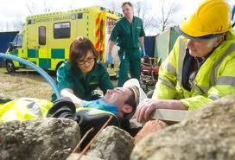
What is Return to Work (RTW)
Return to work simply means helping an employee get back to work as soon as possible after a job related injury or illness
Notes:
Distribute the Problem Based Learning Statement Handout and have participants identify what they ‘already know’ about the problem and what they ‘need to know’ in order to successfully solve the problem.
So what do you know about Return to Work?
What would be some concerns about the employee that was injured?
What concerns would you have about the Department or Say PW Shop?
What do you think an injured workers responsibilities would be in the Return to Work Process.
What other players would be involved?

Slide 4
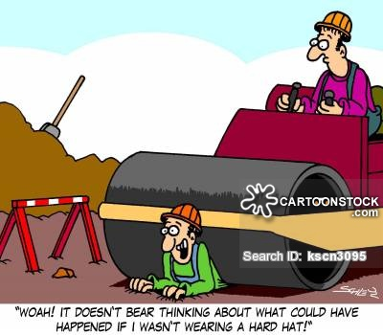
Notes:
Employers of all sizes need to pay attention to safety and the cost of workplace accidents to workers as well as to the employers bottom line, Whole accident prevention is the best way to reduce overall injury costs, an effective workplace Return to Work Program is the best way to manage cost and improve recovery after an injury has occurred.

Slide 5
Most employers today face tremendous financial pressures, forced to do more with fewer resources. When employee accidents and illnesses occur—both on and off the job—employers get hit twice. Not only do they pay wages and benefits during work absences, but also incur indirect costs, such as lost productivity, overtime, decreased morale, increased premiums and the costs of hiring and training new a new employee if you must replace the injured employee.

Slide 6
Value of an early RTW Process
The value of an early RTW process can be seen in the following ways:
keeps loss of productivity at a minimum,
reduced cost due to fewer lost work days,
minimized wage loss to employees,
reduced disability claims and duration,
greater employee morale and communication,
fewer work performance issues.

Slide 7
How it benefits the employee
Expedites the employee’s return to productive activities
Shifts focus from disabilities to abilities
Increases the employee’s self-esteem and self worth
Provides an improved sense of job security
Shows the value of the employee’s contribution
Allows the employee to maintain contact and rapport with co-workers
Keeps the employee physically conditioned and mentally active

Slide 8
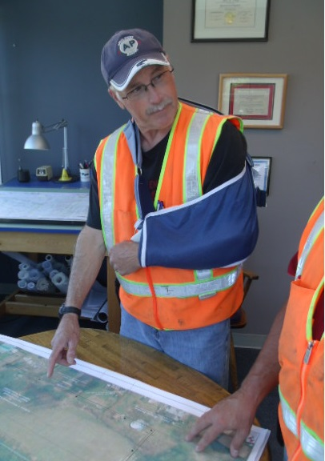
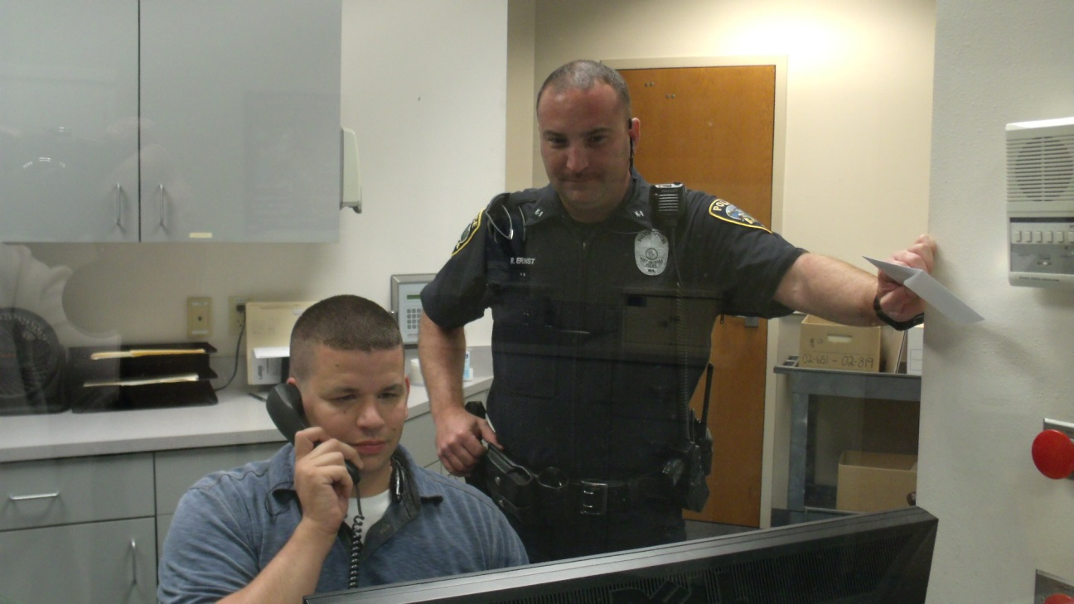
LIGHT DUTY

Slide 9
City of Port Orchard Light Duty Policy
A Light Duty work assignment uses real job duties to accommodate injured workers' medical restrictions for a specified time period. Light duty allows employees to return to the workforce as a productive member of the organization, and can act as a rehabilitation measure to help the employee eventually return to full duty
Notes:
Look at Policy in the folder.

Slide 10
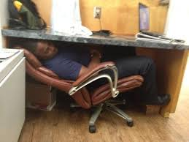
What Light Duty isn’t…
Make-work
An excuse to goof off
A task that could re-injure the worker or aggravate an illness

Slide 11
“You do not get injured workers well to put them back to work. You put them back to work to get them well.”
Richard Pimentral

Slide 12
The RTW Process
When a worker first reports an injury or work-related problem;
When the worker is absent and/undergoing treatment for the injury or health problem; and
When the worker tries to return to work.
Notes:
Show the Accident Form.
So now you are on workman’s compensation
FMLA
Doctor’s release to light duty.
Job Analysis.
Letter generated
Supervisor and employee understand the restrictions- What skills and abilities can be used?

Slide 13
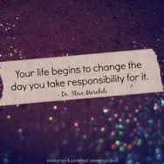
Injured Employee Responsibilities

Slide 14

Follow safety policies and rules
Promptly report injuries
Complete paperwork
Maintain contact with employer when off work
Provide updates on medical condition

Slide 15
Supervisor’s Role in RTW
Keep in contact with employee
Make employee feel welcome
Identify light duty jobs
Never allow employee to work outside restrictions
Notes:
After reviewing the Supervisor’s role, introduce the next Fun activity.
The Activity
Say to the Class: Let’s have some fun today by taking a lighthearted look at celebrities and other people or places in the news.
In a minute, I’m going to show a photo or headline. I want you to jot down a few words of any random thoughts or first impressions you have about the photo, headline or image. Be sure to write something about how you feel or what you think about the image. Any questions?

Slide 16

Notes:
Comments/Discussion

Slide 17
Cameraman suffering from Ebola arrives in Nebraska
Notes:
Comments/Discussion

Slide 18
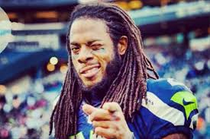
Notes:
Comments/Discussion

Slide 19

Notes:
Comments/Discussion

Slide 20

Notes:
Comments/Discussion

Slide 21

Notes:
Comments/Discussion

Slide 22
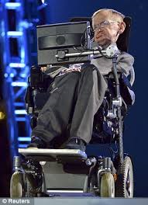
Notes:
Comments/Discussion

Slide 23

Notes:
Comments/Discussion

Slide 24

Notes:
Comments/Discussion

Slide 25

Notes:
Key Questions
Use the following questions as a guided discussion.
➢ Were your thoughts the same as your teammates?
➢ What did you notice that was different? The same?
➢ What do you think influenced our thoughts?
➢ What impact can our preconceived thoughts have about a situation or encounter?
➢ In the workplace, do we have preconceived thoughts about people and encounters?
➢ What impact can these thoughts have on coworkers? Peers?
Others?
➢ How can being aware of our preconceived thoughts about people, events, or encounters help us? Or hurt us? Particularly as it relates to an employee on light-duty or out with an injury?

Slide 26
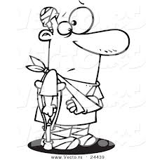
Psychological and Social Barriers
Research has produced compelling evidence based data on the possible range of negative consequences from workplace accidents and illness.
Notes:
Expectations and Beliefs
Say to the Class: For many injured employees, their expectations and beliefs can greatly affect their motivation to return to work. Some of the factors that may negatively influence an employee’s outlook include:
➢ inadequate understanding of medical condition
➢ unrealistic expectations about recovery, and
➢ fear that returning to work may create further injury.
This section will have employees/supervisors identify the factors
that may negatively influence an employee’s outlook and their
ability to return to work. Participants will then explore how they can proactively tackle these concerns before an injury occurs.

Slide 27


Notes:
There are also various psychological and social factors that can affect how an injured employee feels about returning to work. What are they?
Level of overall job satisfaction
Support at home and/or at work
Relationships with supervisor and colleagues
Beliefs about the cause of injury or pain.
Let’s take a look at these factors facing an injured worker.
Serious work related accidents and illness can have widespread impact on individual and their families
Psychological consequences include:
Anxiety , depression,
Feeling isolated
Depending on the severity of the accident the risk of post traumatic stress disorder.

Slide 28

Notes:
Behavioral consequences include:
Disturbed sleep, changes in temperament
Changes in the children’s behavior.
Socializing patterns change.
The whole family is affected.

Slide 29
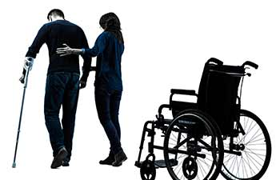
Notes:
Physical Consequences
Quality and disability adjusted life even if it is short term
Hospitalization
Medical care
rehab
Pain management.

Slide 30
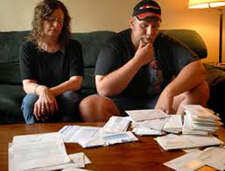
Notes:
Economic Consequences:
Medical expenses
What else?

Slide 31

Notes:
Mortgage payments
Home up keep
Emergency home repairs
What else?

Slide 32

Notes:
Providing for the family.

Slide 33

Notes:
Bills

Slide 34

Notes:
Children in School
Paying for college

Slide 35

Notes:
Taxes

Slide 36

Notes:
Frustration and anxiety about the future.
Be aware that these consequences are real and can affect the injured worker.
How can you proactively tackle these concerns before an injury occurs?
Build and maintain positive relationships
Be flexible
a. Build and maintain positive relationships with your employees / coworkers.
Open communication fosters positive relationships and leads to higher levels of workplace satisfaction. Encourage your employees to share their ideas and concerns with you to demonstrate that you are interested in their well-being and value their contributions.
• Show genuine interest in the employee
• Display active listening
• Use paraphrasing to show understanding
• Ensure confidentiality is maintained
• Have specific follow up plans
• Reinforce positive behaviors
• Demonstrate empathy
Important Teaching Point: You have the biggest influence on the outcome of a RTW and successful reintegration. But more importantly, you have the capacity to influence and determine workplace culture.
b. Flexibility can help motivate your employees.
Understand what motivates your employees and be
prepared to create new options. Some employees seek new challenges while others may want more flexibility in terms of work hours or job tasks.
In general, employee motivation may be greatly influenced by your willingness to share planning decisions and adjust work environments or job tasks. Employees who enjoy their jobs are typically loyal to their employers and more eager to return to their workplace after an injury. These principles also apply when establishing a transitional work assignment for an injured employee.

Slide 37

The Mike Rousselle Story
Notes:
Video Discussion
This section will begin by showing the video: Return to Work - The Mike Rousselle Story and then having participants identify the role the employee/supervisor should play in supporting the City’s RTW program and the injured worker.
The purpose of this section is to create greater awareness and empathy to what an injured worker needs.
2. Key Elements to Reintegration
Say to the Class: Co-worker and supervisor behavior greatly influence workers’ absences after work-related injuries and their efforts to return to work. Positive, supportive responses to worker injuries can help workers return to work sooner and more comfortably.
What were the key elements in Mike’s reintegration into the workplace?
Positive workplace relations Regular follow-up communication Resolution of other work issues Employee / supervisor partnership Commitment of senior management Supportive and open communication Responsiveness
Motivation
Concise Return-to-Work plan Regular meetings with the employee Supportive co-workers
Say to the Class: Conversely, negative responses may derail the RTW process, even if physical accommodations are made available for injured workers.
What behavior have you personally displayed towards an injured employee or have seen displayed?
Participant responses

Slide 38
Recap
Notes:
Let’s Recap what we covered today.

Slide 39
The RTW Process
When a worker first reports an on the job injury
When the worker is absent for the injury
When the worker tries to return to work
Notes:
The City has a light duty policy in place. You need to follow the steps we discussed today.

Slide 40
How you communicate is key.
The first conversation is vital.
Show genuine interest. Ask the worker how he or she is feeling and how can you help.
Don’t pre judge!

Slide 41




Slide 42
Employee costs
Loss of daily routine and social support
Dealing with unfamiliar bureaucracy
Strained relationships
Delayed or reduced cash flow
Notes:
What types of psychological effects can an injured employee experience while off work?

Slide 43
Show you care!
You all have the biggest influence on the outcome of a RTW and successful integration. But more importantly you have the capacity to influence and determine workplace culture.

Slide 44
Don’t Let your injured coworker forget To..
Focus on getting well
Talk with their doctor
Keep in touch with their employer:
Supervisor,
Human Resource Department, or
Other point of contact with your employer
Work toward returning to their regular job, full-time
Don’t give up!

Slide 45
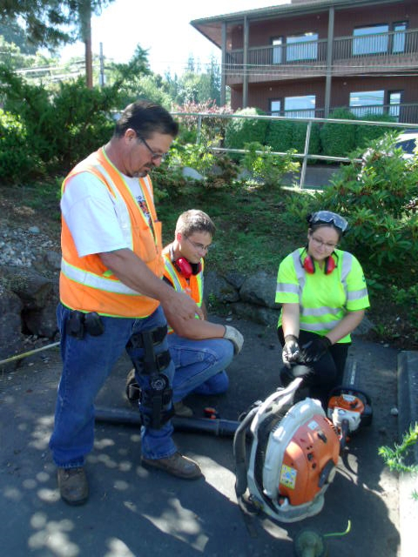
Notes:
Next Steps
Say to the Class: Helping injured employees return to work as soon as medically possible is a priority for the Department of Labor & Industries as well as for the City of Port Orchard.

